Slide 1






Slide 2
Introduction
A data type is called simple if variables of that type can store only one value at a time
A structured data type is one in which each data item is a collection of other data items
C++ Programming: From Problem Analysis to Program Design, Fifth Edition

Slide 3
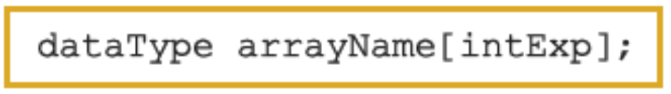
Arrays
Array: a collection of a fixed number of components wherein all of the components have the same data type
In a one-dimensional array, the components are arranged in a list form
Syntax for declaring a one-dimensional array:
intExp evaluates to a positive integer
C++ Programming: From Problem Analysis to Program Design, Fifth Edition

Slide 4
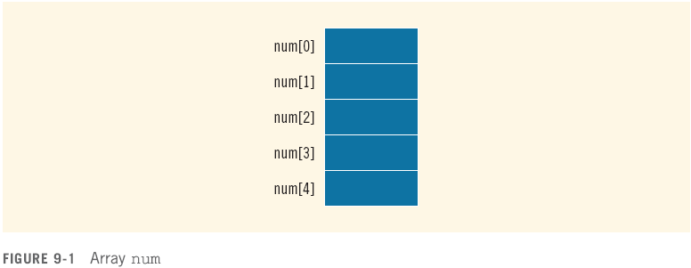
Arrays (cont'd.)
Example:
int num[5];
C++ Programming: From Problem Analysis to Program Design, Fifth Edition

Slide 5
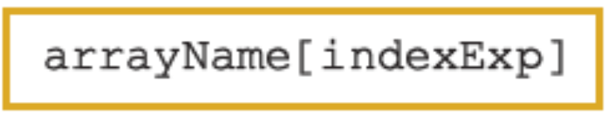
Accessing Array Components
General syntax:
where indexExp, called an index, is any expression whose value is a nonnegative integer
Index value specifies the position of the component in the array
[] is the array subscripting operator
The array index always starts at 0
C++ Programming: From Problem Analysis to Program Design, Fifth Edition

Slide 6

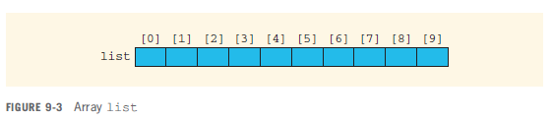
Accessing Array Components (cont'd.)
C++ Programming: From Problem Analysis to Program Design, Fifth Edition

Slide 7

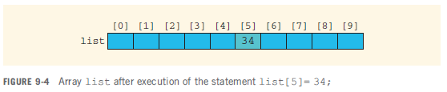
Accessing Array Components (cont'd.)
C++ Programming: From Problem Analysis to Program Design, Fifth Edition

Slide 8
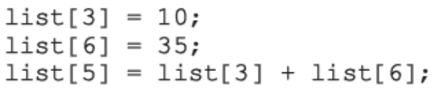
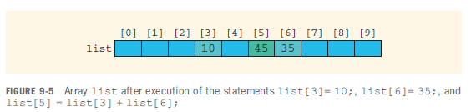
Accessing Array Components (cont'd.)
C++ Programming: From Problem Analysis to Program Design, Fifth Edition

Slide 9
Processing One-Dimensional Arrays
Some basic operations performed on a one-dimensional array are:
  Initializing
  Inputting data
  Outputting data stored in an array
  Finding the largest and/or smallest element
Each operation requires ability to step through the elements of the array
Easily accomplished by a loop
C++ Programming: From Problem Analysis to Program Design, Fifth Edition

Slide 10
Processing One-Dimensional Arrays (cont'd.)
Consider the declaration
int list[100]; //array of size 100
int i;
Using for loops to access array elements:
for (i = 0; i < 100; i++) //Line 1
//process list[i] //Line 2
Example:
for (i = 0; i < 100; i++) //Line 1
cin >> list[i]; //Line 2
C++ Programming: From Problem Analysis to Program Design, Fifth Edition

Slide 11
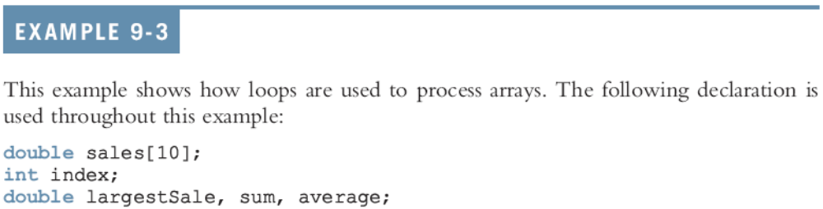

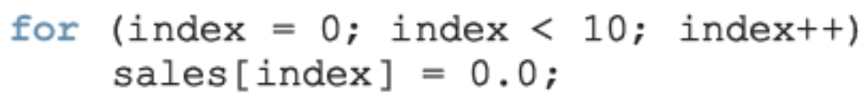



Processing One-Dimensional Arrays (cont'd.)
C++ Programming: From Problem Analysis to Program Design, Fifth Edition

Slide 12
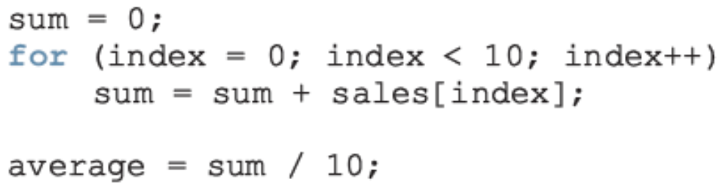
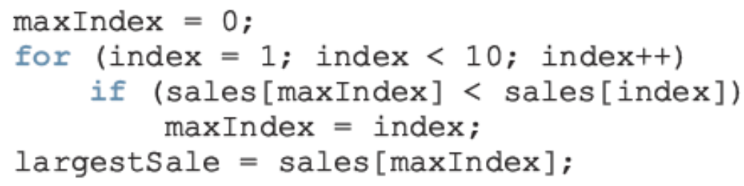
Processing One-Dimensional Arrays (cont'd.)
using index
C++ Programming: From Problem Analysis to Program Design, Fifth Edition

Slide 13
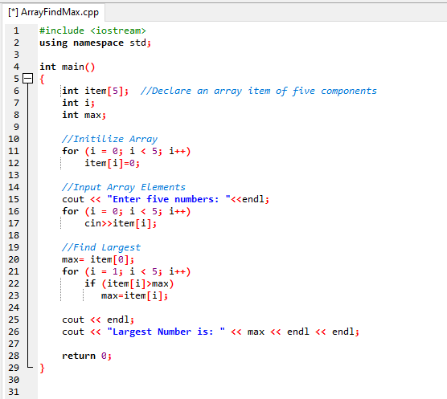
using item
C++ Programming: From Problem Analysis to Program Design, Fifth Edition

Slide 14
Array Index Out of Bounds
If we have the statements:
double num[10];
int i;
The component num[i] is valid if i = 0, 1, 2, 3, 4, 5, 6, 7, 8, or 9
The index of an array is in bounds if the index >=0 and the index <= ARRAY_SIZE-1
  Otherwise, we say the index is out of bounds
In C++, there is no guard against indices that are out of bounds
C++ Programming: From Problem Analysis to Program Design, Fifth Edition

Slide 15
Array Initialization During Declaration
Arrays can be initialized during declaration
  In this case, it is not necessary to specify the size of the array
    Size determined by the number of initial values in the braces
Example:
double sales[] = {12.25, 32.50, 16.90, 23, 45.68};
C++ Programming: From Problem Analysis to Program Design, Fifth Edition

Slide 16
Partial Initialization of Arrays During Declaration
The statement:
int list[10] = {0};
declares list to be an array of 10 components and initializes all of them to zero
The statement:
int list[10] = {8, 5, 12};
declares list to be an array of 10 components, initializes list[0] to 8, list[1] to 5, list[2] to 12 and all other components are initialized to 0
C++ Programming: From Problem Analysis to Program Design, Fifth Edition

Slide 17
Partial Initialization of Arrays During Declaration (cont'd.)
The statement:
int list[] = {5, 6, 3};
  declares list to be an array of 3 components and initializes list[0] to 5, list[1] to 6, and list[2] to 3
The statement:
int list[25]= {4, 7};
  declares an array of 25 components; initializes list[0] to 4 and list[1] to 7; all other components are initialized to 0
C++ Programming: From Problem Analysis to Program Design, Fifth Edition

Slide 18
Some Restrictions on Array Processing
Consider the following statements:
C++ does not allow aggregate operations on an array:
Solution:
C++ Programming: From Problem Analysis to Program Design, Fifth Edition

Slide 19


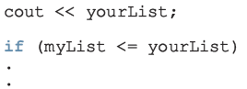
Some Restrictions on Array Processing (cont'd.)
The following is illegal too:
Solution:
The following statements are legal, but do not give the desired results:
C++ Programming: From Problem Analysis to Program Design, Fifth Edition

Slide 20
Base Address of an Array and Array in Computer Memory
The base address of an array is the address, or memory location of the first array component
If list is a one-dimensional array, its base address is the address of list[0]
When we pass an array as a parameter, the base address of the actual array is passed to the formal parameter
C++ Programming: From Problem Analysis to Program Design, Fifth Edition

Slide 21
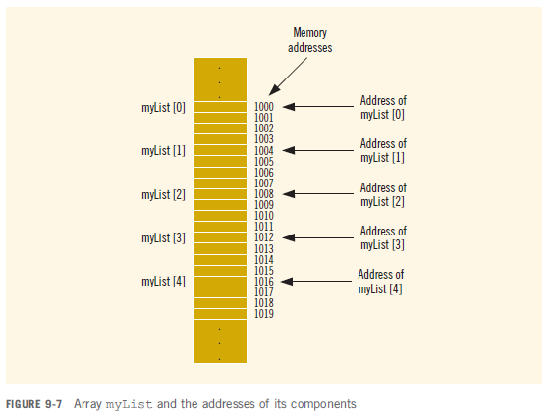
Base Address of an Array and Array in Computer Memory (cont’d.)
C++ Programming: From Problem Analysis to Program Design, Fifth Edition

Slide 22
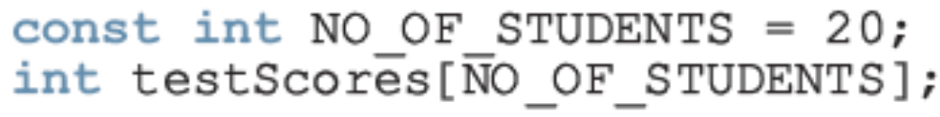
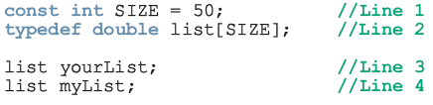
Other Ways to Declare Arrays
C++ Programming: From Problem Analysis to Program Design, Fifth Edition

Slide 23
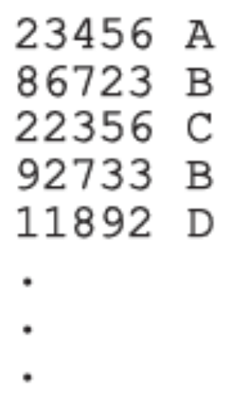
Parallel Arrays
Two (or more) arrays are called parallel if their corresponding components hold related information
Example:
  int studentId[50];
  char courseGrade[50];
C++ Programming: From Problem Analysis to Program Design, Fifth Edition

Slide 24

Two- and Multidimensional Arrays
Two-dimensional array: collection of a fixed number of components (of the same type) arranged in two dimensions
  Sometimes called matrices or tables
Declaration syntax:
  where intexp1 and intexp2 are expressions yielding positive integer values, and specify the number of rows and the number of columns, respectively, in the array
C++ Programming: From Problem Analysis to Program Design, Fifth Edition

Slide 25
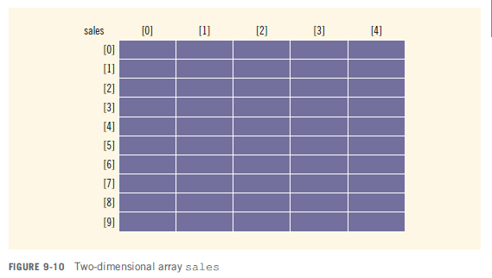
Two- and Multidimensional Arrays (cont'd.)
C++ Programming: From Problem Analysis to Program Design, Fifth Edition

Slide 26

Accessing Array Components
Syntax:
  where indexexp1 and indexexp2 are expressions yielding nonnegative integer values, and specify the row and column position
C++ Programming: From Problem Analysis to Program Design, Fifth Edition

Slide 27
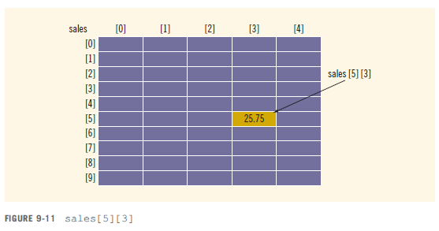
Accessing Array Components (cont'd.)
C++ Programming: From Problem Analysis to Program Design, Fifth Edition

Slide 28

Two-Dimensional Array Initialization During Declaration
Two-dimensional arrays can be initialized when they are declared:
  Elements of each row are enclosed within braces and separated by commas
  All rows are enclosed within braces
  For number arrays, if all components of a row aren’t specified, unspecified ones are set to 0
C++ Programming: From Problem Analysis to Program Design, Fifth Edition

Slide 29

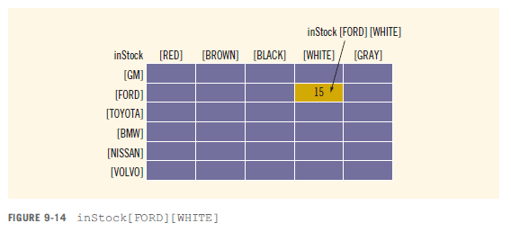
Two-Dimensional Arrays and Enumeration Types
C++ Programming: From Problem Analysis to Program Design, Fifth Edition

Slide 30
Processing Two-Dimensional Arrays
Ways to process a two-dimensional array:
  Process the entire array
  Process a particular row of the array, called row processing
  Process a particular column of the array, called column processing
Each row and each column of a two-dimensional array is a one-dimensional array
  To process, use algorithms similar to processing one-dimensional arrays
C++ Programming: From Problem Analysis to Program Design, Fifth Edition

Slide 31
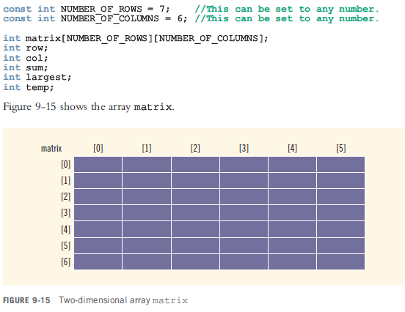
Processing Two-Dimensional Arrays (cont'd.)
C++ Programming: From Problem Analysis to Program Design, Fifth Edition

Slide 32
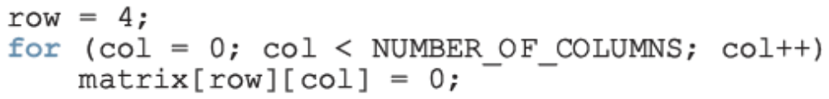

Initialization
To initialize row number 4 (i.e., fifth row) to 0:
To initialize the entire matrix to 0:
C++ Programming: From Problem Analysis to Program Design, Fifth Edition

Slide 33
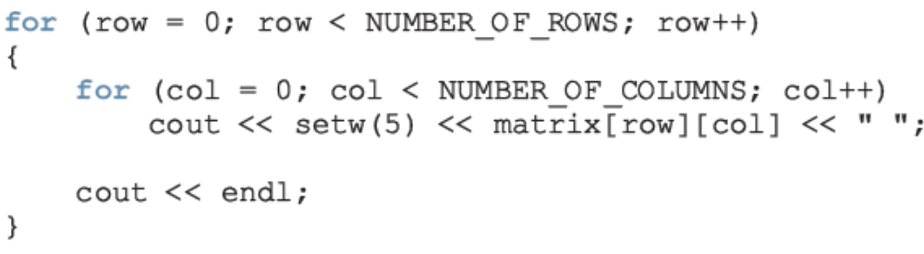
Print
To output the components of matrix:
C++ Programming: From Problem Analysis to Program Design, Fifth Edition

Slide 34
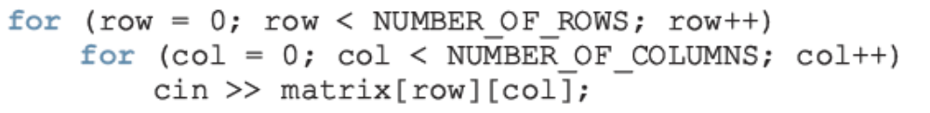
Input
To input data into each component of matrix:
C++ Programming: From Problem Analysis to Program Design, Fifth Edition

Slide 35
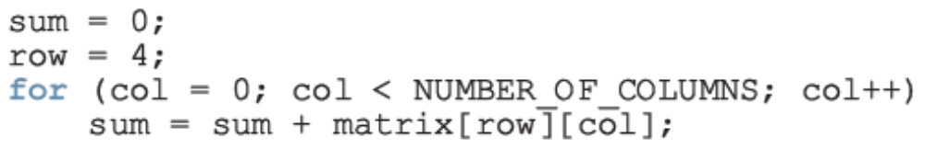
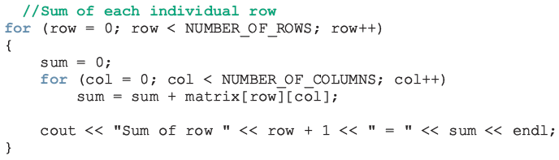
Sum by Row
To find the sum of row number 4 of matrix:
To find the sum of each individual row:
C++ Programming: From Problem Analysis to Program Design, Fifth Edition

Slide 36
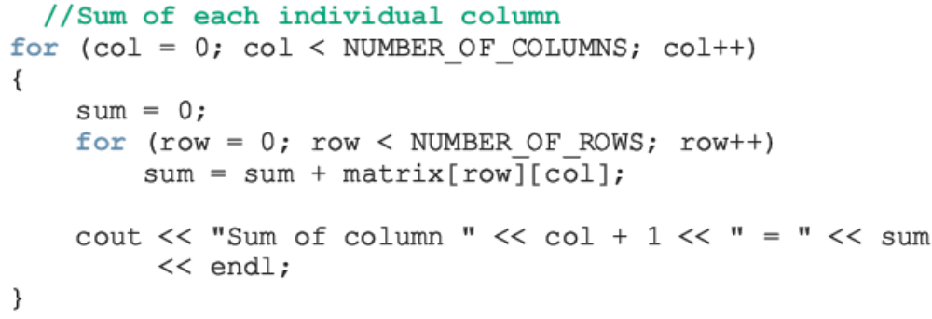
Sum by Column
To find the sum of each individual column:
C++ Programming: From Problem Analysis to Program Design, Fifth Edition

Slide 37
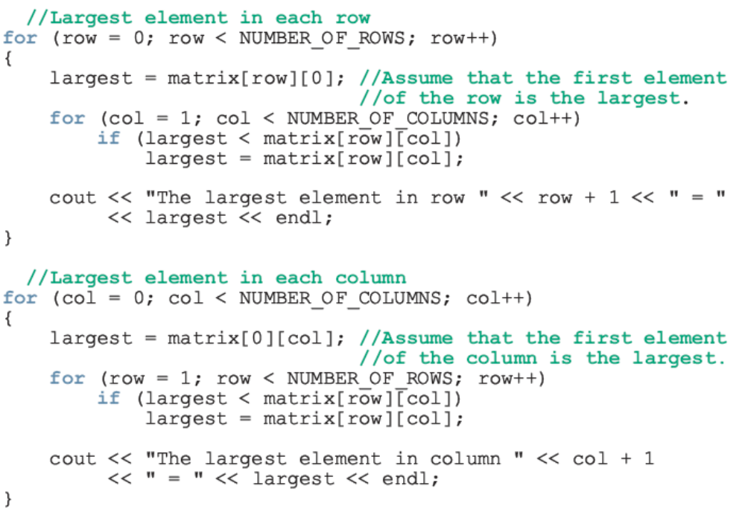
Largest Element in Each Row and Each Column
C++ Programming: From Problem Analysis to Program Design, Fifth Edition

Slide 38
A Small Programming Project
Using Arrays
C++ Programming: From Problem Analysis to Program Design, Fifth Edition

Slide 39
Example 6 Unit1– Revisited
Redesign Using Arrays
10 students in a class
Each student has taken five tests and each test is worth 100 points
Design an algorithm to calculate the grade for each student as well as the class average
  Design an algorithm to find the average test score
  Design an algorithm to determine the grade
Data consists of students’ names and their test scores
C++ Programming: From Problem Analysis to Program Design, Fifth Edition

Slide 40
Example 6 (cont’d.)
Redesign Using Arrays
Algorithm to determine the average test score:
  Get the five test scores
  Add the five test scores
    Suppose sum stands for the sum of the test scores
  Suppose average stands for the average test score:
    average = sum / 5;
C++ Programming: From Problem Analysis to Program Design, Fifth Edition

Slide 41
Example 6 (cont’d.)
Redesign Using Arrays
Algorithm to determine the grade:
if average is greater than or equal to 90
grade = A
otherwise
if average is greater than or equal to 80 and less than 90
grade = B
otherwise
if average is greater than or equal to 70 and less than 80
grade = C
otherwise
if average is greater than or equal to 60 and less than 70
grade = D
otherwise
grade = F
C++ Programming: From Problem Analysis to Program Design, Fifth Edition

Slide 42
Example 6 (cont’d.)
Redesign Using Arrays
Main algorithm is as follows:
  totalAverage = 0;
  Repeat the following for each student:
    Get student’s name
    Use the algorithm to find the average test score
    Use the algorithm to find the grade
    Update totalAverage by adding current student’s average test score
  Determine the class average as follows:
    classAverage = totalAverage / 10
C++ Programming: From Problem Analysis to Program Design, Fifth Edition

