Slide 1

Understanding Cryptography – A Textbook for Students and Practitioners by Christof Paar and Jan Pelzl www.crypto-textbook.com
Chapter 2 – Stream Ciphers
These slides were prepared by Thomas Eisenbarth, Christof Paar and Jan Pelzl

Slide 2
Content of this Chapter
Intro to stream ciphers
Random number generators (RNGs)
One-Time Pad (OTP)
Linear feedback shift registers (LFSRs)
Trivium: a modern stream cipher
<number>/27

Slide 3
Content of this Chapter
Intro to stream ciphers
Random number generators (RNGs)
One-Time Pad (OTP)
Linear feedback shift registers (LFSRs)
Trivium: a modern stream cipher
<number>/27

Slide 4
Stream Ciphers in the Field of Cryptology
Cryptology
Cryptography
Cryptanalysis
Symmetric Ciphers
Asymmetric Ciphers
Protocols
Block Ciphers
Stream Ciphers
Stream Ciphers were invented in 1917 by Gilbert Vernam
<number>/34

Slide 5
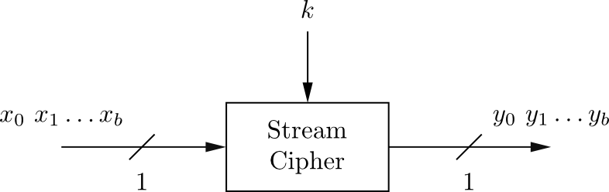
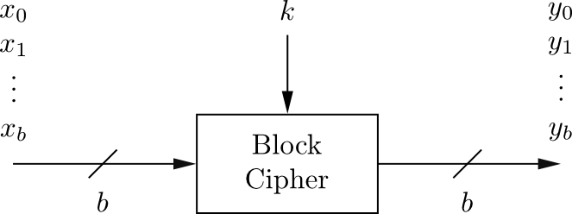
Stream Cipher vs. Block Cipher
Stream Ciphers
  Encrypt bits individually
  Usually small and fast → common in embedded devices (e.g., A5/1 for GSM phones)
Block Ciphers:
  Always encrypt a full block (several bits)
  Are common for Internet applications
<number>/27

Slide 6
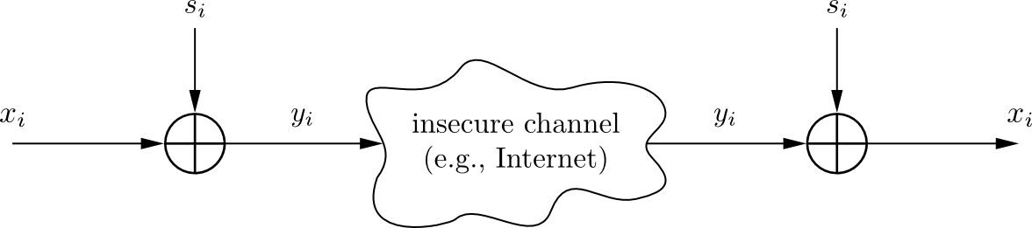
Encryption and Decryption with Stream Ciphers
Plaintext x_{i}, ciphertext y_{i} and key stream s_{i} consist of individual bits
Encryption and decryption are simple additions modulo 2 (aka XOR)
Encryption and decryption are the same functions
Encryption: y_{i} = e_{si}(x_{i} ) = x_{i} + s_{i} mod 2 x_{i} , y_{i} , s_{i} ∈ {0,1}
Decryption: x_{i} = e_{si}(y_{i} ) = y_{i} + s_{i} mod 2
<number>/27

Slide 7
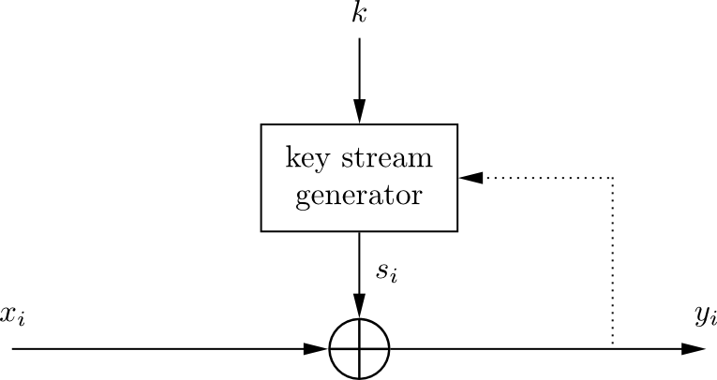
Synchronous vs. Asynchronous Stream Cipher
Security of stream cipher depends entirely on the key stream s_{i} :
  Should be random , i.e., Pr(s_{i} = 0) = Pr(s_{i} = 1) = 0.5
  Must be reproducible by sender and receiver
Synchronous Stream Cipher
  Key stream depend only on the key (and possibly an initialization vector IV)
Asynchronous Stream Ciphers
  Key stream depends also on the ciphertext (dotted feedback enabled)
<number>/27

Slide 8
Why is Modulo 2 Addition a Good Encryption Function?
Modulo 2 addition is equivalent to XOR operation
For perfectly random key stream s_{i} , each ciphertext output bit has a 50% chance to be 0 or 1
→ Good statistic property for ciphertext
Inverting XOR is simple, since it is the same XOR operation
x_{i} | s_{i} | y_{i}
0 | 0 | 0
0 | 1 | 1
1 | 0 | 1
1 | 1 | 0
<number>/27

Slide 9
Stream Cipher: Throughput
Performance comparison of symmetric ciphers (Pentium4):
Cipher | Key length | Mbit/s
DES | 56 | 36.95
3DES | 112 | 13.32
AES | 128 | 51.19
RC4 (stream cipher) | (choosable) | 211.34
Source: Zhao et al., Anatomy and Performance of SSL Processing, ISPASS 2005
Chapter 2 of Understanding Cryptography by Christof Paar and Jan Pelzl
Notes:
Example: Encryption of the letter „A“ by Alice.
„A“ is given in ASCII code as 65₁₀ = 1000001₂.
Let's assume that the first key stream bits are
⇒ z1, ... , z7 = 0101101
Encryption by Alice:
plaintext xi: 1000001 = „A“ (ASCII symbol)
key stream zi: 0101101
ciphertext yi: 1101100 = „l“ (ASCII symbol)
Decryption by Bob:
ciphertext yi: 1101100 = „l“ (ASCII symbol)
key stream zi: 0101101
plaintext xi: 1000001 = „A“ (ASCII symbol)

Slide 10
Content of this Chapter
Intro to stream ciphers
Random number generators (RNGs)
One-Time Pad (OTP)
Linear feedback shift registers (LFSRs)
Trivium: a modern stream cipher
<number>/27

Slide 11
Random number generators (RNGs)
RNG
True RNG
Cryptographically Secure RNG
Pseudorandom NG
<number>/27

Slide 12
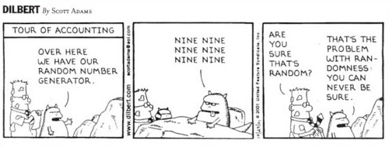
True Random Number Generators (TRNGs)
Based on physical random processes: coin flipping, dice rolling, semiconductor noise, radioactive decay, mouse movement, clock jitter of digital circuits
Output stream s_{i} should have good statistical properties:
Pr(s_{i} = 0) = Pr(s_{i} = 1) = 50% (often achieved by post-processing)
Output can neither be predicted nor be reproduced
Typically used for generation of keys, nonces (used only-once values) and for many other purposes
<number>/27

Slide 13
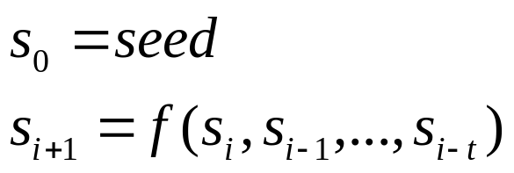
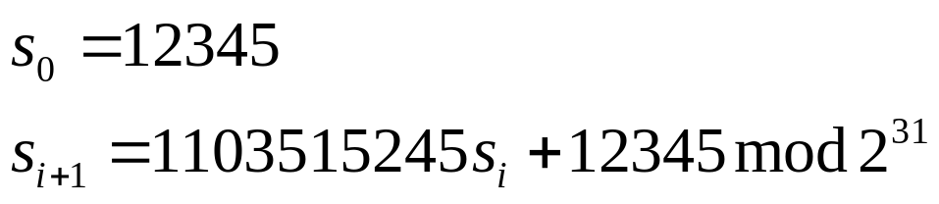
Pseudorandom Number Generator (PRNG)
Generate sequences from initial seed value
Typically, output stream has good statistical properties
Output can be reproduced and can be predicted
Often computed in a recursive way:
Example: rand() function in ANSI C:
Most PRNGs have bad cryptographic properties!
<number>/27

Slide 14
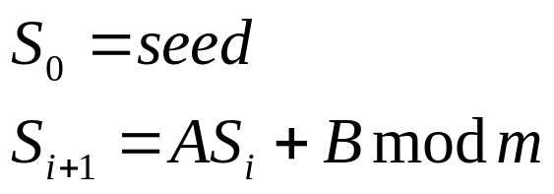
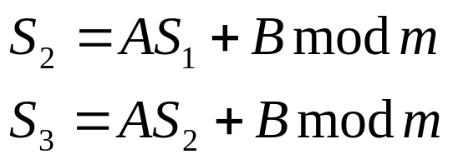
Cryptanalyzing a Simple PRNG
Simple PRNG: Linear Congruential Generator
Assume
  unknown A, B and S₀ as key
  Size of A, B and S_{i} to be 100 bit
  300 bit of output are known, i.e. S₁, S₂ and S₃
Solving
…directly reveals A and B. All S_{i} can be computed easily!
Bad cryptographic properties due to the linearity of most PRNGs
<number>/27

Slide 15
Cryptographically Secure Pseudorandom Number Generator (CSPRNG)
Special PRNG with additional property:
  Output must be unpredictable
More precisely: Given n consecutive bits of output s_{i} , the following output bits s_{n+1} cannot be predicted (in polynomial time).
Needed in cryptography, in particular for stream ciphers
Remark: There are almost no other applications that need unpredictability, whereas many, many (technical) systems need PRNGs.
<number>/27

Slide 16
Content of this Chapter
Intro to stream ciphers
Random number generators (RNGs)
One-Time Pad (OTP)
Linear feedback shift registers (LFSRs)
Trivium: a modern stream cipher
<number>/27

Slide 17
One-Time Pad (OTP)
Unconditionally secure cryptosystem:
A cryptosystem is unconditionally secure if it cannot be broken even with infinite computational resources
One-Time Pad
A cryptosystem developed by Mauborgne that is based on Vernam’s stream cipher:
Properties:
Let the plaintext, ciphertext and key consist of individual bits
x_{i}, y_{i}, k_{i} ∈ {0,1}.
Encryption: e_{ki}(x_{i}) = x_{i} ⊕ k_{i}.
Decryption: d_{ki}(y_{i}) = y_{i} ⊕ k_{i}
OTP is unconditionally secure if and only if the key k_{i}. is used once!
<number>/27

Slide 18
One-Time Pad (OTP)
Unconditionally secure cryptosystem:
y₀ = x₀ ⊕ k₀
y₁ = x₁ ⊕ k₁
:
Every equation is a linear equation with two unknowns
for every y_{i} are x_{i} = 0 and x_{i} = 1 equiprobable!
This is true iff k₀, k₁, ... are independent, i.e., all k_{i} have to be generated truly random
It can be shown that this systems can provably not be solved.
Disadvantage: For almost all applications the OTP is impractical since the key must be as long as the message! (Imagine you have to encrypt a 1GByte email attachment.)
<number>/27

Slide 19
Content of this Chapter
Intro to stream ciphers
Random number generators (RNGs)
One-Time Pad (OTP)
Linear feedback shift registers (LFSRs)
Trivium: a modern stream cipher
<number>/27

Slide 20
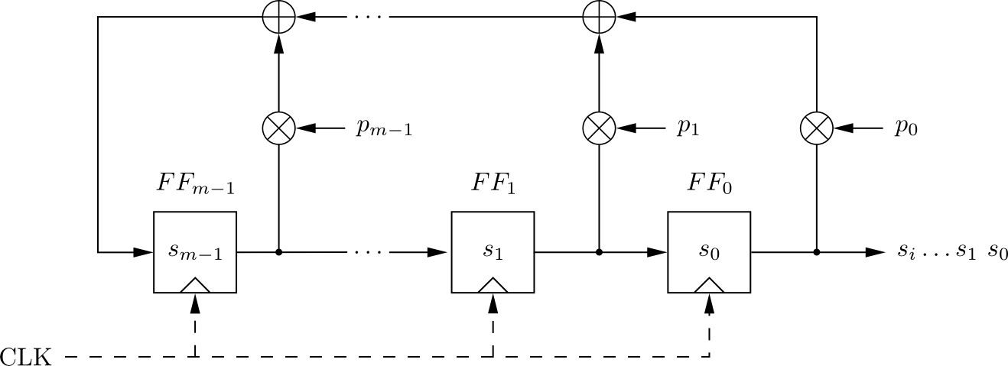
Linear Feedback Shift Registers (LFSRs)
Concatenated flip-flops (FF), i.e., a shift register together with a feedback path
Feedback computes fresh input by XOR of certain state bits
Degree m given by number of storage elements
If p_{i} = 1, the feedback connection is present (“closed switch), otherwise there is not feedback from this flip-flop (“open switch”)
Output sequence repeats periodically
Maximum output length: 2^{m}-1
<number>/27

Slide 21
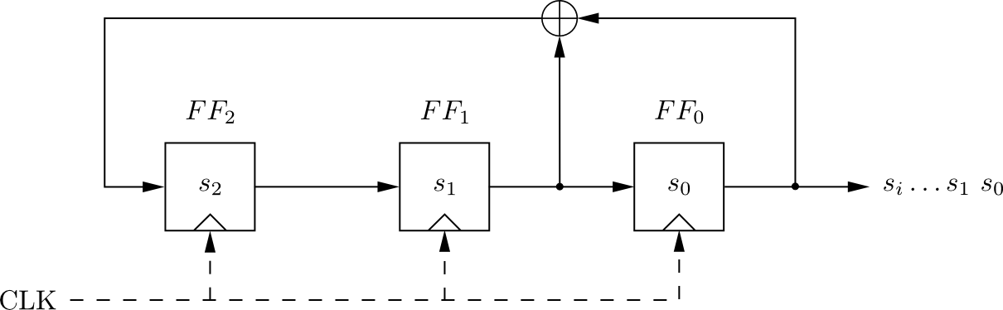

Linear Feedback Shift Registers (LFSRs): Example with m=3
clk | FF₂ | FF₁ | FF₀=s_{i}
0 | 1 | 0 | 0
1 | 0 | 1 | 0
2 | 1 | 0 | 1
3 | 1 | 1 | 0
4 | 1 | 1 | 1
5 | 0 | 1 | 1
6 | 0 | 0 | 1
7 | 1 | 0 | 0
8 | 0 | 1 | 0
LFSR output described by recursive equation:
Maximum output length (of 2³-1=7) achieved only for certain feedback configurations, .e.g., the one shown here.
<number>/27

Slide 22
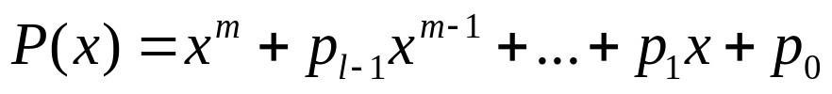
Security of LFSRs
LFSRs typically described by polynomials:
Single LFSRs generate highly predictable output
If 2m output bits of an LFSR of degree m are known, the feedback coefficients p_{i} of the LFSR can be found by solving a system of linear equations*
Because of this many stream ciphers use combinations of LFSRs
*See Chapter 2 of Understanding Cryptography for further details.
<number>/27

Slide 23
Content of this Chapter
Intro to stream ciphers
Random number generators (RNGs)
One-Time Pad (OTP)
Linear feedback shift registers (LFSRs)
Trivium: a modern stream cipher
<number>/27

Slide 24
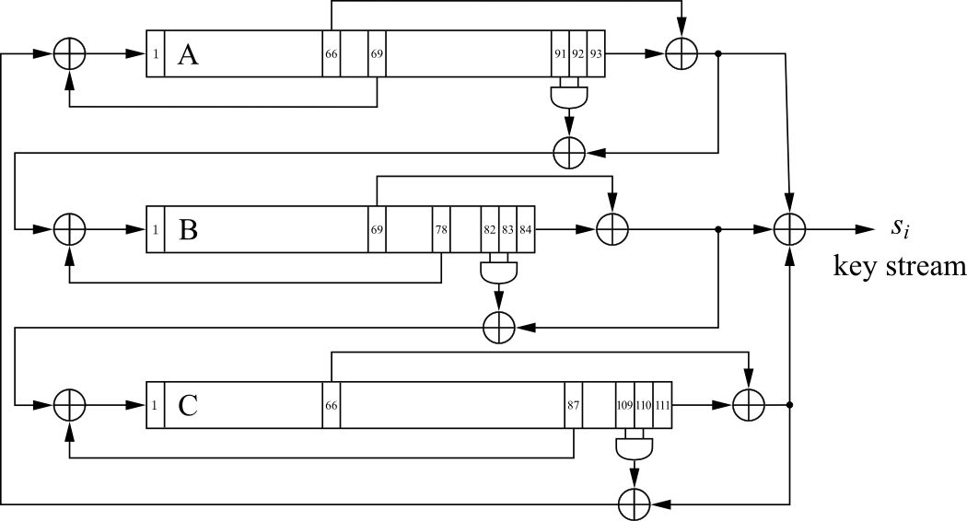
A Modern Stream Cipher - Trivium
Three nonlinear LFSRs (NLFSR) of length 93, 84, 111
XOR-Sum of all three NLFSR outputs generates key stream s_{i}
Small in Hardware:
  Total register count: 288
  Non-linearity: 3 AND-Gates
  7 XOR-Gates (4 with three inputs)
<number>/27

Slide 25
Trivium
Initialization:
Load 80-bit IV into A
Load 80-bit key into B
Set c₁₀₉ , c₁₁₀ , c₁₁₁ =1, all other bits 0
Warm-Up:
Clock cipher 4 x 288 = 1152 times without generating output
Encryption:
XOR-Sum of all three NLFSR outputs generates key stream s_{i}
Design can be parallelized to produce up to 64 bits of output per clock cycle
 | Register length | Feedback bit | Feedforward bit | AND inputs
A | 93 | 69 | 66 | 91, 92
B | 84 | 78 | 69 | 82, 83
C | 111 | 87 | 66 | 109, 110
<number>/27

Slide 26
Lessons Learned
Stream ciphers are less popular than block ciphers in most domains such as Internet security. There are exceptions, for instance, the popular stream cipher RC4.
Stream ciphers sometimes require fewer resources, e.g., code size or chip area, for implementation than block ciphers, and they are attractive for use in constrained environments such as cell phones.
The requirements for a cryptographically secure pseudorandom number generator are far more demanding than the requirements for pseudorandom number generators used in other applications such as testing or simulation
The One-Time Pad is a provable secure symmetric cipher. However, it is highly impractical for most applications because the key length has to equal the message length.
Single LFSRs make poor stream ciphers despite their good statistical properties. However, careful combinations of several LFSR can yield strong ciphers.
<number>/27

