Slide 1
Guide to Computer Forensics and Investigations
Fifth Edition
Chapter 11
E-mail and Social Media Investigations

Slide 2
Objectives
Explain the role of e-mail in investigations
Describe client and server roles in e-mail
Describe tasks in investigating e-mail crimes and violations
Explain the use of e-mail server logs
Explain how to approach investigating social media communications
Describe some available e-mail forensics tools
Guide to Computer Forensics and Investigations, Fifth Edition

Slide 3
Exploring the Role of E-mail in Investigations
An increase in e-mail scams and fraud attempts with phishing or spoofing
  Investigators need to know how to examine and interpret the unique content of e-mail messages
Phishing e-mails contain links to text on a Web page
  Attempts to get personal information from reader
Pharming - DNS poisoning takes user to a fake site
A noteworthy e-mail scam was 419, or the Nigerian Scam
Guide to Computer Forensics and Investigations, Fifth Edition

Slide 4
Exploring the Role of E-mail in Investigations
Spoofing e-mail can be used to commit fraud
Investigators can use the Enhanced/Extended Simple Mail Transfer Protocol (ESMTP) number in the message’s header to check for legitimacy of email
Guide to Computer Forensics and Investigations, Fifth Edition

Slide 5
Exploring the Roles of the Client and Server in E-mail
E-mail can be sent and received in two environments
  Internet
  Intranet (an internal network)
Client/server architecture
  Server OS and e-mail software differs from those on the client side
Protected accounts
  Require usernames and passwords
Guide to Computer Forensics and Investigations, Fifth Edition

Slide 6
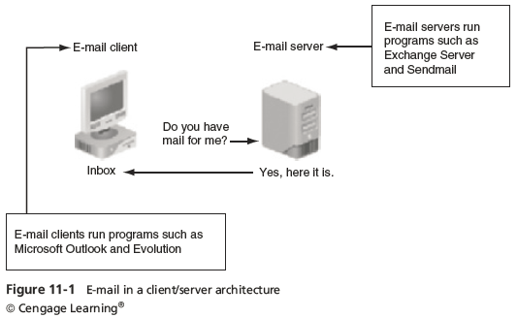
Exploring the Roles of the Client and Server in E-mail
Guide to Computer Forensics and Investigations, Fifth Edition

Slide 7
Exploring the Roles of the Client and Server in E-mail
Name conventions
  Corporate: john.smith@somecompany.com
  Public: whatever@gmail.com
  Everything after @ belongs to the domain name
Tracing corporate e-mails is easier
  Because accounts use standard names the administrator establishes
Many companies are migrating their e-mail services to the cloud
Guide to Computer Forensics and Investigations, Fifth Edition

Slide 8
Investigating E-mail Crimes and Violations
Similar to other types of investigations
Goals
  Find who is behind the crime
  Collect the evidence
  Present your findings
  Build a case
Know the applicable privacy laws for your jurisdiction
Guide to Computer Forensics and Investigations, Fifth Edition

Slide 9
Investigating E-mail Crimes and Violations
E-mail crimes depend on the city, state, or country
  Example: spam may not be a crime in some states
  Always consult with an attorney
Examples of crimes involving e-mails
  Narcotics trafficking
  Extortion
  Sexual harassment and stalking
  Fraud
  Child abductions and pornography
  Terrorism
Guide to Computer Forensics and Investigations, Fifth Edition

Slide 10
Examining E-mail Messages
Access victim’s computer or mobile device to recover the evidence
Using the victim’s e-mail client
  Find and copy evidence in the e-mail
  Access protected or encrypted material
  Print e-mails
Guide victim on the phone
  Open and copy e-mail including headers
You may have to recover deleted e-mails
Guide to Computer Forensics and Investigations, Fifth Edition

Slide 11
Examining E-mail Messages
Copying an e-mail message
  Before you start an e-mail investigation
    You need to copy and print the e-mail involved in the crime or policy violation
  You might also want to forward the message as an attachment to another e-mail address
With many GUI e-mail programs, you can copy an e-mail by dragging it to a storage medium
  Or by saving it in a different location
Guide to Computer Forensics and Investigations, Fifth Edition

Slide 12
Viewing E-mail Headers
Investigators should learn how to find e-mail headers
  GUI clients
  Web-based clients
After you open e-mail headers, copy and paste them into a text document
  So that you can read them with a text editor
Become familiar with as many e-mail programs as possible
  Often more than one e-mail program is installed
Guide to Computer Forensics and Investigations, Fifth Edition

Slide 13
Viewing E-mail Headers
Outlook
  Double-click the message and then click File, Properties
  Copy headers
  Paste them to any text editor
  Save the document as OutlookHeader.txt in your work folder
Guide to Computer Forensics and Investigations, Fifth Edition

Slide 14
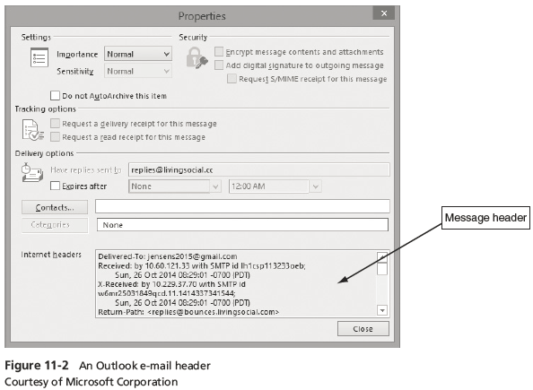
Viewing E-mail Headers
Guide to Computer Forensics and Investigations, Fifth Edition

Slide 15
Viewing E-mail Headers
AOL
  Click the Options link, click E-mail Settings
  Click Always show full headers check box (Save settings)
  Click Back to E-mail
Yahoo
  Click Inbox to view a list of messages
  Above the message window, click More and click View Full Header
  Copy and paste headers to a text file
Guide to Computer Forensics and Investigations, Fifth Edition

Slide 16
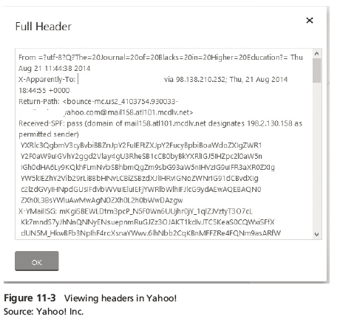
Viewing E-mail Headers
Guide to Computer Forensics and Investigations, Fifth Edition

Slide 17
Examining E-mail Headers
Headers contain useful information
  The mail piece of information you’re looking for is the originating e-mail’s IP address
  Date and time the message was sent
  Filenames of any attachments
  Unique message number (if supplied)
Guide to Computer Forensics and Investigations, Fifth Edition

Slide 18
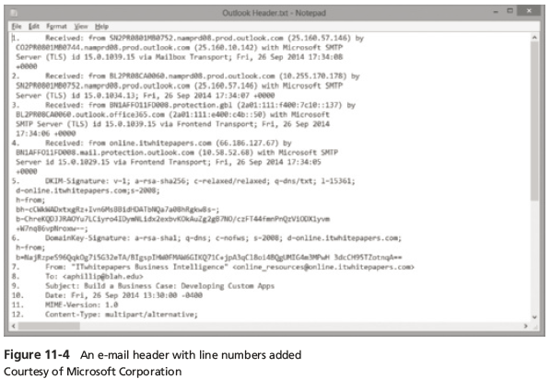
Examining E-mail Headers
Guide to Computer Forensics and Investigations, Fifth Edition

Slide 19
Examining Additional E-mail Files
E-mail messages are saved on the client side or left at the server
Microsoft Outlook uses .pst and .ost files
Most e-mail programs also include an electronic address book, calendar, task list, and memos
In Web-based e-mail
  Messages are displayed and saved as Web pages in the browser’s cache folders
  Many Web-based e-mail providers also offer instant messaging (IM) services
Guide to Computer Forensics and Investigations, Fifth Edition

Slide 20
Tracing an E-mail Message
Determining message origin is referred to as “tracing”
Contact the administrator responsible for the sending server
Use a registry site to find point of contact:
  www.arin.net
  www.internic.com
  www.google.com
Verify your findings by checking network e-mail logs against e-mail addresses
Guide to Computer Forensics and Investigations, Fifth Edition

Slide 21
Using Network E-mail Logs
Router logs
  Record all incoming and outgoing traffic
  Have rules to allow or disallow traffic
  You can resolve the path a transmitted e-mail has taken
Firewall logs
  Filter e-mail traffic
  Verify whether the e-mail passed through
You can use any text editor or specialized tools
Guide to Computer Forensics and Investigations, Fifth Edition

Slide 22
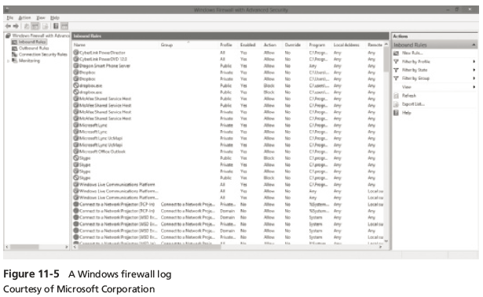
Using Network E-mail Logs
Guide to Computer Forensics and Investigations, Fifth Edition

Slide 23
Understanding E-mail Servers
An e-mail server is loaded with software that uses e-mail protocols for its services
  And maintains logs you can examine and use in your investigation
E-mail storage
  Database
  Flat file system
Logs
  Some servers are set up to log e-mail transactions by default; others have to be configured to do so
Guide to Computer Forensics and Investigations, Fifth Edition

Slide 24
Understanding E-mail Servers
E-mail logs generally identify the following:
  E-mail messages an account received
  Sending IP address
  Receiving and reading date and time
  E-mail content
  System-specific information
Contact suspect’s network e-mail administrator as soon as possible
Servers can recover deleted e-mails
  Similar to deletion of files on a hard drive
Guide to Computer Forensics and Investigations, Fifth Edition

Slide 25
Examining UNIX E-mail Server Logs
Common UNIX e-mail servers: Postfix and Sendmail
/etc/sendmail.cf
  Configuration file for Sendmail
/etc/syslog.conf
  Specifies how and which events Sendmail logs
Postfix has two configuration files
  master. cf and main.cf (found in /etc/postfix)
Guide to Computer Forensics and Investigations, Fifth Edition

Slide 26
Examining UNIX E-mail Server Logs
/var/log/maillog
  Records SMTP, POP3, and IMAP4 communications
    Contains an IP address and time stamp that you can compare with the e-mail the victim received
Default location for storing log files:
  /var/log
  An administrator can change the log location
  Use the find or locate command to find them
Check UNIX man pages for more information
Guide to Computer Forensics and Investigations, Fifth Edition

Slide 27
Examining Microsoft E-mail Server Logs
Microsoft Exchange Server (Exchange)
  Uses a database
  Based on Microsoft Extensible Storage Engine (ESE)
Most useful files in an investigation:
  .edb database files, checkpoint files, and temporary files
Information Store files
  Database files *.edb
    Responsible for MAPI information
Guide to Computer Forensics and Investigations, Fifth Edition

Slide 28
Examining Microsoft E-mail Server Logs
Transaction logs
  Keep track of changes to its data
Checkpoints
  Marks the last point at which the database was written to disk
Temporary files
  Created to prevent loss when the server is busy converting binary data to readable text
Guide to Computer Forensics and Investigations, Fifth Edition

Slide 29
Examining Microsoft E-mail Server Logs
To retrieve log files created by Exchange
  Use the Windows PowerShell cmdlet GetTransactionLogStats.ps1 -Gather
Tracking.log
  An Exchange server log that tracks messages
Another log used for investigating the Exchange environment is the troubleshooting log
  Use Windows Event Viewer to read the log
Guide to Computer Forensics and Investigations, Fifth Edition

Slide 30
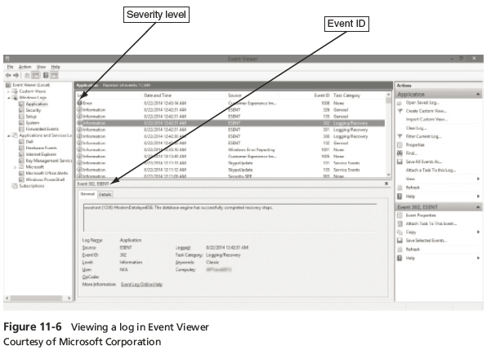
Examining Microsoft E-mail Server Logs
Guide to Computer Forensics and Investigations, Fifth Edition

Slide 31
Using Specialized E-mail Forensics Tools
Tools include:
  DataNumen for Outlook and Outlook Express
  FINALeMAIL for Outlook Express and Eudora
  Sawmill for Novell GroupWise
  DBXtract for Outlook Express
  Fookes Aid4Mail and MailBag Assistant
  Paraben E-Mail Examiner
  AccessData FTK for Outlook and Outlook Express
  Ontrack Easy Recovery EmailRepair
  R-Tools R-Mail
  OfficeRecovery’s MailRecovery
Guide to Computer Forensics and Investigations, Fifth Edition

Slide 32
Using Specialized E-mail Forensics Tools
Tools allow you to find:
  E-mail database files
  Personal e-mail files
  Offline storage files
  Log files
Advantage of using data recovery tools
  You don’t need to know how e-mail servers and clients work to extract data from them
Guide to Computer Forensics and Investigations, Fifth Edition

Slide 33
Using Specialized E-mail Forensics Tools
After you compare e-mail logs with messages, you should verify the:
  Email account, message ID, IP address, date and time stamp to determine whether there’s enough evidence for a warrant
With some tools
  You can scan e-mail database files on a suspect’s Windows computer, locate any e-mails the suspect has deleted and restore them to their original state
Guide to Computer Forensics and Investigations, Fifth Edition

Slide 34
Using OSForensics to Recover
E-mail
OSForensics
  Indexes data on a disk image or an entire drive for faster data retrieval
  Filters or finds files specific to e-mail clients and servers
Follow the steps in the activity on page 439 to learn how to use OSForensics to recover e-mails
Guide to Computer Forensics and Investigations, Fifth Edition

Slide 35
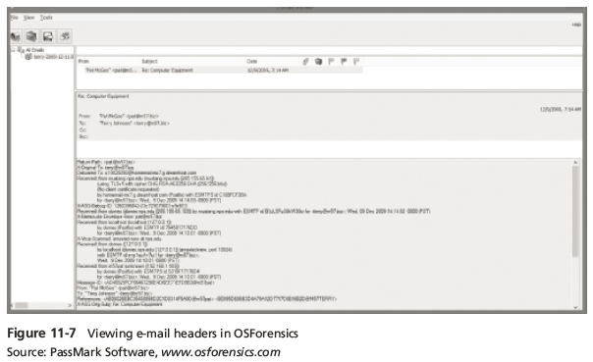
Using OSForensics to Recover
E-mail
Guide to Computer Forensics and Investigations, Fifth Edition

Slide 36
Using a Hex Editor to Carve E-mail Messages
Very few vendors have products for analyzing e-mail in systems other than Microsoft
mbox format
  Stores e-mails in flat plaintext files
Multipurpose Internet Mail Extensions (MIME) format
  Used by vendor-unique e-mail file systems, such as Microsoft .pst or .ost
Example: carve e-mail messages from Evolution
Guide to Computer Forensics and Investigations, Fifth Edition

Slide 37
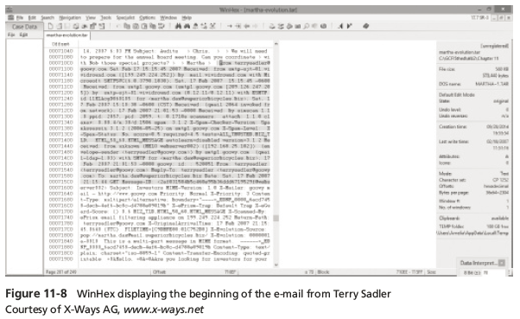
Using a Hex Editor to Carve E-mail Messages
Guide to Computer Forensics and Investigations, Fifth Edition

Slide 38
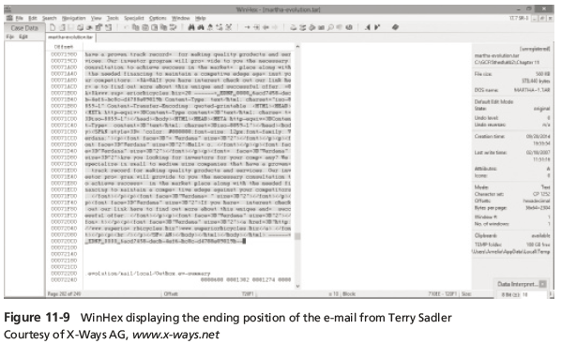
Using a Hex Editor to Carve E-mail Messages
Guide to Computer Forensics and Investigations, Fifth Edition

Slide 39
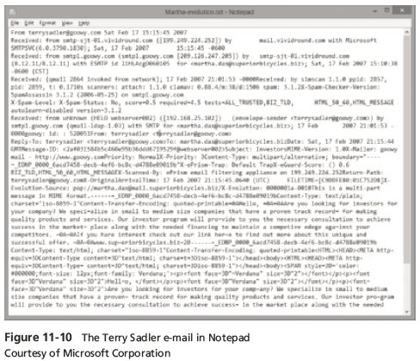
Using a Hex Editor to Carve E-mail Messages
Guide to Computer Forensics and Investigations, Fifth Edition

Slide 40
Recovering Outlook Files
A forensics examiner recovering e-mail messages from Outlook
  May need to reconstruct .pst files and messages
With many advanced forensics tools
  Deleted .pst files can be partially or completely recovered
Scanpst.exe recovery tool
  Comes with Microsoft Office
  Can repair .ost files as well as .pst files
Guide to Computer Forensics and Investigations, Fifth Edition

Slide 41
Recovering Outlook Files
Guidance Software uses the SysTools plug-in
  For Outlook e-mail through version 2013
  Systools extracts .pst files from EnCase Forensic for analysis
DataNumen Outlook Repair
  One of the better e-mail recovery tools
  Can recovery files from VMware and Virtual PC
Guide to Computer Forensics and Investigations, Fifth Edition

Slide 42
E-mail Case Studies
In the Enron Case, more than 10,00 emails contained the following personal information:
  60 containing credit card numbers
  572 containing thousands of Social Security or other identity numbers
  292 containing birth dates
  532 containing information of a highly personal nature
    Such as medical or legal matters
Guide to Computer Forensics and Investigations, Fifth Edition

Slide 43
Applying Digital Forensics to Social Media
Online social networks (OSNs) are used to conduct business, brag about criminal activities, raise money, and have class discussions
Social media can contain:
  Evidence of cyberbullying and witness tampering
  A company’s position on an issue
  Whether intellectual property rights have been violated
  Who posted information and when
Guide to Computer Forensics and Investigations, Fifth Edition

Slide 44
Applying Digital Forensics to Social Media
Social media can often substantiate a party’s claims
OSNs involve multiple jurisdictions that might even cross national boundaries
A warrant or subpoena is needed to access social media servers
In cases involving imminent danger, law enforcement can file for emergency requests
Guide to Computer Forensics and Investigations, Fifth Edition

Slide 45
Forensics Tools for Social Media Investigations
Software for social media forensics is being developed
  Not many tools are available now
There are questions about how the information these tools gather can be used in court or in arbitration
Using social media forensics software might also require getting the permission of the people whose information is being examined
Guide to Computer Forensics and Investigations, Fifth Edition

Slide 46
Summary
E-mail fraudsters use phishing, pharming, and spoofing scam techniques
In both Internet and intranet e-mail environments, e-mail messages are distributed from one central server to connected client computers
E-mail investigations are similar to other kinds of investigations
Access victim’s computer to recover evidence
  Copy and print the e-mail message involved in the crime or policy violation
Guide to Computer Forensics and Investigations, Fifth Edition

Slide 47
Summary
Use the e-mail program that created the message to find the e-mail header, which provides supporting evidence and can help you track the suspect to the originating location
Investigating e-mail abuse
  Be familiar with e-mail servers and clients’ operations
For many e-mail investigations you can rely on e-mail message files, headers, and server log files
Guide to Computer Forensics and Investigations, Fifth Edition

Slide 48
Summary
For e-mail applications that use the mbox format, a hexadecimal editor can be used to carve messages manually
Social media, or OSNs can provide evidence in criminal and civil cases
  Software for collecting OSN information is being developed
Social media forensics tools are still very new
  Can be used to find out which people users have been in touch with, when, and how often
Guide to Computer Forensics and Investigations, Fifth Edition

