Slide 1
Guide to Computer Forensics and Investigations
Fifth Edition
Chapter 1
Understanding The Digital Forensics Profession and Investigations
Notes:
Guide to Computer Forensics and Investigations Fifth Edition
Chapter 1
Understanding The Digital Forensics Profession and Investigations

Slide 2
Objectives
Describe the field of digital forensics
Explain how to prepare computer investigations and summarize the difference between public-sector and private-sector investigations
Explain the importance of maintaining professional conduct
Describe how to prepare a digital forensics investigation by taking a systematic approach
Guide to Computer Forensics and Investigations Fifth Edition
Notes:
Objectives
Describe the field of digital forensics
Explain how to prepare computer investigations and summarize the difference between public-sector and private-sector investigations
Explain the importance of maintaining professional conduct
Describe how to prepare a digital forensics investigation by taking a systematic approach

Slide 3
Objectives
Describe procedures for private-sector digital investigations
Explain requirements for data recovery workstations and software
Summarize how to conduct an investigation, including critiquing a case
Guide to Computer Forensics and Investigations Fifth Edition
Notes:
Objectives
Describe procedures for private-sector digital investigations
Explain requirements for data recovery workstations and software
Summarize how to conduct an investigation, including critiquing a case

Slide 4
An Overview of Digital Forensics
Digital forensics
  The application of computer science and investigative procedures for a legal purpose involving the analysis of digital evidence after proper search authority, chain of custody, validation with mathematics, use of validated tools, repeatability, reporting, and possible expert presentation.
  In October 2012, an ISO standard for digital forensics was ratified - ISO 27037 Information technology - Security techniques
Guide to Computer Forensics and Investigations Fifth Edition
Notes:
An Overview of Digital Forensics
Digital forensics
The application of computer science and investigative procedures for a legal purpose involving the analysis of digital evidence after proper search authority, chain of custody, validation with mathematics, use of validated tools, repeatability, reporting, and possible expert presentation.
In October 2012, an ISO standard for digital forensics was ratified - ISO 27037 Information technology - Security techniques

Slide 5
An Overview of Digital Forensics
The Federal Rules of Evidence (FRE) was created to ensure consistency in federal proceedings
  Signed into law in 1973
  Many states’ rules map to the FRE
FBI Computer Analysis and Response Team (CART) was formed in 1984 to handle cases involving digital evidence
By late 1990s, CART teamed up with Department of Defense Computer Forensics Laboratory (DCFL)
Guide to Computer Forensics and Investigations Fifth Edition
Notes:
An Overview of Digital Forensics
The Federal Rules of Evidence (FRE) was created to ensure consistency in federal proceedings
Signed into law in 1973
Many states’ rules map to the FRE
FBI Computer Analysis and Response Team (CART) was formed in 1984 to handle cases involving digital evidence
By late 1990s, CART teamed up with Department of Defense Computer Forensics Laboratory (DCFL)

Slide 6
An Overview of Digital Forensics
The Fourth Amendment to the U.S. Constitution protects everyone’s right to be secure from search and seizure
  Separate search warrants might not be necessary for digital evidence
Every U.S. jurisdiction has case law related to the admissibility of evidence recovered from computers and other digital devices
Guide to Computer Forensics and Investigations Fifth Edition
Notes:
An Overview of Digital Forensics
The Fourth Amendment to the U.S. Constitution protects everyone’s right to be secure from search and seizure
Separate search warrants might not be necessary for digital evidence
Every U.S. jurisdiction has case law related to the admissibility of evidence recovered from computers and other digital devices

Slide 7
Digital Forensics and Other Related Disciplines
Investigating digital devices includes:
  Collecting data securely
  Examining suspect data to determine details such as origin and content
  Presenting digital information to courts
  Applying laws to digital device practices
Digital forensics is different from data recovery
  Which involves retrieving information that was deleted by mistake or lost during a power surge or server crash
Guide to Computer Forensics and Investigations Fifth Edition
Notes:
Digital Forensics and Other Related Disciplines
Investigating digital devices includes:
Collecting data securely
Examining suspect data to determine details such as origin and content
Presenting digital information to courts
Applying laws to digital device practices
Digital forensics is different from data recovery
Which involves retrieving information that was deleted by mistake or lost during a power surge or server crash

Slide 8
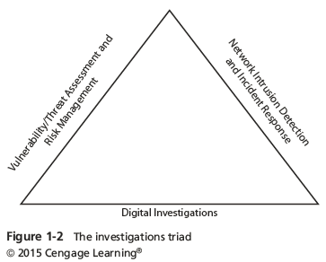
Digital Forensics and Other Related Disciplines
Forensics investigators often work as part of a team, known as the investigations triad
Guide to Computer Forensics and Investigations Fifth Edition
Notes:
Digital Forensics and Other Related Disciplines
Forensics investigators often work as part of a team, known as the investigations triad
Figure 1-2 The investigation triad

Slide 9
Digital Forensics and Other Related Disciplines
Vulnerability/threat assessment and risk management
  Tests and verifies the integrity of stand-along workstations and network servers
Network intrusion detection and incident response
  Detects intruder attacks by using automated tools and monitoring network firewall logs
Digital investigations
  Manages investigations and conducts forensics analysis of systems suspected of containing evidence
Guide to Computer Forensics and Investigations Fifth Edition
Notes:
Digital Forensics and Other Related Disciplines
Vulnerability/threat assessment and risk management
Tests and verifies the integrity of stand-along workstations and network servers
Network intrusion detection and incident response
Detects intruder attacks by using automated tools and monitoring network firewall logs
Digital investigations
Manages investigations and conducts forensics analysis of systems suspected of containing evidence

Slide 10
A Brief History of Digital Forensics
By the early 1990s, the International Association of Computer Investigative Specialists (IACIS) introduced training on software for digital forensics
IRS created search-warrant programs
ASR Data created Expert Witness for Macintosh
ILook is currently maintained by the IRS Criminal Investigation Division
AccessData Forensic Toolkit (FTK) is a popular commercial product
Guide to Computer Forensics and Investigations Fifth Edition
Notes:
A Brief History of Digital Forensics
By the early 1990s, the International Association of Computer Investigative Specialists (IACIS) introduced training on software for digital forensics
IRS created search-warrant programs
ASR Data created Expert Witness for Macintosh
ILook is currently maintained by the IRS Criminal Investigation Division
AccessData Forensic Toolkit (FTK) is a popular commercial product

Slide 11
Understanding Case Law
Existing laws can’t keep up with the rate of technological change
When statutes don’t exist, case law is used
  Allows legal counsel to apply previous similar cases to current one in an effort to address ambiguity in laws
Examiners must be familiar with recent court rulings on search and seizure in the electronic environment
Guide to Computer Forensics and Investigations Fifth Edition
Notes:
Understanding Case Law
Existing laws can’t keep up with the rate of technological change
When statutes don’t exist, case law is used
Allows legal counsel to apply previous similar cases to current one in an effort to address ambiguity in laws
Examiners must be familiar with recent court rulings on search and seizure in the electronic environment

Slide 12
Developing Digital Forensics Resources
To supplement your knowledge:
  Develop and maintain contact with computing, network, and investigative professionals
  Join computer user groups in both the pubic and private sectors
    Example: Computer Technology Investigators Network (CTIN) meets to discuss problems with digital forensics examiners encounter
  Consult outside experts
Guide to Computer Forensics and Investigations Fifth Edition
Notes:
Developing Digital Forensics Resources
To supplement your knowledge:
Develop and maintain contact with computing, network, and investigative professionals
Join computer user groups in both the pubic and private sectors
Example: Computer Technology Investigators Network (CTIN) meets to discuss problems with digital forensics examiners encounter
Consult outside experts

Slide 13
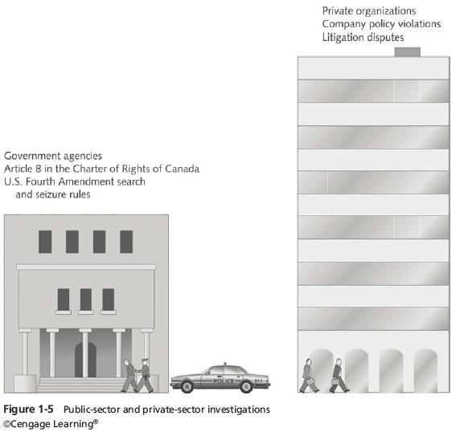
Preparing for Digital Investigations
Digital investigations fall into two categories:
  Public-sector investigations
  Private-sector investigations
Guide to Computer Forensics and Investigations Fifth Edition
Notes:
Preparing for Digital Investigations
Digital investigations fall into two categories:
Public-sector investigations
Private-sector investigations
Figure 1-5 Public-sector and private-sector investigations

Slide 14
Preparing for Digital Investigations
Public-sector investigations involve government agencies responsible for criminal investigations and prosecution
Fourth Amendment to the U.S. Constitution
  Restrict government search and seizure
The Department of Justice (DOJ) updates information on computer search and seizure regularly
Private-sector investigations focus more on policy violations
Guide to Computer Forensics and Investigations Fifth Edition
Notes:
Preparing for Digital Investigations
Public-sector investigations involve government agencies responsible for criminal investigations and prosecution
Fourth Amendment to the U.S. Constitution
Restrict government search and seizure
The Department of Justice (DOJ) updates information on computer search and seizure regularly
Private-sector investigations focus more on policy violations

Slide 15
Understanding Law Enforcement Agency Investigations
When conducting public-sector investigations, you must understand laws on computer-related crimes including:
  Standard legal processes
  Guidelines on search and seizure
  How to build a criminal case
The Computer Fraud and Abuse Act was passed in 1986
  Specific state laws were generally developed later
Guide to Computer Forensics and Investigations Fifth Edition
Notes:
Understanding Law Enforcement Agency Investigations
When conducting public-sector investigations, you must understand laws on computer-related crimes including:
Standard legal processes
Guidelines on search and seizure
How to build a criminal case
The Computer Fraud and Abuse Act was passed in 1986
Specific state laws were generally developed later

Slide 16
Following Legal Processes
A criminal investigation usually begins when someone finds evidence of or witnesses a crime
  Witness or victim makes an allegation to the police
Police interview the complainant and writes a report about the crime
Report is processed and management decides to start an investigation or log the information in a police blotter
  Blotter is a historical database of previous crimes
Guide to Computer Forensics and Investigations Fifth Edition
Notes:
Following Legal Processes
A criminal investigation usually begins when someone finds evidence of or witnesses a crime
Witness or victim makes an allegation to the police
Police interview the complainant and writes a report about the crime
Report is processed and management decides to start an investigation or log the information in a police blotter
Blotter is a historical database of previous crimes

Slide 17
Following Legal Processes
Digital Evidence First Responder (DEFR)
  Arrives on an incident scene, assesses the situation, and takes precautions to acquire and preserve evidence
Digital Evidence Specialist (DES)
  Has the skill to analyze the data and determine when another specialist should be called in to assist
Affidavit - a sworn statement of support of facts about or evidence of a crime
  Must include exhibits that support the allegation
Guide to Computer Forensics and Investigations Fifth Edition
Notes:
Following Legal Processes
Digital Evidence First Responder (DEFR)
Arrives on an incident scene, assesses the situation, and takes precautions to acquire and preserve evidence
Digital Evidence Specialist (DES)
Has the skill to analyze the data and determine when another specialist should be called in to assist
Affidavit - a sworn statement of support of facts about or evidence of a crime
Must include exhibits that support the allegation

Slide 18
Understanding Private-Sector Investigations
Private-sector investigations involve private companies and lawyers who address company policy violations and litigation disputes
  Example: wrongful termination
Businesses strive to minimize or eliminate litigation
Private-sector crimes can involve:
  E-mail harassment, falsification of data, gender and age discrimination, embezzlement, sabotage, and industrial espionage
Guide to Computer Forensics and Investigations Fifth Edition
Notes:
Understanding Private-Sector Investigations
Private-sector investigations involve private companies and lawyers who address company policy violations and litigation disputes
Example: wrongful termination
Businesses strive to minimize or eliminate litigation
Private-sector crimes can involve:
E-mail harassment, falsification of data, gender and age discrimination, embezzlement, sabotage, and industrial espionage

Slide 19
Understanding Private-Sector Investigations
Businesses can reduce the risk of litigation by publishing and maintaining policies that employees find easy to read and follow
Most important policies define rules for using the company’s computers and networks
  Known as an “Acceptable use policy”
Line of authority - states who has the legal right to initiate an investigation, who can take possession of evidence, and who can have access to evidence
Guide to Computer Forensics and Investigations Fifth Edition
Notes:
Understanding Private-Sector Investigations
Businesses can reduce the risk of litigation by publishing and maintaining policies that employees find easy to read and follow
Most important policies define rules for using the company’s computers and networks
Known as an “Acceptable use policy”
Line of authority - states who has the legal right to initiate an investigation, who can take possession of evidence, and who can have access to evidence

Slide 20
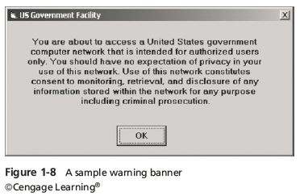
Understanding Private-Sector Investigations
Business can avoid litigation by displaying a warning banner on computer screens
  Informs end users that the organization reserves the right to inspect computer systems and network traffic at will
Guide to Computer Forensics and Investigations Fifth Edition
Notes:
Understanding Private-Sector Investigations
Business can avoid litigation by displaying a warning banner on computer screens
Informs end users that the organization reserves the right to inspect computer systems and network traffic at will
Figure 1-8 A sample warning banner

Slide 21
Understanding Private-Sector Investigations
Sample text that can be used in internal warning banners:
  Use of this system and network is for official business only
  Systems and networks are subject to monitoring at any time by the owner
  Using this system implies consent to monitoring by the owner
  Unauthorized or illegal users of this system or network will be subject to discipline or prosecution
Guide to Computer Forensics and Investigations Fifth Edition
Notes:
Understanding Private-Sector Investigations
Sample text that can be used in internal warning banners:
Use of this system and network is for official business only
Systems and networks are subject to monitoring at any time by the owner
Using this system implies consent to monitoring by the owner
Unauthorized or illegal users of this system or network will be subject to discipline or prosecution

Slide 22
Understanding Private-Sector Investigations
Businesses are advised to specify an authorized requester who has the power to initiate investigations
Examples of groups with authority
  Corporate security investigations
  Corporate ethics office
  Corporate equal employment opportunity office
  Internal auditing
  The general counsel or legal department
Guide to Computer Forensics and Investigations Fifth Edition
Notes:
Understanding Private-Sector Investigations
Businesses are advised to specify an authorized requester who has the power to initiate investigations
Examples of groups with authority
Corporate security investigations
Corporate ethics office
Corporate equal employment opportunity office
Internal auditing
The general counsel or legal department

Slide 23
Understanding Private-Sector Investigations
During private investigations, you search for evidence to support allegations of violations of a company’s rules or an attack on its assets
Three types of situations are common:
  Abuse or misuse of computing assets
  E-mail abuse
  Internet abuse
A private-sector investigator’s job is to minimize risk to the company
Guide to Computer Forensics and Investigations Fifth Edition
Notes:
Understanding Private-Sector Investigations
During private investigations, you search for evidence to support allegations of violations of a company’s rules or an attack on its assets
Three types of situations are common:
Abuse or misuse of computing assets
E-mail abuse
Internet abuse
A private-sector investigator’s job is to minimize risk to the company

Slide 24
Understanding Private-Sector Investigations
The distinction between personal and company computer property can be difficult with cell phones, smartphones, personal notebooks, and tablet computers
Bring your own device (BYOD) environment
  Some companies state that if you connect a personal device to the business network, it falls under the same rules as company property
Guide to Computer Forensics and Investigations Fifth Edition
Notes:
Understanding Private-Sector Investigations
The distinction between personal and company computer property can be difficult with cell phones, smartphones, personal notebooks, and tablet computers
Bring your own device (BYOD) environment
Some companies state that if you connect a personal device to the business network, it falls under the same rules as company property

Slide 25
Maintaining Professional Conduct
Professional conduct - includes ethics, morals, and standards of behavior
An investigator must exhibit the highest level of professional behavior at all times
  Maintain objectivity
  Maintain credibility by maintaining confidentiality
Investigators should also attend training to stay current with the latest technical changes in computer hardware and software, networking, and forensic tools
Guide to Computer Forensics and Investigations Fifth Edition
Notes:
Maintaining Professional Conduct
Professional conduct - includes ethics, morals, and standards of behavior
An investigator must exhibit the highest level of professional behavior at all times
Maintain objectivity
Maintain credibility by maintaining confidentiality
Investigators should also attend training to stay current with the latest technical changes in computer hardware and software, networking, and forensic tools

Slide 26
Preparing a Digital Forensics Investigation
The role of digital forensics professional is to gather evidence to prove that a suspect committed a crime or violated a company policy
Collect evidence that can be offered in court or at a corporate inquiry
  Investigate the suspect’s computer
  Preserve the evidence on a different computer
Chain of custody
  Route the evidence takes from the time you find it until the case is closed or goes to court
Guide to Computer Forensics and Investigations Fifth Edition
Notes:
Preparing a Digital Forensics Investigation
The role of digital forensics professional is to gather evidence to prove that a suspect committed a crime or violated a company policy
Collect evidence that can be offered in court or at a corporate inquiry
Investigate the suspect’s computer
Preserve the evidence on a different computer
Chain of custody
Route the evidence takes from the time you find it until the case is closed or goes to court

Slide 27
An Overview of a Computer Crime
Computers can contain information that helps law enforcement determine:
  Chain of events leading to a crime
  Evidence that can lead to a conviction
Law enforcement officers should follow proper procedure when acquiring the evidence
  Digital evidence can be easily altered by an overeager investigator
A potential challenge: information on hard disks might be password protected so forensics tools may be need to be used in your investigation
Guide to Computer Forensics and Investigations Fifth Edition
Notes:
An Overview of a Computer Crime
Computers can contain information that helps law enforcement determine:
Chain of events leading to a crime
Evidence that can lead to a conviction
Law enforcement officers should follow proper procedure when acquiring the evidence
Digital evidence can be easily altered by an overeager investigator
A potential challenge: information on hard disks might be password protected so forensics tools may be need to be used in your investigation

Slide 28
An Overview of a Company Policy Violation
Employees misusing resources can cost companies millions of dollars
Misuse includes:
  Surfing the Internet
  Sending personal e-mails
  Using company computers for personal tasks
Guide to Computer Forensics and Investigations Fifth Edition
Notes:
An Overview of a Company Policy Violation
Employees misusing resources can cost companies millions of dollars
Misuse includes:
Surfing the Internet
Sending personal e-mails
Using company computers for personal tasks

Slide 29
Taking a Systematic Approach
Steps for problem solving
  Make an initial assessment about the type of case you are investigating
  Determine a preliminary design or approach to the case
  Create a detailed checklist
  Determine the resources you need
  Obtain and copy an evidence drive
Guide to Computer Forensics and Investigations Fifth Edition
Notes:
Taking a Systematic Approach
Steps for problem solving
Make an initial assessment about the type of case you are investigating
Determine a preliminary design or approach to the case
Create a detailed checklist
Determine the resources you need
Obtain and copy an evidence drive

Slide 30
Taking a Systematic Approach
Steps for problem solving (cont’d)
  Identify the risks
  Mitigate or minimize the risks
  Test the design
  Analyze and recover the digital evidence
  Investigate the data you recover
  Complete the case report
  Critique the case
Guide to Computer Forensics and Investigations Fifth Edition
Notes:
Taking a Systematic Approach
Steps for problem solving (cont’d)
Identify the risks
Mitigate or minimize the risks
Test the design
Analyze and recover the digital evidence
Investigate the data you recover
Complete the case report
Critique the case

Slide 31
Assessing the Case
Systematically outline the case details
  Situation
  Nature of the case
  Specifics of the case
  Type of evidence
  Known disk format
  Location of evidence
Based on these details, you can determine the case requirements
Guide to Computer Forensics and Investigations Fifth Edition
Notes:
Assessing the Case
Systematically outline the case details
Situation
Nature of the case
Specifics of the case
Type of evidence
Known disk format
Location of evidence
Based on these details, you can determine the case requirements

Slide 32
Planning Your Investigation
A basic investigation plan should include the following activities:
  Acquire the evidence
  Complete an evidence form and establish a chain of custody
  Transport the evidence to a computer forensics lab
  Secure evidence in an approved secure container
Guide to Computer Forensics and Investigations Fifth Edition
Notes:
Planning Your Investigation
A basic investigation plan should include the following activities:
Acquire the evidence
Complete an evidence form and establish a chain of custody
Transport the evidence to a computer forensics lab
Secure evidence in an approved secure container

Slide 33
Planning Your Investigation
A basic investigation plan (cont’d):
  Prepare your forensics workstation
  Retrieve the evidence from the secure container
  Make a forensic copy of the evidence
  Return the evidence to the secure container
  Process the copied evidence with computer forensics tools
Guide to Computer Forensics and Investigations Fifth Edition
Notes:
Planning Your Investigation
A basic investigation plan (cont’d):
Prepare your forensics workstation
Retrieve the evidence from the secure container
Make a forensic copy of the evidence
Return the evidence to the secure container
Process the copied evidence with computer forensics tools

Slide 34
Planning Your Investigation
An evidence custody form helps you document what has been done with the original evidence and its forensics copies
  Also called a chain-of-evidence form
Two types
  Single-evidence form
    Lists each piece of evidence on a separate page
  Multi-evidence form
Guide to Computer Forensics and Investigations Fifth Edition
Notes:
Planning Your Investigation
An evidence custody form helps you document what has been done with the original evidence and its forensics copies
Also called a chain-of-evidence form
Two types
Single-evidence form
Lists each piece of evidence on a separate page
Multi-evidence form

Slide 35
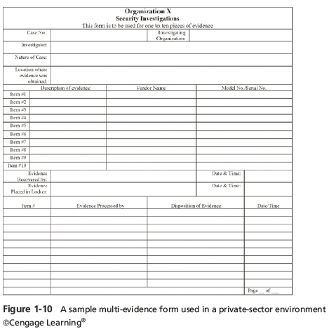
Planning Your Investigation
Guide to Computer Forensics and Investigations Fifth Edition
Notes:
Planning Your Investigation
Figure 1-10 A sample multi-evidence from used on a private-sector environment

Slide 36
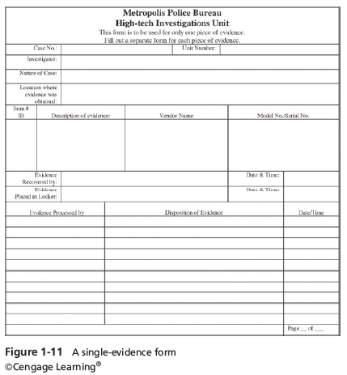
Planning Your Investigation
Guide to Computer Forensics and Investigations Fifth Edition
Notes:
Planning Your Investigation
Figure 1-11 A single-evidence form

Slide 37
Securing Your Evidence
Use evidence bags to secure and catalog the evidence
Use computer safe products when collecting computer evidence
  Antistatic bags
  Antistatic pads
Use well padded containers
Use evidence tape to seal all openings
  CD drive bays
  Insertion slots for power supply electrical cords and USB cables
Guide to Computer Forensics and Investigations Fifth Edition
Notes:
Securing Your Evidence
Use evidence bags to secure and catalog the evidence
Use computer safe products when collecting computer evidence
Antistatic bags
Antistatic pads
Use well padded containers
Use evidence tape to seal all openings
CD drive bays
Insertion slots for power supply electrical cords and USB cables

Slide 38
Securing Your Evidence
Write your initials on tape to prove that evidence has not been tampered with
Consider computer specific temperature and humidity ranges
  Make sure you have a safe environment for transporting and storing it until a secure evidence container is available
Guide to Computer Forensics and Investigations Fifth Edition
Notes:
Securing Your Evidence
Write your initials on tape to prove that evidence has not been tampered with
Consider computer specific temperature and humidity ranges
Make sure you have a safe environment for transporting and storing it until a secure evidence container is available

Slide 39
Procedures for Private-Sector High-Tech Investigations
As an investigator, you need to develop formal procedures and informal checklists
  To cover all issues important to high-tech investigations
  Ensures that correct techniques are used in an investigation
Guide to Computer Forensics and Investigations Fifth Edition
Notes:
Procedures for Private-Sector High-Tech Investigations
As an investigator, you need to develop formal procedures and informal checklists
To cover all issues important to high-tech investigations
Ensures that correct techniques are used in an investigation

Slide 40
Employee Termination Cases
The majority of investigative work for termination cases involves employee abuse of corporate assets
Incidents that create a hostile work environment are the predominant types of cases investigated
  Viewing pornography in the workplace
  Sending inappropriate e-mails
Organizations must have appropriate policies in place
Guide to Computer Forensics and Investigations Fifth Edition
Notes:
Employee Termination Cases
The majority of investigative work for termination cases involves employee abuse of corporate assets
Incidents that create a hostile work environment are the predominant types of cases investigated
Viewing pornography in the workplace
Sending inappropriate e-mails
Organizations must have appropriate policies in place

Slide 41
Internet Abuse Investigations
To conduct an investigation you need:
  Organization’s Internet proxy server logs
  Suspect computer’s IP address
  Suspect computer’s disk drive
  Your preferred computer forensics analysis tool
Guide to Computer Forensics and Investigations Fifth Edition
Notes:
Internet Abuse Investigations
To conduct an investigation you need:
Organization’s Internet proxy server logs
Suspect computer’s IP address
Suspect computer’s disk drive
Your preferred computer forensics analysis tool

Slide 42
Internet Abuse Investigations
Recommended steps
  Use standard forensic analysis techniques and procedures
  Use appropriate tools to extract all Web page URL information
  Contact the network firewall administrator and request a proxy server log
  Compare the data recovered from forensic analysis to the proxy server log
  Continue analyzing the computer’s disk drive data
Guide to Computer Forensics and Investigations Fifth Edition
Notes:
Internet Abuse Investigations
Recommended steps
Use standard forensic analysis techniques and procedures
Use appropriate tools to extract all Web page URL information
Contact the network firewall administrator and request a proxy server log
Compare the data recovered from forensic analysis to the proxy server log
Continue analyzing the computer’s disk drive data

Slide 43
E-mail Abuse Investigations
To conduct an investigation you need:
  An electronic copy of the offending e-mail that contains message header data
  If available, e-mail server log records
  For e-mail systems that store users’ messages on a central server, access to the server
  Access to the computer so that you can perform a forensic analysis on it
  Your preferred computer forensics analysis tool
Guide to Computer Forensics and Investigations Fifth Edition
Notes:
E-mail Abuse Investigations
To conduct an investigation you need:
An electronic copy of the offending e-mail that contains message header data
If available, e-mail server log records
For e-mail systems that store users’ messages on a central server, access to the server
Access to the computer so that you can perform a forensic analysis on it
Your preferred computer forensics analysis tool

Slide 44
E-mail Abuse Investigations
Recommended steps
  Use the standard forensic analysis techniques
  Obtain an electronic copy of the suspect’s and victim’s e-mail folder or data
  For Web-based e-mail investigations, use tools such as FTK’s Internet Keyword Search option to extract all related e-mail address information
  Examine header data of all messages of interest to the investigation
Guide to Computer Forensics and Investigations Fifth Edition
Notes:
E-mail Abuse Investigations
Recommended steps
Use the standard forensic analysis techniques
Obtain an electronic copy of the suspect’s and victim’s e-mail folder or data
For Web-based e-mail investigations, use tools such as FTK’s Internet Keyword Search option to extract all related e-mail address information
Examine header data of all messages of interest to the investigation

Slide 45
Attorney-Client Privilege Investigations
Under attorney-client privilege (ACP) rules for an attorney
  You must keep all findings confidential
Many attorneys like to have printouts of the data you have recovered
  You need to persuade and educate many attorneys on how digital evidence can be viewed electronically
You can also encounter problems if you find data in the form of binary files
Guide to Computer Forensics and Investigations Fifth Edition
Notes:
Attorney-Client Privilege Investigations
Under attorney-client privilege (ACP) rules for an attorney
You must keep all findings confidential
Many attorneys like to have printouts of the data you have recovered
You need to persuade and educate many attorneys on how digital evidence can be viewed electronically
You can also encounter problems if you find data in the form of binary files

Slide 46
Attorney-Client Privilege Investigations
Steps for conducting an ACP case
  Request a memorandum from the attorney directing you to start the investigation
  Request a list of keywords of interest to the investigation
  Initiate the investigation and analysis
  For disk drive examinations, make two bit-stream images using different tools for each image
  Compare hash signatures on all files on the original and re-created disks
Guide to Computer Forensics and Investigations Fifth Edition
Notes:
Attorney-Client Privilege Investigations
Steps for conducting an ACP case
Request a memorandum from the attorney directing you to start the investigation
Request a list of keywords of interest to the investigation
Initiate the investigation and analysis
For disk drive examinations, make two bit-stream images using different tools for each image
Compare hash signatures on all files on the original and re-created disks

Slide 47
Attorney-Client Privilege Investigations
Steps for conducting an ACP case (cont’d)
  Methodically examine every portion of the disk drive and extract all data
  Run keyword searches on allocated and unallocated disk space
  For Windows OSs, use specialty tools to analyze and extract data from the Registry
  For binary data files such as CAD drawings, locate the correct software product
  For unallocated data recovery, use a tool that removes or replaces nonprintable data
Guide to Computer Forensics and Investigations Fifth Edition
Notes:
Attorney-Client Privilege Investigations
Steps for conducting an ACP case (cont’d)
Methodically examine every portion of the disk drive and extract all data
Run keyword searches on allocated and unallocated disk space
For Windows OSs, use specialty tools to analyze and extract data from the Registry
For binary data files such as CAD drawings, locate the correct software product
For unallocated data recovery, use a tool that removes or replaces nonprintable data

Slide 48
Attorney-Client Privilege Investigations
Steps for conducting an ACP case (cont’d)
  Consolidate all recovered data from the evidence bit-stream image into folders and subfolders
Other guidelines
  Minimize written communications with the attorney
  Any documentation written to the attorney must contain a header stating that it’s “Privileged Legal Communication—Confidential Work Product”
  Assist the attorney and paralegal in analyzing data
Guide to Computer Forensics and Investigations Fifth Edition
Notes:
Attorney-Client Privilege Investigations
Steps for conducting an ACP case (cont’d)
Consolidate all recovered data from the evidence bit-stream image into folders and subfolders
Other guidelines
Minimize written communications with the attorney
Any documentation written to the attorney must contain a header stating that it’s “Privileged Legal Communication—Confidential Work Product”
Assist the attorney and paralegal in analyzing data

Slide 49
Industrial Espionage Investigations
All suspected industrial espionage cases should be treated as criminal investigations
Staff needed
  Computing investigator who is responsible for disk forensic examinations
  Technology specialist who is knowledgeable of the suspected compromised technical data
  Network specialist who can perform log analysis and set up network sniffers
  Threat assessment specialist (typically an attorney)
Guide to Computer Forensics and Investigations Fifth Edition
Notes:
Industrial Espionage Investigations
All suspected industrial espionage cases should be treated as criminal investigations
Staff needed
Computing investigator who is responsible for disk forensic examinations
Technology specialist who is knowledgeable of the suspected compromised technical data
Network specialist who can perform log analysis and set up network sniffers
Threat assessment specialist (typically an attorney)

Slide 50
Industrial Espionage Investigations
Guidelines when initiating an investigation
  Determine whether this investigation involves a possible industrial espionage incident
  Consult with corporate attorneys and upper management
  Determine what information is needed to substantiate the allegation
  Generate a list of keywords for disk forensics and sniffer monitoring
  List and collect resources for the investigation
Guide to Computer Forensics and Investigations Fifth Edition
Notes:
Industrial Espionage Investigations
Guidelines when initiating an investigation
Determine whether this investigation involves a possible industrial espionage incident
Consult with corporate attorneys and upper management
Determine what information is needed to substantiate the allegation
Generate a list of keywords for disk forensics and sniffer monitoring
List and collect resources for the investigation

Slide 51
Industrial Espionage Investigations
Guidelines (cont’d)
  Determine goal and scope of the investigation
  Initiate investigation after approval from management
Planning considerations
  Examine all e-mail of suspected employees
  Search Internet newsgroups or message boards
  Initiate physical surveillance
  Examine facility physical access logs for sensitive areas
Guide to Computer Forensics and Investigations Fifth Edition
Notes:
Industrial Espionage Investigations
Guidelines (cont’d)
Determine goal and scope of the investigation
Initiate investigation after approval from management
Planning considerations
Examine all e-mail of suspected employees
Search Internet newsgroups or message boards
Initiate physical surveillance
Examine facility physical access logs for sensitive areas

Slide 52
Industrial Espionage Investigations
Planning considerations (cont’d)
  Determine suspect location in relation to the vulnerable asset
  Study the suspect’s work habits
  Collect all incoming and outgoing phone logs
Steps to conducting an industrial espionage case
  Gather all personnel assigned to the investigation and brief them on the plan
  Gather resources to conduct the investigation
Guide to Computer Forensics and Investigations Fifth Edition
Notes:
Industrial Espionage Investigations
Planning considerations (cont’d)
Determine suspect location in relation to the vulnerable asset
Study the suspect’s work habits
Collect all incoming and outgoing phone logs
Steps to conducting an industrial espionage case
Gather all personnel assigned to the investigation and brief them on the plan
Gather resources to conduct the investigation

Slide 53
Industrial Espionage Investigations
Steps (cont’d)
  Place surveillance systems at key locations
  Discreetly gather any additional evidence
  Collect all log data from networks and e-mail servers
  Report regularly to management and corporate attorneys
  Review the investigation’s scope with management and corporate attorneys
Guide to Computer Forensics and Investigations Fifth Edition
Notes:
Industrial Espionage Investigations
Steps (cont’d)
Place surveillance systems at key locations
Discreetly gather any additional evidence
Collect all log data from networks and e-mail servers
Report regularly to management and corporate attorneys
Review the investigation’s scope with management and corporate attorneys

Slide 54
Interviews and Interrogations in High-Tech Investigations
Becoming a skilled interviewer and interrogator can take many years of experience
Interview
  Usually conducted to collect information from a witness or suspect
    About specific facts related to an investigation
Interrogation
  Process of trying to get a suspect to confess
Guide to Computer Forensics and Investigations Fifth Edition
Notes:
Interviews and Interrogations in High-Tech Investigations
Becoming a skilled interviewer and interrogator can take many years of experience
Interview
Usually conducted to collect information from a witness or suspect
About specific facts related to an investigation
Interrogation
Process of trying to get a suspect to confess

Slide 55
Interviews and Interrogations in High-Tech Investigations
Role as a computing investigator
  To instruct the investigator conducting the interview on what questions to ask
    And what the answers should be
Ingredients for a successful interview or interrogation
  Being patient throughout the session
  Repeating or rephrasing questions to zero in on specific facts from a reluctant witness or suspect
  Being tenacious
Guide to Computer Forensics and Investigations Fifth Edition
Notes:
Interviews and Interrogations in High-Tech Investigations
Role as a computing investigator
To instruct the investigator conducting the interview on what questions to ask
And what the answers should be
Ingredients for a successful interview or interrogation
Being patient throughout the session
Repeating or rephrasing questions to zero in on specific facts from a reluctant witness or suspect
Being tenacious

Slide 56
Understanding Data Recovery Workstations and Software
Investigations are conducted on a computer forensics lab (or data-recovery lab)
  In data recovery, the customer or your company just wants the data back
Computer forensics workstation
  A specially configured PC
  Loaded with additional bays and forensics software
To avoid altering the evidence use:
  Write-blockers devices
    Enable you to boot to Windows without writing data to the evidence drive
Guide to Computer Forensics and Investigations Fifth Edition
Notes:
Understanding Data Recovery Workstations and Software
Investigations are conducted on a computer forensics lab (or data-recovery lab)
In data recovery, the customer or your company just wants the data back
Computer forensics workstation
A specially configured PC
Loaded with additional bays and forensics software
To avoid altering the evidence use:
Write-blockers devices
Enable you to boot to Windows without writing data to the evidence drive

Slide 57
Setting Up Your Workstation for Digital Forensics
Basic requirements
  A workstation running Windows XP or later
  A write-blocker device
  Digital forensics acquisition tool
  Digital forensics analysis tool
  Target drive to receive the source or suspect disk data
  Spare PATA or SATA ports
  USB ports
Guide to Computer Forensics and Investigations Fifth Edition
Notes:
Setting Up Your Workstation for Digital Forensics
Basic requirements
A workstation running Windows XP or later
A write-blocker device
Digital forensics acquisition tool
Digital forensics analysis tool
Target drive to receive the source or suspect disk data
Spare PATA or SATA ports
USB ports

Slide 58
Setting Up your Workstation for Digital Forensics
Additional useful items
  Network interface card (NIC)
  Extra USB ports
  FireWire 400/800 ports
  SCSI card
  Disk editor tool
  Text editor tool
  Graphics viewer program
  Other specialized viewing tools
Guide to Computer Forensics and Investigations Fifth Edition
Notes:
Setting Up your Workstation for Digital Forensics
Additional useful items
Network interface card (NIC)
Extra USB ports
FireWire 400/800 ports
SCSI card
Disk editor tool
Text editor tool
Graphics viewer program
Other specialized viewing tools

Slide 59
Conducting an Investigation
Gather resources identified in investigation plan
Items needed
  Original storage media
  Evidence custody form
  Evidence container for the storage media
  Bit-stream imaging tool
  Forensic workstation to copy and examine your evidence
  Securable evidence locker, cabinet, or safe
Guide to Computer Forensics and Investigations Fifth Edition
Notes:
Conducting an Investigation
Gather resources identified in investigation plan
Items needed
Original storage media
Evidence custody form
Evidence container for the storage media
Bit-stream imaging tool
Forensic workstation to copy and examine your evidence
Securable evidence locker, cabinet, or safe

Slide 60
Gathering the Evidence
Avoid damaging the evidence
Steps
  Meet the IT manager to interview him
  Fill out the evidence form, have the IT manager sign
  Place the evidence in a secure container
  Carry the evidence to the computer forensics lab
  Complete the evidence custody form
  Secure evidence by locking the container
Guide to Computer Forensics and Investigations Fifth Edition
Notes:
Gathering the Evidence
Avoid damaging the evidence
Steps
Meet the IT manager to interview him
Fill out the evidence form, have the IT manager sign
Place the evidence in a secure container
Carry the evidence to the computer forensics lab
Complete the evidence custody form
Secure evidence by locking the container

Slide 61
Understanding Bit-Stream Copies
Bit-stream copy
  Bit-by-bit copy of the original storage medium
  Exact copy of the original disk
  Different from a simple backup copy
    Backup software only copy known files
    Backup software cannot copy deleted files, e-mail messages or recover file fragments
Bit-stream image
  File containing the bit-stream copy of all data on a disk or partition
  Also known as “image” or “image file”
Guide to Computer Forensics and Investigations Fifth Edition
Notes:
Understanding Bit-Stream Copies
Bit-stream copy
Bit-by-bit copy of the original storage medium
Exact copy of the original disk
Different from a simple backup copy
Backup software only copy known files
Backup software cannot copy deleted files, e-mail messages or recover file fragments
Bit-stream image
File containing the bit-stream copy of all data on a disk or partition
Also known as “image” or “image file”

Slide 62
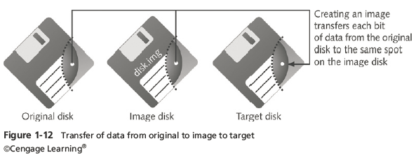
Understanding Bit-stream Copies
Copy image file to a target disk that matches the original disk’s manufacturer, size and model
Guide to Computer Forensics and Investigations Fifth Edition
Notes:
Understanding Bit-stream Copies
Copy image file to a target disk that matches the original disk’s manufacturer, size and model
Figure 1-12 Transfer of data from original to image to target

Slide 63
Acquiring an Image of Evidence Media
First rule of computer forensics
  Preserve the original evidence
Conduct your analysis only on a copy of the data
Several vendors provide MS-DOS, Linux, and Windows acquisition tools
  Windows tools require a write-blocking device when acquiring data from FAT or NTFS file systems
Guide to Computer Forensics and Investigations Fifth Edition
Notes:
Acquiring an Image of Evidence Media
First rule of computer forensics
Preserve the original evidence
Conduct your analysis only on a copy of the data
Several vendors provide MS-DOS, Linux, and Windows acquisition tools
Windows tools require a write-blocking device when acquiring data from FAT or NTFS file systems

Slide 64
Using ProDiscover Basic to Acquire a USB Drive
Create a work folder for data storage
Steps to perform an acquisition on a USB drive:
  On the USB drive locate the write-protect switch and place the drive in write-protect mode
  Start ProDiscover Basic
  In the main window, click Action, Capture Image from the menu
  Click the Source Drive drop-down list, and select the thumb drive
Guide to Computer Forensics and Investigations Fifth Edition
Notes:
Using ProDiscover Basic to Acquire a USB Drive
Create a work folder for data storage
Steps to perform an acquisition on a USB drive:
On the USB drive locate the write-protect switch and place the drive in write-protect mode
Start ProDiscover Basic
In the main window, click Action, Capture Image from the menu
Click the Source Drive drop-down list, and select the thumb drive

Slide 65
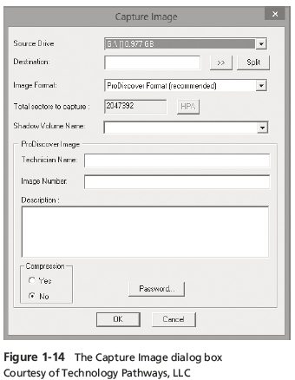
Using ProDiscover Basic to Acquire a USB Drive
Guide to Computer Forensics and Investigations Fifth Edition
Notes:
Using ProDiscover Basic to Acquire a USB Drive
Figure 1-14 The Capture Image dialog box

Slide 66
Using ProDiscover Basic to Acquire a USB Drive
Steps (cont’d)
  Click the >> button next to the Destination text box
  Type your name in the Technician Name text box
  ProDiscover Basic then acquires an image of the USB thumb drive
  Click OK in the completion message box
Guide to Computer Forensics and Investigations Fifth Edition
Notes:
Using ProDiscover Basic to Acquire a USB Drive
Steps (cont’d)
Click the >> button next to the Destination text box
Type your name in the Technician Name text box
ProDiscover Basic then acquires an image of the USB thumb drive
Click OK in the completion message box

Slide 67
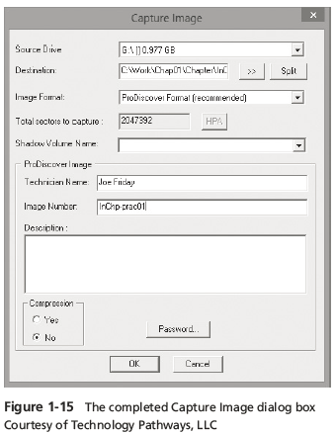
Using ProDiscover Basic to Acquire a USB Drive
Guide to Computer Forensics and Investigations Fifth Edition
Notes:
Using ProDiscover Basic to Acquire a USB Drive
Figure 1-15 The complement Capture Image dialog box

Slide 68
Analyzing Your Digital Evidence
Your job is to recover data from:
  Deleted files
  File fragments
  Complete files
Deleted files linger on the disk until new data is saved on the same physical location
Tools can be used to retrieve deleted files
  ProDiscover Basic
Guide to Computer Forensics and Investigations Fifth Edition
Notes:
Analyzing Your Digital Evidence
Your job is to recover data from:
Deleted files
File fragments
Complete files
Deleted files linger on the disk until new data is saved on the same physical location
Tools can be used to retrieve deleted files
ProDiscover Basic

Slide 69
Analyzing Your Digital Evidence
Steps to analyze a USB drive
  Start ProDiscover Basic
  Create a new case
  Type the project number
  Add an Image File
Steps to display the contents of the acquired data
  Click to expand Content View
  Click All Files under the image filename path
Guide to Computer Forensics and Investigations Fifth Edition
Notes:
Analyzing Your Digital Evidence
Steps to analyze a USB drive
Start ProDiscover Basic
Create a new case
Type the project number
Add an Image File
Steps to display the contents of the acquired data
Click to expand Content View
Click All Files under the image filename path

Slide 70
Analyzing Your Digital Evidence
Steps to display the contents of the acquired data (cont’d)
  Click letter1 to view its contents in the data area
  In the data area, view contents of letter1
Analyze the data
  Search for information related to the complaint
Data analysis can be most time-consuming task
Guide to Computer Forensics and Investigations Fifth Edition
Notes:
Analyzing Your Digital Evidence
Steps to display the contents of the acquired data (cont’d)
Click letter1 to view its contents in the data area
In the data area, view contents of letter1
Analyze the data
Search for information related to the complaint
Data analysis can be most time-consuming task

Slide 71
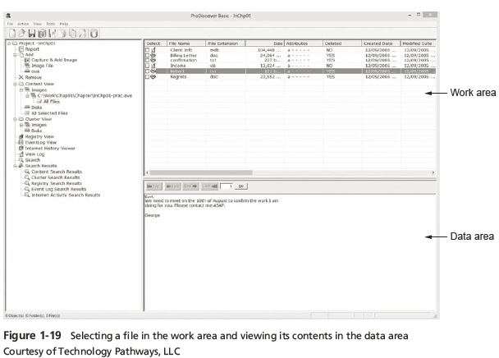
Analyzing Your Digital Evidence
Guide to Computer Forensics and Investigations Fifth Edition
Notes:
Analyzing Your Digital Evidence
Figure 1-19 Selecting a file in the work area and viewing its contents in the data area

Slide 72
Analyzing Your Digital Evidence
With ProDiscover Basic you can:
  Search for keywords of interest in the case
  Display the results in a search results window
  Click each file in the search results window and examine its content in the data area
  Export the data to a folder of your choice
  Search for specific filenames
  Generate a report of your activities
Guide to Computer Forensics and Investigations Fifth Edition
Notes:
Analyzing Your Digital Evidence
With ProDiscover Basic you can:
Search for keywords of interest in the case
Display the results in a search results window
Click each file in the search results window and examine its content in the data area
Export the data to a folder of your choice
Search for specific filenames
Generate a report of your activities

Slide 73
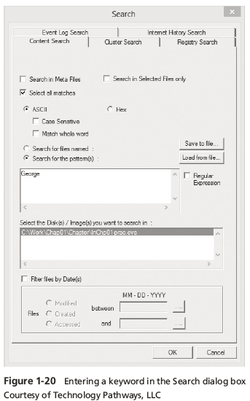
Analyzing Your Digital Evidence
Guide to Computer Forensics and Investigations Fifth Edition
Notes:
Analyzing Your Digital Evidence
Figure 1-20 Entering a keyboard in the Search dialog box

Slide 74
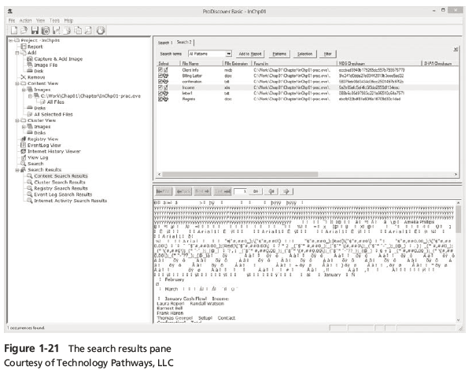
Analyzing Your Digital Evidence
Guide to Computer Forensics and Investigations Fifth Edition
Notes:
Analyzing Your Digital Evidence
Figure 1-21 The search results pane

Slide 75
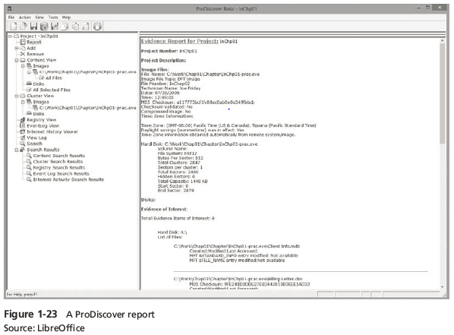
Analyzing Your Digital Evidence
Guide to Computer Forensics and Investigations Fifth Edition
Notes:
Analyzing Your Digital Evidence
Figure 1-23 A ProDiscover report

Slide 76
Completing the Case
You need to produce a final report
  State what you did and what you found
Include ProDiscover report to document your work
Repeatable findings
  Repeat the steps and produce the same result
If required, use a report template
Report should show conclusive evidence
  Suspect did or did not commit a crime or violate a company policy
Guide to Computer Forensics and Investigations Fifth Edition
Notes:
Completing the Case
You need to produce a final report
State what you did and what you found
Include ProDiscover report to document your work
Repeatable findings
Repeat the steps and produce the same result
If required, use a report template
Report should show conclusive evidence
Suspect did or did not commit a crime or violate a company policy

Slide 77
Completing the Case
Keep a written journal of everything you do
  Your notes can be used in court
Answer the six Ws:
  Who, what, when, where, why, and how
You must also explain computer and network processes
Guide to Computer Forensics and Investigations Fifth Edition
Notes:
Completing the Case
Keep a written journal of everything you do
Your notes can be used in court
Answer the six Ws:
Who, what, when, where, why, and how
You must also explain computer and network processes

Slide 78
Critiquing the Case
Ask yourself the following questions:
  How could you improve your performance in the case?
  Did you expect the results you found? Did the case develop in ways you did not expect?
  Was the documentation as thorough as it could have been?
  What feedback has been received from the requesting source?
Guide to Computer Forensics and Investigations Fifth Edition
Notes:
Critiquing the Case
Ask yourself the following questions:
How could you improve your performance in the case?
Did you expect the results you found? Did the case develop in ways you did not expect?
Was the documentation as thorough as it could have been?
What feedback has been received from the requesting source?

Slide 79
Critiquing the Case
Ask yourself the following questions (cont’d):
  Did you discover any new problems? If so, what are they?
  Did you use new techniques during the case or during research?
Guide to Computer Forensics and Investigations Fifth Edition
Notes:
Critiquing the Case
Ask yourself the following questions (cont’d):
Did you discover any new problems? If so, what are they?
Did you use new techniques during the case or during research?

Slide 80
Summary
Digital forensics involves systematically accumulating and analyzing digital information for use as evidence in civil, criminal, and administrative cases
Investigators need specialized workstations to examine digital evidence
Public-sector and private-sector investigations differ; public-sector typically require search warrants before seizing digital evidence
Guide to Computer Forensics and Investigations Fifth Edition
Notes:
Summary
Digital forensics involves systematically accumulating and analyzing digital information for use as evidence in civil, criminal, and administrative cases
Investigators need specialized workstations to examine digital evidence
Public-sector and private-sector investigations differ; public-sector typically require search warrants before seizing digital evidence

Slide 81
Summary
Always use a systematic approach to your investigations
Always plan a case taking into account the nature of the case, case requirements, and gathering evidence techniques
Both criminal cases and corporate-policy violations can go to court
Plan for contingencies for any problems you might encounter
Keep track of the chain of custody of your evidence
Guide to Computer Forensics and Investigations Fifth Edition
Notes:
Summary
Always use a systematic approach to your investigations
Always plan a case taking into account the nature of the case, case requirements, and gathering evidence techniques
Both criminal cases and corporate-policy violations can go to court
Plan for contingencies for any problems you might encounter
Keep track of the chain of custody of your evidence

Slide 82
Summary
Internet abuse investigations require examining server log data
For attorney-client privilege cases, all written communication should remain confidential
A bit-stream copy is a bit-by-bit duplicate of the original disk
Always maintain a journal to keep notes on exactly what you did
You should always critique your own work
Guide to Computer Forensics and Investigations Fifth Edition
Notes:
Summary
Internet abuse investigations require examining server log data
For attorney-client privilege cases, all written communication should remain confidential
A bit-stream copy is a bit-by-bit duplicate of the original disk
Always maintain a journal to keep notes on exactly what you did
You should always critique your own work

