Slide 1
Guide to Computer Forensics and Investigations
Fifth Edition
Chapter 14
Report Writing for High-Tech Investigations

Slide 2
Objectives
Explain the importance of reports
Describe guidelines for writing reports
Explain how to use forensics tools to generate reports
Guide to Computer Forensics and Investigations, Fifth Edition

Slide 3
Understanding the Importance of Reports
Communicate the results of your investigation
  Including expert opinion
Forensic reports can:
  Provide justification for collecting more evidence
  Be used at a probable cause hearing
  Communicate expert opinion
U.S. district courts require expert witnesses to submit written reports
  State courts are starting to also require them
Guide to Computer Forensics and Investigations, Fifth Edition

Slide 4
Understanding the Importance of Reports
Rule 26, Federal Rules of Civil Procedure requires submission of the expert’s written report that includes:
  All opinions, the basis for the opinions, and information considered in coming to those opinions
Written report must specify fees paid for the expert’s services
  And list all other civil or criminal cases in which the expert has testified
Guide to Computer Forensics and Investigations, Fifth Edition

Slide 5
Understanding the Importance of Reports
Keep a copy of any deposition notice or subpoena so that you can include the following:
  Jurisdiction
  Style of the case
  Cause number
  Date and location of the deposition
  Name of the deponent
Deposition banks
  Examples of expert witness’ previous testimonies
Guide to Computer Forensics and Investigations, Fifth Edition

Slide 6
Limiting a Report to Specifics
All reports to clients should start with the job mission or goal
  Find information on a specific subject
  Recover certain important documents
  Recover certain types of files with specific dates and times
Before you begin writing, identify your audience and the purpose of the report
Guide to Computer Forensics and Investigations, Fifth Edition

Slide 7
Types of Reports
Digital forensics examiners are required to create different types of reports
Examination plan
  What questions to expect when testifying
  Attorney uses the examination plan to guide you in your testimony
  You can propose changes to clarify or define information
  Helps your attorney learn the terms and functions used in computer forensics
Guide to Computer Forensics and Investigations, Fifth Edition

Slide 8
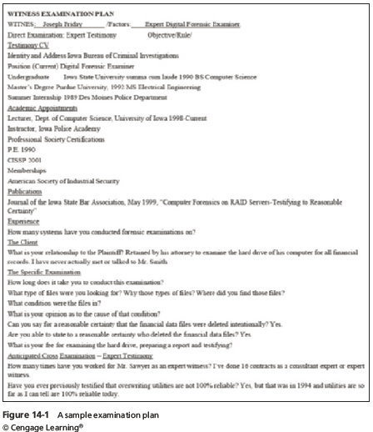
Guide to Computer Forensics and Investigations, Fifth Edition

Slide 9
Types of Reports
Verbal report
  Less structured
  Attorneys cannot be forced to release verbal reports
  Preliminary report
  Addresses areas of investigation yet to be completed
    Tests that have not been concluded
    Interrogatories
    Document production
    Depositions
Guide to Computer Forensics and Investigations, Fifth Edition

Slide 10
Types of Reports
Written report
  Affidavit or declaration
  Limit what you write and pay attention to details
    Include thorough documentation and support of what you write
Guide to Computer Forensics and Investigations, Fifth Edition

Slide 11
Guidelines for Writing Reports
Hypothetical questions based on factual evidence
  Guide and support your opinion
  Can be abused and overly complex
Opinions based on knowledge and experience
Exclude from hypothetical questions
  Facts that can change, cannot be used, or are not relevant to your opinion
Guide to Computer Forensics and Investigations, Fifth Edition

Slide 12
Guidelines for Writing Reports
As an expert witness, you may testify to an opinion, or conclusion, if four basic conditions are met:
  Opinion, inferences, or conclusions depend on special knowledge or skills
  Expert should qualify as a true expert in the field
  Expert must testify to a certain degree of certainty
  Experts must describe facts on which their opinions are based, or they must testify to a hypothetical question
Guide to Computer Forensics and Investigations, Fifth Edition

Slide 13
What to Include in Written Preliminary Reports
Anything you write down as part of your examination for a report
  Subject to discovery from the opposing attorney
  Discovery: the process of opposing attorneys seeking information from each other
Written preliminary reports are considered high-risk documents
  It’s better if there’s no written report to provide
Destroying the report could be considered destroying or concealing evidence (spoliation)
Guide to Computer Forensics and Investigations, Fifth Edition

Slide 14
What to Include in Written Preliminary Reports
Include the same information as in verbal reports
Additional items to include in your report:
  Summarize your billing to date and estimate costs to complete the effort
  Identify the tentative conclusion (rather than the preliminary conclusion)
  Identify areas for further investigation and obtain confirmation from the attorney on the scope of your examination
Guide to Computer Forensics and Investigations, Fifth Edition

Slide 15
Report Structure
Structure
  Abstract (summary)
  Table of contents
  Body of report
  Conclusion
  References
  Glossary
  Acknowledgements
  Appendixes
Guide to Computer Forensics and Investigations, Fifth Edition

Slide 16
Report Structure
An abstract condenses the report to concentrate on the essential information
The body consists of the introduction and discussion sections
The conclusion starts by referring to the report’s purpose, states the main points, draws conclusions, and possibly renders an opinion
References and appendixes list the supporting material to which your work refers
Guide to Computer Forensics and Investigations, Fifth Edition

Slide 17
Writing Reports Clearly
Consider
  Communicative quality
  Ideas and organization
  Grammar and vocabulary
  Punctuation and spelling
Lay out ideas in logical order
Build arguments piece by piece
Group related ideas and sentences into paragraphs
  Group paragraphs into sections
Guide to Computer Forensics and Investigations, Fifth Edition

Slide 18
Writing Reports Clearly
Avoid jargon, slang, and colloquial terms
Define technical terms
  Consider your audience
Considering writing style
  Use a natural language style
  Avoid repetition and vague language
  Be precise and specific
  Use active rather than passive voice
  Avoid presenting too many details and personal observations
Guide to Computer Forensics and Investigations, Fifth Edition

Slide 19
Writing Reports Clearly
Considering writing style (cont’d)
  Project objectivity
    Communicate calm, detached observations
Including signposts
  Draw reader’s attention to a point
  Assist readers in scanning the text quickly by highlighting the main points and logical development of information
Guide to Computer Forensics and Investigations, Fifth Edition

Slide 20
Designing the Layout and Presentation of Reports
Two numbering systems are typically used
Decimal numbering structure
  Divides material into sections
  Readers can scan heading
  Readers see how parts relate to each other
Legal-sequential numbering
  Used in pleadings
  Roman numerals represent major aspects
  Arabic numbers are supporting information
Guide to Computer Forensics and Investigations, Fifth Edition

Slide 21
Designing the Layout and Presentation of Reports
Providing supporting material
  Use material such as figures, tables, data, and equations to help tell the story as it unfolds
Formatting consistently
  How you format text is less important than being consistent in applying formatting
Explaining examination and data collection methods
  Explain how you studied the problem, which should follow logically from the purpose of the report
Guide to Computer Forensics and Investigations, Fifth Edition

Slide 22
Designing the Layout and Presentation of Reports
Including calculations
  If you use any hashing algorithms, be sure to give the common name
Providing for uncertainty and error analysis
  Protect your credibility
Explaining results and conclusions
  Explain your findings, using subheadings to divide the discussion into logical parts
  Save broader generalizations and summaries for the report’s conclusion
Guide to Computer Forensics and Investigations, Fifth Edition

Slide 23
Designing the Layout and Presentation of Reports
Providing references
  Cite references by author’s last name and year of publication
  Follow a standard format
Including appendixes
  You can include appendixes containing material such as raw data, figures not used in the body of the report, and anticipated exhibits
  Arrange them in the order referred to in the report
Guide to Computer Forensics and Investigations, Fifth Edition

Slide 24
Generating Report Findings with Forensics Software Tools
Forensics tools generate reports when performing analysis
  It is still your responsibility to explain the significance of the evidence
Report formats
  Plaintext
  Word processor
  HTML format
Guide to Computer Forensics and Investigations, Fifth Edition

Slide 25
Using ProDiscover Basic to Generate Reports
Create a new project
Add an image file to the project
Search for file extensions
Guide to Computer Forensics and Investigations, Fifth Edition

Slide 26
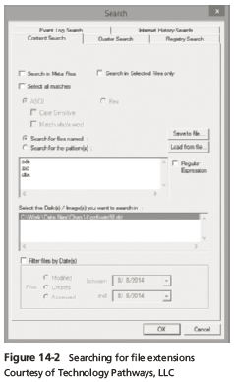
Guide to Computer Forensics and Investigations, Fifth Edition

Slide 27
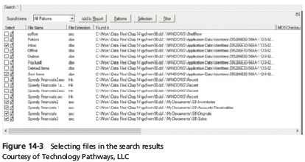
Using ProDiscover Basic to Generate Reports
Guide to Computer Forensics and Investigations, Fifth Edition

Slide 28
Using OSForensics to Generate Reports
Create a new case
Index the drive
Analyze evidence with OSForensics
  Search for *.dbx files
  Bookmark important files
    Normal correspondence - Green
    Suspicious correspondence - Yellow
    Very suspicious correspondence - Red
Guide to Computer Forensics and Investigations, Fifth Edition

Slide 29
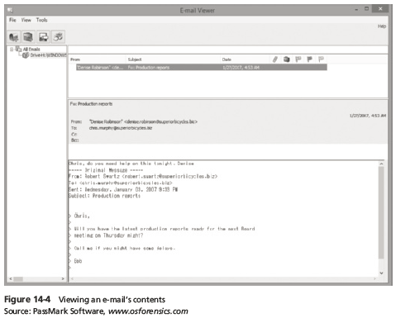
Using OSForensics to Generate Reports
Guide to Computer Forensics and Investigations, Fifth Edition

Slide 30
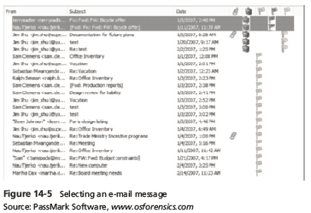
Using OSForensics to Generate Reports
Guide to Computer Forensics and Investigations, Fifth Edition

Slide 31
Using OSForensics to Generate Reports
Generate an OSForensics report
  Includes the ProDiscover report created previously
Guide to Computer Forensics and Investigations, Fifth Edition

Slide 32
Summary
All U.S. district courts and many state courts require expert witnesses to submit written reports
Rule 26 of the FRCP requires expert witnesses who anticipate testifying to submit written reports
Attorneys use deposition banks to research expert witnesses’ previous testimony
Reports should answer the questions you were retained to answer
Guide to Computer Forensics and Investigations, Fifth Edition

Slide 33
Summary
A well-defined report structure contributes to readers’ ability to understand the information you’re communicating
Clarity of writing is critical to a report’s success
Convey a tone of objectivity and be detached in your observations
Guide to Computer Forensics and Investigations, Fifth Edition

