Slide 1
Guide to Computer Forensics and Investigations
Fifth Edition
Chapter 7
Linux and Macintosh File Systems

Slide 2
Objectives
Describe Linux file structures
Describe Macintosh file structures
Use Linux forensics tools
Guide to Computer Forensics and Investigations, Fifth Edition

Slide 3
Examining Linux File Structures
UNIX flavors
  Silicon Graphics, Inc. (SGI) IRIX, Santa Cruz Operation (SCO) UnixWare, Sun Solaris, IBM AIX, and HP-UX
Linux distributions
  Ubuntu, Debian, Red Hat, OpenSUSE, and Slackware
  Linux is only the core of the OS
All UNIX-like OSs have a kernel
  So do all Windows OSs
Guide to Computer Forensics and Investigations, Fifth Edition

Slide 4
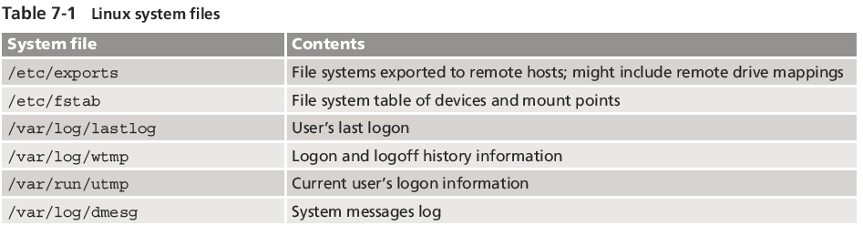
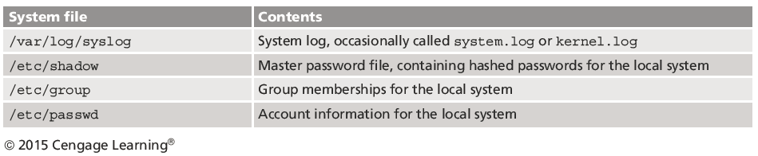
Examining Linux File Structures
Guide to Computer Forensics and Investigations, Fifth Edition

Slide 5
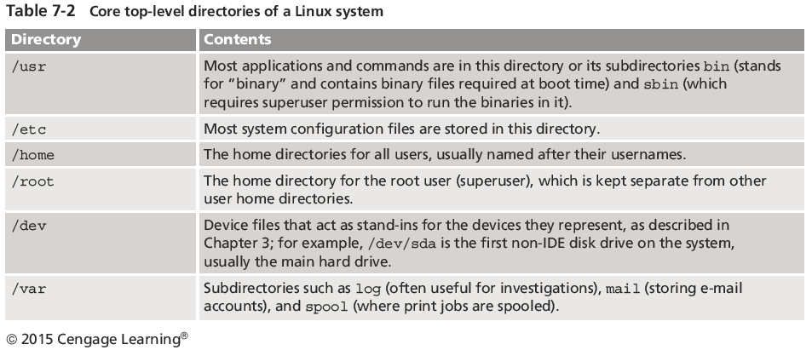
Examining Linux File Structures
Guide to Computer Forensics and Investigations, Fifth Edition

Slide 6
Examining Linux File Structures
Remember that UNIX and Linux commands are case sensitive
  Wrong capitalization can mean your commands are rejected as incorrect or interpreted as something different
Review some Linux commands by working through the activity on pages 289-291
  Use the echo command to add notes or headings in the logs
Guide to Computer Forensics and Investigations, Fifth Edition

Slide 7
File Structures in Ext4
The early file system standard was Second Extended File System (Ext2)
  Third Extended File System (Ext3) replaced Ext2 in most Linux distributions
Fourth Extended File System (Ext4) added support for partitions larger than 16 TB
  Improved management of large files and offered more flexibility
  Adoption of Ext4 was slower in some Linux distributions
Guide to Computer Forensics and Investigations, Fifth Edition

Slide 8
File Structures in Ext4
Everything is a file
  Files are objects with properties and methods
UNIX consists of four components
Boot block
  Block is a disk allocation unit of at least 512 bytes
  Contains the bootstrap code
  UNIX/Linux computer has only one boot block, located on the main hard disk
Guide to Computer Forensics and Investigations, Fifth Edition

Slide 9
File Structures in Ext4
Superblock
  Indicates disk geometry, available space, and location of the first inode
  Manages the file system
Inode blocks
  First data after the superblock
  Assigned to every file allocation unit
Data blocks
  Where directories and files are stored
  This location is linked directly to inodes
Guide to Computer Forensics and Investigations, Fifth Edition

Slide 10
Inodes
Contain file and directory metadata
  Also link data stored in data blocks
An assigned inode contains the following:
  Mode and type of file or directory
  Number of links to a file or directory
  UID and GID of the file’s or directory’s owner
  Number of bytes in the file or directory
  File’s or directory’s last access time and last modified time
Guide to Computer Forensics and Investigations, Fifth Edition

Slide 11
Inodes
An assigned inode contains the following (cont’d):
  Inode’s last file status change time
  Block address for the file data
  Indirect, double-indirect, and triple-indirect block addresses for the file data
  Current usage status of the inode
  Number of actual blocks assigned to a file
  File generation number of version number
  Continuation inode’s link
Guide to Computer Forensics and Investigations, Fifth Edition

Slide 12
Inodes
First inode has 13 pointers
  Pointers 1 to 10 are direct pointers to data storage blocks
Pointer 11 is an indirect pointer
  Links to 128 pointer inodes and each pointer links directly to 128 blocks
  Pointer 12 is a double-indirect pointer
  Pointer 13 is a triple-indirect pointer
Guide to Computer Forensics and Investigations, Fifth Edition

Slide 13
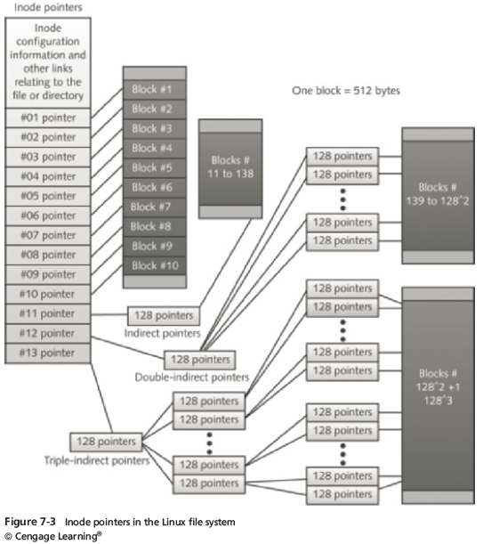
Inodes
Guide to Computer Forensics and Investigations, Fifth Edition

Slide 14
Inodes
Bad block inode
  Keeps track of disk’s bad sectors
To find bad blocks on a Linux computer, use the following commands
  badblocks - must log in as root to use
  mke2fs and e2fsck - include safeguards that prevent them from overwriting important information
Guide to Computer Forensics and Investigations, Fifth Edition

Slide 15
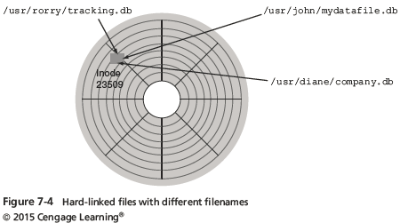
Hard Links and Symbolic Links
Hard link
  A pointer that allows accessing the same file by different filenames
  Use the ln command to create a hard link
Guide to Computer Forensics and Investigations, Fifth Edition

Slide 16
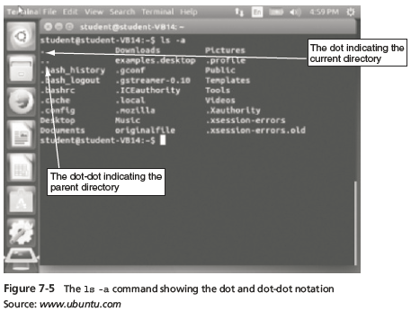
Hard Links and Symbolic Links
Link count
  A field inside each inode that specifies the number of hard links
Guide to Computer Forensics and Investigations, Fifth Edition

Slide 17
Hard Links and Symbolic Links
Symbolic links
  Pointers to other files and aren’t included in the link
  Also known as “soft links” or “symlinks”
  Can point to items on other drives or other parts of the network
  Have an inode of their own
    Not the same as the inode of the item they are pointing to
  Depend on the existence of the destination they are pointing to
Guide to Computer Forensics and Investigations, Fifth Edition

Slide 18
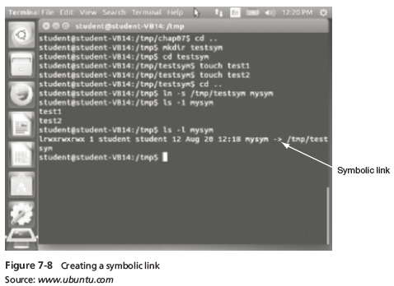
Hard Links and Symbolic Links
Guide to Computer Forensics and Investigations, Fifth Edition

Slide 19
Understanding Macintosh File Structures
Mac OS X version 10.9
  Code-named Mavericks
Yosemite, version 10.10
  Scheduled to be released October 2014
MAC OS X is built on a core called Darwin
  Consists of a Berkeley Software Distribution (BSD) UNIX application layer
With OS X, Macintosh moved to the Intel processor and become UNIX based
Guide to Computer Forensics and Investigations, Fifth Edition

Slide 20
Understanding Macintosh File Structures
Before OS X, Hierarchical File System (HFS)
  Files stored in nested directories (folders)
Extended Format File System (HFS+)
  Introduced with Mac OS 8.1
  Supports smaller file sizes on larger volumes, resulting in more efficient disk use
Guide to Computer Forensics and Investigations, Fifth Edition

Slide 21
An Overview of Mac File Structures
In Mac, a file consists of two parts:
  Data fork and resource fork
  Stores file metadata and application information
The data fork typically contains data the user creates, such as text or spreadsheets
  Applications also read and write to the data fork
A volume is any storage medium used to store files
  It can be all or part of the storage media for hard disks
Guide to Computer Forensics and Investigations, Fifth Edition

Slide 22
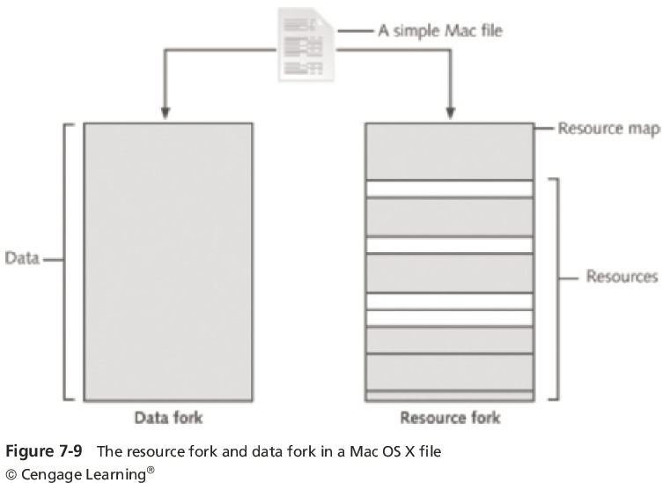
An Overview of Mac File Structures
Guide to Computer Forensics and Investigations, Fifth Edition

Slide 23
An Overview of Mac File Structures
Volumes have allocation and logical blocks
  Logical blocks cannot exceed 512 bytes
  Allocation blocks are a set of consecutive logical blocks
Two end of file (EOF) descriptors
  Logical EOF
    Actual size of the file
  Physical EOF
    The number of allocation blocks for that file
Guide to Computer Forensics and Investigations, Fifth Edition

Slide 24
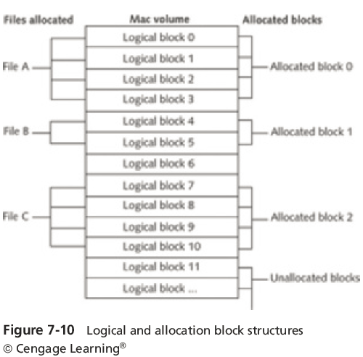
An Overview of Mac File Structures
Guide to Computer Forensics and Investigations, Fifth Edition

Slide 25
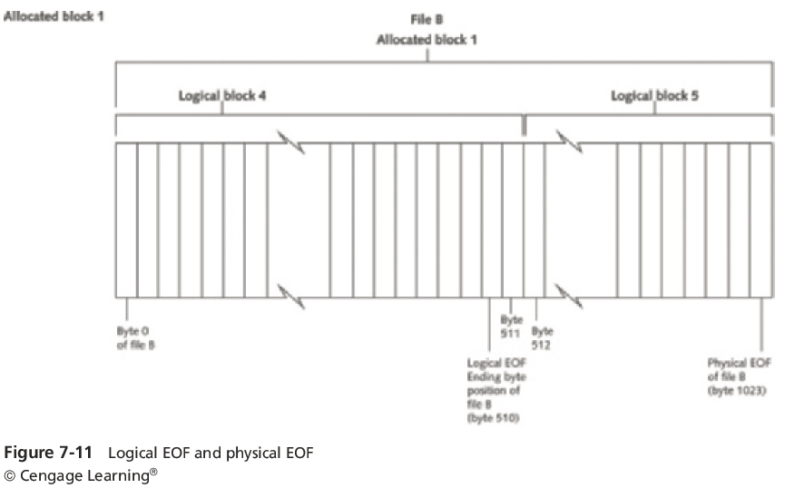
An Overview of Mac File Structures
Guide to Computer Forensics and Investigations, Fifth Edition

Slide 26
An Overview of Mac File Structures
Clumps
  Groups of contiguous allocation blocks
  Reduce fragmentation
Older Macintosh OSs use
  First two logical blocks, 0 and 1, as boot blocks
  Master Directory Block (MDB) or Volume Information Block (VIB)
    Stores all information about a volume
  Volume Control Block (VCB)
    Stores information from the MDB when OS mounts
Extents overflow file
  Stores any file information not in the MDB or a VCB
Guide to Computer Forensics and Investigations, Fifth Edition

Slide 27
An Overview of Mac File Structures
Extents overflow file
  Stores any file information not in the MDB or a VCB
Catalog
  The listing of all files and directories on the volume
  Maintains relationships between files and directories
B*-tree file system in earlier Mac version
  Actual file data is stored on the leaf nodes
  B*-tree also uses header, index, and map nodes
Guide to Computer Forensics and Investigations, Fifth Edition

Slide 28
Forensics Procedures in Mac
There are some differences between Linux and Mac OS X file systems
  Linux has the /home/username and /root directories
  In Mac, the folders are /users/username and /private/var/root
  The /home directory exists in the Mac OS but it is empty
  Mac users have limited access to other user accounts’ files and the guest account is disabled
Guide to Computer Forensics and Investigations, Fifth Edition

Slide 29
Forensics Procedures in Mac
For forensics procedures in Mac OS X:
  You must know where file system components are located and how both files and file components are stored
Application settings are in three formats:
  Plaintext, plist files, and the SQLite database
  Plist files are preference files for installed applications on a system
FileVault is used to encrypt and decrypt a user’s /users directory
Guide to Computer Forensics and Investigations, Fifth Edition

Slide 30
Forensics Procedures in Mac
Keychains
  Files used to manage passwords for applications, Web sites, and other system files
  The Mac application Keychain Access enables you to restore passwords
Deleted files are in the Trashes folder
  If a file is deleted at the command line, however, it doesn’t show up in the trash
Guide to Computer Forensics and Investigations, Fifth Edition

Slide 31
Forensics Procedures in Mac
Macintosh Acquisition Methods
  Make an image of the drive
  Static acquisition of the suspect drive is preferable to a live acquisition
  Removing the drive from a Macintosh Mini’s CPU case is difficult
    Attempting to do so without Apple factory training could damage the computer
  Use a Macintosh-compatible forensic boot CD to make an image
Guide to Computer Forensics and Investigations, Fifth Edition

Slide 32
Forensics Procedures in Mac
Macintosh Acquisition Methods (cont’d)
  BlackBag Technologies sells acquisition products specifically designed for OS 9 and earlier
    As well as OS X
  MacQuisition is a forensic boot CD that makes an image of a Macintosh drive
  After making an acquisition, examine the image of the file system
    The tool you use depends on the image file format
Guide to Computer Forensics and Investigations, Fifth Edition

Slide 33
Forensics Procedures in Mac
Macintosh Acquisition Methods (cont’d)
  BlackBag Technologies Macintosh Forensic Software and SubRosaSoft MacForensicsLab
    Can disable/enable Disk Arbitration
  Being able to turn off the mount function in OS X
    Allows you to connect a suspect drive to a Macintosh without a write-blocking device
Guide to Computer Forensics and Investigations, Fifth Edition

Slide 34
Forensics Procedures in Mac
Tools and vendors
  BlackBag Technologies Macintosh Forensic Software (OS X only)
  SubRosaSoft MacForensicsLab (OS X only)
  Guidance EnCase
  X-Ways Forensics
  AccessData FTK
Guide to Computer Forensics and Investigations, Fifth Edition

Slide 35
Using Linux Forensics Tools
Most commercial computer forensics tools can analyze Linux Ext2, Ext3, Ext4, ReiserFS, and Reiser4 file systems
Freeware tools include Sleuth Kit and its Web browser interface, Autopsy Forensic Browser
Foremost
  A freeware carving tool that can read many image file formats
  Configuration file: foremost.conf
Guide to Computer Forensics and Investigations, Fifth Edition

Slide 36
Using Linux Forensics Tools
Tarball
  A data file containing one or more files or whole directories and their contents
Installing Sleuth Kit and Autopsy
  Download the most current source code from www.sleuthkit.org
  To run Sleuth Kit and Autopsy Browser, you need to have root privileges
Guide to Computer Forensics and Investigations, Fifth Edition

Slide 37
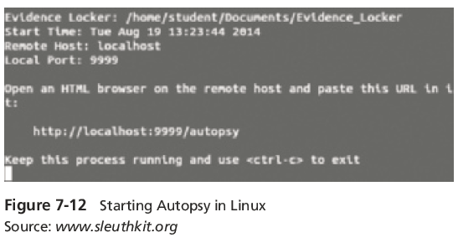
Using Linux Forensics Tools
Guide to Computer Forensics and Investigations, Fifth Edition

Slide 38
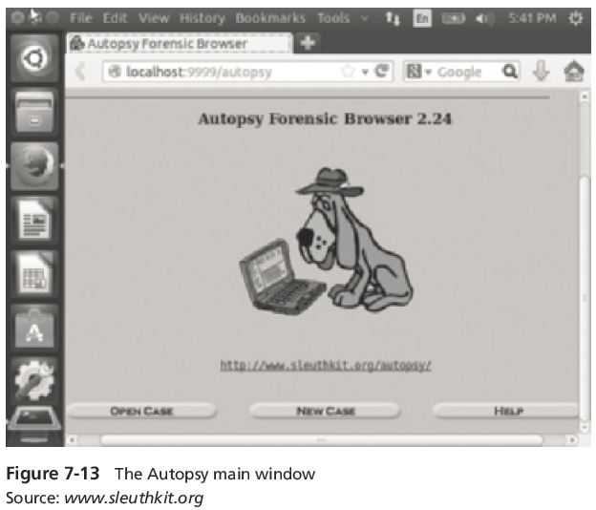
Using Linux Forensics Tools
Guide to Computer Forensics and Investigations, Fifth Edition

Slide 39
Using Linux Forensics Tools
Examining a case with Sleuth Kit and Autopsy
  Follow instructions to use Sleuth Kit and Autopsy Browser to examine an older Linux file system
    See Figures 7-14 through 7-15
Guide to Computer Forensics and Investigations, Fifth Edition

Slide 40
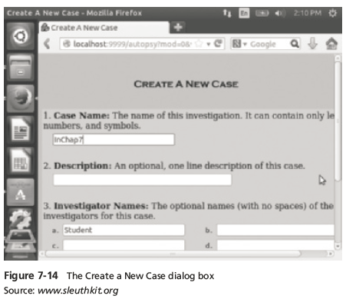
Using Linux Forensics Tools
Guide to Computer Forensics and Investigations, Fifth Edition

Slide 41
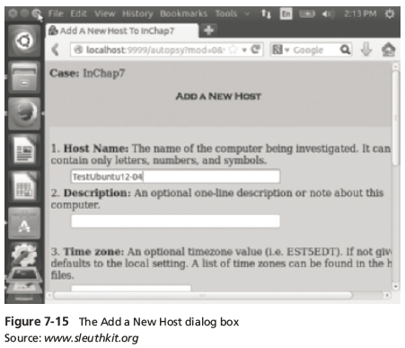
Using Linux Forensics Tools
Guide to Computer Forensics and Investigations, Fifth Edition

Slide 42
Summary
UNIX was created to be a multiuser, multithreaded, secure OS
The Linux kernel is usually packaged with other software components, such as a GUI and applications
Linux supports a wide range of file systems
UNIX and Linux have four components defining the file system: boot block, superblock, inode block, and data block
Guide to Computer Forensics and Investigations, Fifth Edition

Slide 43
Summary
In the Linux file system, a hard link is a pointer that allows accessing the same file by different filenames
Before Mac OS X, the file systems HFS and HFS+ were used
In Mac, a file consists of two parts: a data fork and a resource fork
A volume is any storage medium used to store files
Guide to Computer Forensics and Investigations, Fifth Edition

Slide 44
Summary
Plist files are files for installed applications on a Mac system
The biggest challenge in acquiring images from Mac systems is often physical access to the drive
Linux forensic tools are often freeware
Guide to Computer Forensics and Investigations, Fifth Edition

