Slide 1
Guide to Computer Forensics and Investigations
Fifth Edition
Chapter 9
Digital Forensics Analysis and Validation

Slide 2
Objectives
Determine what data to analyze in a digital forensics investigation
Explain tools used to validate data
Explain common data-hiding techniques
Guide to Computer Forensics and Investigations, Fifth Edition

Slide 3
Determining What Data to Collect and Analyze
Examining and analyzing digital evidence depend on the nature of the investigation
  And the amount of data to process
Scope creep - when an investigation expands beyond the original description
  Because of unexpected evidence found
  Attorneys may ask investigators to examine other areas to recover more evidence
  Increases the time and resources needed to extract, analyze, and present evidence
Guide to Computer Forensics and Investigations, Fifth Edition

Slide 4
Determining What Data to Collect and Analyze
Scope creep has become more common
  Criminal investigations require more detailed examination of evidence just before trial
  To help prosecutors fend off attacks from defense attorneys
New evidence often isn’t revealed to prosecution
  It’s become more important for prosecution teams to ensure they have analyzed the evidence exhaustively before trial
Guide to Computer Forensics and Investigations, Fifth Edition

Slide 5
Approaching Digital Forensics Cases
Begin a case by creating an investigation plan that defines the:
  Goal and scope of investigation
  Materials needed
  Tasks to perform
The approach you take depends largely on the type of case you’re investigating
  Corporate, civil, or criminal
Guide to Computer Forensics and Investigations, Fifth Edition

Slide 6
Approaching Digital Forensics Cases
Follow these basic steps for all digital forensics investigations:
  1. For target drives, use recently wiped media that have been reformatted and inspected for viruses
  2. Inventory the hardware on the suspect’s computer, and note condition of seized computer
  3. For static acquisitions, remove original drive and check the date and time values in system’s CMOS
  4. Record how you acquired data from the suspect drive
Guide to Computer Forensics and Investigations, Fifth Edition

Slide 7
Approaching Digital Forensics Cases
Follow these basic steps for all digital forensics investigations (cont’d):
  5. Process drive’s contents methodically and logically
  6. List all folders and files on the image or drive
  7. Examine contents of all data files in all folders
  8. Recover file contents for all password-protected files
  9. Identify function of every executable file that doesn’t match hash values
Guide to Computer Forensics and Investigations, Fifth Edition

Slide 8
Approaching Digital Forensics Cases
Follow these basic steps for all digital forensics investigations (cont’d):
  10. Maintain control of all evidence and findings
Refining and Modifying the Investigation Plan
  Even if initial plan is sound, at times you may need to deviate from it and follow evidence
  Knowing the types of data to look for helps you make the best use of your time
  The key is to start with a plan but remain flexible in the face of new evidence
Guide to Computer Forensics and Investigations, Fifth Edition

Slide 9
Using OSForensics to Analyze Data
OSForensics can perform forensics analysis on the following file systems:
  Microsoft FAT12, FAT16, and FAT32
  Microsoft NTFS
  Mac HFS+ and HFSX
  Linux Ext2fs, and Ext4fs
OSForensics can analyze data from several sources
  Including image files from other vendors
Guide to Computer Forensics and Investigations, Fifth Edition

Slide 10
Using OSForensics to Analyze Data
Includes OSFMount utility which can access many formats, including:
  Raw, Expert Witness, and Advanced Forensics Format (AFF)
  Can also mount and examine VMware images (.vmdk), SMART images (.s01), and VHD images (.vhd)
Can use the NIST National Software Reference Library (NSRL)
  Enables you to mount the NSRL ISO image
Guide to Computer Forensics and Investigations, Fifth Edition

Slide 11
Using OSForensics to Analyze Data
Using the Index Feature in OS Forensics
  OSForensics indexes text data so that you can perform searches immediately
  Follow steps starting on page 5 to learn how to index a case
Guide to Computer Forensics and Investigations, Fifth Edition

Slide 12
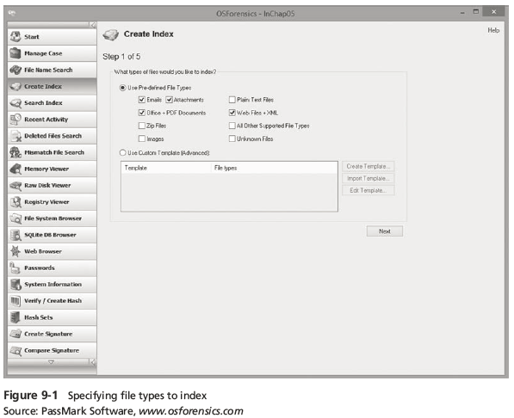
Using OSForensics to Analyze Data
Guide to Computer Forensics and Investigations, Fifth Edition

Slide 13
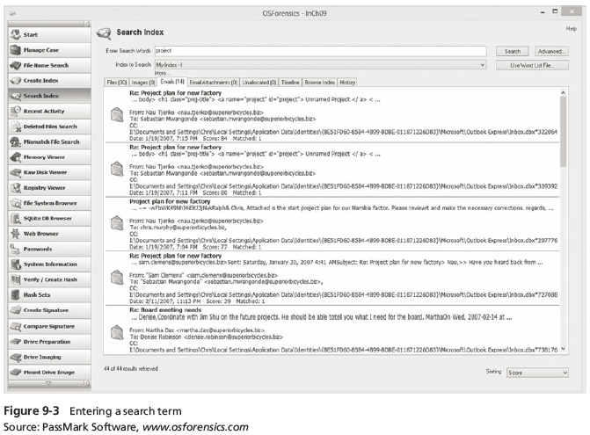
Using OSForensics to Analyze Data
Guide to Computer Forensics and Investigations, Fifth Edition

Slide 14
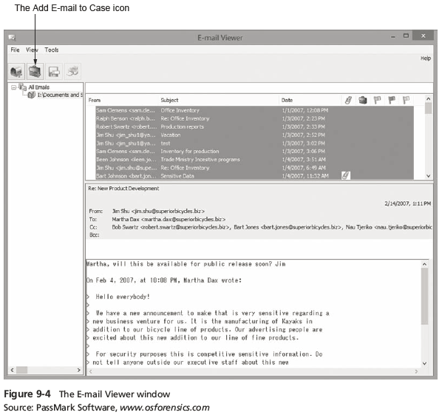
Using OSForensics to Analyze Data
Guide to Computer Forensics and Investigations, Fifth Edition

Slide 15
Validating Forensic Data
Ensuring the integrity of data collected is essential for presenting evidence in court
Most forensic tools offer hashing of image files
Example - when ProDiscover loads an image file:
  It runs a hash and compares the value with the original hash calculated when the image was first acquired
Using advanced hexadecimal editors ensures data integrity
Guide to Computer Forensics and Investigations, Fifth Edition

Slide 16
Validating with Hexadecimal Editors
Advanced hex editors offer features not available in digital forensics tools, such as:
  Hashing specific files or sectors
With the hash value in hand
  You can use a forensics tool to search for a suspicious file that might have had its name changed to look like an innocuous file
WinHex provides MD5 and SHA-1 hashing algorithms
Guide to Computer Forensics and Investigations, Fifth Edition

Slide 17
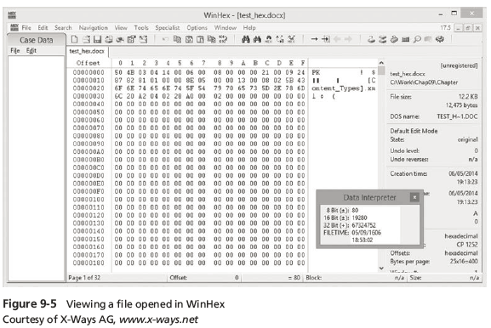
Validating with Hexadecimal Editors
Guide to Computer Forensics and Investigations, Fifth Edition

Slide 18
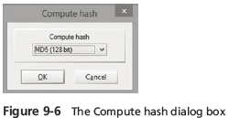
Validating with Hexadecimal Editors
Guide to Computer Forensics and Investigations, Fifth Edition

Slide 19
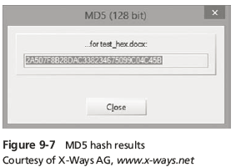
Validating with Hexadecimal Editors
Guide to Computer Forensics and Investigations, Fifth Edition

Slide 20
Validating with Hexadecimal Editors
Advantage of recording hash values
  You can determine whether data has changed
Block-wise hashing
  A process that builds a data set of hashes of sectors from the original file
  Then examines sectors on the suspect’s drive to see whether any other sectors match
  If an identical hash value is found, you have confirmed that the file was stored on the suspect’s drive
Guide to Computer Forensics and Investigations, Fifth Edition

Slide 21
Validating with Hexadecimal Editors
Using Hash Values to Discriminate Data
  AccessData has its own hashing database, Known File Filter (KFF)
  KFF filters known program files from view and contains has values of known illegal files
  It compares known file hash values with files on your evidence drive to see if they contain suspicious data
  Other digital forensics tools can import the NSRL database and run hash comparisons
Guide to Computer Forensics and Investigations, Fifth Edition

Slide 22
Validating with Digital Forensics Tools
ProDiscover
  .eve files contain metadata that includes hash value
  Has a preference you can enable for using the Auto Verify Image Checksum feature when image files are loaded
  If the Auto Verify Image Checksum and the hashes in the .eve file’s metadata don’t match
    ProDiscover will notify that the acquisition is corrupt and can’t be considered reliable evidence
Guide to Computer Forensics and Investigations, Fifth Edition

Slide 23
Validating with Digital Forensics Tools
Raw format image files don’t contain metadata
  You must validate them manually to ensure integrity
In AccessData FTK Imager, when selecting the Expert Witness (.e01) or SMART (.s01) format:
  Additional options for validating the acquisition are available
  Validation report lists MD5 and SHA-1 hash values
Follow steps starting on page 12 to see how ProDiscover’s built-in validation feature works
Guide to Computer Forensics and Investigations, Fifth Edition

Slide 24
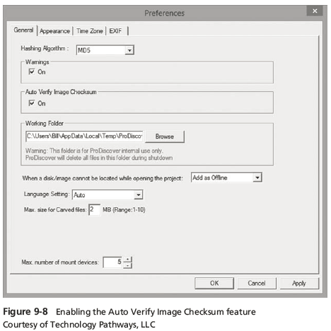
Validating with Digital Forensics Tools
Guide to Computer Forensics and Investigations, Fifth Edition

Slide 25
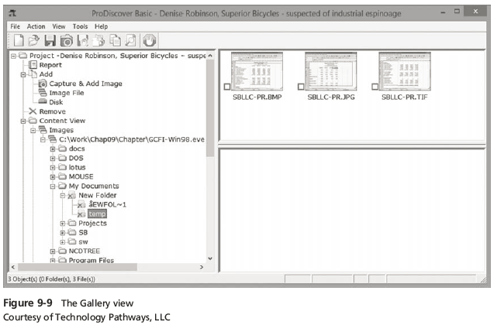
Validating with Digital Forensics Tools
Guide to Computer Forensics and Investigations, Fifth Edition

Slide 26
Addressing Data-Hiding Techniques
Data hiding - changing or manipulating a file to conceal information
Techniques:
  Hiding entire partitions
  Changing file extensions
  Setting file attributes to hidden
  Bit-shifting
  Using encryption
  Setting up password protection
Guide to Computer Forensics and Investigations, Fifth Edition

Slide 27
Hiding Files by Using the OS
One of the first techniques to hide data:
  Changing file extensions
Advanced digital forensics tools check file headers
  Compare the file extension to verify that it’s correct
  If there’s a discrepancy, the tool flags the file as a possible altered file
Another hiding technique
  Selecting the Hidden attribute in a file’s Properties dialog box
Guide to Computer Forensics and Investigations, Fifth Edition

Slide 28
Hiding Partitions
By using the Windows diskpart remove letter command
  You can unassign the partition’s letter, which hides it from view in File Explorer
To unhide, use the diskpart assign letter command
Other disk management tools:
  Partition Magic, Partition Master, and Linux Grand Unified Bootloader (GRUB)
Guide to Computer Forensics and Investigations, Fifth Edition

Slide 29
Hiding Partitions
To detect whether a partition has been hidden
  Account for all disk space when examining an evidence drive
  Analyze any disk areas containing space you can’t account for
In ProDiscover, a hidden partition appears as the highest available drive letter set in the BIOS
  Other forensics tools have their own methods of assigning drive letters to hidden partitions
Guide to Computer Forensics and Investigations, Fifth Edition

Slide 30
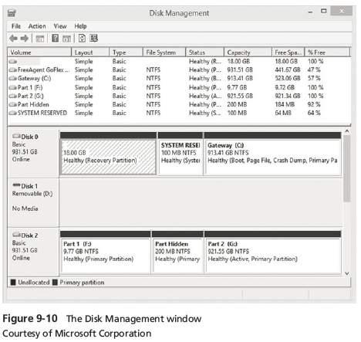
Hiding Partitions
Guide to Computer Forensics and Investigations, Fifth Edition

Slide 31
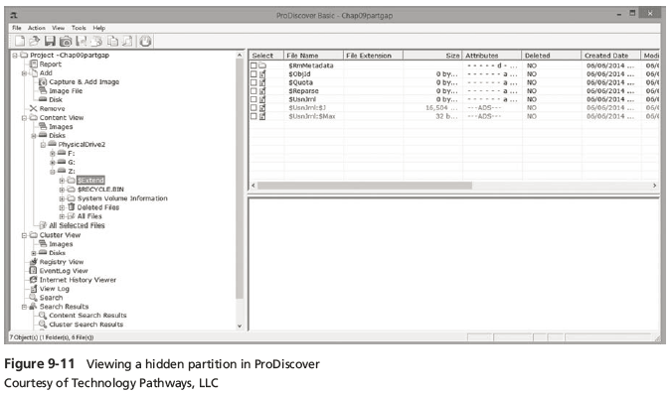
Hiding Partitions
Guide to Computer Forensics and Investigations, Fifth Edition

Slide 32
Marking Bad Clusters
A data-hiding technique used in FAT file systems is placing sensitive or incriminating data in free or slack space on disk partition clusters
  Involves using old utilities such as Norton DiskEdit
Can mark good clusters as bad clusters in the FAT table so the OS considers them unusable
  Only way they can be accessed from the OS is by changing them to good clusters with a disk editor
DiskEdit runs only in MS-DOS and can access only FAT-formatted disk media
Guide to Computer Forensics and Investigations, Fifth Edition

Slide 33
Bit-Shifting
Some users use a low-level encryption program that changes the order of binary data
  Makes altered data unreadable To secure a file, users run an assembler program (also called a “macro”) to scramble bits
  Run another program to restore the scrambled bits to their original order
Bit shifting changes data from readable code to data that looks like binary executable code
WinHex includes a feature for shifting bits
Guide to Computer Forensics and Investigations, Fifth Edition

Slide 34
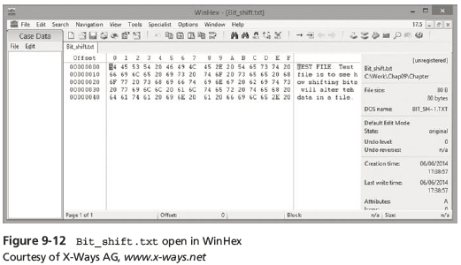
Bit-Shifting
Guide to Computer Forensics and Investigations, Fifth Edition

Slide 35
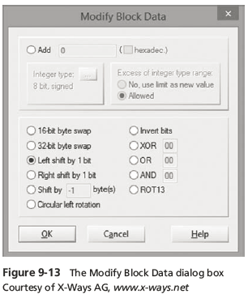
Bit-Shifting
Guide to Computer Forensics and Investigations, Fifth Edition

Slide 36
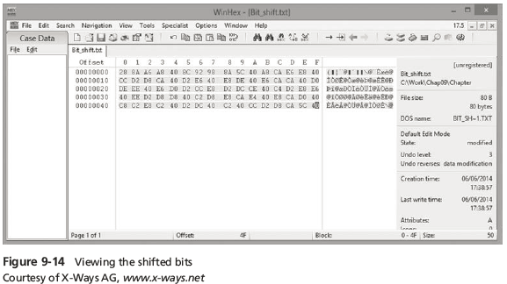
Bit-Shifting
Guide to Computer Forensics and Investigations, Fifth Edition

Slide 37
Understanding Steganalysis Methods
Steganography - comes from the Greek word for “hidden writing”
  Hiding messages in such a way that only the intended recipient knows the message is there
Steganalysis - term for detecting and analyzing steganography files
Digital watermarking - developed as a way to protect file ownership
  Usually not visible when used for steganography
Guide to Computer Forensics and Investigations, Fifth Edition

Slide 38
Understanding Steganalysis Methods
A way to hide data is to use steganography tools
  Many are freeware or shareware
  Insert information into a variety of files
If you encrypt a plaintext file with PGP and insert the encrypted text into a steganography file
  Cracking the encrypted message is extremely difficult
Guide to Computer Forensics and Investigations, Fifth Edition

Slide 39
Understanding Steganalysis Methods
Steganalysis methods
  Stego-only attack
  Known cover attack
  Known message attack
  Chosen stego attack
  Chosen message attack
Guide to Computer Forensics and Investigations, Fifth Edition

Slide 40
Examining Encrypted Files
To decode an encrypted file
  Users supply a password or passphrase
Many encryption programs use a technology called “key escrow”
  Designed to recover encrypted data if users forget their passphrases or if the user key is corrupted after a system failure
Key sizes of 128 bits to 4096 bits make breaking them nearly impossible with current technology
Guide to Computer Forensics and Investigations, Fifth Edition

Slide 41
Recovering Passwords
Password-cracking tools are available for handling password-protected data or systems
  Some are integrated into digital forensics tools
Stand-alone tools:
  Last Bit
  AccessData PRTK
  ophcrack
  John the Ripper
  Passware
Guide to Computer Forensics and Investigations, Fifth Edition

Slide 42
Recovering Passwords
Brute-force attacks
  Use every possible letter, number, and character found on a keyboard
  This method can require a lot of time and processing power
Dictionary attack
  Uses common words found in the dictionary and tries them as passwords
  Most use a variety of languages
Guide to Computer Forensics and Investigations, Fifth Edition

Slide 43
Recovering Passwords
With many programs, you can build profiles of a suspect to help determine his or her password
Many password-protected OSs and application store passwords in the form of MD5 or SHA hash values
A brute-force attack requires converting a dictionary password from plaintext to a hash value
  Requires additional CPU cycle time
Guide to Computer Forensics and Investigations, Fifth Edition

Slide 44
Recovering Passwords
Rainbow table
  A file containing the hash values for every possible password that can be generated from a computer’s keyboard
  No conversion necessary, so it is faster than a brute-force or dictionary attack
Salting passwords
  Alters hash values and makes cracking passwords more difficult
Guide to Computer Forensics and Investigations, Fifth Edition

Slide 45
Summary
Examining and analyzing digital evidence depend on the nature of the investigation and the amount of data to process
General procedures:
  Wipe and prepare target drives, document all hardware components on the suspect’s computer, check date and time values in the suspect’s computer’s CMOS, acquire data and document steps, list all folders and files, attempt to open password-protected files, determine function of executable files, and document steps
Guide to Computer Forensics and Investigations, Fifth Edition

Slide 46
Summary
Advanced digital forensics tools have features such as indexing text data, making keyword searches faster
A critical aspect of digital forensics is validating digital evidence
  ensuring the integrity of data you collect is essential for presenting evidence in court
Data hiding involves changing or manipulating a file to conceal information
Guide to Computer Forensics and Investigations, Fifth Edition

Slide 47
Summary
Three ways to recover passwords:
  Dictionary attacks
  Brute-force attacks
  Rainbows tables
Guide to Computer Forensics and Investigations, Fifth Edition

