Slide 1
Guide to Computer Forensics and Investigations
Fifth Edition
Chapter 3
Data Acquisition
Notes:
Guide to Computer Forensics and Investigations Fifth Edition
Chapter 3
Data Acquisition

Slide 2
Objectives
List digital evidence storage formats
Explain ways to determine the best acquisition method
Describe contingency planning for data acquisitions
Explain how to use acquisition tools
Guide to Computer Forensics and Investigations Fifth Edition
Notes:
Objectives
List digital evidence storage formats
Explain ways to determine the best acquisition method
Describe contingency planning for data acquisitions
Explain how to use acquisition tools

Slide 3
Objectives
Explain how to validate data acquisitions
Describe RAID acquisition methods
Explain how to use remote network acquisition tools
List other forensic tools available for data acquisitions
Guide to Computer Forensics and Investigations Fifth Edition
Notes:
Objectives
Explain how to validate data acquisitions
Describe RAID acquisition methods
Explain how to use remote network acquisition tools
List other forensic tools available for data acquisitions

Slide 4
Understanding Storage Formats for Digital Evidence
Data in a forensics acquisition tool is stored as an image file
Three formats
  Raw format
  Proprietary formats
  Advanced Forensics Format (AFF)
Guide to Computer Forensics and Investigations Fifth Edition
Notes:
Understanding Storage Formats for Digital Evidence
Data in a forensics acquisition tool is stored as an image file
Three formats
Raw format
Proprietary formats
Advanced Forensics Format (AFF)

Slide 5
Raw Format
Makes it possible to write bit-stream data to files
Advantages
  Fast data transfers
  Ignores minor data read errors on source drive
  Most computer forensics tools can read raw format
Disadvantages
  Requires as much storage as original disk or data
  Tools might not collect marginal (bad) sectors
Guide to Computer Forensics and Investigations Fifth Edition
Notes:
Raw Format
Makes it possible to write bit-stream data to files
Advantages
Fast data transfers
Ignores minor data read errors on source drive
Most computer forensics tools can read raw format
Disadvantages
Requires as much storage as original disk or data
Tools might not collect marginal (bad) sectors

Slide 6
Proprietary Formats
Most forensics tools have their own formats
Features offered
  Option to compress or not compress image files
  Can split an image into smaller segmented files
  Can integrate metadata into the image file
Disadvantages
  Inability to share an image between different tools
  File size limitation for each segmented volume
The Expert Witness format is unofficial standard
Guide to Computer Forensics and Investigations Fifth Edition
Notes:
Proprietary Formats
Most forensics tools have their own formats
Features offered
Option to compress or not compress image files
Can split an image into smaller segmented files
Can integrate metadata into the image file
Disadvantages
Inability to share an image between different tools
File size limitation for each segmented volume
The Expert Witness format is unofficial standard

Slide 7
Advanced Forensics Format
Developed by Dr. Simson L. Garfinkel as an open-source acquisition format
Design goals
  Provide compressed or uncompressed image files
  No size restriction for disk-to-image files
  Provide space in the image file or segmented files for metadata
  Simple design with extensibility
  Open source for multiple platforms and OSs
Guide to Computer Forensics and Investigations Fifth Edition
Notes:
Advanced Forensics Format
Developed by Dr. Simson L. Garfinkel as an open-source acquisition format
Design goals
Provide compressed or uncompressed image files
No size restriction for disk-to-image files
Provide space in the image file or segmented files for metadata
Simple design with extensibility
Open source for multiple platforms and OSs

Slide 8
Advanced Forensics Format
Design goals (cont’d)
  Internal consistency checks for self-authentication
File extensions include .afd for segmented image files and .afm for AFF metadata
AFF is open source
Guide to Computer Forensics and Investigations Fifth Edition
Notes:
Advanced Forensics Format
Design goals (cont’d)
Internal consistency checks for self-authentication
File extensions include .afd for segmented image files and .afm for AFF metadata
AFF is open source

Slide 9
Determining the Best Acquisition Method
Types of acquisitions
  Static acquisitions and live acquisitions
Four methods of data collection
  Creating a disk-to-image file
  Creating a disk-to-disk
  Creating a logical disk-to-disk or disk-to-data file
  Creating a sparse data copy of a file or folder
Determining the best method depends on the circumstances of the investigation
Guide to Computer Forensics and Investigations Fifth Edition
Notes:
Determining the Best Acquisition Method
Types of acquisitions
Static acquisitions and live acquisitions
Four methods of data collection
Creating a disk-to-image file
Creating a disk-to-disk
Creating a logical disk-to-disk or disk-to-data file
Creating a sparse data copy of a file or folder
Determining the best method depends on the circumstances of the investigation

Slide 10
Determining the Best Acquisition Method
Creating a disk-to-image file
  Most common method and offers most flexibility
  Can make more than one copy
  Copies are bit-for-bit replications of the original drive
  ProDiscover, EnCase, FTK, SMART, Sleuth Kit, X-Ways, iLookIX
Creating a disk-to-disk
  When disk-to-image copy is not possible
  Tools can adjust disk’s geometry configuration
  EnCase, SafeBack, SnapCopy
Guide to Computer Forensics and Investigations Fifth Edition
Notes:
Determining the Best Acquisition Method
Creating a disk-to-image file
Most common method and offers most flexibility
Can make more than one copy
Copies are bit-for-bit replications of the original drive
ProDiscover, EnCase, FTK, SMART, Sleuth Kit, X-Ways, iLookIX
Creating a disk-to-disk
When disk-to-image copy is not possible
Tools can adjust disk’s geometry configuration
EnCase, SafeBack, SnapCopy

Slide 11
Determining the Best Acquisition Method
Logical acquisition or sparse acquisition
  Can take several hours; use when your time is limited
  Logical acquisition captures only specific files of interest to the case
  Sparse acquisition collects fragments of unallocated (deleted) data
  For large disks
  PST or OST mail files, RAID servers
Guide to Computer Forensics and Investigations Fifth Edition
Notes:
Determining the Best Acquisition Method
Logical acquisition or sparse acquisition
Can take several hours; use when your time is limited
Logical acquisition captures only specific files of interest to the case
Sparse acquisition collects fragments of unallocated (deleted) data
For large disks
PST or OST mail files, RAID servers

Slide 12
Determining the Best Acquisition Method
When making a copy, consider:
  Size of the source disk
    Lossless compression might be useful
    Use digital signatures for verification
  When working with large drives, an alternative is using tape backup systems
  Whether you can retain the disk
Guide to Computer Forensics and Investigations Fifth Edition
Notes:
Determining the Best Acquisition Method
When making a copy, consider:
Size of the source disk
Lossless compression might be useful
Use digital signatures for verification
When working with large drives, an alternative is using tape backup systems
Whether you can retain the disk

Slide 13
Contingency Planning for Image Acquisitions
Create a duplicate copy of your evidence image file
Make at least two images of digital evidence
  Use different tools or techniques
Copy host protected area of a disk drive as well
  Consider using a hardware acquisition tool that can access the drive at the BIOS level
Be prepared to deal with encrypted drives
  Whole disk encryption feature in Windows called BitLocker makes static acquisitions more difficult
  May require user to provide decryption key
Guide to Computer Forensics and Investigations Fifth Edition
Notes:
Contingency Planning for Image Acquisitions
Create a duplicate copy of your evidence image file
Make at least two images of digital evidence
Use different tools or techniques
Copy host protected area of a disk drive as well
Consider using a hardware acquisition tool that can access the drive at the BIOS level
Be prepared to deal with encrypted drives
Whole disk encryption feature in Windows called BitLocker makes static acquisitions more difficult
May require user to provide decryption key

Slide 14
Using Acquisition Tools
Acquisition tools for Windows
  Advantages
    Make acquiring evidence from a suspect drive more convenient
      Especially when used with hot-swappable devices
  Disadvantages
    Must protect acquired data with a well-tested write-blocking hardware device
    Tools can’t acquire data from a disk’s host protected area
    Some countries haven’t accepted the use of write-blocking devices for data acquisitions
Guide to Computer Forensics and Investigations Fifth Edition
Notes:
Using Acquisition Tools
Acquisition tools for Windows
Advantages
Make acquiring evidence from a suspect drive more convenient
Especially when used with hot-swappable devices
Disadvantages
Must protect acquired data with a well-tested write-blocking hardware device
Tools can’t acquire data from a disk’s host protected area
Some countries haven’t accepted the use of write-blocking devices for data acquisitions

Slide 15
Mini-WinFE Boot CDs and USB Drives
Mini-WinFE
  Enables you to build a Windows forensic boot CD/DVD or USB drive so that connected drives are mounted as read-only
Before booting a suspect’s computer:
  Connect your target drive, such as a USB drive
After Mini-WinFE is booted:
  You can list all connected drives and alter your target USB drive to read-write mode so you can run an acquisition program
Guide to Computer Forensics and Investigations Fifth Edition
Notes:
Mini-WinFE Boot CDs and USB Drives
Mini-WinFE
Enables you to build a Windows forensic boot CD/DVD or USB drive so that connected drives are mounted as read-only
Before booting a suspect’s computer:
Connect your target drive, such as a USB drive
After Mini-WinFE is booted:
You can list all connected drives and alter your target USB drive to read-write mode so you can run an acquisition program

Slide 16
Acquiring Data with a Linux Boot CD
Linux can access a drive that isn’t mounted
Windows OSs and newer Linux automatically mount and access a drive
Forensic Linux Live CDs don’t access media automatically
  Which eliminates the need for a write-blocker
Using Linux Live CD Distributions
  Forensic Linux Live CDs
    Contain additionally utilities
Guide to Computer Forensics and Investigations Fifth Edition
Notes:
Acquiring Data with a Linux Boot CD
Linux can access a drive that isn’t mounted
Windows OSs and newer Linux automatically mount and access a drive
Forensic Linux Live CDs don’t access media automatically
Which eliminates the need for a write-blocker
Using Linux Live CD Distributions
Forensic Linux Live CDs
Contain additionally utilities

Slide 17
Acquiring Data with a Linux Boot CD
Using Linux Live CD Distributions (cont’d)
  Forensic Linux Live CDs (cont’d)
    Configured not to mount, or to mount as read-only, any connected storage media
    Well-designed Linux Live CDs for computer forensics
      Penguin Sleuth
      F.I.R.E
      CAINE
      Deft
      Kali Linux
      Knoppix
      SANS Investigative Toolkit
Guide to Computer Forensics and Investigations Fifth Edition
Notes:
Acquiring Data with a Linux Boot CD
Using Linux Live CD Distributions (cont’d)
Forensic Linux Live CDs (cont’d)
Configured not to mount, or to mount as read-only, any connected storage media
Well-designed Linux Live CDs for computer forensics
Penguin Sleuth
F.I.R.E
CAINE
Deft
Kali Linux
Knoppix
SANS Investigative Toolkit

Slide 18
Acquiring Data with a Linux Boot CD
Preparing a target drive for acquisition in Linux
  Current Linux distributions can create Microsoft FAT and NTFS partition tables
  fdisk command lists, creates, deletes, and verifies partitions in Linux
  mkfs.msdos command formats a FAT file system from Linux
  If you have a functioning Linux computer, follow steps starting on page 99 to learn how to prepare a target drive for acquisition
Guide to Computer Forensics and Investigations Fifth Edition
Notes:
Acquiring Data with a Linux Boot CD
Preparing a target drive for acquisition in Linux
Current Linux distributions can create Microsoft FAT and NTFS partition tables
fdisk command lists, creates, deletes, and verifies partitions in Linux
mkfs.msdos command formats a FAT file system from Linux
If you have a functioning Linux computer, follow steps starting on page 99 to learn how to prepare a target drive for acquisition

Slide 19
Acquiring Data with a Linux Boot CD
Acquiring data with dd in Linux
  dd (“data dump”) command
    Can read and write from media device and data file
    Creates raw format file that most computer forensics analysis tools can read
  Shortcomings of dd command
    Requires more advanced skills than average user
    Does not compress data
  dd command combined with the split command
    Segments output into separate volumes
Guide to Computer Forensics and Investigations Fifth Edition
Notes:
Acquiring Data with a Linux Boot CD
Acquiring data with dd in Linux
dd (“data dump”) command
Can read and write from media device and data file
Creates raw format file that most computer forensics analysis tools can read
Shortcomings of dd command
Requires more advanced skills than average user
Does not compress data
dd command combined with the split command
Segments output into separate volumes

Slide 20
Acquiring Data with a Linux Boot CD
Acquiring data with dd in Linux (cont’d)
  Follow the step starting on page 104 in the text to make an image of an NTFS disk on a FAT32 disk
Acquiring data with dcfldd in Linux
  The dd command is intended as a data management tool
    Not designed for forensics acquisitions
Guide to Computer Forensics and Investigations Fifth Edition
Notes:
Acquiring Data with a Linux Boot CD
Acquiring data with dd in Linux (cont’d)
Follow the step starting on page 104 in the text to make an image of an NTFS disk on a FAT32 disk
Acquiring data with dcfldd in Linux
The dd command is intended as a data management tool
Not designed for forensics acquisitions

Slide 21
Acquiring Data with a Linux Boot CD
Acquiring data with dcfldd in Linux (cont’d)
  dcfldd additional functions
    Specify hex patterns or text for clearing disk space
    Log errors to an output file for analysis and review
    Use several hashing options
    Refer to a status display indicating the progress of the acquisition in bytes
    Split data acquisitions into segmented volumes with numeric extensions
    Verify acquired data with original disk or media data
Guide to Computer Forensics and Investigations Fifth Edition
Notes:
Acquiring Data with a Linux Boot CD
Acquiring data with dcfldd in Linux (cont’d)
dcfldd additional functions
Specify hex patterns or text for clearing disk space
Log errors to an output file for analysis and review
Use several hashing options
Refer to a status display indicating the progress of the acquisition in bytes
Split data acquisitions into segmented volumes with numeric extensions
Verify acquired data with original disk or media data

Slide 22
Capturing an Image with ProDiscover Basic
Connecting the suspect’s drive to your workstation
  Document the chain of evidence for the drive
  Remove the drive from the suspect’s computer
  Configure the suspect drive’s jumpers as needed
  Connect the suspect drive to write-blocker device
  Create a storage folder on the target drive
Using ProDiscover’s Proprietary Acquisition Format
  Follow the steps starting on page 108 to start ProDiscover Basic and configure settings for acquisition
Guide to Computer Forensics and Investigations Fifth Edition
Notes:
Capturing an Image with ProDiscover Basic
Connecting the suspect’s drive to your workstation
Document the chain of evidence for the drive
Remove the drive from the suspect’s computer
Configure the suspect drive’s jumpers as needed
Connect the suspect drive to write-blocker device
Create a storage folder on the target drive
Using ProDiscover’s Proprietary Acquisition Format
Follow the steps starting on page 108 to start ProDiscover Basic and configure settings for acquisition

Slide 23
Capturing an Image with ProDiscover Basic
Using ProDiscover’s Proprietary Acquisition Format (con’t)
  ProDiscover creates image files with an .eve extension, a log file (.log extension), and a special inventory file (.pds extension)
  If the compression option was selected, ProDiscover uses a .cmp rather than an .eve extension on all segmented volumes
Guide to Computer Forensics and Investigations Fifth Edition
Notes:
Capturing an Image with ProDiscover Basic
Using ProDiscover’s Proprietary Acquisition Format (con’t)
ProDiscover creates image files with an .eve extension, a log file (.log extension), and a special inventory file (.pds extension)
If the compression option was selected, ProDiscover uses a .cmp rather than an .eve extension on all segmented volumes

Slide 24
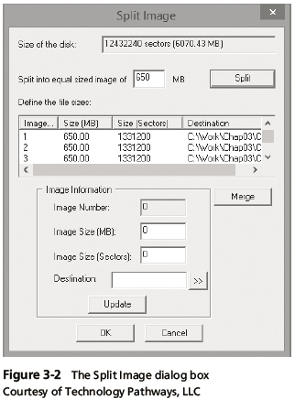
Capturing an Image with ProDiscover Basic
Guide to Computer Forensics and Investigations Fifth Edition
Notes:
Capturing an Image with ProDiscover Basic
Figure 3-2 The Split Image dialog box

Slide 25
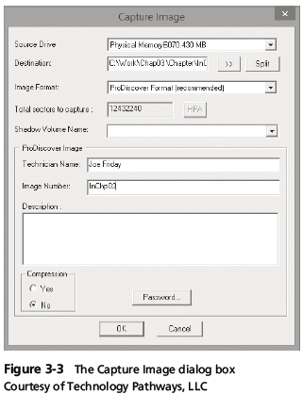
Capturing an Image with ProDiscover Basic
Guide to Computer Forensics and Investigations Fifth Edition
Notes:
Capturing an Image with ProDiscover Basic
Figure 3-3 The Capture Image dialog box

Slide 26
Capturing an Image with ProDiscover Basic
Using ProDiscover’s Raw Acquisition Format
  Follow the same steps as for the proprietary format, but select the “UNIX style dd” format in the Image Format list box
  Raw acquisition saves only the image data and hash value
  The raw format creates a log file (.pds extension) and segmented volume files
Guide to Computer Forensics and Investigations Fifth Edition
Notes:
Capturing an Image with ProDiscover Basic
Using ProDiscover’s Raw Acquisition Format
Follow the same steps as for the proprietary format, but select the “UNIX style dd” format in the Image Format list box
Raw acquisition saves only the image data and hash value
The raw format creates a log file (.pds extension) and segmented volume files

Slide 27
Capturing an Image with AccessData FTK Imager Lite
Included with AccessData Forensic Toolkit
Designed for viewing evidence disks and disk-to-image files
Makes disk-to-image copies of evidence drives
  At logical partition and physical drive level
  Can segment the image file
Evidence drive must have a hardware write-blocking device
  Or run from a Live CD, such as Mini-WinFE
Guide to Computer Forensics and Investigations Fifth Edition
Notes:
Capturing an Image with AccessData FTK Imager Lite
Included with AccessData Forensic Toolkit
Designed for viewing evidence disks and disk-to-image files
Makes disk-to-image copies of evidence drives
At logical partition and physical drive level
Can segment the image file
Evidence drive must have a hardware write-blocking device
Or run from a Live CD, such as Mini-WinFE

Slide 28
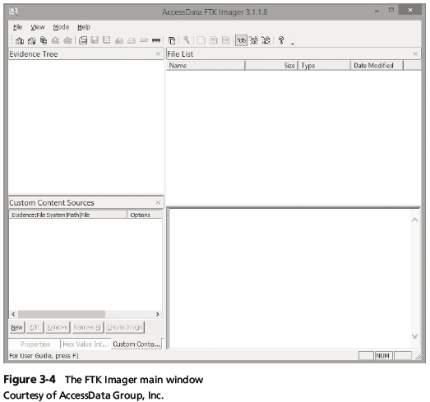
Capturing an Image with AccessData FTK Imager Lite
Guide to Computer Forensics and Investigations Fifth Edition
Notes:
Capturing an Image with AccessData FTK Imager Lite
Figure 3-4 The FTK Imager main window

Slide 29
Capturing an Image with AccessData FTK Imager Lite
FTK Imager can’t acquire a drive’s host protected area
Use a write-blocking device and follow these steps
  Boot to Windows
  Connect evidence disk to a write-blocker
  Connect target disk to write-blocker
  Start FTK Imager Lite
  Create Disk Image - use Physical Drive option
  See Figures on the following slides for more steps
Guide to Computer Forensics and Investigations Fifth Edition
Notes:
Capturing an Image with AccessData FTK Imager Lite
FTK Imager can’t acquire a drive’s host protected area
Use a write-blocking device and follow these steps
Boot to Windows
Connect evidence disk to a write-blocker
Connect target disk to write-blocker
Start FTK Imager Lite
Create Disk Image - use Physical Drive option
See Figures on the following slides for more steps

Slide 30
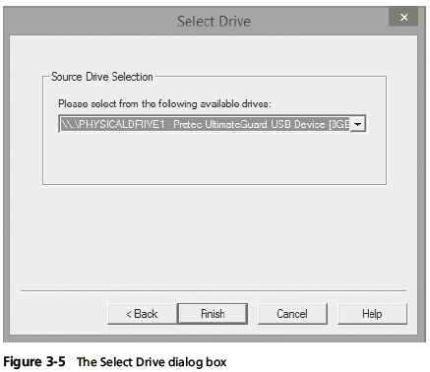
Capturing an Image with AccessData FTK Imager Lite
Guide to Computer Forensics and Investigations Fifth Edition
Notes:
Capturing an Image with AccessData FTK Imager Lite
Figure 3-5 The Select Drive dialog box

Slide 31
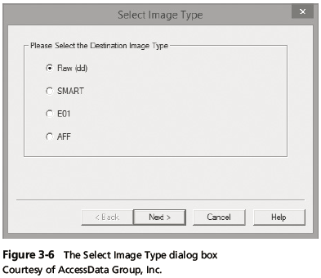
Capturing an Image with AccessData FTK Imager Lite
Guide to Computer Forensics and Investigations Fifth Edition
Notes:
Capturing an Image with AccessData FTK Imager Lite
Figure 3-6 The Select Image Type dialog box

Slide 32
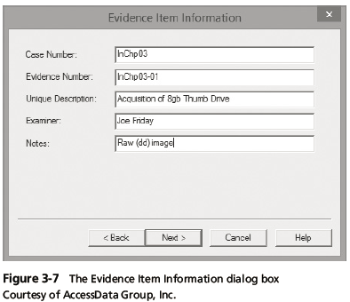
Capturing an Image with AccessData FTK Imager Lite
Guide to Computer Forensics and Investigations Fifth Edition
Notes:
Capturing an Image with AccessData FTK Imager Lite
Figure 3-7 The Evidence Item dialog box

Slide 33
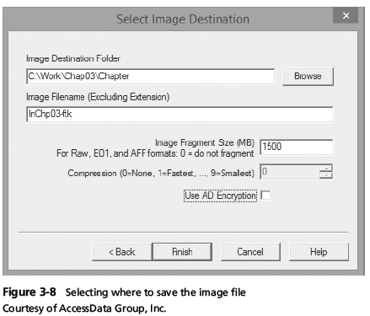
Capturing an Image with AccessData FTK Imager Lite
Guide to Computer Forensics and Investigations Fifth Edition
Notes:
Capturing an Image with AccessData FTK Imager Lite
Figure 3-8 Selecting where to save the image file

Slide 34
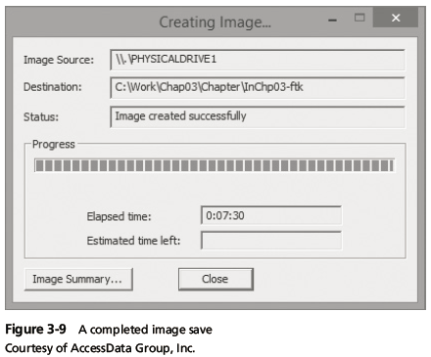
Capturing an Image with AccessData FTK Imager Lite
Guide to Computer Forensics and Investigations Fifth Edition
Notes:
Capturing an Image with AccessData FTK Imager Lite
Figure 3-9 A completed image save

Slide 35
Validating Data Acquisitions
Validating evidence may be the most critical aspect of computer forensics
Requires using a hashing algorithm utility
Validation techniques
  CRC-32, MD5, and SHA-1 to SHA-512
Guide to Computer Forensics and Investigations Fifth Edition
Notes:
Validating Data Acquisitions
Validating evidence may be the most critical aspect of computer forensics
Requires using a hashing algorithm utility
Validation techniques
CRC-32, MD5, and SHA-1 to SHA-512

Slide 36
Linux Validation Methods
Validating dd acquired data
  You can use md5sum or sha1sum utilities
  md5sum or sha1sum utilities should be run on all suspect disks and volumes or segmented volumes
Validating dcfldd acquired data
  Use the hash option to designate a hashing algorithm of md5, sha1, sha256, sha384, or sha512
  hashlog option outputs hash results to a text file that can be stored with the image files
  vf (verify file) option compares the image file to the original medium
Guide to Computer Forensics and Investigations Fifth Edition
Notes:
Linux Validation Methods
Validating dd acquired data
You can use md5sum or sha1sum utilities
md5sum or sha1sum utilities should be run on all suspect disks and volumes or segmented volumes
Validating dcfldd acquired data
Use the hash option to designate a hashing algorithm of md5, sha1, sha256, sha384, or sha512
hashlog option outputs hash results to a text file that can be stored with the image files
vf (verify file) option compares the image file to the original medium

Slide 37
Windows Validation Methods
Windows has no built-in hashing algorithm tools for computer forensics
  Third-party utilities can be used
Commercial computer forensics programs also have built-in validation features
  Each program has its own validation technique
Raw format image files don’t contain metadata
  Separate manual validation is recommended for all raw acquisitions
Guide to Computer Forensics and Investigations Fifth Edition
Notes:
Windows Validation Methods
Windows has no built-in hashing algorithm tools for computer forensics
Third-party utilities can be used
Commercial computer forensics programs also have built-in validation features
Each program has its own validation technique
Raw format image files don’t contain metadata
Separate manual validation is recommended for all raw acquisitions

Slide 38
Performing RAID Data Acquisitions
Acquisition of RAID drives can be challenging and frustrating because of how RAID systems are
  Designed
  Configured
  Sized
Size is the biggest concern
  Many RAID systems now have terabytes of data
Guide to Computer Forensics and Investigations Fifth Edition
Notes:
Performing RAID Data Acquisitions
Acquisition of RAID drives can be challenging and frustrating because of how RAID systems are
Designed
Configured
Sized
Size is the biggest concern
Many RAID systems now have terabytes of data

Slide 39
Understanding RAID
Redundant array of independent (formerly “inexpensive”) disks (RAID)
  Computer configuration involving two or more disks
  Originally developed as a data-redundancy measure
RAID 0
  Provides rapid access and increased storage
  Biggest disadvantage is lack of redundancy
RAID 1
  Designed for data recovery
  More expensive than RAID 0
Guide to Computer Forensics and Investigations Fifth Edition
Notes:
Understanding RAID
Redundant array of independent (formerly “inexpensive”) disks (RAID)
Computer configuration involving two or more disks
Originally developed as a data-redundancy measure
RAID 0
Provides rapid access and increased storage
Biggest disadvantage is lack of redundancy
RAID 1
Designed for data recovery
More expensive than RAID 0

Slide 40
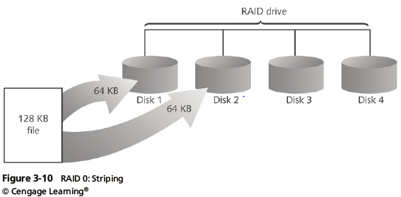
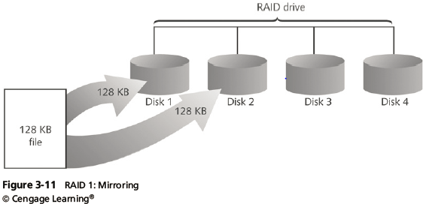
Understanding RAID
Guide to Computer Forensics and Investigations Fifth Edition
Notes:
Understanding RAID
Figure 3-11 RAID 1: Mirroring

Slide 41
Understanding RAID
RAID 2
  Similar to RAID 1
  Data is written to a disk on a bit level
  Has better data integrity checking than RAID 0
  Slower than RAID 0
RAID 3
  Uses data stripping and dedicated parity
RAID 4
  Data is written in blocks
Guide to Computer Forensics and Investigations Fifth Edition
Notes:
Understanding RAID
RAID 2
Similar to RAID 1
Data is written to a disk on a bit level
Has better data integrity checking than RAID 0
Slower than RAID 0
RAID 3
Uses data stripping and dedicated parity
RAID 4
Data is written in blocks

Slide 42
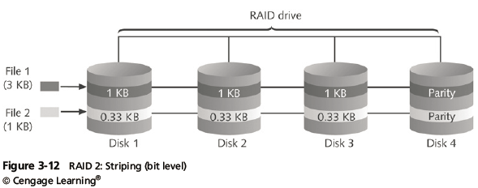
Understanding RAID
Guide to Computer Forensics and Investigations Fifth Edition
Notes:
Understanding RAID
Figure 3-12 RAID 2: Striping (bit level)

Slide 43
Understanding RAID
RAID 5
  Similar to RAIDs 0 and 3
  Places parity recovery data on each disk
RAID 6
  Redundant parity on each disk
RAID 10, or mirrored striping
  Also known as RAID 1+0
  Combination of RAID 1 and RAID 0
Guide to Computer Forensics and Investigations Fifth Edition
Notes:
Understanding RAID
RAID 5
Similar to RAIDs 0 and 3
Places parity recovery data on each disk
RAID 6
Redundant parity on each disk
RAID 10, or mirrored striping
Also known as RAID 1+0
Combination of RAID 1 and RAID 0

Slide 44
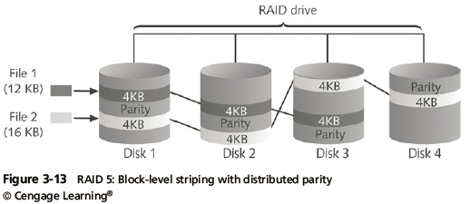
Understanding RAID
Guide to Computer Forensics and Investigations Fifth Edition
Notes:
Understanding RAID
Figure 3-13 RAID 5: Block-level striping with distributed parity

Slide 45
Acquiring RAID Disks
Address the following concerns
  How much data storage is needed?
  What type of RAID is used?
  Do you have the right acquisition tool?
  Can the tool read a forensically copied RAID image?
  Can the tool read split data saves of each RAID disk?
Copying small RAID systems to one large disk is possible
Guide to Computer Forensics and Investigations Fifth Edition
Notes:
Acquiring RAID Disks
Address the following concerns
How much data storage is needed?
What type of RAID is used?
Do you have the right acquisition tool?
Can the tool read a forensically copied RAID image?
Can the tool read split data saves of each RAID disk?
Copying small RAID systems to one large disk is possible

Slide 46
Acquiring RAID Disks
Vendors offering RAID acquisition functions
  Technology Pathways ProDiscover
  Guidance Software EnCase
  X-Ways Forensics
  AccessData FTK
  Runtime Software
  R-Tools Technologies
Occasionally, a RAID system is too large for a static acquisition
  Retrieve only the data relevant to the investigation with the sparse or logical acquisition method
Guide to Computer Forensics and Investigations Fifth Edition
Notes:
Acquiring RAID Disks
Vendors offering RAID acquisition functions
Technology Pathways ProDiscover
Guidance Software EnCase
X-Ways Forensics
AccessData FTK
Runtime Software
R-Tools Technologies
Occasionally, a RAID system is too large for a static acquisition
Retrieve only the data relevant to the investigation with the sparse or logical acquisition method

Slide 47
Using Remote Network Acquisition Tools
You can remotely connect to a suspect computer via a network connection and copy data from it
Remote acquisition tools vary in configurations and capabilities
Drawbacks
  Antivirus, antispyware, and firewall tools can be configured to ignore remote access programs
  Suspects could easily install their own security tools that trigger an alarm to notify them of remote access intrusions
Guide to Computer Forensics and Investigations Fifth Edition
Notes:
Using Remote Network Acquisition Tools
You can remotely connect to a suspect computer via a network connection and copy data from it
Remote acquisition tools vary in configurations and capabilities
Drawbacks
Antivirus, antispyware, and firewall tools can be configured to ignore remote access programs
Suspects could easily install their own security tools that trigger an alarm to notify them of remote access intrusions

Slide 48
Remote Acquisition with ProDiscover
ProDiscover Incident Response additional functions
  Capture volatile system state information
  Analyze current running processes
  Locate unseen files and processes
  Remotely view and listen to IP ports
  Run hash comparisons
  Create a hash inventory of all files remotely
Guide to Computer Forensics and Investigations Fifth Edition
Notes:
Remote Acquisition with ProDiscover
ProDiscover Incident Response additional functions
Capture volatile system state information
Analyze current running processes
Locate unseen files and processes
Remotely view and listen to IP ports
Run hash comparisons
Create a hash inventory of all files remotely

Slide 49
Remote Acquisition with ProDiscover
PDServer remote agent
  ProDiscover utility for remote access
  Needs to be loaded on the suspect
PDServer installation modes
  Trusted CD
  Preinstallation
  Pushing out and running remotely
PDServer can run in a stealth mode
  Can change process name to appear as OS function
Guide to Computer Forensics and Investigations Fifth Edition
Notes:
Remote Acquisition with ProDiscover
PDServer remote agent
ProDiscover utility for remote access
Needs to be loaded on the suspect
PDServer installation modes
Trusted CD
Preinstallation
Pushing out and running remotely
PDServer can run in a stealth mode
Can change process name to appear as OS function

Slide 50
Remote Acquisition with ProDiscover
Remote connection security features
  Password Protection
  Encryption
  Secure Communication Protocol
  Write Protected Trusted Binaries
  Digital Signatures
Guide to Computer Forensics and Investigations Fifth Edition
Notes:
Remote Acquisition with ProDiscover
Remote connection security features
Password Protection
Encryption
Secure Communication Protocol
Write Protected Trusted Binaries
Digital Signatures

Slide 51
Remote Acquisition with EnCase Enterprise
Remote acquisition features
  Remote data acquisition of a computer’s media and RAM data
  Integration with intrusion detection system (IDS) tools
  Options to create an image of data from one or more systems
  Preview of systems
  A wide range of file system formats
  RAID support for both hardware and software
Guide to Computer Forensics and Investigations Fifth Edition
Notes:
Remote Acquisition with EnCase Enterprise
Remote acquisition features
Remote data acquisition of a computer’s media and RAM data
Integration with intrusion detection system (IDS) tools
Options to create an image of data from one or more systems
Preview of systems
A wide range of file system formats
RAID support for both hardware and software

Slide 52
Remote Acquisition with R-Tools R-Studio
R-Tools suite of software is designed for data recovery
Remote connection uses Triple Data Encryption Standard (3DES) encryption
Creates raw format acquisitions
Supports various file systems
Guide to Computer Forensics and Investigations Fifth Edition
Notes:
Remote Acquisition with R-Tools R-Studio
R-Tools suite of software is designed for data recovery
Remote connection uses Triple Data Encryption Standard (3DES) encryption
Creates raw format acquisitions
Supports various file systems

Slide 53
Remote Acquisition with WetStone US-LATT PRO
US-LATT PRO
  Part of a suite of tools developed by WetStone
  Can connect to a networked computer remotely and perform a live acquisition of all drives connected to it
Guide to Computer Forensics and Investigations Fifth Edition
Notes:
Remote Acquisition with WetStone US-LATT PRO
US-LATT PRO
Part of a suite of tools developed by WetStone
Can connect to a networked computer remotely and perform a live acquisition of all drives connected to it

Slide 54
Remote Acquisition with F-Response
F-Response
  A vendor-neutral remote access utility
  Designed to work with any digital forensics program
  Sets up a security read-only connection
    Allows forensics examiners to access it
Four different version of F-Response
  Enterprise Edition, Consultant + Convert Edition, Consultant Edition, and TACTICAL Edition
Guide to Computer Forensics and Investigations Fifth Edition
Notes:
Remote Acquisition with F-Response
F-Response
A vendor-neutral remote access utility
Designed to work with any digital forensics program
Sets up a security read-only connection
Allows forensics examiners to access it
Four different version of F-Response
Enterprise Edition, Consultant + Convert Edition, Consultant Edition, and TACTICAL Edition

Slide 55
Using Other Forensics-Acquisition Tools
Other commercial acquisition tools
  PassMark Software ImageUSB
  ASRData SMART
  Runtime Software
  ILookIX Investigator IXimager
  SourceForge
Guide to Computer Forensics and Investigations Fifth Edition
Notes:
Using Other Forensics-Acquisition Tools
Other commercial acquisition tools
PassMark Software ImageUSB
ASRData SMART
Runtime Software
ILookIX Investigator IXimager
SourceForge

Slide 56
PassMark Software ImageUSB
PassMark Software has an acquisition tool called ImageUSB for its OSForensics analysis product
To create a bootable flash drive, you need:
  Windows XP or later
  ImageUSB downloaded from the OSForensics Web site
Guide to Computer Forensics and Investigations Fifth Edition
Notes:
PassMark Software ImageUSB
PassMark Software has an acquisition tool called ImageUSB for its OSForensics analysis product
To create a bootable flash drive, you need:
Windows XP or later
ImageUSB downloaded from the OSForensics Web site

Slide 57
ASRData SMART
ASRData SMART
  A Linux forensics analysis tool that can make image files of a suspect drive
  Can produce proprietary or raw format images
Capabilities:
  Data reading of bad sectors
  Can mount drives in write-protected mode
  Can mount target drives in read/write mode
  Compression schemes to speed up acquisition or reduce amount of storage needed
Guide to Computer Forensics and Investigations Fifth Edition
Notes:
ASRData SMART
ASRData SMART
A Linux forensics analysis tool that can make image files of a suspect drive
Can produce proprietary or raw format images
Capabilities:
Data reading of bad sectors
Can mount drives in write-protected mode
Can mount target drives in read/write mode
Compression schemes to speed up acquisition or reduce amount of storage needed

Slide 58
Runtime Software
Runtime Software offers shareware programs for data acquisition and recovery:
  DiskExplorer for FAT and NTFS
Features:
  Create a raw format image file
  Segment the raw format or compressed image for archiving purposes
  Access network computers’ drives
Guide to Computer Forensics and Investigations Fifth Edition
Notes:
Runtime Software
Runtime Software offers shareware programs for data acquisition and recovery:
DiskExplorer for FAT and NTFS
Features:
Create a raw format image file
Segment the raw format or compressed image for archiving purposes
Access network computers’ drives

Slide 59
ILook Investigator IXimager
IXimager
  Runs from a bootable floppy or CD
  Designed to work only with ILook Investigator
  Can acquire single drives and RAID drives
  Supports:
    IDE (PATA)
    SCSI
    USB
    FireWire
Guide to Computer Forensics and Investigations Fifth Edition
Notes:
ILook Investigator Iximager
IXimager
Runs from a bootable floppy or CD
Designed to work only with ILook Investigator
Can acquire single drives and RAID drives
Supports:
IDE (PATA)
SCSI
USB
FireWire

Slide 60
SourceForge
SourceForge provides several applications for security, analysis, and investigations
For a list of current tools, see:
  http://sourceforge.net/directory/security-utilities/storage/archiving/os:windows/freshness:recently-updated
Guide to Computer Forensics and Investigations Fifth Edition
Notes:
SourceForge
SourceForge provides several applications for security, analysis, and investigations
For a list of current tools, see:
http://sourceforge.net/directory/security-utilities/storage/archiving/os:windows/freshness:recently-updated

Slide 61
Summary
Forensics data acquisitions are stored in three different formats:
  Raw, proprietary, and AFF
Data acquisition methods
  Disk-to-image file
  Disk-to-disk copy
  Logical disk-to-disk or disk-to-data file
  Sparse data copy
Guide to Computer Forensics and Investigations Fifth Edition
Notes:
Summary
Forensics data acquisitions are stored in three different formats:
Raw, proprietary, and AFF
Data acquisition methods
Disk-to-image file
Disk-to-disk copy
Logical disk-to-disk or disk-to-data file
Sparse data copy

Slide 62
Summary
Several tools available
  Lossless compression is acceptable
Plan your digital evidence contingencies
  Make a copy of each acquisition
Write-blocking devices or utilities must be used with GUI acquisition tools
Always validate acquisition
A Linux Live CD, such as SIFT, Kali Linux, or Deft, provides many useful tools for digital forensics acquisitions
Guide to Computer Forensics and Investigations Fifth Edition
Notes:
Summary
Several tools available
Lossless compression is acceptable
Plan your digital evidence contingencies
Make a copy of each acquisition
Write-blocking devices or utilities must be used with GUI acquisition tools
Always validate acquisition
A Linux Live CD, such as SIFT, Kali Linux, or Deft, provides many useful tools for digital forensics acquisitions

Slide 63
Summary
Preferred Linux acquisition tool is dcfldd (not dd)
Use a physical write-blocker device for acquisitions
To acquire RAID disks, determine the type of RAID
  And then which acquisition tool to use
Remote network acquisition tools require installing a remote agent on the suspect computer
Guide to Computer Forensics and Investigations Fifth Edition
Notes:
Summary
Preferred Linux acquisition tool is dcfldd (not dd)
Use a physical write-blocker device for acquisitions
To acquire RAID disks, determine the type of RAID
And then which acquisition tool to use
Remote network acquisition tools require installing a remote agent on the suspect computer

