Slide 1
Guide to Computer Forensics and Investigations
Fifth Edition
Chapter 5
Working with Windows and CLI Systems

Slide 2
Objectives
Explain the purpose and structure of file systems
Describe Microsoft file structures
Explain the structure of NTFS disks
List some options for decrypting drives encrypted with whole disk encryption
Explain how the Windows Registry works
Describe Microsoft startup tasks
Explain the purpose of a virtual machine
Guide to Computer Forensics and Investigations, Fifth Edition

Slide 3
Understanding File Systems
File system
  Gives OS a road map to data on a disk
Type of file system an OS uses determines how data is stored on the disk
When you need to access a suspect’s computer to acquire or inspect data
  You should be familiar with both the computer’s OS and file systems
Guide to Computer Forensics and Investigations, Fifth Edition

Slide 4
Understanding the Boot Sequence
Complementary Metal Oxide Semiconductor (CMOS)
  Computer stores system configuration and date and time information in the CMOS
    When power to the system is off
Basic Input/Output System (BIOS) or Extensible Firmware Interface (EFI)
  Contains programs that perform input and output at the hardware level
Guide to Computer Forensics and Investigations, Fifth Edition

Slide 5
Understanding the Boot Sequence
Bootstrap process
  Contained in ROM, tells the computer how to proceed
  Displays the key or keys you press to open the CMOS setup screen
CMOS should be modified to boot from a forensic floppy disk or CD
Guide to Computer Forensics and Investigations, Fifth Edition

Slide 6
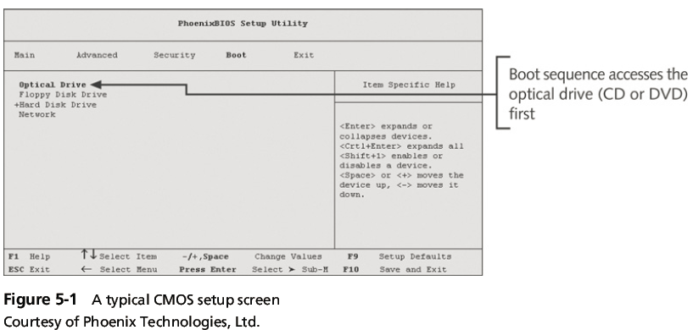
Understanding the Boot Sequence
Guide to Computer Forensics and Investigations, Fifth Edition

Slide 7
Understanding Disk Drives
Disk drives are made up of one or more platters coated with magnetic material
Disk drive components
  Geometry
  Head
  Tracks
  Cylinders
  Sectors
Guide to Computer Forensics and Investigations, Fifth Edition

Slide 8
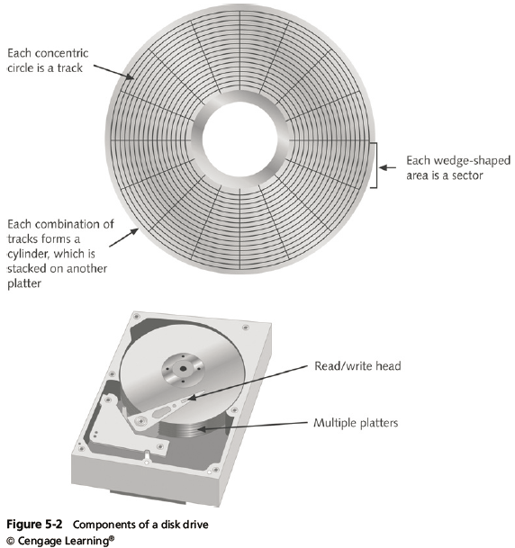
Understanding Disk Drives
Guide to Computer Forensics and Investigations, Fifth Edition

Slide 9
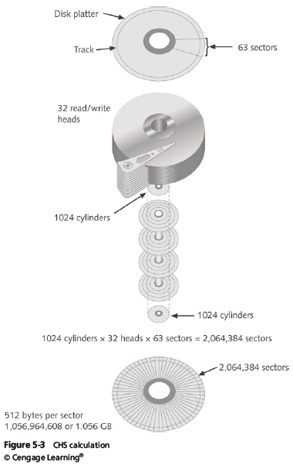
Understanding Disk Drives
Guide to Computer Forensics and Investigations, Fifth Edition

Slide 10
Understanding Disk Drives
Properties handled at the drive’s hardware or firmware level
  Zone bit recording (ZBR)
  Track density
  Areal density
  Head and cylinder skew
Guide to Computer Forensics and Investigations, Fifth Edition

Slide 11
Solid-State Storage Devices
All flash memory devices have a feature called wear-leveling
  An internal firmware feature used in solid-state drives that ensures even wear of read/writes for all memory cells
When dealing with solid-state devices, making a full forensic copy as soon as possible is crucial
  In case you need to recover data from unallocated disk space
Guide to Computer Forensics and Investigations, Fifth Edition

Slide 12
Exploring Microsoft File Structures
In Microsoft file structures, sectors are grouped to form clusters
  Storage allocation units of one or more sectors
Clusters range from 512 bytes up to 32,000 bytes each
Combining sectors minimizes the overhead of writing or reading files to a disk
Guide to Computer Forensics and Investigations, Fifth Edition

Slide 13
Exploring Microsoft File Structures
Clusters are numbered sequentially starting at 0 in NTFS and 2 in FAT
  First sector of all disks contains a system area, the boot record, and a file structure database
OS assigns these cluster numbers, called logical addresses
Sector numbers are called physical addresses
Clusters and their addresses are specific to a logical disk drive, which is a disk partition
Guide to Computer Forensics and Investigations, Fifth Edition

Slide 14
Disk Partitions
A partition is a logical drive
Windows OSs can have three primary partitions followed by an extended partition that can contain one or more logical drives
Hidden partitions or voids
  Large unused gaps between partitions on a disk
Partition gap
  Unused space between partitions
Guide to Computer Forensics and Investigations, Fifth Edition

Slide 15
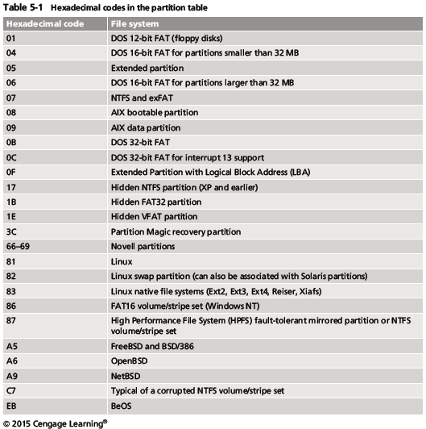
Disk Partitions
Guide to Computer Forensics and Investigations, Fifth Edition

Slide 16
Disk Partitions
The partition table is in the Master Boot Record (MBR)
  Located at sector 0 of the disk drive
MBR stores information about partitions on a disk and their locations, size, and other important items
In a hexadecimal editor, such as WinHex, you can find the first partition at offset 0x1BE
  The file system’s hexadecimal code is offset 3 bytes from 0x1BE for the first partition
Guide to Computer Forensics and Investigations, Fifth Edition

Slide 17
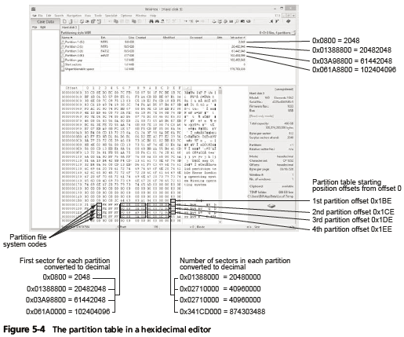
Disk Partitions
Guide to Computer Forensics and Investigations, Fifth Edition

Slide 18
Examining FAT Disks
File Allocation Table (FAT)
  File structure database that Microsoft originally designed for floppy disks
FAT database is typically written to a disk’s outermost track and contains:
  Filenames, directory names, date and time stamps, the starting cluster number, and file attributes
Three current FAT versions
  FAT16, FAT32, and exFAT (used by Xbox game systems)
Guide to Computer Forensics and Investigations, Fifth Edition

Slide 19
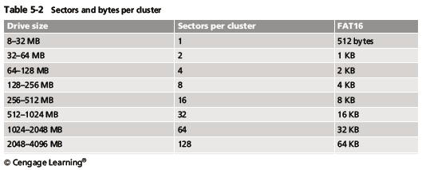
Examining FAT Disks
Cluster sizes vary according to the hard disk size and file system
Guide to Computer Forensics and Investigations, Fifth Edition

Slide 20
Examining FAT Disks
Microsoft OSs allocate disk space for files by clusters
  Results in drive slack
    Unused space in a cluster between the end of an active file and the end of the cluster
Drive slack includes:
  RAM slack and file slack
An unintentional side effect of FAT16 having large clusters was that it reduced fragmentation
  As cluster size increased
Guide to Computer Forensics and Investigations, Fifth Edition

Slide 21
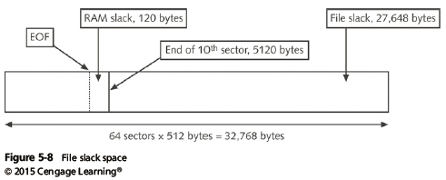
Examining FAT Disks
Guide to Computer Forensics and Investigations, Fifth Edition

Slide 22
Examining FAT Disks
When you run out of room for an allocated cluster
  OS allocates another cluster for your file, which creates more slack space on the disk
As files grow and require more disk space, assigned clusters are chained together
  The chain can be broken or fragmented
When the OS stores data in a FAT file system, it assigns a starting cluster position to a file
  Data for the file is written to the first sector of the first assigned cluster
Guide to Computer Forensics and Investigations, Fifth Edition

Slide 23
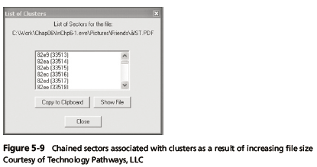
Examining FAT Disks
Guide to Computer Forensics and Investigations, Fifth Edition

Slide 24
Examining FAT Disks
When this first assigned cluster is filled and runs out of room
  FAT assigns the next available cluster to the file
If the next available cluster isn’t contiguous to the current cluster
  File becomes fragmented
Guide to Computer Forensics and Investigations, Fifth Edition

Slide 25
Deleting FAT Files
In Microsoft OSs, when a file is deleted
  Directory entry is marked as a deleted file
    With the HEX E5 character replacing the first letter of the filename
    FAT chain for that file is set to 0
Data in the file remains on the disk drive
Area of the disk where the deleted file resides becomes unallocated disk space
  Available to receive new data from newly created files or other files needing more space
Guide to Computer Forensics and Investigations, Fifth Edition

Slide 26
Examining NTFS Disks
NT File System (NTFS)
  Introduced with Windows NT
  Primary file system for Windows 8
Improvements over FAT file systems
  NTFS provides more information about a file
  NTFS gives more control over files and folders
NTFS was Microsoft’s move toward a journaling file system
  It records a transaction before the system carries it out
Guide to Computer Forensics and Investigations, Fifth Edition

Slide 27
Examining NTFS Disks
In NTFS, everything written to the disk is considered a file
On an NTFS disk
  First data set is the Partition Boot Sector
  Next is Master File Table (MFT)
NTFS results in much less file slack space
Clusters are smaller for smaller disk drives
NTFS also uses Unicode
  An international data format
Guide to Computer Forensics and Investigations, Fifth Edition

Slide 28
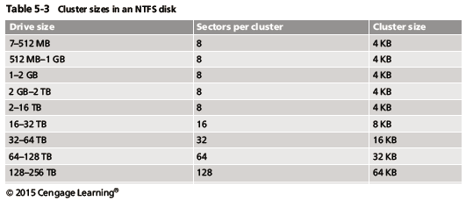
Examining NTFS Disks
Guide to Computer Forensics and Investigations, Fifth Edition

Slide 29
NTFS System Files
MFT contains information about all files on the disk
  Including the system files the OS uses
In the MFT, the first 15 records are reserved for system files
Records in the MFT are called metadata
Guide to Computer Forensics and Investigations, Fifth Edition

Slide 30
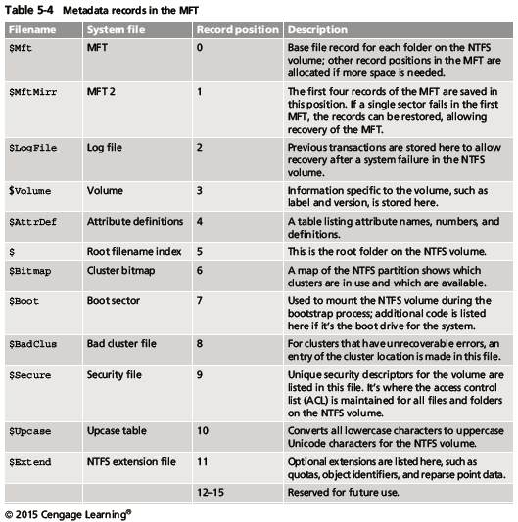
NTFS File System
Guide to Computer Forensics and Investigations, Fifth Edition

Slide 31
MFT and File Attributes
In the NTFS MFT
  All files and folders are stored in separate records of 1024 bytes each
Each record contains file or folder information
  This information is divided into record fields containing metadata
A record field is referred to as an attribute ID
File or folder information is typically stored in one of two ways in an MFT record:
  Resident and nonresident
Guide to Computer Forensics and Investigations, Fifth Edition

Slide 32
MFT and File Attributes
Files larger than 512 bytes are stored outside the MFT
  MFT record provides cluster addresses where the file is stored on the drive’s partition
    Referred to as data runs
Each MFT record starts with a header identifying it as a resident or nonresident attribute
Guide to Computer Forensics and Investigations, Fifth Edition

Slide 33
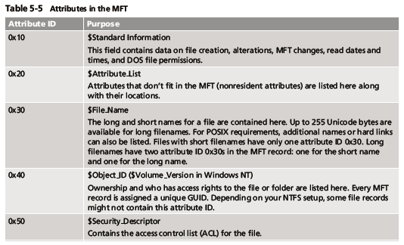
MFT and File Attributes
Guide to Computer Forensics and Investigations, Fifth Edition

Slide 34
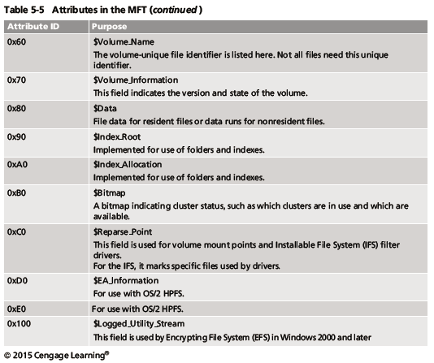
MFT and File Attributes
Guide to Computer Forensics and Investigations, Fifth Edition

Slide 35
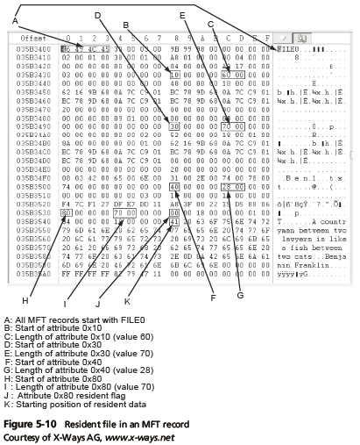
MFT and File Attributes
Guide to Computer Forensics and Investigations, Fifth Edition

Slide 36
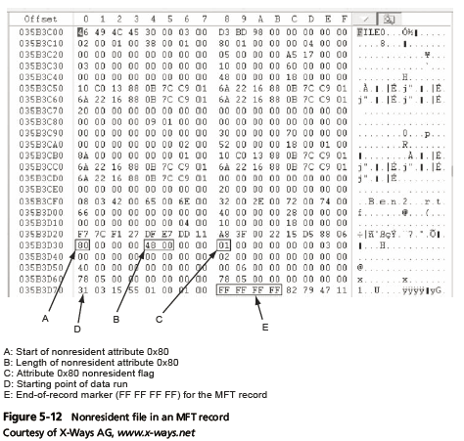
MFT and File Attributes
Guide to Computer Forensics and Investigations, Fifth Edition

Slide 37
MFT and File Attributes
When a disk is created as an NTFS file structure
  OS assigns logical clusters to the entire disk partition
These assigned clusters are called logical cluster numbers (LCNs)
  Become the addresses that allow the MFT to link to nonresident files on the disk’s partition
When data is first written to nonresident files, an LCN address is assigned to the file
  This LCN becomes the file’s virtual cluster number (VCN)
Guide to Computer Forensics and Investigations, Fifth Edition

Slide 38
MFT Structures for File Data
For the header of all MFT records, the record fields of interest are as follows:
  At offset 0x00 - the MFT record identifier FILE
  At offset 0x1C to 0x1F - size of the MFT record
  At offset 0x14 - length of the header (indicates where the next attribute starts)
  At offset 0x32 and 0x33 - the update sequence array, which stores the last 2 bytes of the first sector of the MFT record
Guide to Computer Forensics and Investigations, Fifth Edition

Slide 39
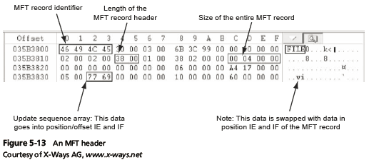
MFT Structures for File Data
Guide to Computer Forensics and Investigations, Fifth Edition

Slide 40
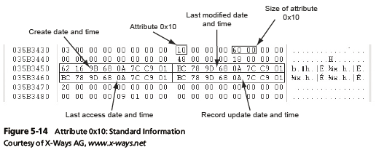
MFT Structures for File Data
Guide to Computer Forensics and Investigations, Fifth Edition

Slide 41
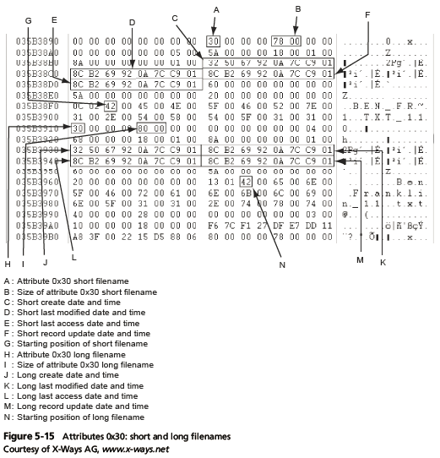
MFT Structures for File Data
Guide to Computer Forensics and Investigations, Fifth Edition

Slide 42
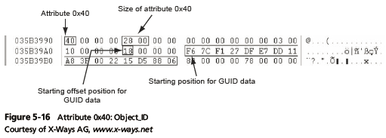
MFT Structures for File Data
Guide to Computer Forensics and Investigations, Fifth Edition

Slide 43
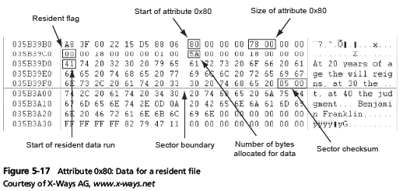
MFT Structures for File Data
Guide to Computer Forensics and Investigations, Fifth Edition

Slide 44
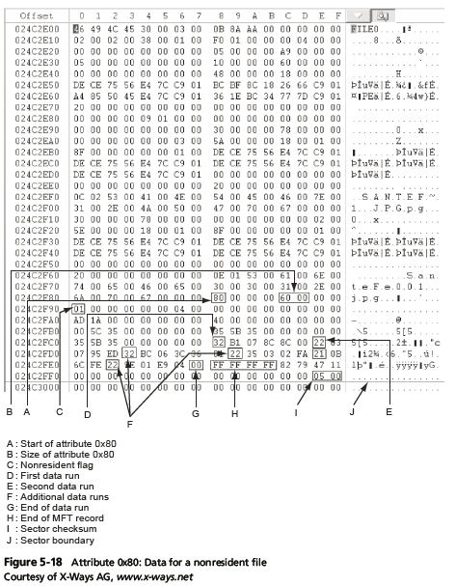
MFT Structures for File Data
Guide to Computer Forensics and Investigations, Fifth Edition

Slide 45
NTFS Alternate Data Streams
Alternate data streams
  Ways data can be appended to existing files
  Can obscure valuable evidentiary data, intentionally or by coincidence
In NTFS, an alternate data stream becomes an additional file attribute
  Allows the file to be associated with different applications
You can only tell whether a file has a data stream attached by examining that file’s MFT entry
Guide to Computer Forensics and Investigations, Fifth Edition

Slide 46
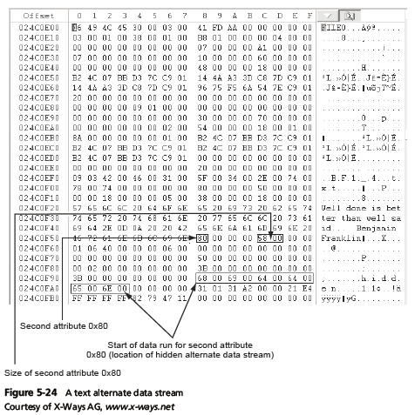
NTFS Alternate Data Streams
Guide to Computer Forensics and Investigations, Fifth Edition

Slide 47
NTFS Compressed Files
NTFS provides compression similar to FAT DriveSpace 3 (a Windows 98 compression utility)
Under NTFS, files, folders, or entire volumes can be compressed
Most computer forensics tools can uncompress and analyze compressed Windows data
Guide to Computer Forensics and Investigations, Fifth Edition

Slide 48
NTFS Encrypting File System (EFS)
Encrypting File System (EFS)
  Introduced with Windows 2000
  Implements a public key and private key method of encrypting files, folders, or disk volumes
When EFS is used in Windows 2000 and later
  A recovery certificate is generated and sent to the local Windows administrator account
Users can apply EFS to files stored on their local workstations or a remote server
Guide to Computer Forensics and Investigations, Fifth Edition

Slide 49
EFS Recovery Key Agent
Recovery Key Agent implements the recovery certificate
  Which is in the Windows administrator account
Windows administrators can recover a key in two ways: through Windows or from an MS-DOS command prompt
MS-DOS commands
  cipher
  copy
  efsrecvr (used to decrypt EFS files)
Guide to Computer Forensics and Investigations, Fifth Edition

Slide 50
Deleting NTFS Files
When a file is deleted in Windows NT and later
  The OS renames it and moves it to the Recycle Bin
Can use the Del (delete) MS-DOS command
  Eliminates the file from the MFT listing in the same way FAT does
Guide to Computer Forensics and Investigations, Fifth Edition

Slide 51
Resilient File System
Resilient File System (ReFS) - designed to address very large data storage needs
  Such as the cloud
Features incorporated into ReFS’s design:
  Maximized data availability
  Improved data integrity
  Designed for scalability
ReFS uses disk structures similar to the MFT in NTFS
Guide to Computer Forensics and Investigations, Fifth Edition

Slide 52
Understanding Whole Disk Encryption
In recent years, there has been more concern about loss of
  Personal identity information (PII) and trade secrets caused by computer theft
Of particular concern is the theft of laptop computers and other handheld devices
To help prevent loss of information, software vendors now provide whole disk encryption
Guide to Computer Forensics and Investigations, Fifth Edition

Slide 53
Understanding Whole Disk Encryption
Current whole disk encryption tools offer the following features:
  Preboot authentication
  Full or partial disk encryption with secure hibernation
  Advanced encryption algorithms
  Key management function
Guide to Computer Forensics and Investigations, Fifth Edition

Slide 54
Understanding Whole Disk Encryption
Whole disk encryption tools encrypt each sector of a drive separately
Many of these tools encrypt the drive’s boot sector
  To prevent any efforts to bypass the secured drive’s partition
To examine an encrypted drive, decrypt it first
  Run a vendor-specific program to decrypt the drive
  Many vendors use a bootable CD or USB drive that prompts for a one-time passphrase
Guide to Computer Forensics and Investigations, Fifth Edition

Slide 55
Examining Microsoft BitLocker
Available Vista Enterprise/Ultimate, Windows 7 and 8 Professional/Enterprise, and Server 08 and 12
Hardware and software requirements
  A computer capable of running Windows Vista or later
  The TPM microchip, version 1.2 or newer
  A computer BIOS compliant with Trusted Computing Group (TCG)
  Two NTFS partitions
  The BIOS configured so that the hard drive boots first before checking other bootable peripherals
Guide to Computer Forensics and Investigations, Fifth Edition

Slide 56
Examining Third-Party Disk Encryption Tools
Some available third-party WDE utilities:
  PGP Full Disk Encryption
  Voltage SecureFile
  Utimaco SafeGuard Easy
  Jetico BestCrypt Volume Encryption
  TrueCrypt
Guide to Computer Forensics and Investigations, Fifth Edition

Slide 57
Understanding the Windows Registry
Registry
  A database that stores hardware and software configuration information, network connections, user preferences, and setup information
To view the Registry, you can use:
  Regedit (Registry Editor) program for Windows 9x systems
  Regedt32 for Windows 2000, XP, and Vista
  Both utilities can be used for Windows 7 and 8
Guide to Computer Forensics and Investigations, Fifth Edition

Slide 58
Exploring the Organization of the Windows Registry
Registry terminology:
  Registry
  Registry Editor
  HKEY
  Key
  Subkey
  Branch
  Value
  Default value
  Hives
Guide to Computer Forensics and Investigations, Fifth Edition

Slide 59
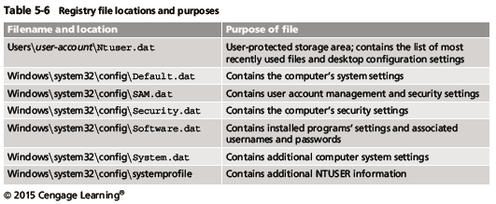
Exploring the Organization of the Windows Registry
Guide to Computer Forensics and Investigations, Fifth Edition

Slide 60
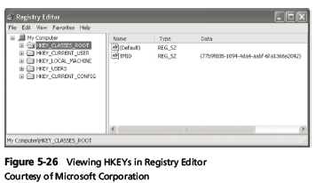
Exploring the Organization of the Windows Registry
Guide to Computer Forensics and Investigations, Fifth Edition

Slide 61
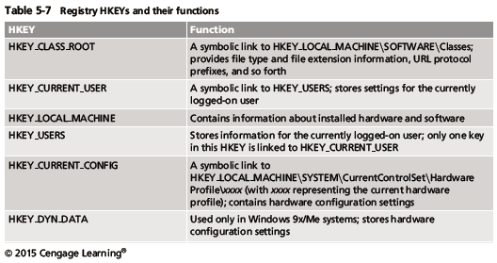
Exploring the Organization of the Windows Registry
Guide to Computer Forensics and Investigations, Fifth Edition

Slide 62
Understanding Microsoft Startup Tasks
Learn what files are accessed when Windows starts
This information helps you determine when a suspect’s computer was last accessed
  Important with computers that might have been used after an incident was reported
Guide to Computer Forensics and Investigations, Fifth Edition

Slide 63
Startup in Windows 7 and Windows 8
Windows 8 is a multiplatform OS
  Can run on desktops, laptops, tablets, and smartphones
The boot process uses a boot configuration data (BCD) store
The BCD contains the boot loader that initiates the system’s bootstrap process
  Press F8 or F12 when the system starts to access the Advanced Boot Options
Guide to Computer Forensics and Investigations, Fifth Edition

Slide 64
Startup in Windows NT and Later
All NTFS computers perform the following steps when the computer is turned on:
  Power-on self test (POST)
  Initial startup
  Boot loader
  Hardware detection and configuration
  Kernel loading
  User logon
Guide to Computer Forensics and Investigations, Fifth Edition

Slide 65
Startup in Windows NT and Later
Startup Files for Windows Vista:
  The Ntldr program in Windows XP used to load the OS has been replaced with these three boot utilities:
    Bootmgr.exe
    Winload.exe
    Winresume.exe
  Windows Vista includes the BCD editor for modifying boot options and updating the BCD registry file
  The BCD store replaces the Windows XP boot.ini file
Guide to Computer Forensics and Investigations, Fifth Edition

Slide 66
Startup in Windows NT and Later
Startup Files for Windows XP:
  NT Loader (NTLDR)
  Boot.ini
  Ntoskrnl.exe
  Bootvid.dll
  Hal.dll
  BootSect.dos
  NTDetect.com
  NTBootdd.sys
  Pagefile.sys
Guide to Computer Forensics and Investigations, Fifth Edition

Slide 67
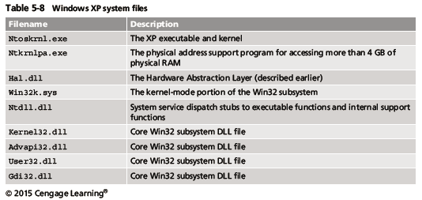
Startup in Windows NT and Later
Windows XP System Files
Guide to Computer Forensics and Investigations, Fifth Edition

Slide 68
Startup in Windows NT and Later
Contamination Concerns with Windows XP
  When you start a Windows XP NTFS workstation, several files are accessed immediately
    The last access date and time stamp for the files change to the current date and time
  Destroys any potential evidence
    That shows when a Windows XP workstation was last used
Guide to Computer Forensics and Investigations, Fifth Edition

Slide 69
Understanding Virtual Machines
Virtual machine
  Allows you to create a representation of another computer on an existing physical computer
A virtual machine is just a few files on your hard drive
  Must allocate space to it
A virtual machine recognizes components of the physical machine it’s loaded on
  Virtual OS is limited by the physical machine’s OS
Guide to Computer Forensics and Investigations, Fifth Edition

Slide 70
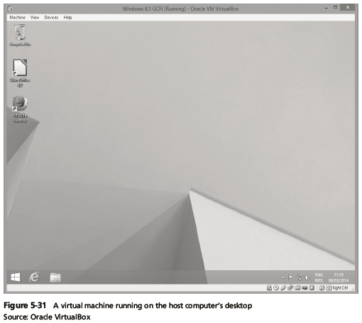
Understanding Virtual Machines
Guide to Computer Forensics and Investigations, Fifth Edition

Slide 71
Understanding Virtual Machines
In digital forensics
  Virtual machines make it possible to restore a suspect drive on your virtual machine
    And run nonstandard software the suspect might have loaded
From a network forensics standpoint, you need to be aware of some potential issues, such as:
  A virtual machine used to attack another system or network
Guide to Computer Forensics and Investigations, Fifth Edition

Slide 72
Creating a Virtual Machine
Popular applications for creating virtual machines
  VMware Server, VMware Player and VMware Workstation, Oracle VM VirtualBox, Microsoft Virtual PC, and Hyper-V
Using VirtualBox
  An open-source program that can be downloaded at www.virtualbox.org/wiki/Downloads
Consult with your instructor before doing the activities using VirtualBox
Guide to Computer Forensics and Investigations, Fifth Edition

Slide 73
Summary
When booting a suspect’s computer, using boot media, such as forensic boot CDs or USB drives, you must ensure that disk evidence isn’t altered
The Master Boot Record (MBR) stores information about partitions on a disk
Microsoft used FAT12 and FAT16 on older operating systems
To find a hard disk’s capacity, use the cylinders, heads, and sectors (CHS) calculation
Guide to Computer Forensics and Investigations, Fifth Edition

Slide 74
Summary
When files are deleted in a FAT file system, the Greek letter sigma (0x05) is inserted in the first character of the filename in the directory
NTFS is more versatile because it uses the Master File Table (MFT) to track file information
Records in the MFT contain attribute IDs that store metadata about files
In NTFS, data streams can obscure information that might have evidentiary value
Guide to Computer Forensics and Investigations, Fifth Edition

Slide 75
Summary
File slack, RAM slack, and drive slack are areas in which valuable information can reside on a drive
NTFS can encrypt data with EFS and BitLocker
NTFS can compress files, folders, or volumes
Windows Registry keeps a record of attached hardware, user preferences, network connections, and installed software
Virtual machines enable you to run other OSs from a Windows computer
Guide to Computer Forensics and Investigations, Fifth Edition

