Slide 1
Guide to Computer Forensics and Investigations
Fifth Edition
Chapter 6
Current Digital Forensics Tools

Slide 2
Objectives
Explain how to evaluate needs for digital forensics tools
Describe available digital forensics software tools
List some considerations for digital forensics hardware tools
Describe methods for validating and testing forensics tools
Guide to Computer Forensics and Investigations, Fifth Edition

Slide 3
Evaluating Digital Forensics Tool Needs
Consider open-source tools; the best value for as many features as possible
Questions to ask when evaluating tools:
  On which OS does the forensics tool run
  What file systems can the tool analyze?
  Can a scripting language be used with the tool to automate repetitive functions?
  Does it have automated features?
  What is the vendor’s reputation for providing support?
Guide to Computer Forensics and Investigations, Fifth Edition

Slide 4
Types of Digital Forensics Tools
Hardware forensic tools
  Range from single-purpose components to complete computer systems and servers
Software forensic tools
  Types
    Command-line applications
    GUI applications
  Commonly used to copy data from a suspect’s disk drive to an image file
Guide to Computer Forensics and Investigations, Fifth Edition

Slide 5
Tasks Performed by Digital Forensics Tools
Follow guidelines set up by NIST’s Computer Forensics Tool Testing (CFTT) program
ISO standard 27037 states: Digital Evidence First Responders (DEFRs) should use validated tools
Five major categories:
  Acquisition
  Validation and verification
  Extraction
  Reconstruction
  Reporting
Guide to Computer Forensics and Investigations, Fifth Edition

Slide 6
Tasks Performed by Digital Forensics Tools
Acquisition
  Making a copy of the original drive
Acquisition subfunctions:
  Physical data copy
  Logical data copy
  Data acquisition format
  Command-line acquisition
  GUI acquisition
  Remote, live, and memory acquisitions
Guide to Computer Forensics and Investigations, Fifth Edition

Slide 7
Tasks Performed by Digital Forensics Tools
Acquisition (cont’d)
  Two types of data-copying methods are used in software acquisitions:
    Physical copying of the entire drive
    Logical copying of a disk partition
  The formats for disk acquisitions vary
    From raw data to vendor-specific proprietary
  You can view the contents of a raw image file with any hexadecimal editor
Guide to Computer Forensics and Investigations, Fifth Edition

Slide 8
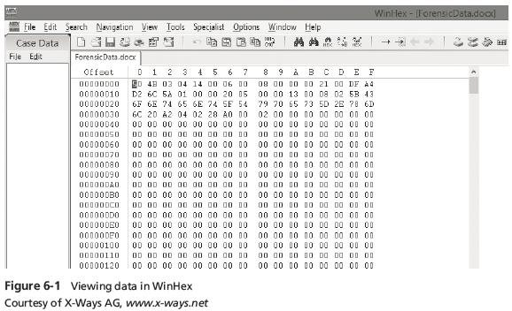
Tasks Performed by Digital Forensics Tools
Guide to Computer Forensics and Investigations, Fifth Edition

Slide 9
Tasks Performed by Digital Forensics Tools
Acquisition (cont’d)
  Creating smaller segmented files is a typical feature in vendor acquisition tools
  Remote acquisition of files is common in larger organizations
    Popular tools, such as AccessData and EnCase, can do remote acquisitions of forensics drive images on a network
Guide to Computer Forensics and Investigations, Fifth Edition

Slide 10
Tasks Performed by Digital Forensics Tools
Validation and Verification
  Validation
    A way to confirm that a tool is functioning as intended
  Verification
    Proves that two sets of data are identical by calculating hash values or using another similar method
    A related process is filtering, which involves sorting and searching through investigation findings to separate good data and suspicious data
Guide to Computer Forensics and Investigations, Fifth Edition

Slide 11
Tasks Performed by Digital Forensics Tools
Validation and verification (cont’d)
  Subfunctions
    Hashing
      CRC-32, MD5, SHA-1 (Secure Hash Algorithms)
    Filtering
      Based on hash value sets
    Analyzing file headers
      Discriminate files based on their types
  National Software Reference Library (NSRL) has compiled a list of known file hashes
    For a variety of OSs, applications, and images
Guide to Computer Forensics and Investigations, Fifth Edition

Slide 12
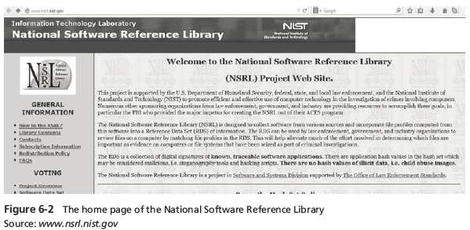
Tasks Performed by Digital Forensics Tools
Guide to Computer Forensics and Investigations, Fifth Edition

Slide 13
Tasks Performed by Digital Forensics Tools
Validation and discrimination (cont’d)
  Many computer forensics programs include a list of common header values
    With this information, you can see whether a file extension is incorrect for the file type
  Most forensics tools can identify header values
Guide to Computer Forensics and Investigations, Fifth Edition

Slide 14
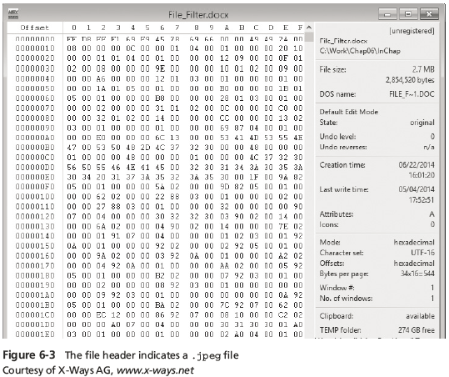
Tasks Performed by Digital Forensics Tools
Guide to Computer Forensics and Investigations, Fifth Edition

Slide 15
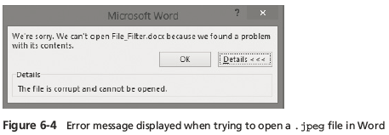
Tasks Performed by Digital Forensics Tools
Guide to Computer Forensics and Investigations, Fifth Edition

Slide 16
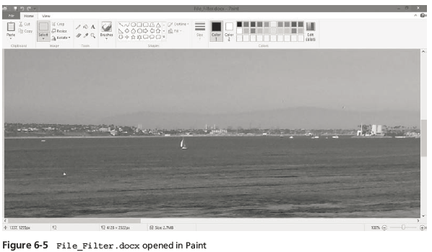
Tasks Performed by Digital Forensics Tools
Guide to Computer Forensics and Investigations, Fifth Edition

Slide 17
Tasks Performed by Digital Forensics Tools
Extraction
  Recovery task in a digital investigation
  Most challenging of all tasks to master
  Recovering data is the first step in analyzing an investigation’s data
Guide to Computer Forensics and Investigations, Fifth Edition

Slide 18
Tasks Performed by Digital Forensics Tools
Extraction (cont’d)
  Subfunctions of extraction
    Data viewing
    Keyword searching
    Decompressing or uncompressing
    Carving
    Decrypting
    Bookmarking or tagging
  Keyword search speeds up analysis for investigators
Guide to Computer Forensics and Investigations, Fifth Edition

Slide 19
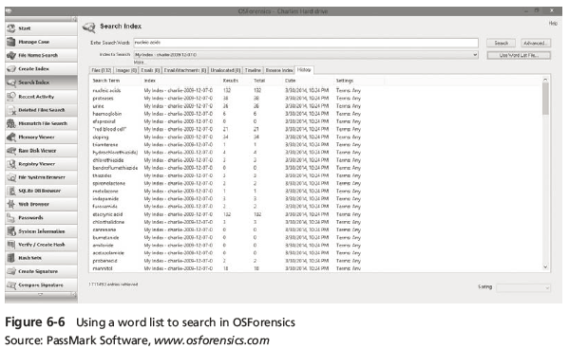
Tasks Performed by Digital Forensics Tools
Guide to Computer Forensics and Investigations, Fifth Edition

Slide 20
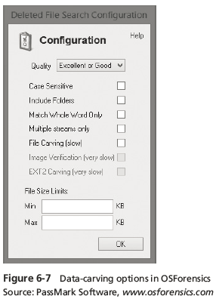
Tasks Performed by Digital Forensics Tools
Guide to Computer Forensics and Investigations, Fifth Edition

Slide 21
Tasks Performed by Digital Forensics Tools
Extraction (cont’d)
  From an investigation perspective, encrypted files and systems are a problem
  Many password recovery tools have a feature for generating potential password lists
    For a password dictionary attack
  If a password dictionary attack fails, you can run a brute-force attack
Guide to Computer Forensics and Investigations, Fifth Edition

Slide 22
Tasks Performed by Digital Forensics Tools
Reconstruction
  Re-create a suspect drive to show what happened during a crime or an incident
  Methods of reconstruction
    Disk-to-disk copy
    Partition-to-partition copy
    Image-to-disk copy
    Image-to-partition copy
    Rebuilding files from data runs and carving
Guide to Computer Forensics and Investigations, Fifth Edition

Slide 23
Tasks Performed by Digital Forensics Tools
Reconstruction (cont’d)
  To re-create an image of a suspect drive
    Copy an image to another location, such as a partition, a physical disk, or a virtual machine
    Simplest method is to use a tool that makes a direct disk-to-image copy
  Examples of disk-to-image copy tools:
    Linux dd command
    ProDiscover
    Voom Technologies Shadow Drive
Guide to Computer Forensics and Investigations, Fifth Edition

Slide 24
Tasks Performed by Digital Forensics Tools
Reporting
  To perform a forensics disk analysis and examination, you need to create a report
  Subfunctions of reporting
    Bookmarking or tagging
    Log reports
    Report generator
  Use this information when producing a final report for your investigation
Guide to Computer Forensics and Investigations, Fifth Edition

Slide 25
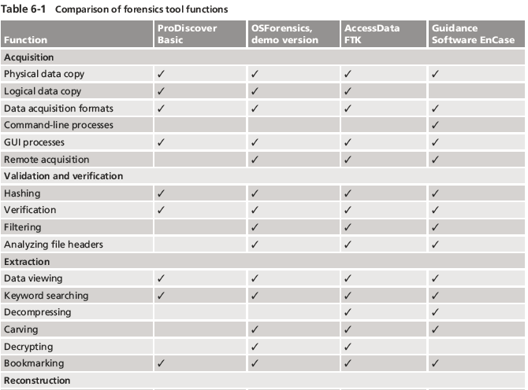
Tool Comparisons
Guide to Computer Forensics and Investigations, Fifth Edition

Slide 26
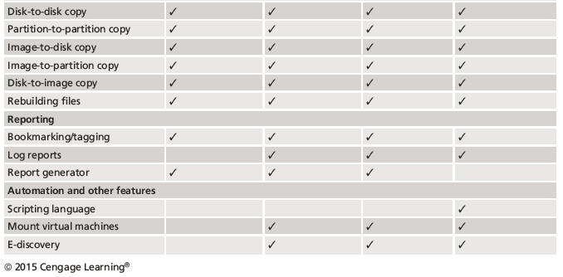
Tool Comparisons
Guide to Computer Forensics and Investigations, Fifth Edition

Slide 27
Other Considerations for Tools
Considerations
  Flexibility
  Reliability
  Future expandability
Create a software library containing older versions of forensics utilities, OSs, and other programs
Guide to Computer Forensics and Investigations, Fifth Edition

Slide 28
Digital Forensics Software Tools
The following sections explore some options for command-line and GUI tools in both Windows and UNIX/Linux
Guide to Computer Forensics and Investigations, Fifth Edition

Slide 29
Command-line Forensics Tools
The first tools that analyzed and extracted data from floppy disks and hard disks were MS-DOS tools for IBM PC file systems
Norton DiskEdit
  One of the first MS-DOS tools used for computer investigations
  Command-line tools require few system resources
    Designed to run in minimal configurations
  Current programs are more powerful and have many more capabilities
Guide to Computer Forensics and Investigations, Fifth Edition

Slide 30
Linux Forensics Tools
UNIX has been mostly replaced by Linux
  You might still encounter systems running UNIX
Linux platforms are becoming more popular with home and business end users
SMART
  Designed to be installed on numerous Linux versions
  Can analyze a variety of file systems with SMART
  Many plug-in utilities are included with SMART
  Another useful option in SMART is its hex viewer
Guide to Computer Forensics and Investigations, Fifth Edition

Slide 31
Linux Forensics Tools
Helix 3
  One of the easiest suites to begin with
  You can load it on a live Windows system
    Loads as a bootable Linux OS from a cold boot
  **Some international courts have not accepted live acquisitions as a valid forensics practice
Kali Linux
  Formerly known as BackTrack
  Includes a variety of tools and has an easy-to-use KDE interface
Guide to Computer Forensics and Investigations, Fifth Edition

Slide 32
Linux Forensics Tools
Autopsy and SleuthKit
  Sleuth Kit is a Linux forensics tool
  Autopsy is the GUI browser interface used to access Sleuth Kit’s tools
  Chapter 7 explains how to use these tools
Guide to Computer Forensics and Investigations, Fifth Edition

Slide 33
Other GUI Forensics Tools
GUI forensics tools can simplify digital forensics investigations
Have also simplified training for beginning examiners
Most of them are put together as suites of tools
Advantages
  Ease of use
  Multitasking
  No need for learning older OSs
Guide to Computer Forensics and Investigations, Fifth Edition

Slide 34
Other GUI Forensics Tools
Disadvantages
  Excessive resource requirements
  Produce inconsistent results
  Create tool dependencies
    Investigators’ may want to use only one tool
    Should be familiar with more than one type of tool
Guide to Computer Forensics and Investigations, Fifth Edition

Slide 35
Digital Forensics Hardware Tools
Technology changes rapidly
Hardware eventually fails
  Schedule equipment replacements periodically
When planning your budget consider:
  Amount of time you expect the forensic workstation to be running
  Failures
  Consultant and vendor fees
  Anticipate equipment replacement
Guide to Computer Forensics and Investigations, Fifth Edition

Slide 36
Forensic Workstations
Carefully consider what you need
Categories
  Stationary workstation
  Portable workstation
  Lightweight workstation
Balance what you need and what your system can handle
  Remember that RAM and storage need updating as technology advances
Guide to Computer Forensics and Investigations, Fifth Edition

Slide 37
Forensic Workstations
Police agency labs
  Need many options
  Use several PC configurations
Keep a hardware library in addition to your software library
Private corporation labs
  Handle only system types used in the organization
Guide to Computer Forensics and Investigations, Fifth Edition

Slide 38
Forensic Workstations
Building a forensic workstation is not as difficult as it sounds
Advantages
  Customized to your needs
  Save money
Disadvantages
  Hard to find support for problems
  Can become expensive if careless
Also need to identify what you intend to analyze
Guide to Computer Forensics and Investigations, Fifth Edition

Slide 39
Forensic Workstations
Some vendors offer workstations designed for digital forensics
Examples
  F.R.E.D. unit from Digital Intelligence
  Hardware mounts from ForensicPC
Having vendor support can save you time and frustration when you have problems
Can mix and match components to get the capabilities you need for your forensic workstation
Guide to Computer Forensics and Investigations, Fifth Edition

Slide 40
Using a Write-Blocker
Write-blocker
  Prevents data writes to a hard disk
Software-enabled blockers
  Typically run in a shell mode (Windows CLI)
  Example: PDBlock from Digital Intelligence
Hardware options
  Ideal for GUI forensic tools
  Act as a bridge between the suspect drive and the forensic workstation
Guide to Computer Forensics and Investigations, Fifth Edition

Slide 41
Using a Write-Blocker
You can navigate to the blocked drive with any application
Discards the written data
  For the OS the data copy is successful
Connecting technologies
  FireWire
  USB 2.0 and 3.0
  SATA, PATA, and SCSI controllers
Guide to Computer Forensics and Investigations, Fifth Edition

Slide 42
Recommendations for a Forensic Workstation
Determine where data acquisitions will take place
With Firewire and USB write-blocking devices
  You can acquire data easily with Digital Intelligence FireChief and a laptop computer
  FireWire
If you want to reduce hardware to carry:
  WiebeTech Forensic DriveDock with its regular DriveDock FireWire bridge or the Logicube Talon
Guide to Computer Forensics and Investigations, Fifth Edition

Slide 43
Recommendations for a Forensic Workstation
Recommendations when choosing stationary or lightweight workstation:
  Full tower to allow for expansion devices
  As much memory and processor power as budget allows
  Different sizes of hard drives
  400-watt or better power supply with battery backup
  External FireWire and USB 2.0 ports
  Assortment of drive adapter bridges
Guide to Computer Forensics and Investigations, Fifth Edition

Slide 44
Recommendations for a Forensic Workstation
Recommendations when choosing stationary or lightweight workstation (cont’d):
  Ergonomic keyboard and mouse
  A good video card with at least a 17-inch monitor
  High-end video card and dual monitors
If you have a limited budget, one option for outfitting your lab is to use high-end game PCs
Guide to Computer Forensics and Investigations, Fifth Edition

Slide 45
Validating and Testing Forensic Software
It is important to make sure the evidence you recover and analyze can be admitted in court
You must test and validate your software to prevent damaging the evidence
Guide to Computer Forensics and Investigations, Fifth Edition

Slide 46
Using National Institute of Standards and Technology Tools
NIST publishes articles, provides tools, and creates procedures for testing/validating forensics software
Computer Forensics Tool Testing (CFTT) project
  Manages research on computer forensics tools
NIST has created criteria for testing computer forensics tools based on:
  Standard testing methods
  ISO 17025 criteria for testing items that have no current standards
Guide to Computer Forensics and Investigations, Fifth Edition

Slide 47
Using National Institute of Standards and Technology Tools
Your lab must meet the following criteria
  Establish categories for digital forensics tools
  Identify forensics category requirements
  Develop test assertions
  Identify test cases
  Establish a test method
  Report test results
ISO 5725 - specifies results must be repeatable and reproducible
Guide to Computer Forensics and Investigations, Fifth Edition

Slide 48
Using National Institute of Standards and Technology Tools
NIST created the National Software Reference Library (NSRL) project
  Collects all known hash values for commercial software applications and OS files
    Uses SHA-1 to generate a known set of digital signatures called the Reference Data Set (RDS)
  Helps filtering known information
  Can use RDS to locate and identify known bad files
Guide to Computer Forensics and Investigations, Fifth Edition

Slide 49
Using Validation Protocols
Always verify your results by performing the same tasks with other similar forensics tools
Use at least two tools
  Retrieving and examination
  Verification
Understand how forensics tools work
One way to compare results and verify a new tool is by using a disk editor
  Such as Hex Workshop or WinHex
Guide to Computer Forensics and Investigations, Fifth Edition

Slide 50
Using Validation Protocols
Disk editors do not have a flashy interface, however they:
  Are reliable tools
  Can access raw data
Computer Forensics Examination Protocol
  Perform the investigation with a GUI tool
  Verify your results with a disk editor
  Compare hash values obtained with both tools
Guide to Computer Forensics and Investigations, Fifth Edition

Slide 51
Using Validation Protocols
Digital Forensics Tool Upgrade Protocol
  Test
    New releases
    OS patches and upgrades
  If you find a problem, report it to forensics tool vendor
    Do not use the forensics tool until the problem has been fixed
  Use a test hard disk for validation purposes
  Check the Web for new editions, updates, patches, and validation tests for your tools
Guide to Computer Forensics and Investigations, Fifth Edition

Slide 52
Summary
Consult your business plan to get the best hardware and software
Computer forensics tools functions
  Acquisition
  Validation and verification
  Extraction
  Reconstruction
  Reporting
Maintain a software library on your lab
Guide to Computer Forensics and Investigations, Fifth Edition

Slide 53
Summary
Computer Forensics tools types
  Software
  Hardware
Forensics software
  Command-line
  GUI
Forensics hardware
  Customized equipment
  Commercial options
  Include workstations and write-blockers
Guide to Computer Forensics and Investigations, Fifth Edition

Slide 54
Summary
Tools that run in Windows and other GUI environments don’t require the same level of computing expertise as command-line tools
Always run a validation test when upgrading your forensics tools
Guide to Computer Forensics and Investigations, Fifth Edition

