Slide 1
Finite Automata
Reading: Chapter 2

Slide 2
Finite Automaton (FA)
Informally, a state diagram that comprehensively captures all possible states and transitions that a machine can take while responding to a stream or sequence of input symbols
Recognizer for “Regular Languages”
Deterministic Finite Automata (DFA)
The machine can exist in only one state at any given time
Non-deterministic Finite Automata (NFA)
The machine can exist in multiple states at the same time

Slide 3
Deterministic Finite Automata - Definition
A Deterministic Finite Automaton (DFA) consists of:
Q ==> a finite set of states
∑ ==> a finite set of input symbols (alphabet)
q₀ ==> a start state
F ==> set of accepting states
δ ==> a transition function, which is a mapping between Q x ∑ ==> Q
A DFA is defined by the 5-tuple:
{Q, ∑ , q₀,F, δ }

Slide 4
What does a DFA do on reading an input string?
Input: a word w in ∑*
Question: Is w acceptable by the DFA?
Steps:
Start at the “start state” q₀
For every input symbol in the sequence w do
Compute the next state from the current state, given the current input symbol in w and the transition function
If after all symbols in w are consumed, the current state is one of the accepting states (F) then accept w;
Otherwise, reject w.

Slide 5
Regular Languages
Let L(A) be a language recognized by a DFA A.
Then L(A) is called a “Regular Language”.
Locate regular languages in the Chomsky Hierarchy

Slide 6
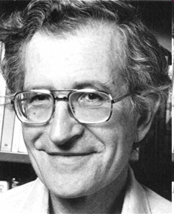
The Chomsky Hierachy
A containment hierarchy of classes of formal languages
Recursively- enumerable (TM)
Context- sensitive (LBA)
Context- free
(PDA)
Regular
(DFA)

Slide 7
Example #1
Build a DFA for the following language:
L = {w | w is a binary string that contains 01 as a substring}
Steps for building a DFA to recognize L:
∑ = {0,1}
Decide on the states: Q
Designate start state and final state(s)
δ: Decide on the transitions:
“Final” states == same as “accepting states”
Other states == same as “non-accepting states”

Slide 8
DFA for strings containing 01
Regular expression: (0+1)*01(0+1)*
What makes this DFA deterministic?
Q = {q₀,q₁,q₂}
∑ = {0,1}
start state = q₀
F = {q₂}
Transition table
1
0
0,1
start
0
1
q₀
q₁
q₂
Accepting
state
symbols
0
1
q₀
q₁
q₀
What if the language allows empty strings?
q₁
q₁
q₂
states
*q₂
q₂
q₂

Slide 9
Example #2
Clamping Logic:
A clamping circuit waits for a ”1” input, and turns on forever. However, to avoid clamping on spurious noise, we’ll design a DFA that waits for two consecutive 1s in a row before clamping on.
Build a DFA for the following language: L = { w | w is a bit string which contains the substring 11}
State Design:
q₀ : start state (initially off), also means the most recent input was not a 1
q₁: has never seen 11 but the most recent input was a 1
q₂: has seen 11 at least once

Slide 10
Example #3
Build a DFA for the following language: L = { w | w is a binary string that has even number of 1s and even number of 0s}
?

Slide 11
Extension of transitions (δ) to Paths (δ)
δ (q,w) = destination state from state q on input string w
δ (q,wa) = δ (δ(q,w), a)
Work out example #3 using the input sequence w=10010, a=1:
δ (q₀,wa) = ?

Slide 12
Language of a DFA
A DFA A accepts string w if there is a path from q₀ to an accepting (or final) state that is labeled by w
i.e., L(A) = { w | δ(q₀,w) ∈ F }
I.e., L(A) = all strings that lead to an accepting state from q₀

Slide 13
Non-deterministic Finite Automata (NFA)
A Non-deterministic Finite Automaton (NFA)
is of course “non-deterministic”
Implying that the machine can exist in more than one state at the same time
Transitions could be non-deterministic
1
q_{j}
q_{i}
…
Each transition function therefore maps to a set of states
1
q_{k}

Slide 14
Non-deterministic Finite Automata (NFA)
A Non-deterministic Finite Automaton (NFA) consists of:
Q ==> a finite set of states
∑ ==> a finite set of input symbols (alphabet)
q₀ ==> a start state
F ==> set of accepting states
δ ==> a transition function, which is a mapping between Q x ∑ ==> subset of Q
An NFA is also defined by the 5-tuple:
{Q, ∑ , q₀,F, δ }

Slide 15
How to use an NFA?
Input: a word w in ∑*
Question: Is w acceptable by the NFA?
Steps:
Start at the “start state” q₀
For every input symbol in the sequence w do
Determine all possible next states from all current states, given the current input symbol in w and the transition function
If after all symbols in w are consumed and if at least one of the current states is a final state then accept w;
Otherwise, reject w.

Slide 16
NFA for strings containing 01
Regular expression: (0+1)*01(0+1)*
Why is this non-deterministic?
Q = {q₀,q₁,q₂}
Σ = {0,1}
start state = q₀
F = {q₂}
Transition table
0,1
0,1
start
0
1
q₀
q₁
q₂
Final
state
symbols
0
1
What will happen if at state q₁ an input of 0 is received?
q₀
{q₀,q₁}
{q₀}
states
q₁
Φ
{q₂}
*q₂
{q₂}
{q₂}

Slide 17
What is an “error state”?
Note: Omitting to explicitly show error states is just a matter of design convenience (one that is generally followed for NFAs), and i.e., this feature should not be confused with the notion of non-determinism.
A DFA for recognizing the key word “while”
An NFA for the same purpose:
w
h
i
l
e
q₀
q₁
q₂
q₃
q₄
q₅
Any other input symbol
q_{err}
Any symbol
w
h
i
l
e
q₀
q₁
q₂
q₃
q₄
q₅
Transitions into a dead state are implicit

Slide 18
Example #2
Build an NFA for the following language: L = { w | w ends in 01}
?
Other examples
Keyword recognizer (e.g., if, then, else, while, for, include, etc.)
Strings where the first symbol is present somewhere later on at least once

Slide 19
Extension of δ to NFA Paths
Basis: δ (q,ε) = {q}
Induction:
Let δ (q₀,w) = {p₁,p₂…,p_{k}}
δ (p_{i},a) = S_{i} for i=1,2...,k
Then, δ (q₀,wa) = S₁ U S₂ U … U S_{k}

Slide 20
Language of an NFA
An NFA accepts w if there exists at least one path from the start state to an accepting (or final) state that is labeled by w
L(N) = { w | δ(q₀,w) ∩ F ≠ Φ }

Slide 21
Advantages & Caveats for NFA
Great for modeling regular expressions
String processing - e.g., grep, lexical analyzer
Could a non-deterministic state machine be implemented in practice?
Probabilistic models could be viewed as extensions of non-deterministic state machines (e.g., toss of a coin, a roll of dice)
They are not the same though
A parallel computer could exist in multiple “states” at the same time

Slide 22
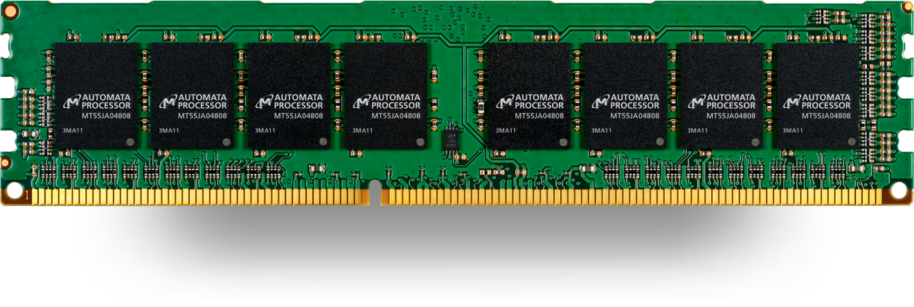
Technologies for NFAs
Micron’s Automata Processor (introduced in 2013)
2D array of MISD (multiple instruction single data) fabric w/ thousands to millions of processing elements.
1 input symbol = fed to all states (i.e., cores)
Non-determinism using circuits
http://www.micronautomata.com/

Slide 23
Differences: DFA vs. NFA
But, DFAs and NFAs are equivalent in their power to capture langauges !!
DFA
All transitions are deterministic
Each transition leads to exactly one state
For each state, transition on all possible symbols (alphabet) should be defined
Accepts input if the last state visited is in F
Sometimes harder to construct because of the number of states
Practical implementation is feasible
NFA
Some transitions could be non-deterministic
A transition could lead to a subset of states
Not all symbol transitions need to be defined explicitly (if undefined will go to an error state – this is just a design convenience, not to be confused with “non-determinism”)
Accepts input if one of the last states is in F
Generally easier than a DFA to construct
Practical implementations limited but emerging (e.g., Micron automata processor)

Slide 24
Summary
DFA
Definition
Transition diagrams & tables
Regular language
NFA
Definition
Transition diagrams & tables
DFA vs. NFA

