Slide 1

Understanding Cryptography – A Textbook for Students and Practitioners by Christof Paar and Jan Pelzl www.crypto-textbook.com
Chapter 11 – Hash Functions ver. October 29, 2009
These slides were prepared by Stefan Heyse and Christof Paar and Jan Pelzl

Slide 2
Some legal stuff (sorry): Terms of Use
The slides can used free of charge. All copyrights for the slides remain with Christof Paar and Jan Pelzl.
The title of the accompanying book “Understanding Cryptography” by Springer and the author’s names must remain on each slide.
If the slides are modified, appropriate credits to the book authors and the book title must remain within the slides.
It is not permitted to reproduce parts or all of the slides in printed form whatsoever without written consent by the authors.
<number>/23
Chapter 11 of Understanding Cryptography by Christof Paar and Jan Pelzl

Slide 3
Content of this Chapter
Why we need hash functions
How does it work
Security properties
Algorithms
Example: The Secure Hash Algorithm SHA-1
<number>/23
Chapter 11 of Understanding Cryptography by Christof Paar and Jan Pelzl

Slide 4
Content of this Chapter
Why we need hash functions
How does it work
Security properties
Algorithms
Example: The Secure Hash Algorithm SHA-1
<number>/23
Chapter 11 of Understanding Cryptography by Christof Paar and Jan Pelzl

Slide 5

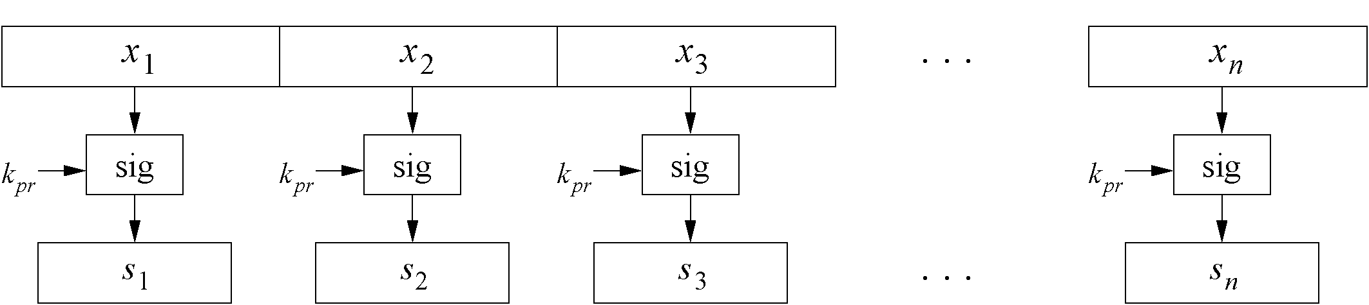
Motivation
Problem:
Naive signing of long messages generates a signature of same length.
Three Problems
Computational overhead
Message overhead
Security limitations
For more info see Section 11.1 in “Understanding Cryptography”.
Solution:
Instead of signing the whole message, sign only a digest (=hash)
Also secure, but much faster
Needed:
Hash Functions
<number>/23
Chapter 11 of Understanding Cryptography by Christof Paar and Jan Pelzl

Slide 6
Digital Signature with a Hash Function
x
x_{i}
Notes:
x has fixed length
z, y have fixed length
z, x do not have equal length in general
h(x) does not require a key.
h(x) is public.
z_{i} = h( x_{i} || z_{i-1} )
z
sig_{kpr}z)
y = sig_{kpr}(z)
<number>/23
Chapter 11 of Understanding Cryptography by Christof Paar and Jan Pelzl

Slide 7
Basic Protocol for Digital Signatures with a Hash Function:
Alice
Bob
K_{pub}
z = h(x)
s = sig_{Kpr}(z)
(x, s)
z' = h(x)
ver_{Kpub}(s,z')=true/false
<number>/23
Chapter 11 of Understanding Cryptography by Christof Paar and Jan Pelzl

Slide 8
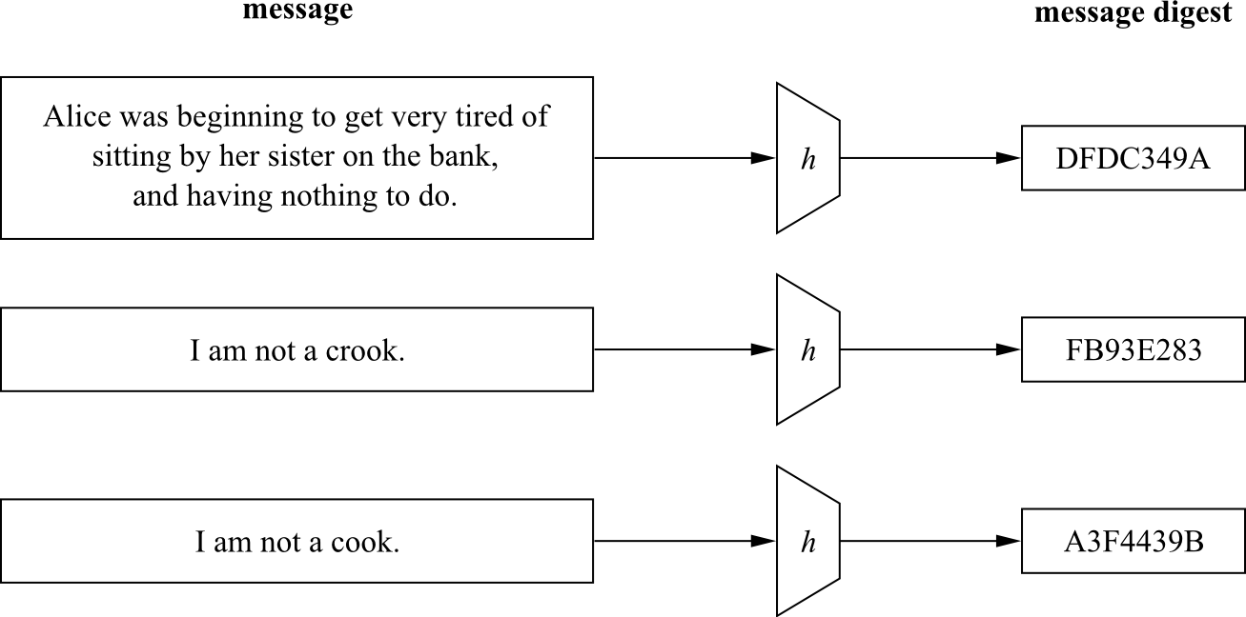
Principal input–output behavior of hash functions
<number>/23
Chapter 11 of Understanding Cryptography by Christof Paar and Jan Pelzl

Slide 9
Content of this Chapter
Why we need hash functions
How does it work
Security properties
Algorithms
Example: The Secure Hash Algorithm SHA-1
<number>/23
Chapter 11 of Understanding Cryptography by Christof Paar and Jan Pelzl

Slide 10
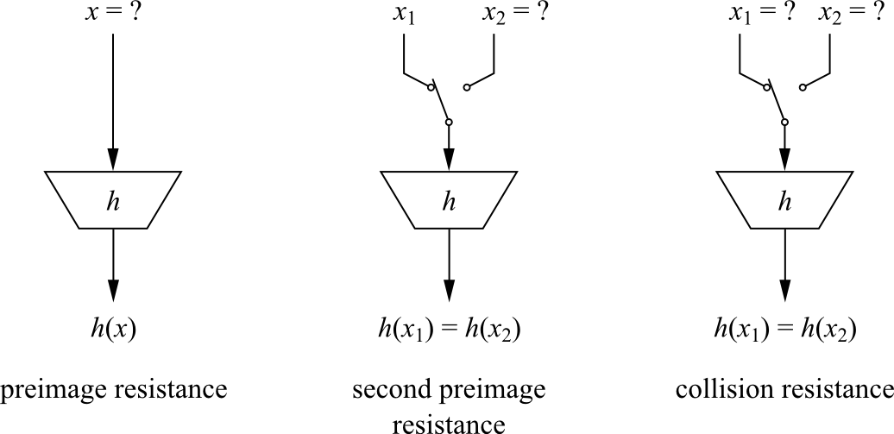
The three security properties of hash functions
<number>/23
Chapter 11 of Understanding Cryptography by Christof Paar and Jan Pelzl

Slide 11
Hash Funktionen: Security Properties
Preimage resistance: For a given output z, it is impossible to ﬁnd any
input x such that h(x) = z, i.e., h(x) is one-way.
Second preimage resistance: Given x₁, and thus h(x₁), it is computa-
tionally infeasible to ﬁnd any x₂ such that h(x₁) = h(x₂).
Collision resistance: It is computationally infeasible to ﬁnd any pairs
x₁ ≠ x₂ such that h(x₁) = h(x₂).
<number>/23
Chapter 11 of Understanding Cryptography by Christof Paar and Jan Pelzl

Slide 12
Hash Funktionen: Security
It turns out that collison resistance causes most problems
How hard is it to find a collision with a probability of 0.5 ?
Related Problem: How many people are needed such that two of them have the same birthday with a probability of 0.5 ?
No! Not 365/2=183. 23 are enough ! This is called the birthday paradoxon (Search takes ≈√2^{n} steps) .
For more info see Chapter 11.2.3 in Understanding Cryptography.
To deal with this paradox, hash functions need a output size of at least 160 bits.
<number>/23
Chapter 11 of Understanding Cryptography by Christof Paar and Jan Pelzl

Slide 13
Content of this Chapter
Why we need hash functions
How does it work
Security properties
Algorithms
Example: The Secure Hash Algorithm SHA-1
<number>/23
Chapter 11 of Understanding Cryptography by Christof Paar and Jan Pelzl

Slide 14
Hash Funktionen: Algorithms
Hash Algorithms
Special Algorithms,
e.g. MD5 - family
based on
block ciphers
MD5 - family
SHA-1: output - 160 Bit; input - 512 bit chunks of message x;
operations - bitwise AND, OR, XOR, complement und cyclic shifts.
RIPE-MD 160: output - 160 Bit; input - 512 bit chunks of message x; operations – like in SHA-1, but two in parallel and combinations of them after each round.
<number>/23
Chapter 11 of Understanding Cryptography by Christof Paar and Jan Pelzl

Slide 15
Content of this Chapter
Why we need hash functions
How does it work
Security properties
Algorithms
Example: The Secure Hash Algorithm SHA-1
<number>/23
Chapter 11 of Understanding Cryptography by Christof Paar and Jan Pelzl

Slide 16
SHA-1
Part of the MD-4 family.
Based on a Merkle-Dåmgard construction.
160-bit output from a message of maximum length 2⁶⁴ bit.
Widely used ( even tough some weaknesses are known)
<number>/23
Chapter 11 of Understanding Cryptography by Christof Paar and Jan Pelzl

Slide 17
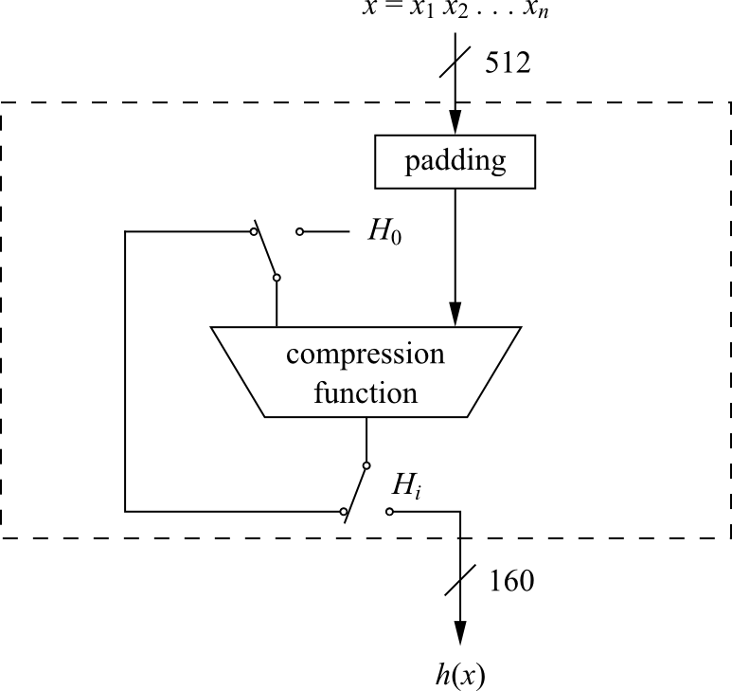
SHA-1 High Level Diagramm
Compression Function consists of 80 rounds which are divided into four stages of 20 rounds each
<number>/23
Chapter 11 of Understanding Cryptography by Christof Paar and Jan Pelzl

Slide 18
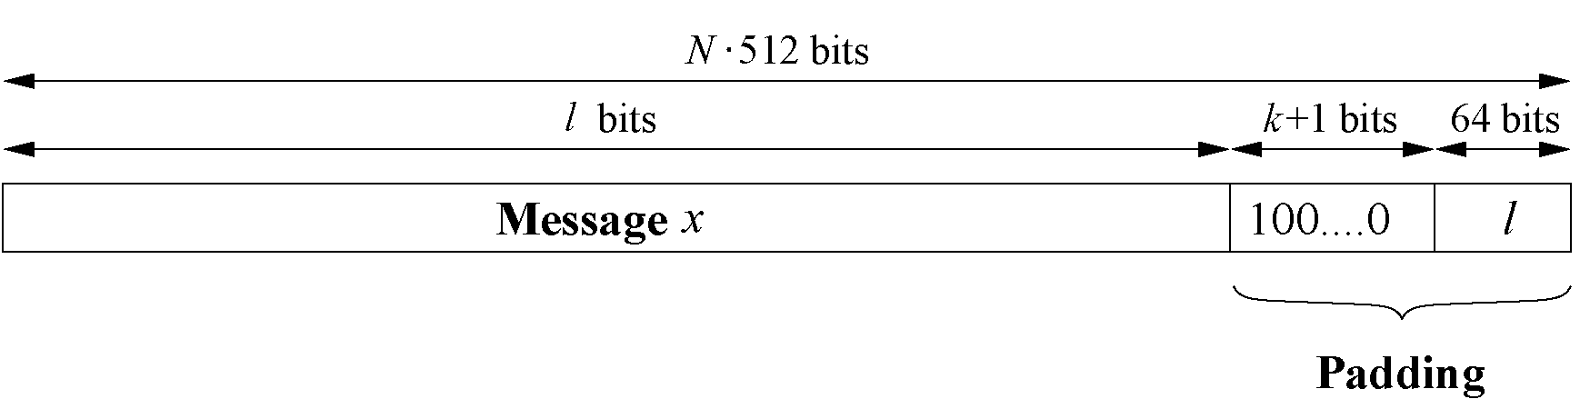
SHA-1: Padding
Message x has to be padded to fit a size of a multiple of 512 bit.
k ≡ 512 − 64 − 1 − l = 448 − (l + 1) mod 512.
<number>/23
Chapter 11 of Understanding Cryptography by Christof Paar and Jan Pelzl

Slide 19
SHA-1: Hash Computation
Each message block x_{i} is processed in four stages with 20 rounds each
SHA-1 uses:
A message schedule which computes a 32-bit word W0,W1,...,W79 for each of the 80 rounds
Five working registers of size of 32 bits A,B,C,D,E
A hash value H_{i} consisting of ﬁve 32-bit words H_{i}⁽⁰⁾, H_{i}⁽¹⁾, H_{i}⁽²⁾ , H_{i}⁽³⁾, H_{i}⁽⁴⁾
In the beginning, the hash value holds the initial value H₀, which is replaced by a new hash value after the processing of each single message block.
The ﬁnal hash value H_{n} is equal to the output h(x) of SHA-1.
<number>/23
Chapter 11 of Understanding Cryptography by Christof Paar and Jan Pelzl

Slide 20
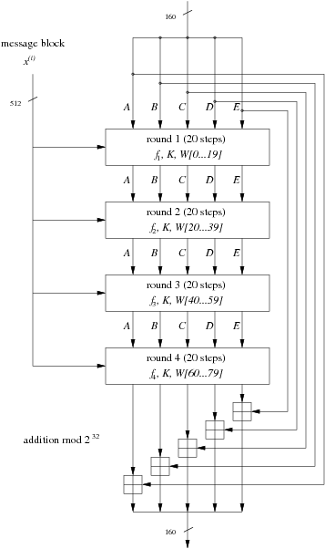
SHA-1: All four stages
<number>/23
Chapter 11 of Understanding Cryptography by Christof Paar and Jan Pelzl

Slide 21
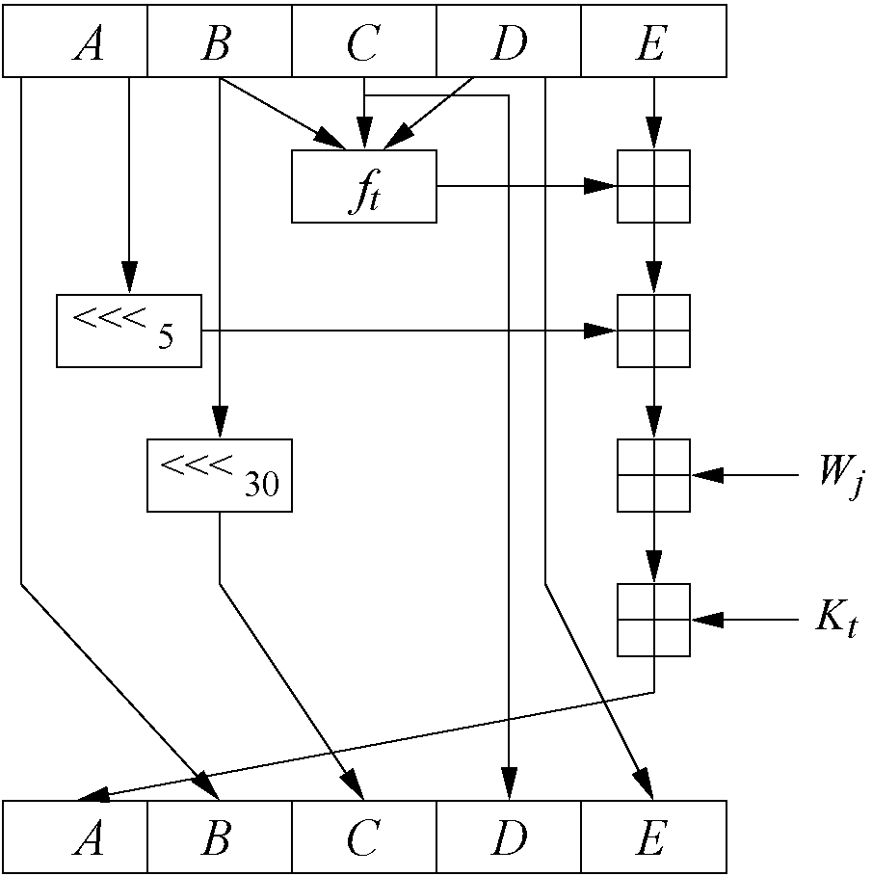
SHA-1: Internals of a Round
Stage t | Round j | Constant K_{t} | Function f_{t}
1 | 00…19 | K=5A827999 | f(B,C,D)=(B∧C)∨(¯B∧D)
2 | 20…39 | K=6ED9EBA1 | f(B,C,D)=B⊕C⊕D
3 | 40…59 | K=8F1BBCDC | f(B,C,D)=(B⊕C)∨(B⊕D)∨(C⊕D)
4 | 60…79 | K=CA62C1D6 | f(B,C,D)=B⊕C⊕D
<number>/23
Chapter 11 of Understanding Cryptography by Christof Paar and Jan Pelzl

Slide 22
Lessons Learned: Hash-Funktionen
Hash functions are keyless. The two most important applications of hash functions are their use in digital signatures and in message authentication codes such as HMAC.
The three security requirements for hash functions are one-wayness, second preimage resistance and collision resistance.
Hash functions should have at least 160-bit output length in order to withstand collision attacks; 256 bit or more is desirable for long-term security.
MD5, which was widely used, is insecure. Serious security weaknesses have been found in SHA-1, and the hash function should be phased out. The SHA-2 algorithms all appear to be secure.
The ongoing SHA-3 competition will result in new standardized hash functions in a few years.
<number>/23
Chapter 11 of Understanding Cryptography by Christof Paar and Jan Pelzl

Slide 23
Further Informations: Hash-Funktionen
Overview over many Hash Functions with Spezifications:
  http://ehash.iaik.tugraz.at/wiki/The_Hash_Function_Zoo
Birthday Paradox: Wikipedia has a nice explanation
  http://en.wikipedia.org/wiki/Birthday_problem
SHA Standards
  SHA1+2: http://csrc.nist.gov/publications/fips/fips180-2/fips180-2withchangenotice.pdf
  SHA3 Overview: http://ehash.iaik.tugraz.at/wiki/The_SHA-3_Zoo
CrypTool is a learning program which also can hash:
  http://www.cryptool.org/
<number>/23
Chapter 11 of Understanding Cryptography by Christof Paar and Jan Pelzl

