Slide 1

Understanding Cryptography – A Textbook for Students and Practitioners by Christof Paar and Jan Pelzl www.crypto-textbook.com
Chapter 5 – More About Block Ciphers
These slides were prepared by Amir Moradi, Christof Paar and Jan Pelzl

Slide 2
Content of this Chapter
Encryption with Block Ciphers: Modes of Operation
  Electronic Code Book mode (ECB)
  Cipher Block Chaining mode (CBC)
  Output Feedback mode (OFB)
  Cipher Feedback mode (CFB)
  Counter mode (CTR)
  Galois Counter Mode (GCM)
Exhaustive Key Search Revisited
Increasing the Security of Block Ciphers
<number>/38

Slide 3
Block Ciphers
A block cipher is much more than just an encryption algorithm, it can be used ...
  to build different types of block-based encryption schemes
  to realize stream ciphers
  to construct hash functions
  to make message authentication codes
  to build key establishment protocols
  to make a pseudo-random number generator
  ...
The security of block ciphers also can be increased by
  key whitening
  multiple encryption
<number>/38

Slide 4
Content of this Chapter
Encryption with Block Ciphers: Modes of Operation
  Electronic Code Book mode (ECB)
  Cipher Block Chaining mode (CBC)
  Output Feedback mode (OFB)
  Cipher Feedback mode (CFB)
  Counter mode (CTR)
  Galois Counter Mode (GCM)
Exhaustive Key Search Revisited
Increasing the Security of Block Ciphers
<number>/38

Slide 5
Encryption with Block Ciphers
There are several ways of encrypting long plaintexts, e.g., an e-mail or a computer file, with a block cipher (“modes of operation”)
  Electronic Code Book mode (ECB)
  Cipher Block Chaining mode (CBC)
  Output Feedback mode (OFB)
  Cipher Feedback mode (CFB)
  Counter mode (CTR)
  Galois Counter Mode (GCM)
All of the 6 modes have one goal:
  In addition to confidentiality, they provide authenticity and integrity:
    Is the message really coming from the original sender? (authenticity)
    Was the ciphertext altered during transmission? (integrity)
<number>/38

Slide 6
Content of this Chapter
Encryption with Block Ciphers: Modes of Operation
  Electronic Code Book mode (ECB)
  Cipher Block Chaining mode (CBC)
  Output Feedback mode (OFB)
  Cipher Feedback mode (CFB)
  Counter mode (CTR)
  Galois Counter Mode (GCM)
Exhaustive Key Search Revisited
Increasing the Security of Block Ciphers
<number>/38

Slide 7
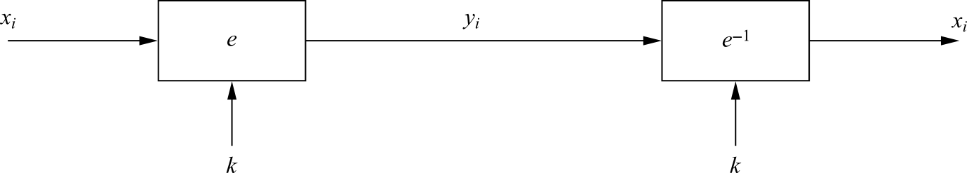
Electronic Code Book mode (ECB)
e_{k}(x_{i}) denote the encryption of a b-bit plaintext block x_{i} with key k
e_{k}⁻¹(y_{i}) denote the decryption of b-bit ciphertext block y_{i} with key k
Messages which exceed b bits are partitioned into b-bit blocks
Each Block is encrypted separately
Encryption: y_{i} = e_{k} (x_{i}), i ≥ 1
Decryption: x_{i} = e_{k}⁻¹ (y_{i}) = e_{k}⁻¹ (e_{k} (x_{i})), i ≥ 1
<number>/38

Slide 8
ECB: advantages/disadvantages
Advantages
  no block synchronization between sender and receiver is required
  bit errors caused by noisy channels only affect the corresponding block but not succeeding blocks
  Block cipher operating can be parallelized
    advantage for high-speed implementations
Disadvantages
  ECB encrypts highly deterministically
    identical plaintexts result in identical ciphertexts
    an attacker recognizes if the same message has been sent twice
    plaintext blocks are encrypted independently of previous blocks
      an attacker may reorder ciphertext blocks which results in valid plaintext
<number>/38

Slide 9

Substitution Attack on ECB
Once a particular plaintext to ciphertext block mapping x_{i} → y_{i} is known, a sequence of ciphertext blocks can easily be manipulated
Suppose an electronic bank transfer
  the encryption key between the two banks does not change too frequently
  The attacker sends $1.00 transfers from his account at bank A to his account at bank B repeatedly
    He can check for ciphertext blocks that repeat, and he stores blocks 1,3 and 4 of these transfers
  He now simply replaces block 4 of other transfers with the block 4 that he stored before
    all transfers from some account of bank A to some account of bank B are redirected to go into the attacker’s B account!
<number>/38

Slide 10


Example of encrypting bitmaps in ECB mode
Identical plaintexts are mapped to identical ciphertexts
Statistical properties in the plaintext are preserved in the ciphertext
<number>/38

Slide 11
Content of this Chapter
Encryption with Block Ciphers: Modes of Operation
  Electronic Code Book mode (ECB)
  Cipher Block Chaining mode (CBC)
  Output Feedback mode (OFB)
  Cipher Feedback mode (CFB)
  Counter mode (CTR)
  Galois Counter Mode (GCM)
Exhaustive Key Search Revisited
Increasing the Security of Block Ciphers
<number>/38

Slide 12
Cipher Block Chaining mode (CBC)
There are two main ideas behind the CBC mode:
  The encryption of all blocks are “chained together”
    ciphertext y_{i} depends not only on block x_{i} but on all previous plaintext blocks as well
  The encryption is randomized by using an initialization vector (IV)
Encryption (first block): y₁ = e_{k} (x₁ ⊕ IV)
Encryption (general block): y_{i} = e_{k} (x_{i} ⊕ y_{i−1}), i ≥ 2
Decryption (first block): x₁ = e_{k}⁻¹ (y₁) ⊕ IV
Decryption (general block) : x_{i} = e_{k}⁻¹ (y_{i}) ⊕ y_{i−1}, i ≥ 2
<number>/38

Slide 13
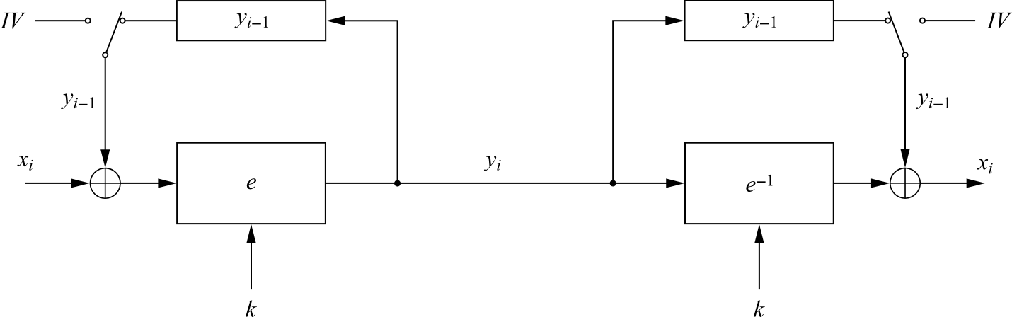
Cipher Block Chaining mode (CBC)
For the first plaintext block x₁ there is no previous ciphertext
  an IV is added to the first plaintext to make each CBC encryption nondeterministic
  the first ciphertext y₁ depends on plaintext x₁ and the IV
The second ciphertext y₂ depends on the IV, x₁ and x₂
The third ciphertext y₃ depends on the IV and x₁, x₂ and x₃, and so on
<number>/38

Slide 14
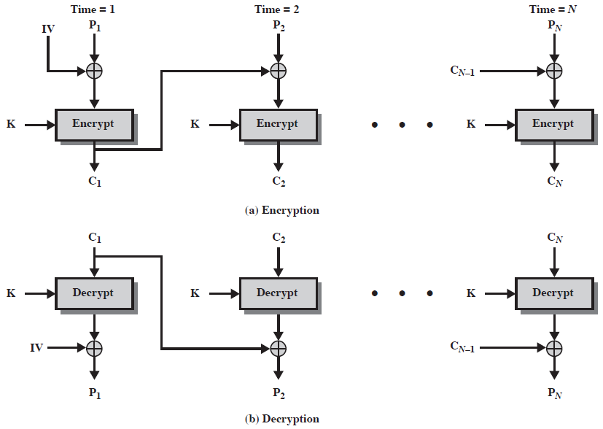
Cipher Block Chaining (CBC)

Slide 15
Substitution Attack on CBC
Suppose the last example (electronic bank transfer)
If the IV is properly chosen for every wire transfer, the attack will not work at all
If the IV is kept the same for several transfers, the attacker would recognize the transfers from his account at bank A to back B
If we choose a new IV every time we encrypt, the CBC mode becomes a probabilistic encryption scheme, i.e., two encryptions of the same plaintext look entirely different
It is not needed to keep the IV secret!
Typically, the IV should be a non-secret nonce (value used only once)
<number>/38

Slide 16
Content of this Chapter
Encryption with Block Ciphers: Modes of Operation
  Electronic Code Book mode (ECB)
  Cipher Block Chaining mode (CBC)
  Output Feedback mode (OFB)
  Cipher Feedback mode (CFB)
  Counter mode (CTR)
  Galois Counter Mode (GCM)
Exhaustive Key Search Revisited
Increasing the Security of Block Ciphers
<number>/38

Slide 17
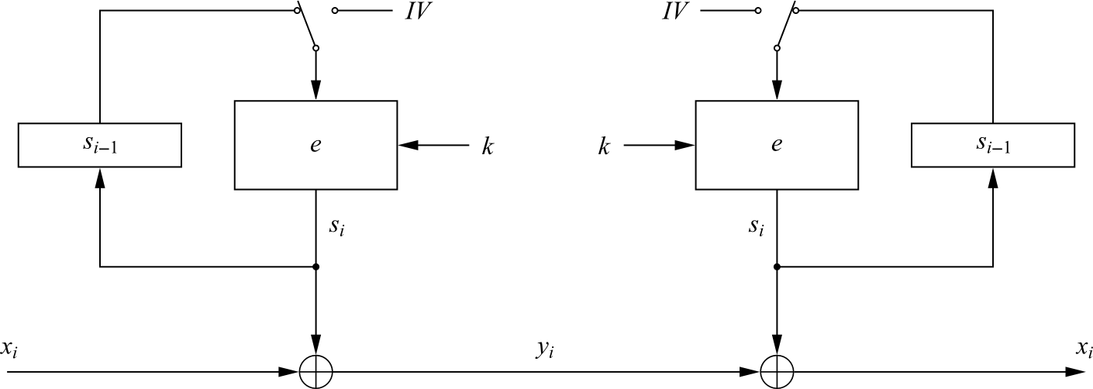
Output Feedback mode (OFB)
It is used to build a synchronous stream cipher from a block cipher
The key stream is not generated bitwise but instead in a blockwise fashion
The output of the cipher gives us key stream bits S_{i} with which we can encrypt plaintext bits using the XOR operation
Encryption (first block): s₁ = e_{k} (IV) and y₁ = s₁ ⊕ x₁
Encryption (general block): s_{i} = e_{k} (s_{i−1}) and y_{i} = s_{i} ⊕ x_{i} , i ≥ 2
Decryption (first block): s₁ = e_{k} (IV) and x₁ = s₁ ⊕ y₁
Decryption (general block) : s_{i} = e_{k} (s_{i−1}) and x_{i} = s_{i} ⊕ y_{i} , i ≥ 2
<number>/38

Slide 18
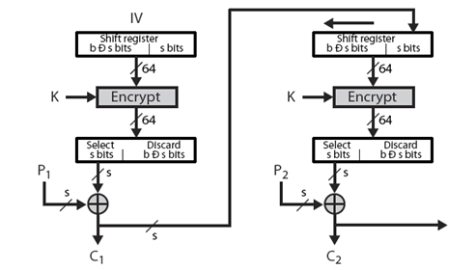
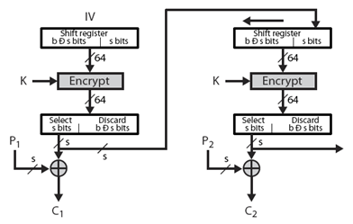
Cipher Feedback
Output Feedback

Slide 19
Content of this Chapter
Encryption with Block Ciphers: Modes of Operation
  Electronic Code Book mode (ECB)
  Cipher Block Chaining mode (CBC)
  Output Feedback mode (OFB)
  Cipher Feedback mode (CFB)
  Counter mode (CTR)
  Galois Counter Mode (GCM)
Exhaustive Key Search Revisited
Increasing the Security of Block Ciphers
<number>/38

Slide 20
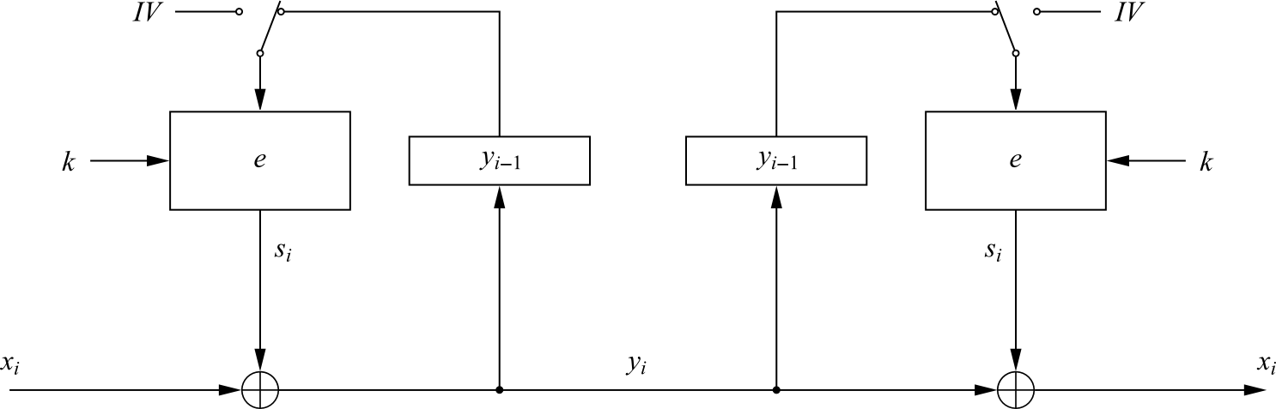
Cipher Feedback mode (CFB)
It uses a block cipher as a building block for an asynchronous stream cipher (similar to the OFB mode), more accurate name: “Ciphertext Feedback Mode”
The key stream S_{i} is generated in a blockwise fashion and is also a function of the ciphertext
As a result of the use of an IV, the CFB encryption is also nondeterministic
It can be used in situations where short plaintext blocks are to be encrypted
Encryption (first block): y₁ = e_{k} (IV) ⊕ x₁
Encryption (general block): y_{i} = e_{k} (y_{i−1}) ⊕ x_{i} , i ≥ 2
Decryption (first block): x₁ = e_{k} (IV) ⊕ y₁
Decryption (general block) : x_{i} = e_{k} (y_{i−1}) ⊕ y_{i} , i ≥ 2
<number>/38

Slide 21
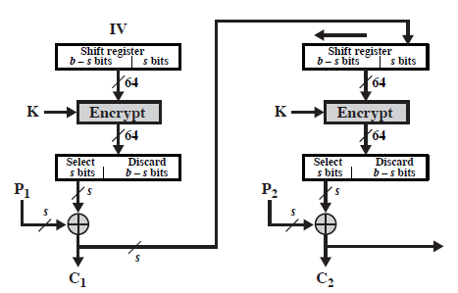
Encryption in CFB Mode

Slide 22
Content of this Chapter
Encryption with Block Ciphers: Modes of Operation
  Electronic Code Book mode (ECB)
  Cipher Block Chaining mode (CBC)
  Output Feedback mode (OFB)
  Cipher Feedback mode (CFB)
  Counter mode (CTR)
  Galois Counter Mode (GCM)
Exhaustive Key Search Revisited
Increasing the Security of Block Ciphers
<number>/38

Slide 23
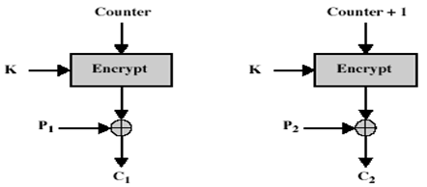
Counter Mode (CTR)
Plaintext blocks: p₁, p₂, p₃, …
Key: k
Basic idea: construct key stream k₁, k₂, k₃, …
Encryption:
  T₁ = IV (random)
  T_{i} = IV + i - 1
  C_{i} = P_{i} ♁ E_{K}(T_{i})
  C = (IV, C₁, C₂, C₃, ...)

Slide 24
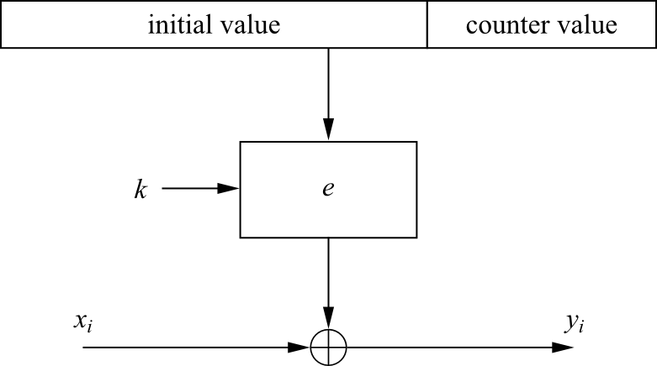
Counter mode (CTR)
It uses a block cipher as a stream cipher (like the OFB and CFB modes)
The key stream is computed in a blockwise fashion
The input to the block cipher is a counter which assumes a different value every time the block cipher computes a new key stream block
Unlike CFB and OFB modes, the CTR mode can be parallelized since the 2nd encryption can begin before the 1st one has finished
  Desirable for high-speed implementations, e.g., in network routers
Encryption: y_{i} = e_{k} (IV || CTR_{i} ) ⊕ x_{i}, i ≥ 1
Decryption : x_{i} = e_{k} (IV || CTR_{i} ) ⊕ y_{i}, i ≥ 1
<number>/38

Slide 25
Content of this Chapter
Encryption with Block Ciphers: Modes of Operation
  Electronic Code Book mode (ECB)
  Cipher Block Chaining mode (CBC)
  Output Feedback mode (OFB)
  Cipher Feedback mode (CFB)
  Counter mode (CTR)
  Galois Counter Mode (GCM)
Exhaustive Key Search Revisited
Increasing the Security of Block Ciphers
<number>/38

Slide 26
Galois Counter Mode (GCM)
It also computes a message authentication code (MAC), i.e., a cryptographic checksum is computed for a message (for more information see Chapter 12 in Understanding Cryptography)
By making use of GCM, two additional services are provided:
  Message Authentication
    the receiver can make sure that the message was really created by the original sender
  Message Integrity
    the receiver can make sure that nobody tampered with the ciphertext during transmission
<number>/38

Slide 27
Galois Counter Mode (GCM)
For encryption
  An initial counter is derived from an IV and a serial number
  The initial counter value is incremented then encrypted and XORed with the first plaintext block
  For subsequent plaintexts, the counter is incremented and then encrypted
For authentication
  A chained Galois field multiplication is performed (for more information Galois field see Chapter 4.3 in Understanding Cryptography)
  For every plaintext an intermediate authentication parameter g_{i} is derived
    g_{i} is computed as the XOR of the current ciphertext and the last g_{i-1}, and multiplied by the constant H
      H is generated by encryption of the zero input with the block cipher
  All multiplications are in the 128-bit Galois field GF(2¹²⁸)
<number>/38

Slide 28
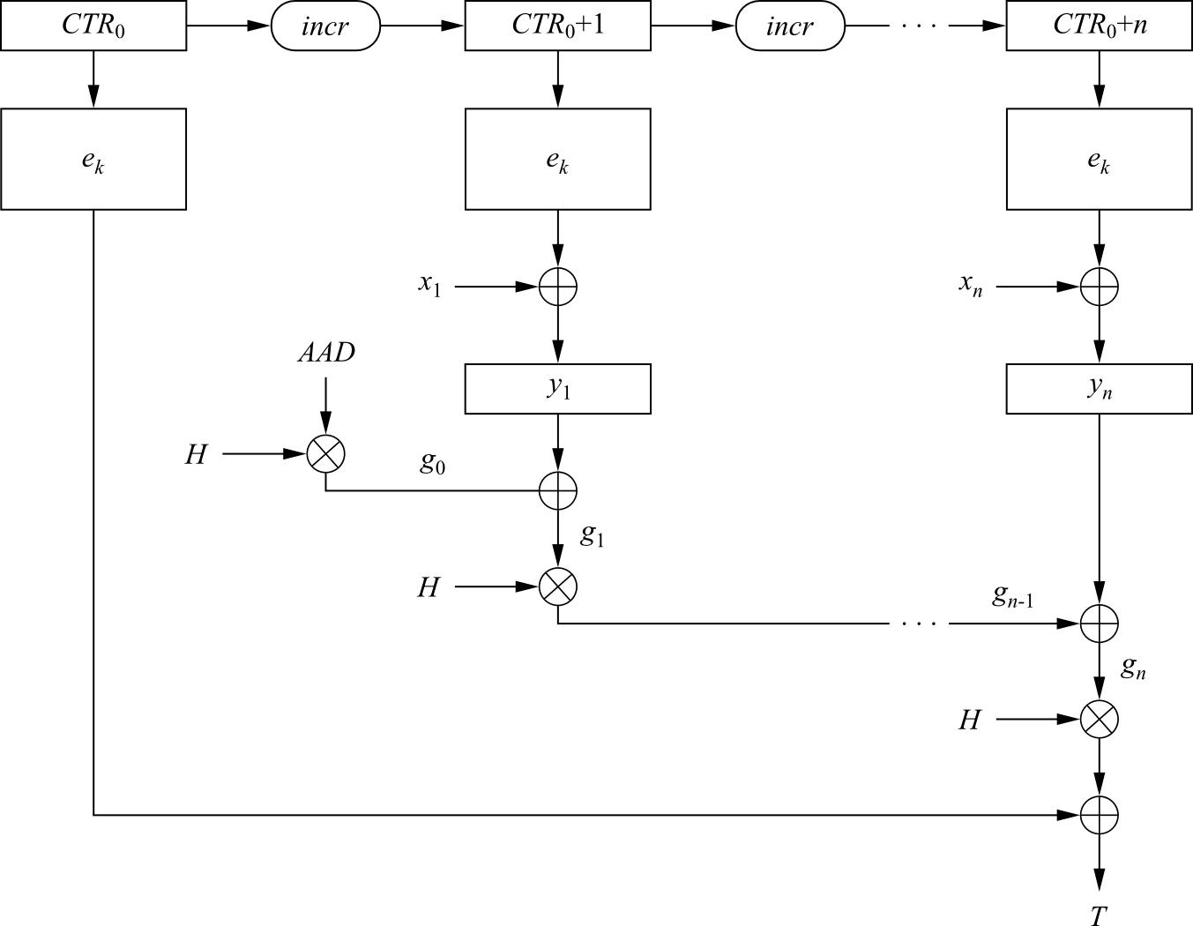
Galois Counter Mode (GCM)
Encryption:
a. Derive a counter value CTR₀ from the IV and compute CTR₁ = CTR₀ + 1
b. Compute ciphertext: y_{i} = e_{k} (CTR_{i}) ⊕ x_{i}, i ≥ 1
Authentication:
a. Generate authentication subkey H = e_{k} (0)
b. Compute g₀ = AAD × H (Galois field multiplication)
c. Compute g_{i} = (g_{i−1} ⊕ y_{i}) × H, 1 ≤ i ≤ n (Galois field multiplication)
d. Final authentication tag: T = (g_{n} × H) ⊕ e_{k} (CTR₀)
<number>/38

Slide 29
Content of this Chapter
Encryption with Block Ciphers: Modes of Operation
Exhaustive Key Search Revisited
Increasing the Security of Block Ciphers
<number>/38

Slide 30
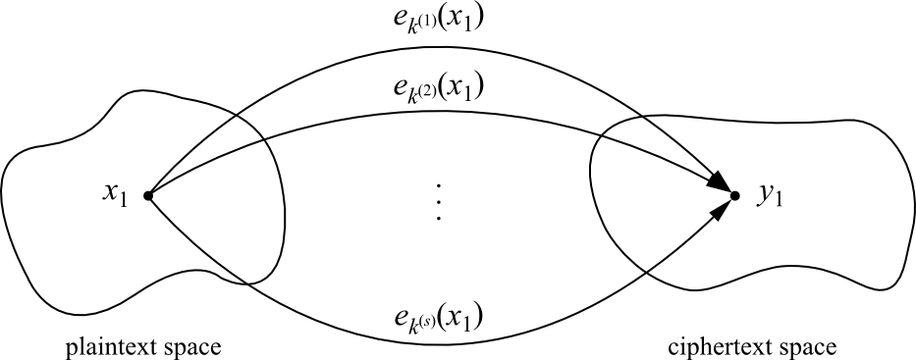
Exhaustive Key Search Revisited
A simple exhaustive search for a DES key knowing one pair (x₁,y₁):
DES_{k}^{(i)} (x₁) y₁, i = 0,1, . . . ,2⁵⁶−1
However, for most other block ciphers a key search is somewhat more complicated
A brute-force attack can produce false positive results
  keys k_{i} that are found are not the one used for the encryption
  The likelihood of this is related to the relative size of the key space and the plaintext space
  A brute-force attack is still possible, but several pairs of plaintext–ciphertext are needed
?
=
<number>/38

Slide 31
An Exhaustive Key Search Example
Assume a cipher with a block width of 64 bit and a key size of 80 bit
If we encrypt x₁ under all possible 2⁸⁰ keys, we obtain 2⁸⁰ ciphertexts
  However, there exist only 2⁶⁴ different ones
If we run through all keys for a given plaintext–ciphertext pair, we find on average 2⁸⁰/2⁶⁴ = 2¹⁶ keys that perform the mapping e_{k}(x₁) = y₁
In this example assuming two plaintext-ciphertext pairs, the likelihood is
2^{80−2·64}=2 ⁻⁴⁸
  for almost all practical purposes two plaintext-ciphertext pairs are sufficient
Given a block cipher with a key length of k bits and block size of n bits, as well as t plaintext–ciphertext pairs (x₁, y₁), ... , (x_{t} , y_{t}), the expected number of false keys which encrypt all plaintexts to the corresponding ciphertexts is:
2^{k−tn}
<number>/38

Slide 32
Content of this Chapter
Encryption with Block Ciphers: Modes of Operation
Exhaustive Key Search Revisited
Increasing the Security of Block Ciphers
  Double Encryption and Meet-in-the-Middle Attack
  Triple Encryption
  Key Whitening
<number>/38

Slide 33
Increasing the Security of Block Ciphers
In some situations we wish to increase the security of block ciphers, e.g., if a cipher such as DES is available in hardware or software for legacy reasons in a given application
Two approaches are possible
  Multiple encryption
    theoretically much more secure, but sometimes in practice increases the security very little
  Key whitening
<number>/38

Slide 34
Content of this Chapter
Encryption with Block Ciphers: Modes of Operation
Exhaustive Key Search Revisited
Increasing the Security of Block Ciphers
  Double Encryption and Meet-in-the-Middle Attack
  Triple Encryption
  Key Whitening
<number>/38

Slide 35
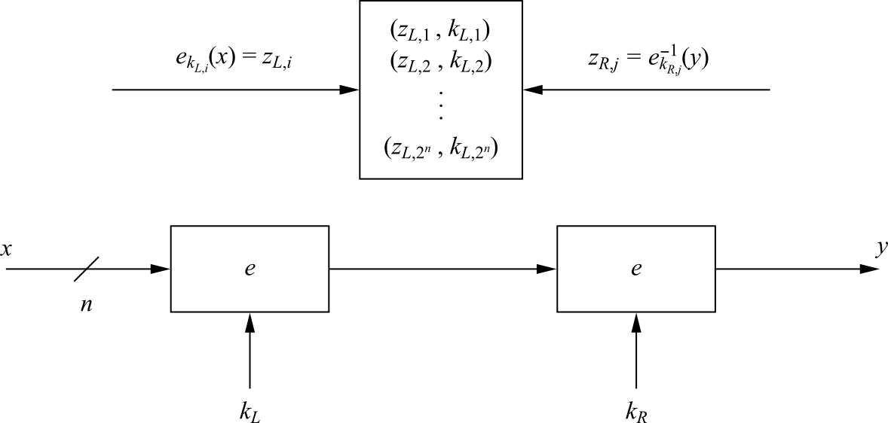
Double Encryption
A plaintext x is first encrypted with a key k_{L}, and the resulting ciphertext is encrypted again using a second key k_{R}
Assuming a key length of k bits, an exhaustive key search would require 2^{k}·2^{k} = 2^{2k} encryptions or decryptions
<number>/38

Slide 36
Meet-in-the-Middle Attack
A Meet-in-the-Middle attack requires 2^{k}+2^{k} = 2^{k+1} operations!
  Phase I: for the given (x₁, y₁) the left encryption is brute-forced for all k_{L,i}, i=1,2, ..., 2^{k} and a lookup table with 2^{k} entry (each n+k bits wide) is computed
    the lookup table should be ordered by the result of the encryption (z_{L,i})
  Phase II: the right encryption is brute-forced (using decryption) and for each z_{R,i} it is checked whether z_{R,i} is equal to any z_{L,i} value in the table of the first phase
Computational Complexity
Double encryption is not much more secure then single encryption!
number of encryptions and decryptions = 2^{k} +2^{k} = 2^{k+1}
number of storage locations = 2^{k}
<number>/38

Slide 37
Content of this Chapter
Encryption with Block Ciphers: Modes of Operation
Exhaustive Key Search Revisited
Increasing the Security of Block Ciphers
  Double Encryption and Meet-in-the-Middle Attack
  Triple Encryption
  Key Whitening
<number>/38

Slide 38
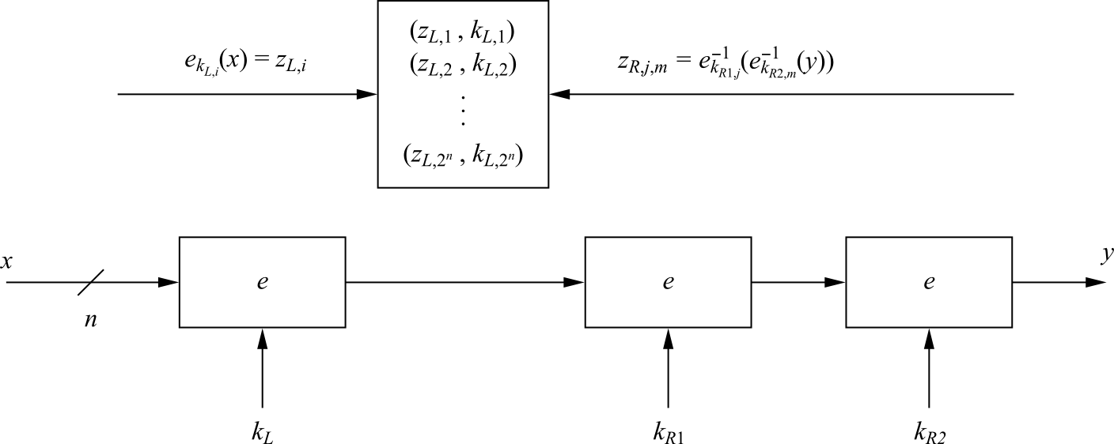
Triple Encryption
The encryption of a block three times y = e_{k3} (e_{k2} (e_{k1} (x)))
In practice a variant scheme is often used EDE (encryption-decryption-encryption)
y = e_{k3} (e⁻¹_{k2} (e_{k1} (x)))
  Advantage: choosing k1=k2=k3 performs single DES encryption
Still we can perform a meet-in-the middle attack, and it reduces the effective key length of triple encryption from 3K to 2K!
  The attacker must run 2¹¹² tests in the case of 3DES
Triple encryption effectively doubles the key length
<number>/38

Slide 39
Content of this Chapter
Encryption with Block Ciphers: Modes of Operation
Exhaustive Key Search Revisited
Increasing the Security of Block Ciphers
  Double Encryption and Meet-in-the-Middle Attack
  Triple Encryption
  Key Whitening
<number>/38

Slide 40
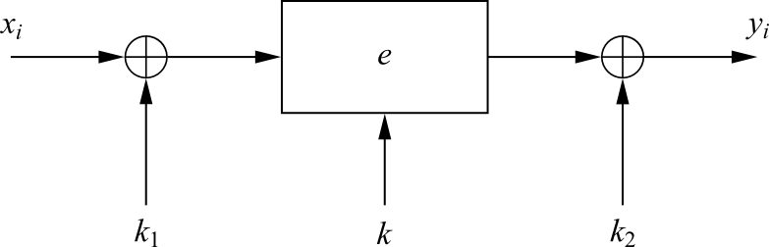
Key Whitening
Makes block ciphers such as DES much more resistant against brute-force attacks
In addition to the regular cipher key k, two whitening keys k₁ and k₂ are used to XOR-mask the plaintext and ciphertext
It does not strengthen block ciphers against most analytical attacks such as linear and differential cryptanalysis
It is not a “cure” for inherently weak ciphers
The additional computational load is negligible
Its main application is ciphers that are relatively strong against analytical attacks but possess too short a key space especially DES
  a variant of DES which uses key whitening is called DESX
<number>/38

Slide 41
Lessons Learned
There are many different ways to encrypt with a block cipher. Each mode of operation has some advantages and disadvantages
Several modes turn a block cipher into a stream cipher
There are modes that perform encryption together together with authentication, i.e., a cryptographic checksum protects against message manipulation
The straightforward ECB mode has security weaknesses, independent of the underlying block cipher
The counter mode allows parallelization of encryption and is thus suited for high speed implementations
Double encryption with a given block cipher only marginally improves the resistance against brute-force attacks
Triple encryption with a given block cipher roughly doubles the key length
Triple DES (3DES) has an effective key length of 112 bits
Key whitening enlarges the DES key length without much computational overhead.
<number>/38

