Slide 1
Basics of Algorithm Analysis

Slide 2
Algorithm
An algorithm is a set of instructions to be followed to solve a problem.
There can be more than one solution (more than one algorithm) to solve a given problem.
An algorithm can be implemented using different programming languages on different platforms.
An algorithm must be correct. It should correctly solve the problem.
e.g. For sorting, this means even if (1) the input is already sorted, or (2) it contains repeated elements.
Once we have a correct algorithm for a problem, we have to determine the efficiency of that algorithm.

Slide 3
Algorithmic Performance
There are two aspects of algorithmic performance:
Time
Instructions take time.
How fast does the algorithm perform?
What affects its runtime?
Space
Data structures take space
What kind of data structures can be used?
How does choice of data structure affect the runtime?
We will focus on time:
How to estimate the time required for an algorithm
How to reduce the time required

Slide 4
Analysis of Algorithms
Analysis of Algorithms is the area of computer science that provides tools to analyze the efficiency of different methods of solutions.
How do we compare the time efficiency of two algorithms that solve the same problem?
Naïve Approach: implement these algorithms in a programming language (C++), and run them to compare their time requirements. Comparing the programs (instead of algorithms) has difficulties.
How are the algorithms coded?
Comparing running times means comparing the implementations.
We should not compare implementations, because they are sensitive to programming style that may cloud the issue of which algorithm is inherently more efficient.
What computer should we use?
We should compare the efficiency of the algorithms independently of a particular computer.
What data should the program use?
Any analysis must be independent of specific data.

Slide 5
Analysis of Algorithms
When we analyze algorithms, we should employ mathematical techniques that analyze algorithms independently of specific implementations, computers, or data.
To analyze algorithms:
First, we start to count the number of significant operations in a particular solution to assess its efficiency.
Then, we will express the efficiency of algorithms using growth functions.

Slide 6
The Execution Time of Algorithms
Each operation in an algorithm (or a program) has a cost.
➔ Each operation takes a certain of time.
count = count + 1; ➔ take a certain amount of time, but it is constant
A sequence of operations:
count = count + 1; Cost: c₁
sum = sum + count; Cost: c₂
➔ Total Cost = c₁ + c₂

Slide 7
The Execution Time of Algorithms (cont.)
Example: Simple If-Statement
Cost Times
if (n < 0) c1 1
absval = -n c2 1
else
absval = n; c3 1
Total Cost <= c1 + max(c2,c3)

Slide 8
The Execution Time of Algorithms (cont.)
Example: Simple Loop
Cost Times
i = 1; c1 1
sum = 0; c2 1
while (i <= n) { c3 n+1
i = i + 1; c4 n
sum = sum + i; c5 n
}
Total Cost = c1 + c2 + (n+1)*c3 + n*c4 + n*c5
➔ The time required for this algorithm is proportional to n

Slide 9
The Execution Time of Algorithms (cont.)
Example: Nested Loop
Cost Times
i=1; c1 1
sum = 0; c2 1
while (i <= n) { c3 n+1
j=1; c4 n
while (j <= n) { c5 n*(n+1)
sum = sum + i; c6 n*n
j = j + 1; c7 n*n
}
i = i +1; c8 n
}
Total Cost = c1 + c2 + (n+1)*c3 + n*c4 + n*(n+1)*c5+n*n*c6+n*n*c7+n*c8
➔ The time required for this algorithm is proportional to n²

Slide 10
Algorithm Growth Rates
We measure an algorithm’s time requirement as a function of the problem size.
Problem size depends on the application: e.g. number of elements in a list for a sorting algorithm, the number disks for towers of hanoi.
So, for instance, we say that (if the problem size is n)
Algorithm A requires 5*n² time units to solve a problem of size n.
Algorithm B requires 7*n time units to solve a problem of size n.
The most important thing to learn is how quickly the algorithm’s time requirement grows as a function of the problem size.
Algorithm A requires time proportional to n².
Algorithm B requires time proportional to n.
An algorithm’s proportional time requirement is known as growth rate.
We can compare the efficiency of two algorithms by comparing their growth rates.

Slide 11
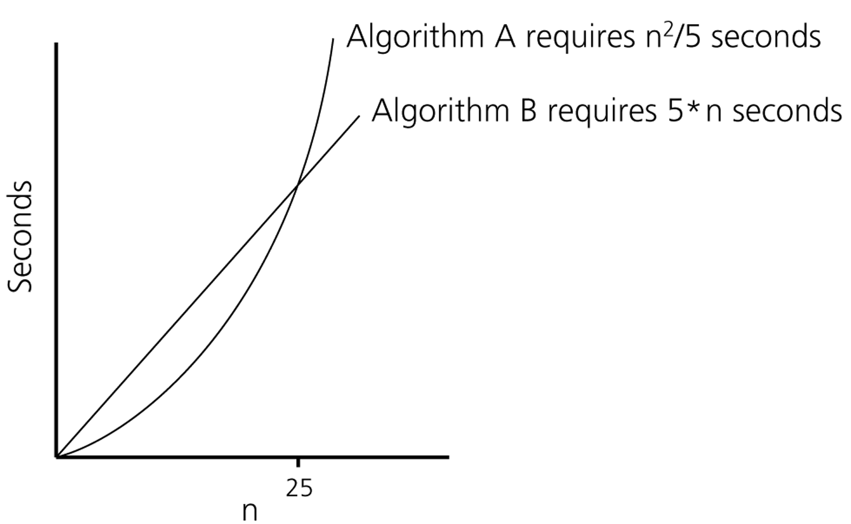
Algorithm Growth Rates (cont.)
Time requirements as a function
of the problem size n

Slide 12
Common Growth Rates
Function | Growth Rate Name
c | Constant
log N | Logarithmic
log²N | Log-squared
N | Linear
N log N
N² | Quadratic
N³ | Cubic
2^{N} | Exponential

Slide 13
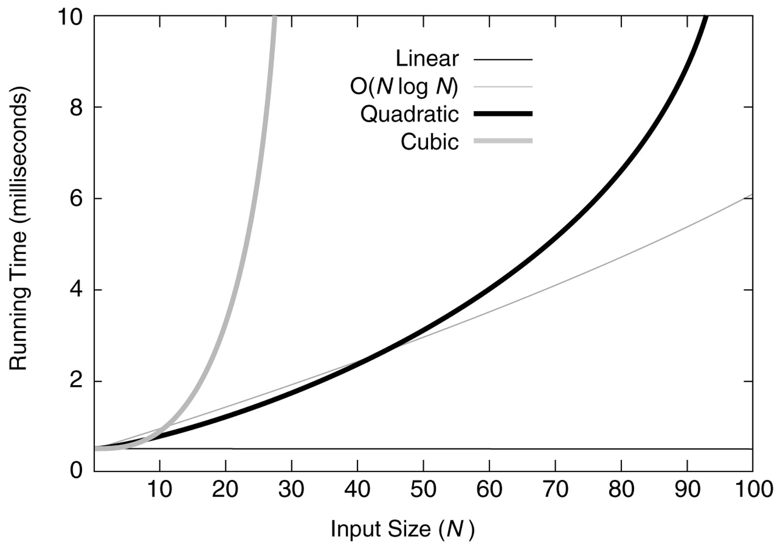
Figure 6.1 Running times for small inputs

Slide 14
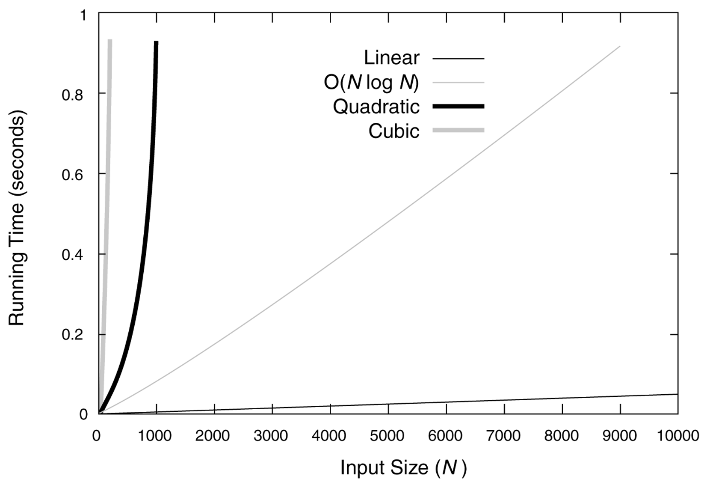
Figure 6.2 Running times for moderate inputs

Slide 15
Order-of-Magnitude Analysis and Big O Notation
If Algorithm A requires time proportional to f(n), Algorithm A is said to be order f(n), and it is denoted as O(f(n)).
The function f(n) is called the algorithm’s growth-rate function.
Since the capital O is used in the notation, this notation is called the Big O notation.
If Algorithm A requires time proportional to n², it is O(n²).
If Algorithm A requires time proportional to n, it is O(n).

Slide 16
Definition of the Order of an Algorithm
Definition:
Algorithm A is order f(n) – denoted as O(f(n)) –
if constants k and n₀ exist such that A requires
no more than k*f(n) time units to solve a problem
of size n ≥ n₀.
The requirement of n ≥ n₀ in the definition of O(f(n)) formalizes the notion of sufficiently large problems.
In general, many values of k and n can satisfy this definition.

Slide 17
Order of an Algorithm
If an algorithm requires n²–3*n+10 seconds to solve a problem size n. If constants k and n₀ exist such that
k*n² > n²–3*n+10 for all n ≥ n₀ .
the algorithm is order n² (In fact, k is 3 and n₀ is 2)
3*n² > n²–3*n+10 for all n ≥ 2 .
Thus, the algorithm requires no more than k*n² time units for n ≥ n₀ ,
So it is O(n²)

Slide 18
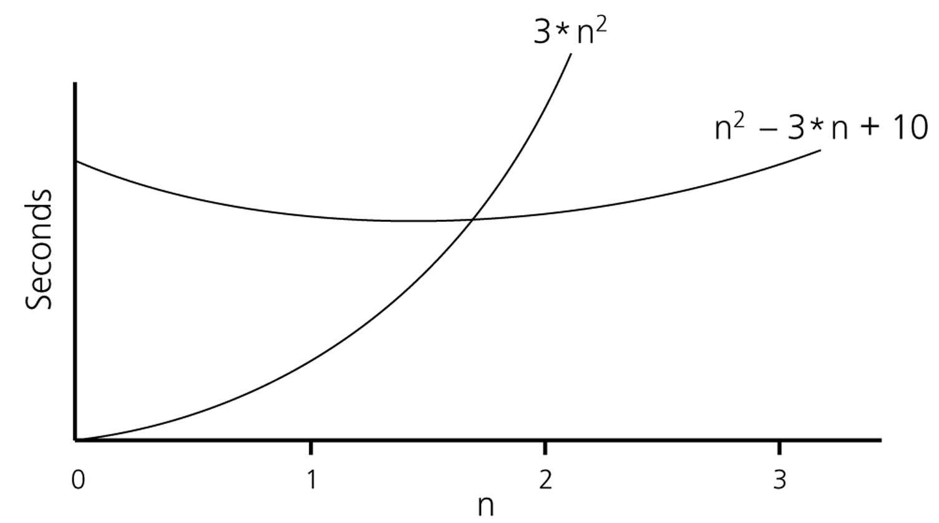
Order of an Algorithm (cont.)

Slide 19
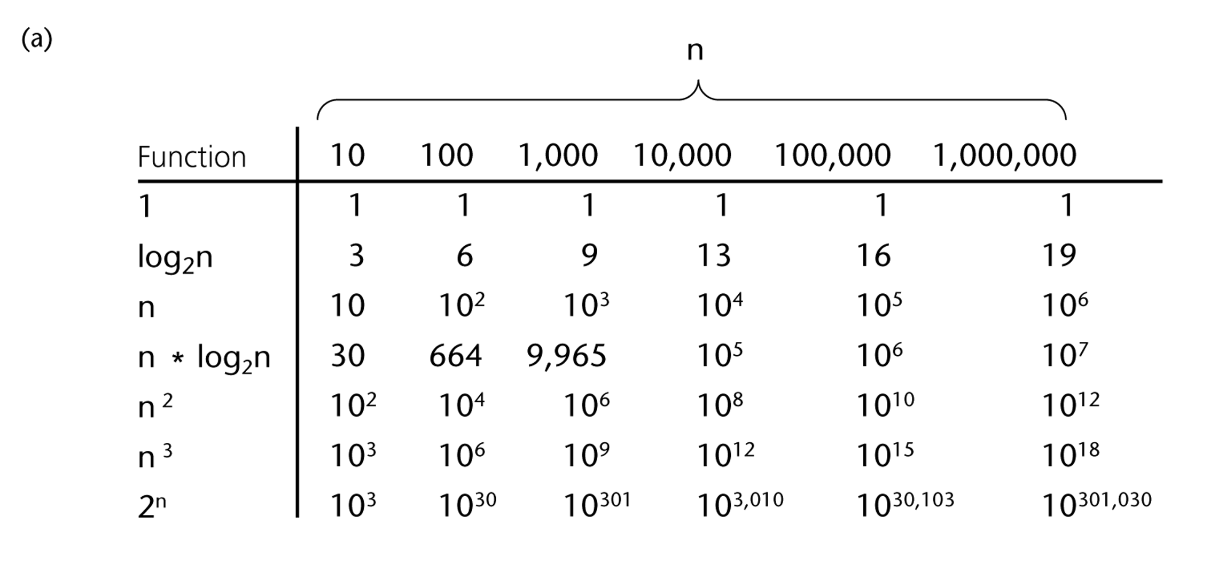
A Comparison of Growth-Rate Functions

Slide 20
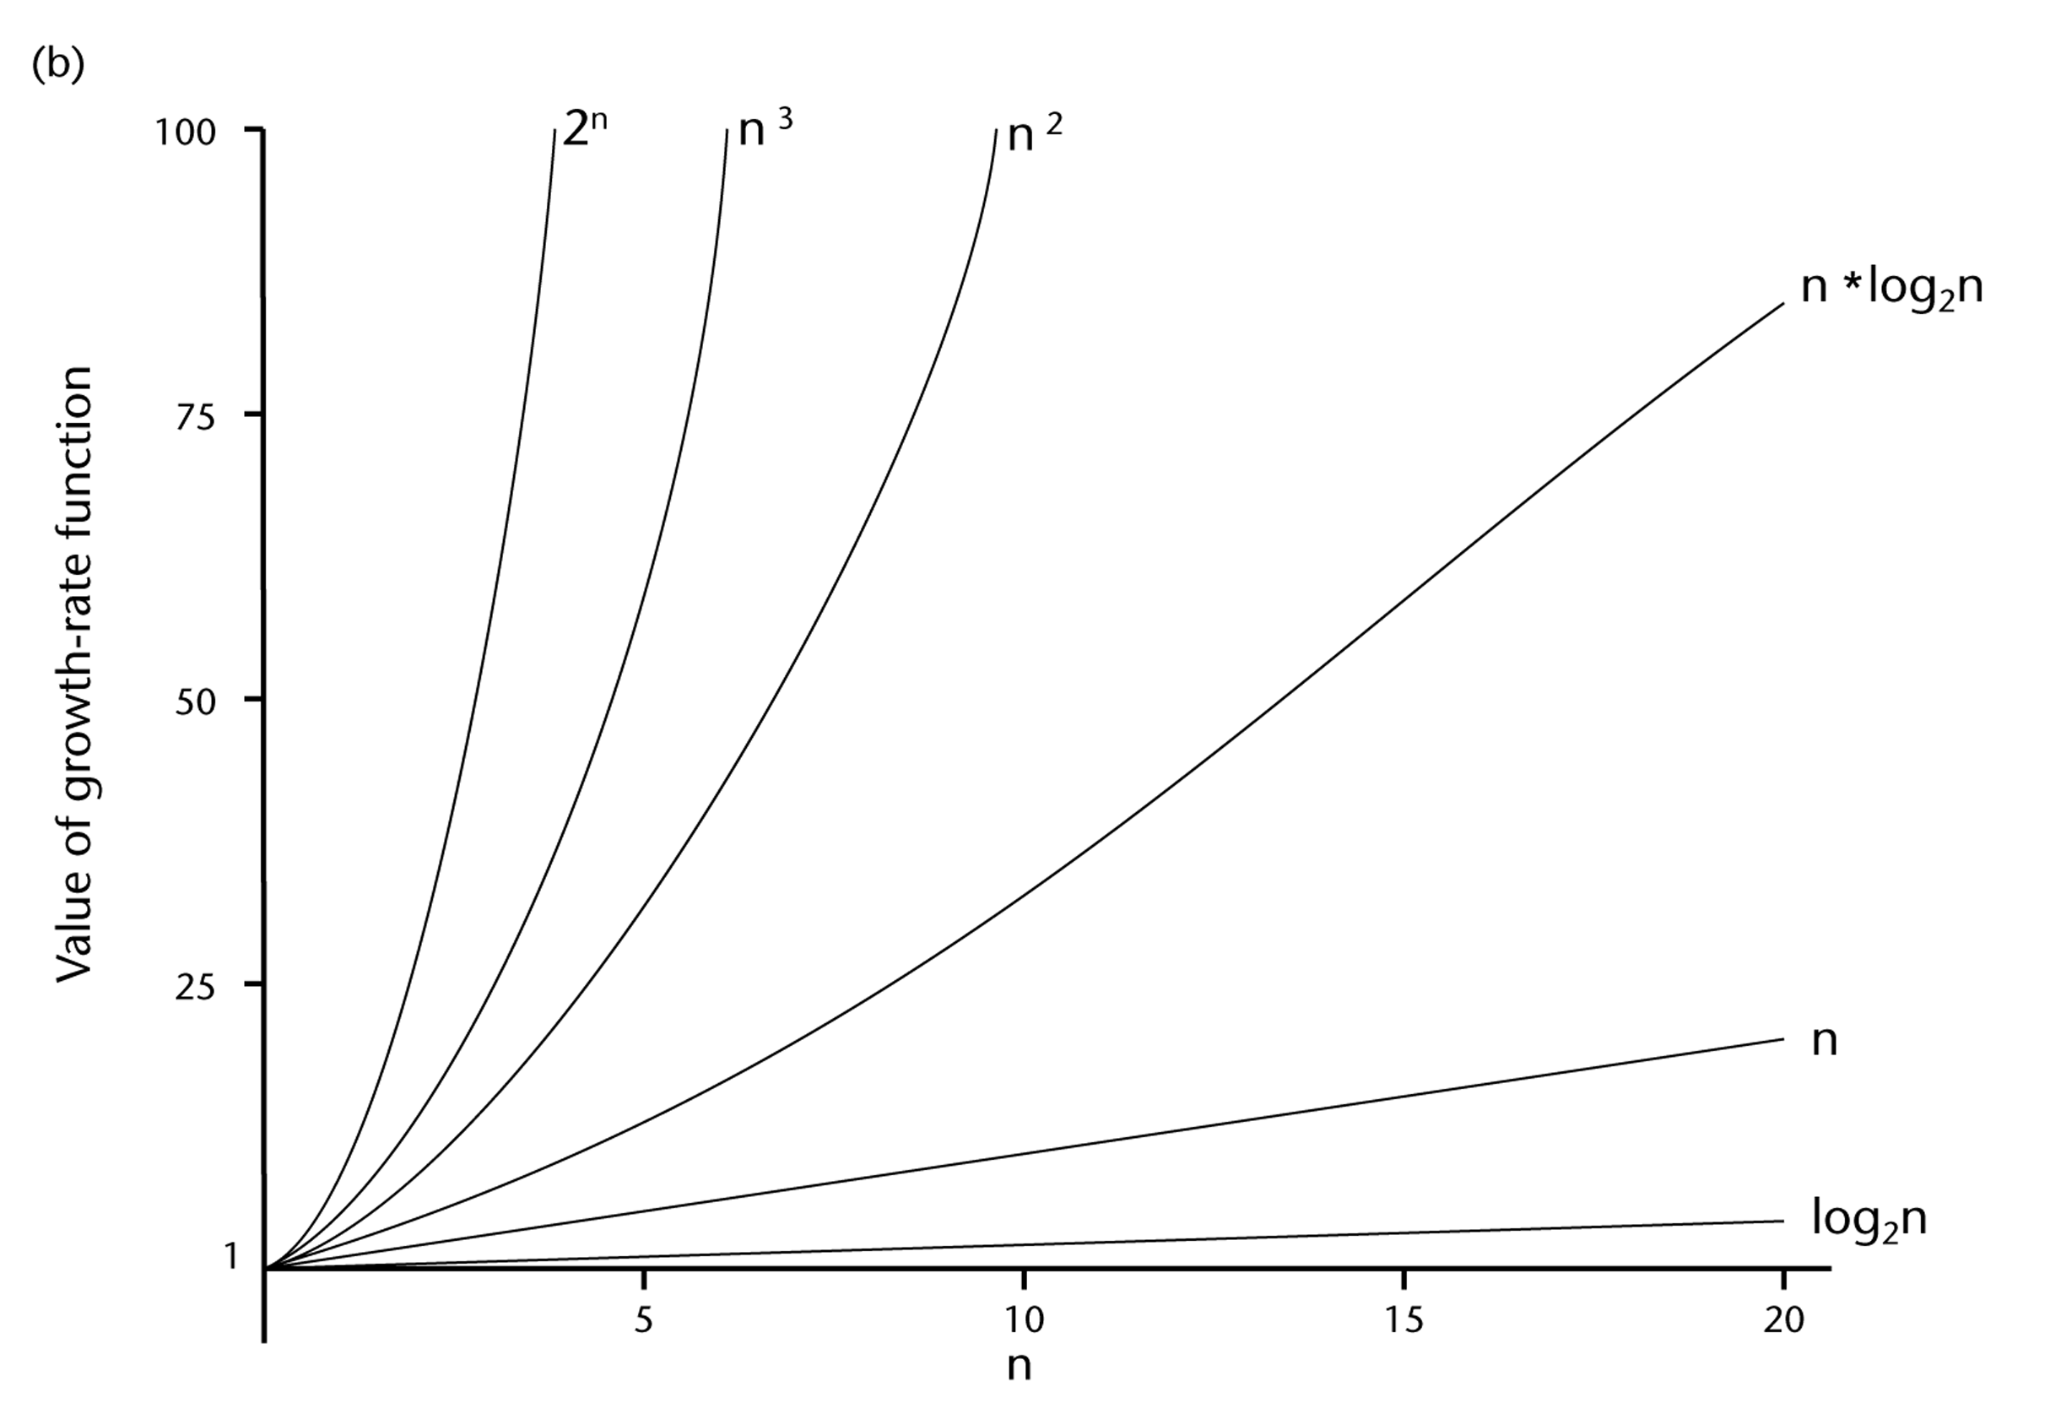
A Comparison of Growth-Rate Functions (cont.)

