Slide 1
Graphs

Slide 2
GRAPH – Definitions
A graph G = (V, E) consists of
a set of vertices, V, and
a set of edges, E, where each edge is a pair (v,w) s.t. v,w ∈ V
Vertices are sometimes called nodes, edges are sometimes called arcs.
If the edge pair is ordered then the graph is called a directed graph (also called digraphs) .
We also call a normal graph (which is not a directed graph) an undirected graph.
When we say graph we mean that it is an undirected graph.

Slide 3
Graph – Definitions
Two vertices of a graph are adjacent if they are joined by an edge.
Vertex w is adjacent to v iff (v,w) ∈ E.
In an undirected graph with edge (v, w) and hence (w,v) w is adjacent to v and v is adjacent to w.
A path between two vertices is a sequence of edges that begins at one vertex and ends at another vertex.
i.e. w₁, w₂, …, w_{N} is a path if (w_{i}, w_{i+1}) ∈ E for 1 ≤ i ≤. N-1
A simple path passes through a vertex only once.
A cycle is a path that begins and ends at the same vertex.
A simple cycle is a cycle that does not pass through other vertices more than once.

Slide 4
Graph – An Example
1
2
A graph G (undirected)
3
4
5
The graph G= (V,E) has 5 vertices and 6 edges:
V = {1,2,3,4,5}
E = { (1,2),(1,3),(1,4),(2,5),(3,4),(4,5), (2,1),(3,1),(4,1),(5,2),(4,3),(5,4) }
Adjacent:
1 and 2 are adjacent -- 1 is adjacent to 2 and 2 is adjacent to 1
Path:
1,2,5 ( a simple path), 1,3,4,1,2,5 (a path but not a simple path)
Cycle:
1,3,4,1 (a simple cycle), 1,3,4,1,4,1 (cycle, but not simple cycle)

Slide 5
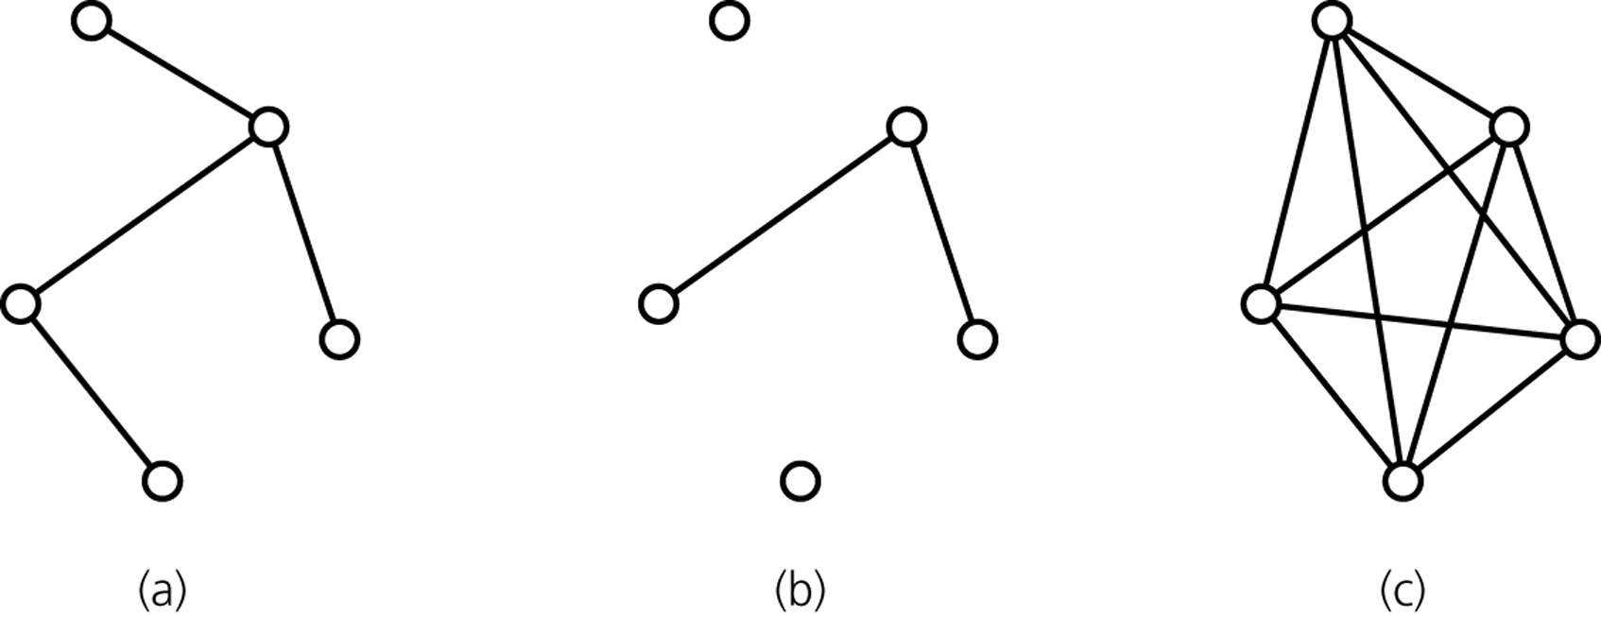
Graph -- Definitions
A connected graph has a path between each pair of distinct vertices.
A complete graph has an edge between each pair of distinct vertices.
A complete graph is also a connected graph. But a connected graph may not be a complete graph.
connected
disconnected
complete

Slide 6
Directed Graph – An Example
1
2
3
4
5
The graph G= (V,E) has 5 vertices and 6 edges:
V = {1,2,3,4,5}
E = { (1,2),(1,4),(2,5),(4,5),(3,1),(4,3) }
Adjacent:
2 is adjacent to 1, but 1 is NOT adjacent to 2
Path:
1,2,5 ( a directed path),
Cycle:
1,4,3,1 (a directed cycle),

Slide 7
Weighted Graph
We can label the edges of a graph with numeric values, the graph is called a weighted graph.
1
8
2
Weighted (Undirected) Graph
10
3
6
3
5
4
7
5
1
8
2
Weighted Directed Graph
10
3
6
3
5
4
7
5

Slide 8
Graph Implementations
The two most common implementations of a graph are:
Adjacency Matrix
A two dimensional array
Adjacency List
For each vertex we keep a list of adjacent vertices

Slide 9
Adjacency Matrix
An adjacency matrix for a graph with n vertices numbered 0,1,...,n-1 is an n by n array matrix such that matrix[i][j] is 1 (true) if there is an edge from vertex i to vertex j, and 0 (false) otherwise.
When the graph is weighted, we can let matrix[i][j] be the weight that labels the edge from vertex i to vertex j, instead of simply 1, and let matrix[i][j] equal to ∞ instead of 0 when there is no edge from vertex i to vertex j.
Adjacency matrix for an undirected graph is symmetrical.
i.e. matrix[i][j] is equal to matrix[j][i]
Space requirement O(|V|²)
Acceptable if the graph is dense.

Slide 10
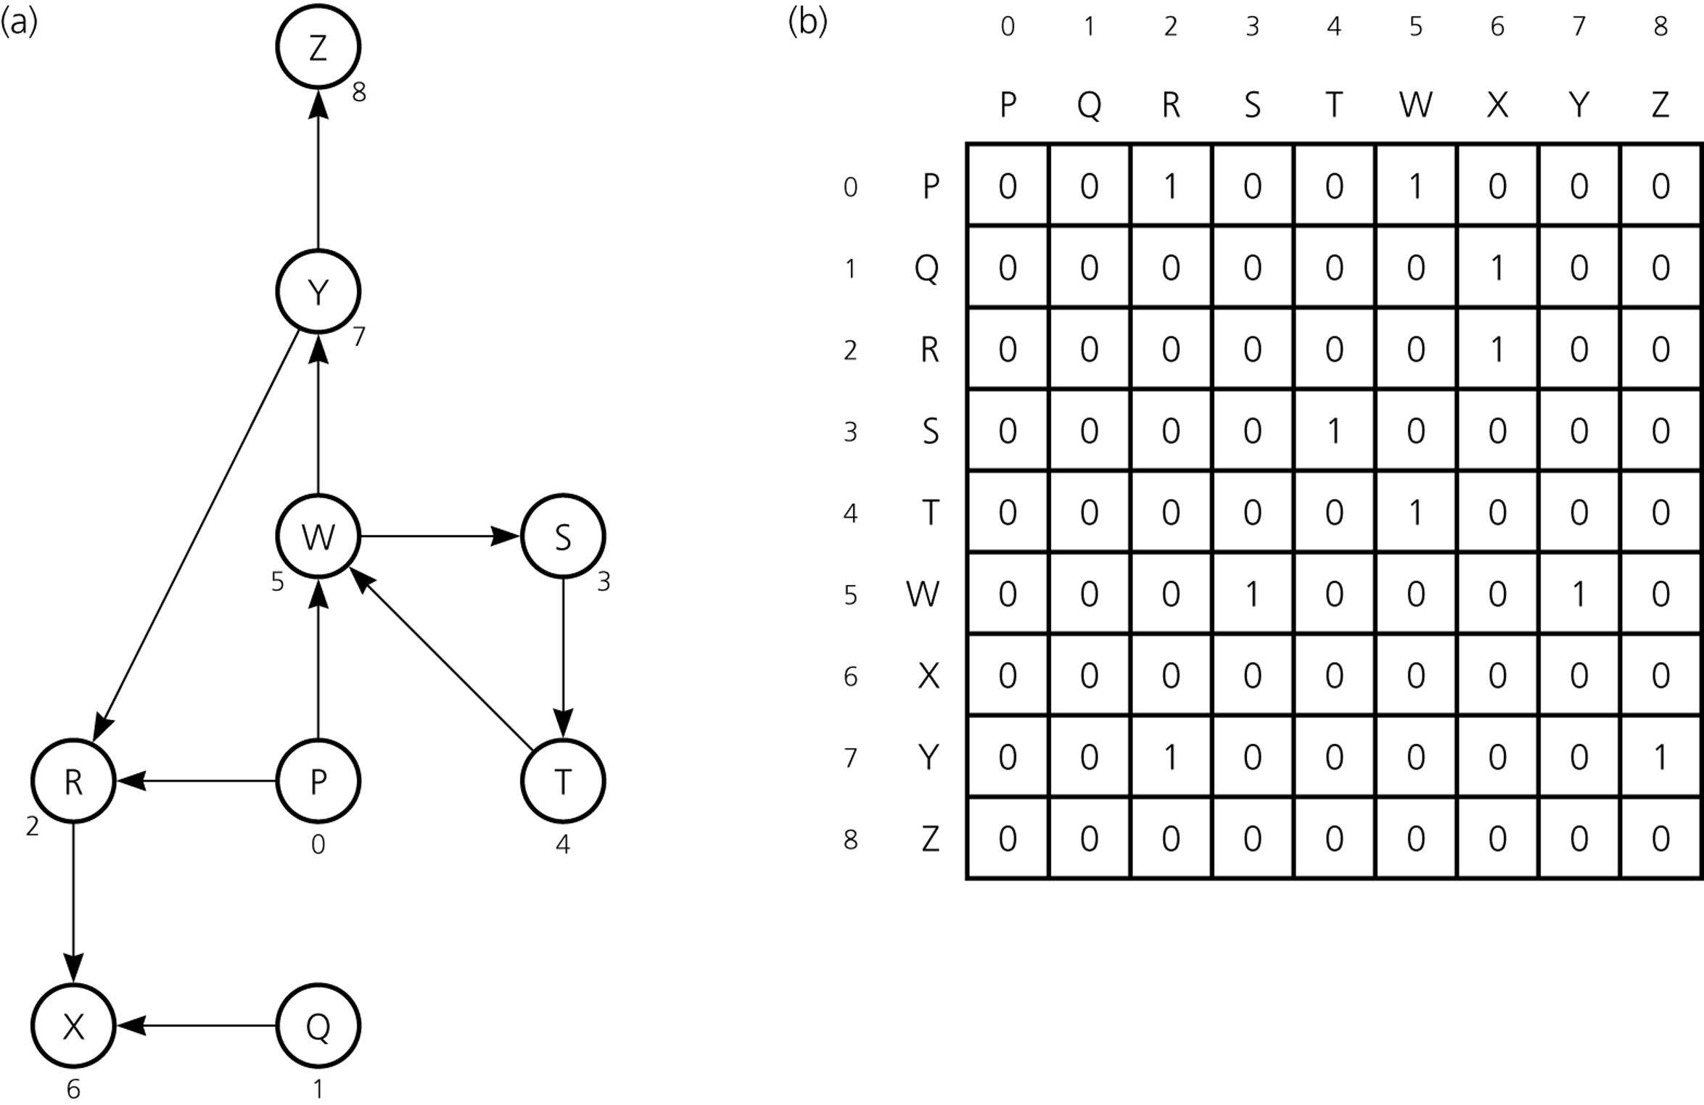
Adjacency Matrix – Example1
A directed graph
Its adjacency matrix

Slide 11
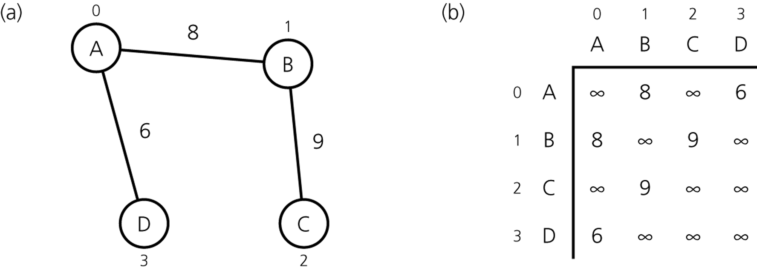
Adjacency Matrix – Example2
An Undirected Weighted Graph
Its Adjacency Matrix

Slide 12
Adjacency List
An adjacency list for a graph with n vertices numbered 0,1,...,n-1 consists of n linked lists. The i^{th} linked list has a node for vertex j if and only if the graph contains an edge from vertex i to vertex j.
Adjacency list is a better solution if the graph is sparse.
Space requirement is O(|E| + |V|), which is linear in the size of the graph.
In an undirected graph each edge (v,w) appears in two lists.
Space requirement is doubled.

Slide 13
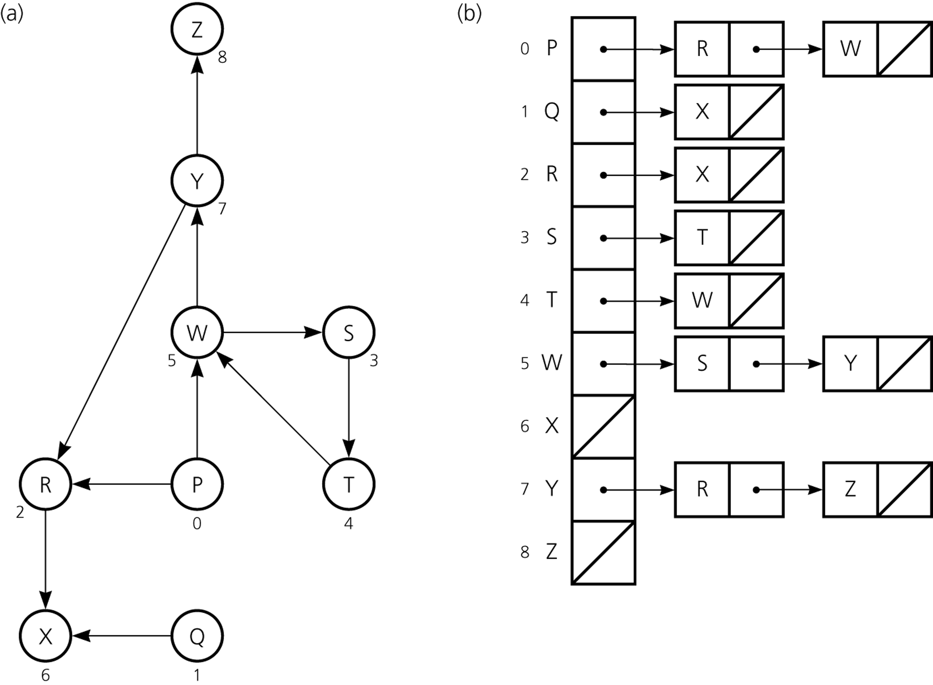
Adjacency List – Example1
A directed graph
Its Adjacency List

Slide 14
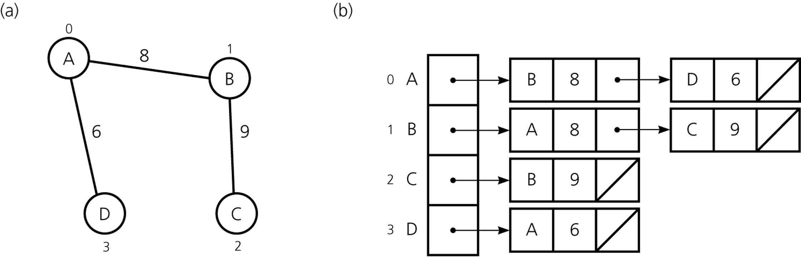
Adjacency List – Example2
An Undirected Weighted Graph
Its Adjacency List

Slide 15
Graph Traversals
A graph-traversal algorithm starts from a vertex v, visits all of the vertices that can be reachable from the vertex v.
A graph-traversal algorithm visits all vertices if and only if the graph is connected.
A connected component is the subset of vertices visited during a traversal algorithm that begins at a given vertex.
A graph-traversal algorithm must mark each vertex during a visit and must never visit a vertex more than once.
Thus, if a graph contains a cycle, the graph-traversal algorithm can avoid infinite loop.
We look at two graph-traversal algorithms:
Depth-First Search (aka Depth-First Traversal)
Breadth-First Search (aka Breadth-First Traversal)

Slide 16
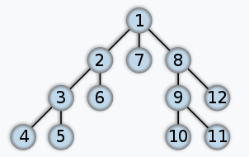
Depth-First Search
For a given vertex v, the depth-first search algorithm proceeds along a path from v as deeply into the graph as possible before backing up.
That is, after visiting a vertex v, the depth-first search algorithm visits (if possible) an unvisited adjacent vertex to vertex v.
The depth-first traversal algorithm does not completely specify the order in which it should visit the vertices adjacent to v.
We may visit the vertices adjacent to v in sorted order.

Slide 17
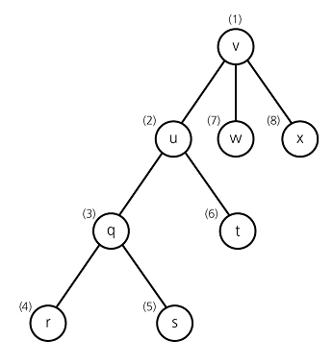
Depth-First Search – Example
A depth-first search of the
graph starting from vertex v.
Visit a vertex, then visit a vertex
adjacent to that vertex.
If there is no unvisited vertex adjacent
to visited vertex, back up to the previous
step.

Slide 18
Recursive Depth-First Search Algorithm
dfs(in v:Vertex) {
// Traverses a graph beginning at vertex v
// by using depth-first strategy
// Recursive Version
Mark v as visited;
for (each unvisited vertex u adjacent to v)
dfs(u)
}

Slide 19
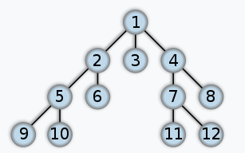
Breadth-First Search
After visiting a given vertex v, the breadth-first search algorithm visits every vertex adjacent to v that it can before visiting any other vertex.
The breadth-first traversal algorithm does not completely specify the order in which it should visit the vertices adjacent to v.
We may visit the vertices adjacent to v in sorted order.

Slide 20
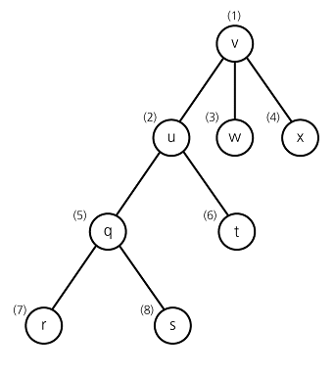
Breadth-First Search– Example
A breadth-first search of the
graph starting from vertex v.
Visit a vertex, then visit all vertices
adjacent to that vertex.

