Slide 1

Understanding Cryptography by Christof Paar and Jan Pelzl www.crypto-textbook.com
Chapter 4 – The Advanced Encryption Standard (AES)
These slides were prepared by Daehyun Strobel, Christof Paar and Jan Pelzl

Slide 2
Content of this Chapter
Overview of the AES algorithm
Internal structure of AES
  Byte Substitution layer
  Diffusion layer
  Key Addition layer
  Key schedule
Decryption
Practical issues
<number>/28

Slide 3
Content of this Chapter
Overview of the AES algorithm
Internal structure of AES
  Byte Substitution layer
  Diffusion layer
  Key Addition layer
  Key schedule
Decryption
Practical issues
<number>/28

Slide 4
Some Basic Facts
AES is the most widely used symmetric cipher today
The algorithm for AES was chosen by the US National Institute of Standards and Technology (NIST) in a multi-year selection process
The requirements for all AES candidate submissions were:
  Block cipher with 128-bit block size
  Three supported key lengths: 128, 192 and 256 bit
  Security relative to other submitted algorithms
  Efficiency in software and hardware
<number>/28

Slide 5
Chronology of the AES Selection
The need for a new block cipher announced by NIST in January, 1997
15 candidates algorithms accepted in August, 1998
5 finalists announced in August, 1999:
  Mars – IBM Corporation
  RC6 – RSA Laboratories
  Rijndael – J. Daemen & V. Rijmen
  Serpent – Eli Biham et al.
  Twofish – B. Schneier et al.
In October 2000, Rijndael was chosen as the AES
AES was formally approved as a US federal standard in November 2001
<number>/28

Slide 6
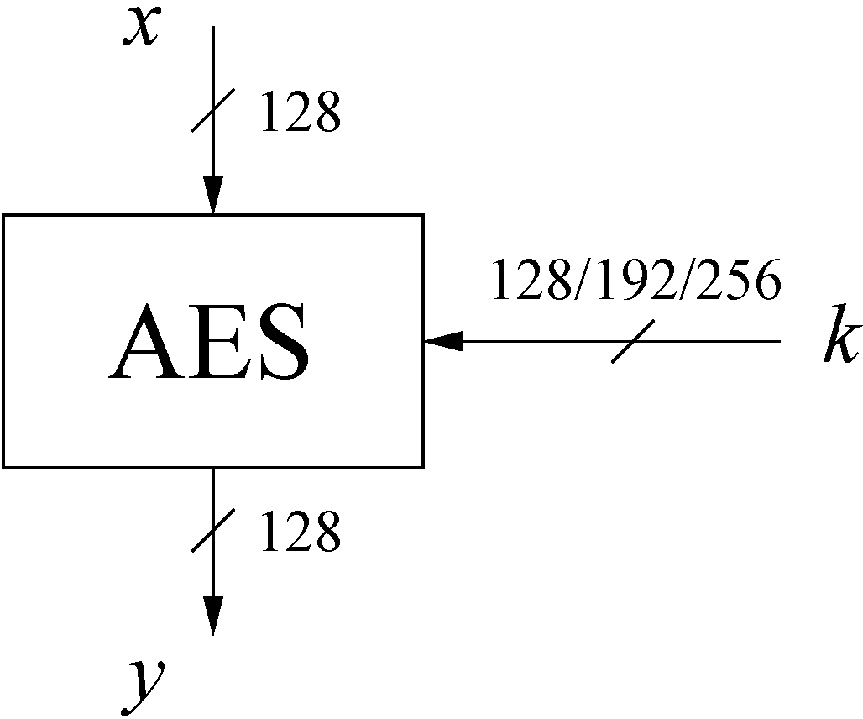
AES: Overview
The number of rounds depends on the chosen key length:
Key length (bits) | Number of rounds
128 | 10
192 | 12
256 | 14
<number>/28

Slide 7
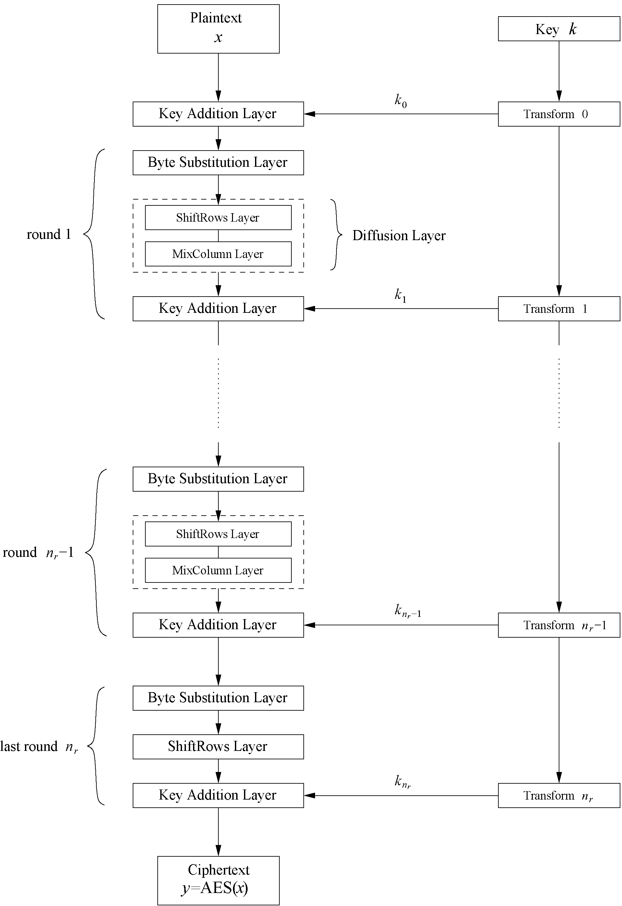
AES: Overview
Iterated cipher with 10/12/14 rounds
Each round consists of “Layers”
<number>/28

Slide 8
Content of this Chapter
Overview of the AES algorithm
Internal structure of AES
  Byte Substitution layer
  Diffusion layer
  Key Addition layer
  Key schedule
Decryption
Practical issues
<number>/28

Slide 9
Internal Structure of AES
AES is a byte-oriented cipher
The state A (i.e., the 128-bit data path) can be arranged in a 4x4 matrix:
with A₀,…, A₁₅ denoting the 16-byte input of AES
A₀ | A₄ | A₈ | A₁₂
A₁ | A₅ | A₉ | A₁₃
A₂ | A₆ | A₁₀ | A₁₄
A₃ | A₇ | A₁₁ | A₁₅
<number>/28

Slide 10
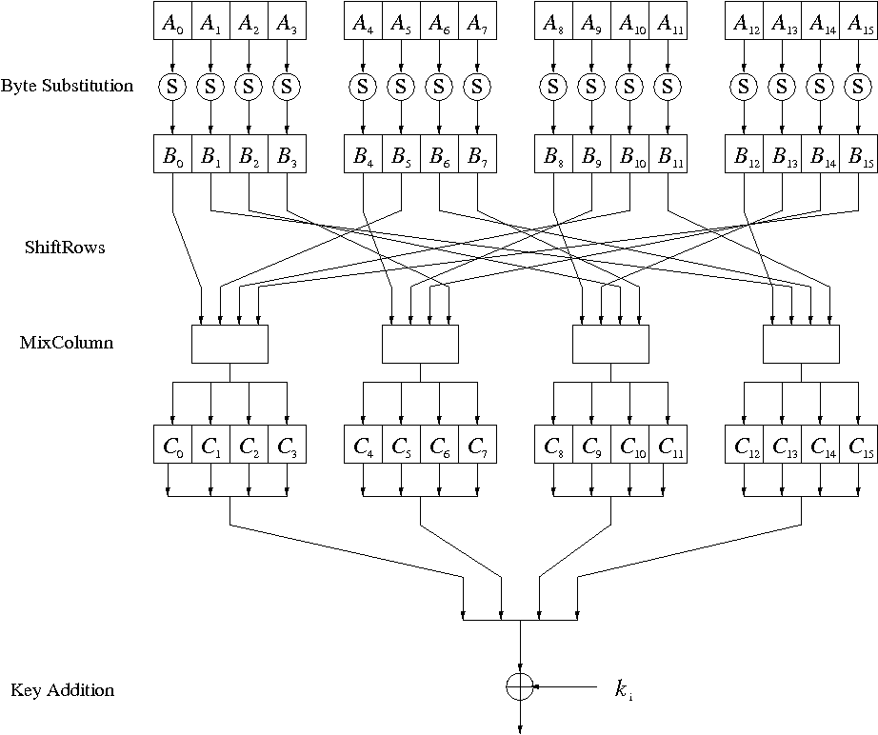
Internal Structure of AES
Round function for rounds 1,2,…,n_{r-1}:
Note: In the last round, the MixColumn tansformation is omitted
<number>/28

Slide 11
Byte Substitution Layer
The Byte Substitution layer consists of 16 S-Boxes with the following properties:
  The S-Boxes are
  identical
  the only nonlinear elements of AES, i.e.,
  ByteSub(A_{i}) + ByteSub(A_{j}) ≠ ByteSub(A_{i} + A_{j}), for i,j = 0,…,15
  bijective, i.e., there exists a one-to-one mapping of input and output bytes
  ⇒ S-Box can be uniquely reversed
In software implementations, the S-Box is usually realized as a lookup table
<number>/28

Slide 12
Diffusion Layer
The Diffusion layer
provides diffusion over all input state bits
consists of two sublayers:
  ShiftRows Sublayer: Permutation of the data on a byte level
  MixColumn Sublayer: Matrix operation which combines (“mixes”) blocks of four bytes
performs a linear operation on state matrices A, B, i.e.,
DIFF(A) + DIFF(B) = DIFF(A + B)
<number>/28

Slide 13
ShiftRows Sublayer
Rows of the state matrix are shifted cyclically:
Input matrix
Output matrix
B₀ | B₄ | B₈ | B₁₂
B₁ | B₅ | B₉ | B₁₃
B₂ | B₆ | B₁₀ | B₁₄
B₃ | B₇ | B₁₁ | B₁₅
B₀ | B₄ | B₈ | B₁₂
B₅ | B₉ | B₁₃ | B₁
B₁₀ | B₁₄ | B₂ | B₆
B₁₅ | B₃ | B₇ | B₁₁
no shift
← one position left shift
← two positions left shift
← three positions left shift
<number>/28

Slide 14
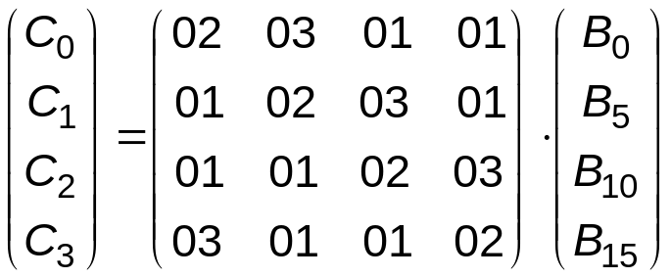
MixColumn Sublayer
Linear transformation which mixes each column of the
state matrix
Each 4-byte column is considered as a vector and multiplied
by a fixed 4x4 matrix, e.g.,
where 01, 02 and 03 are given in hexadecimal notation
All arithmetic is done in the Galois field GF(2⁸) (for more information see Chapter 4.3 in Understanding Cryptography)
<number>/28

Slide 15
Key Addition Layer
Inputs:
  16-byte state matrix C
  16-byte subkey k_{i}
Output: C ⊕ k_{i}
The subkeys are generated in the key schedule
<number>/28

Slide 16
Key Schedule
Subkeys are derived recursively from the original 128/192/256-bit input key
Each round has 1 subkey, plus 1 subkey at the beginning of AES
Key whitening: Subkey is used both at the input and output of AES
⇒ # subkeys = # rounds + 1
There are different key schedules for the different key sizes
Key length (bits) | Number of subkeys
128 | 11
192 | 13
256 | 15
<number>/28

Slide 17
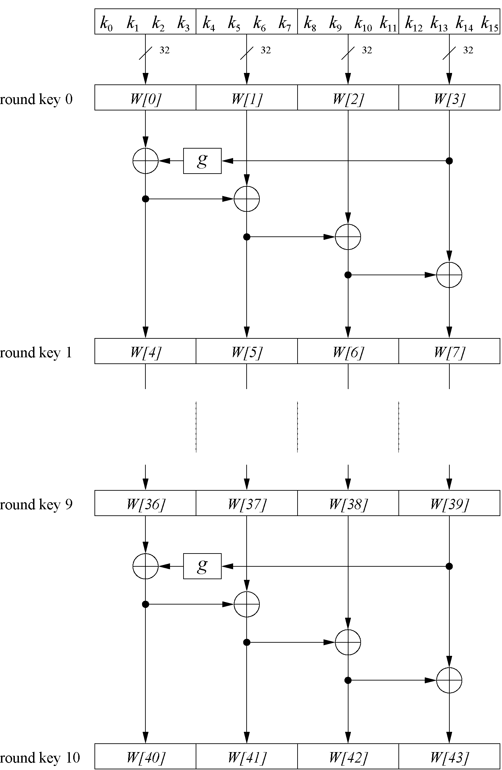
Key Schedule
Example: Key schedule for 128-bit key AES
Word-oriented: 1 word = 32 bits
11 subkeys are stored in W[0]…W[3], W[4]…W[7], … , W[40]…W[43]
First subkey W[0]…W[3] is the original AES key
<number>/28

Slide 18
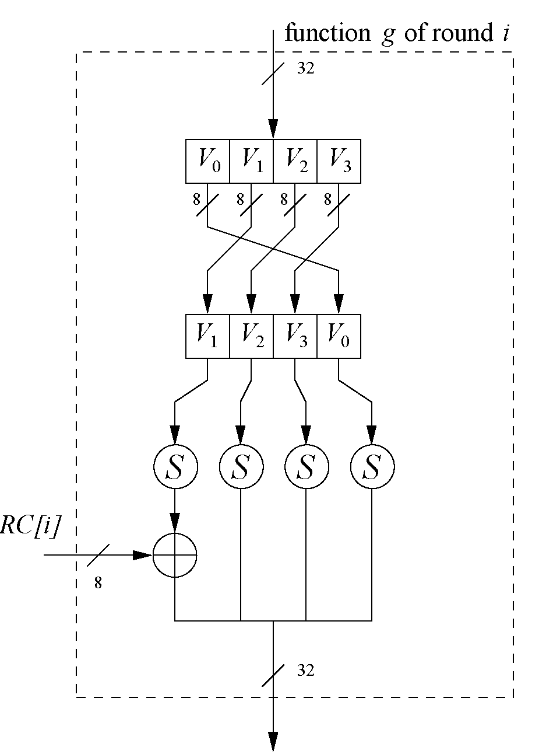
Key Schedule
Function g rotates its four input bytes and performs a bytewise S-Box substitution
⇒ nonlinearity
The round coefficient RC is only added to the leftmost
byte and varies from round to round:
RC[1] = x⁰ = (00000001)₂
RC[2] = x¹ = (00000010)₂
RC[3] = x² = (00000100)₂
...
RC[10] = x⁹ = (00110110)₂
x^{i} represents an element in a Galois field
(again, cf. Chapter 4.3 of Understanding Cryptography)
<number>/28

Slide 19
Content of this Chapter
Overview of the AES algorithm
Internal structure of AES
  Byte Substitution layer
  Diffusion layer
  Key Addition layer
  Key schedule
Decryption
Practical issues
<number>/28

Slide 20
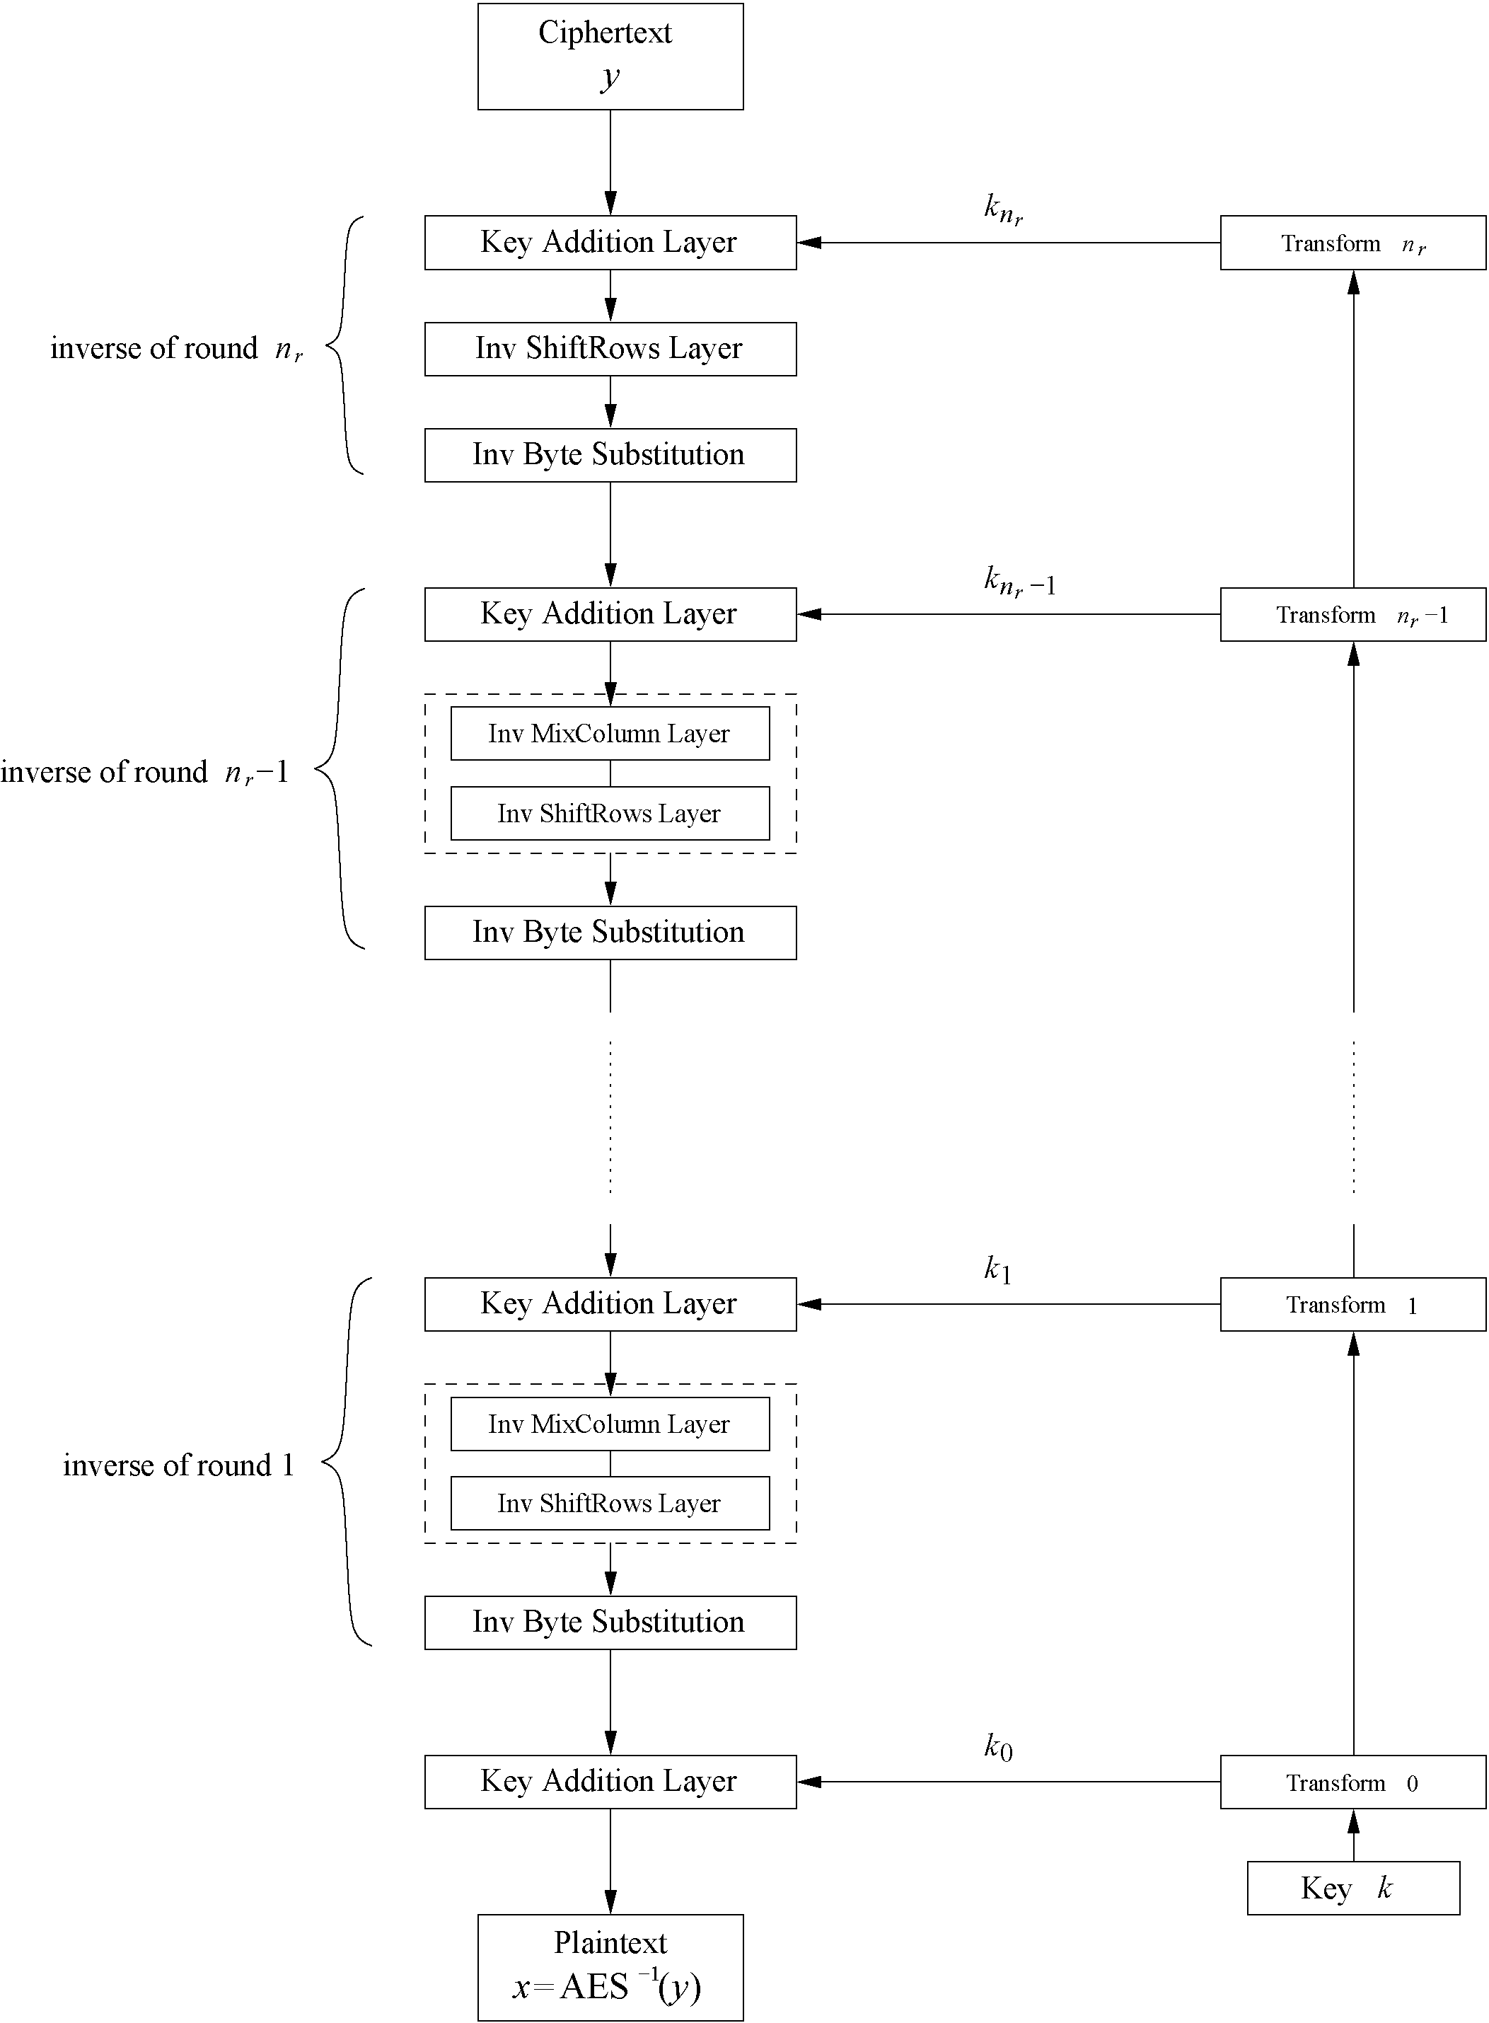
Decryption
AES is not based on a Feistel network
⇒ All layers must be inverted for decryption:
  MixColumn layer → Inv MixColumn layer
  ShiftRows layer→ Inv ShiftRows layer
  Byte Substitution layer → Inv Byte Substitution layer
  Key Addition layer is its own inverse
<number>/28

Slide 21
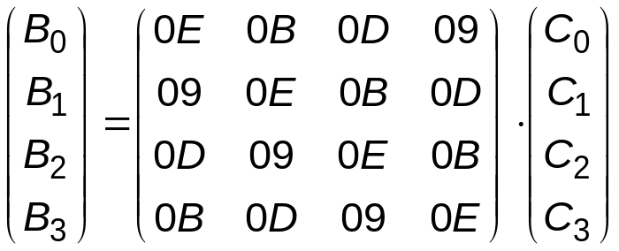
Decryption
Inv MixColumn layer:
  To reverse the MixColumn operation, each column of the state matrix C must be multiplied with the inverse of the 4x4 matrix, e.g.,
  where 09, 0B, 0D and 0E are given in hexadecimal notation
Again, all arithmetic is done in the Galois field GF(2⁸) (for more information see Chapter 4.3 in Understanding Cryptography)
<number>/28

Slide 22
Decryption
Inv ShiftRows layer:
  All rows of the state matrix B are shifted to the opposite direction:
  Input matrix
  Output matrix
B₀ | B₄ | B₈ | B₁₂
B₁ | B₅ | B₉ | B₁₃
B₂ | B₆ | B₁₀ | B₁₄
B₃ | B₇ | B₁₁ | B₁₅
B₀ | B₄ | B₈ | B₁₂
B₁₃ | B₁ | B₅ | B₉
B₁₀ | B₁₄ | B₂ | B₆
B₇ | B₁₁ | B₁₅ | B₃
no shift
→ one position right shift
→ two positions right shift
→ three positions right shift
<number>/28

Slide 23
Decryption
Inv Byte Substitution layer:
  Since the S-Box is bijective, it is possible to construct an inverse, such that
  A_{i} = S⁻¹(B_{i}) = S⁻¹(S(A_{i}))
  ⇒ The inverse S-Box is used for decryption. It is usually realized as a lookup table
Decryption key schedule:
  Subkeys are needed in reversed order (compared to encryption)
  In practice, for encryption and decryption, the same key schedule is used. This requires that all subkeys must be computed before the encryption of the first block can begin
<number>/28

Slide 24
Content of this Chapter
Overview of the AES algorithm
Internal structure of AES
  Byte Substitution layer
  Diffusion layer
  Key Addition layer
  Key schedule
Decryption
Practical issues
<number>/28

Slide 25
Implementation in Software
One requirement of AES was the possibility of an efficient software implementation
Straightforward implementation is well suited for 8-bit processors (e.g., smart cards), but inefficient on 32-bit or 64-bit processors
A more sophisticated approach: Merge all round functions (except the key addition) into one table look-up
  This results in four tables with 256 entries, where each entry is 32 bits wide
  One round can be computed with 16 table look-ups
Typical SW speeds are more than 1.6 Gbit/s on modern 64-bit processors
<number>/28

Slide 26
Security
Brute-force attack: Due to the key length of 128, 192 or 256 bits, a brute-force attack is not possible
Analytical attacks: There is no analytical attack known that is better than brute-force
Side-channel attacks:
  Several side-channel attacks have been published
  Note that side-channel attacks do not attack the underlying algorithm but the implementation of it
<number>/28

Slide 27
Lessons Learned
AES is a modern block cipher which supports three key lengths of 128, 192 and 256 bit. It provides excellent long-term security against brute-force attacks.
AES has been studied intensively since the late 1990s and no attacks have been found that are better than brute-force.
AES is not based on Feistel networks. Its basic operations use Galois field arithmetic and provide strong diffusion and confusion.
AES is part of numerous open standards such as IPsec or TLS, in addition to being the mandatory encryption algorithm for US government applications. It seems likely that the cipher will be the dominant encryption algorithm for many years to come.
AES is efficient in software and hardware.
<number>/28

