Slide 1

Presenting to you the:
PASSENGER POSITIONING SYSTEM

Slide 2
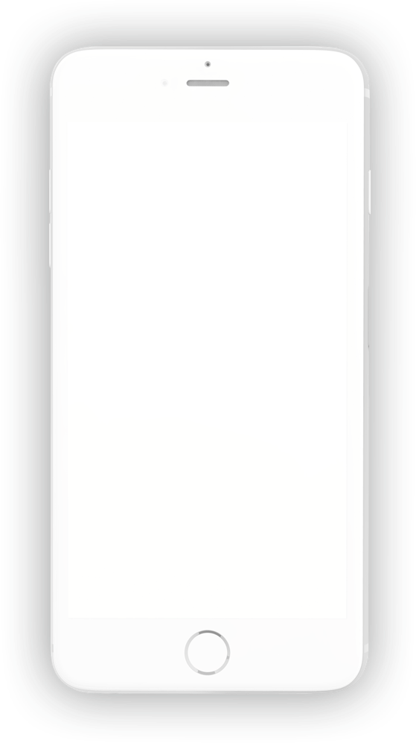

UI/UX DESIGN AND IMPLEMENTATION

Slide 3
Table Of Contents
01
02
Introduction
User Interface
03
User Experience
04
Implementation

Slide 4
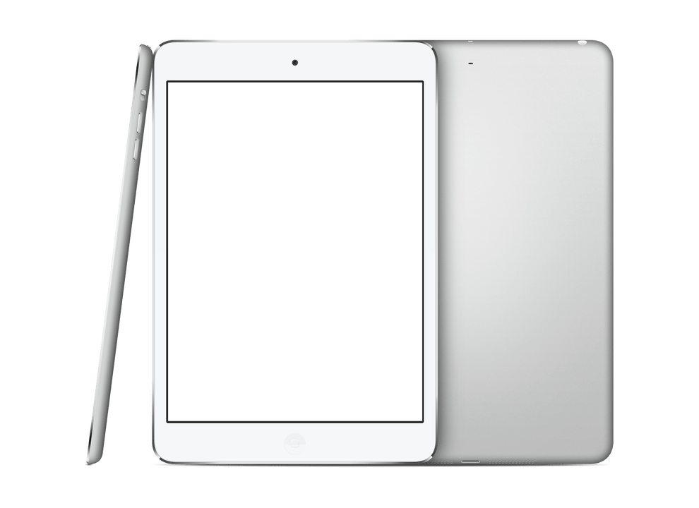
Introduction
Overview
Objective

Slide 5
User Interface
It is a space where interactions between human and machines occur. Applying knowledge of fundamental and visual design principles,we came up with some interfaces:
01
02
04
03
Sign Up
Verification
Dashboard
Login

Slide 6
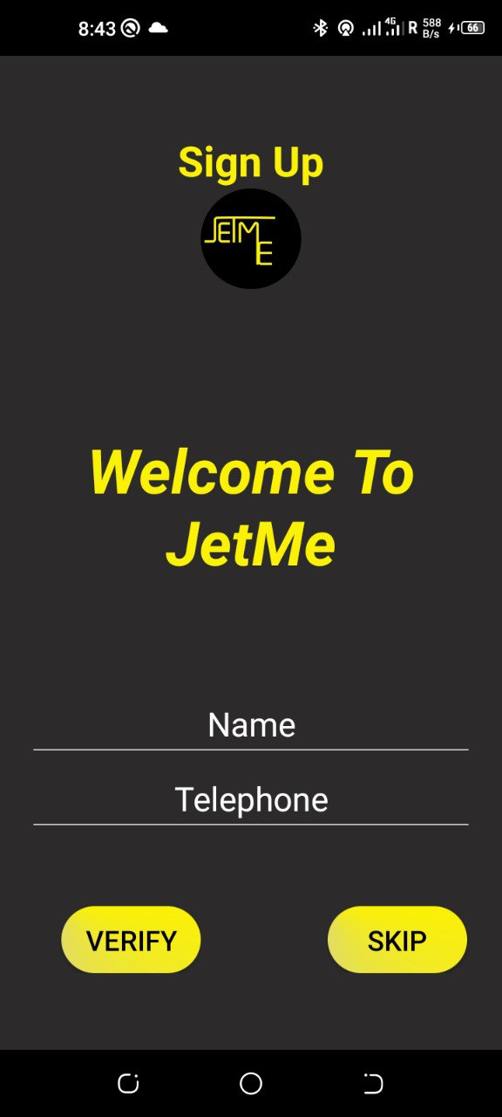
Sign Up
01

Slide 7
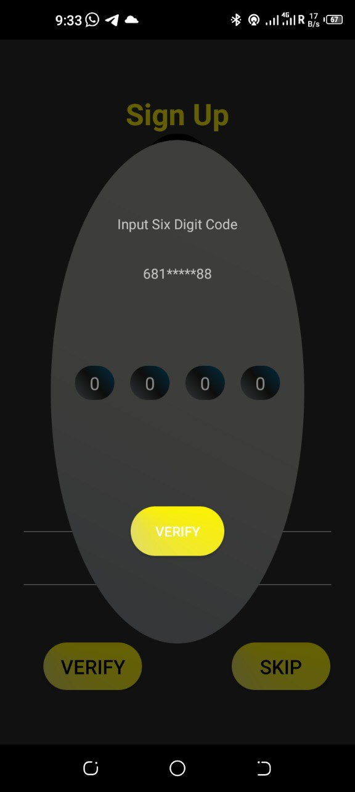
Verification
02

Slide 8
Dashboard
03

Slide 9
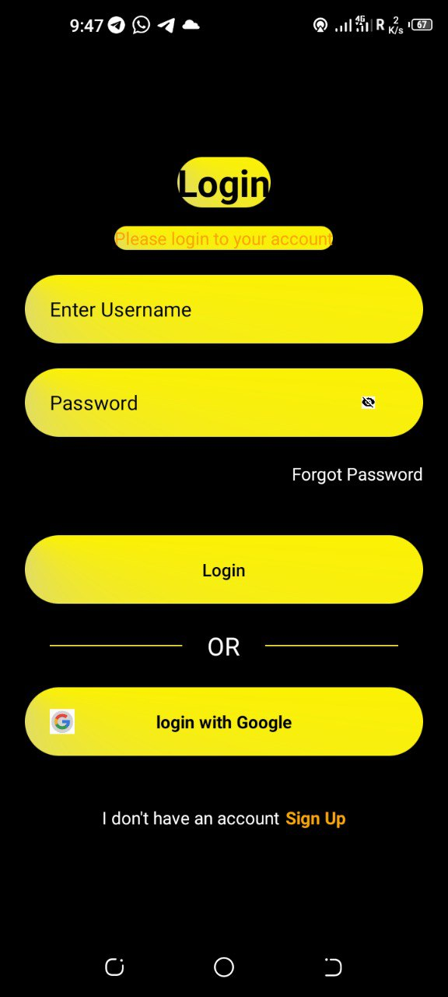
Login
04

Slide 10

Thank You!

