Slide 1
Digital Signatures

Slide 2
Content
Introduction to Digital Signature
Digital Signature Mechanism
Advantages and Disadvantages
A new efficient Digital Signature Algorithm Scheme
Performance Comparison
PKI vs OTPK : A proposed approach
Conclusion
References

Slide 3
Introduction to Digital Signatures
A digital signature is a mathematical method used to validate the authenticity and integrity of a message, software or any digital document.
Digital signatures provides the added evidence of origination, identity and status of an electronic message, as well as acknowledging informed consent by the signer.

Slide 4
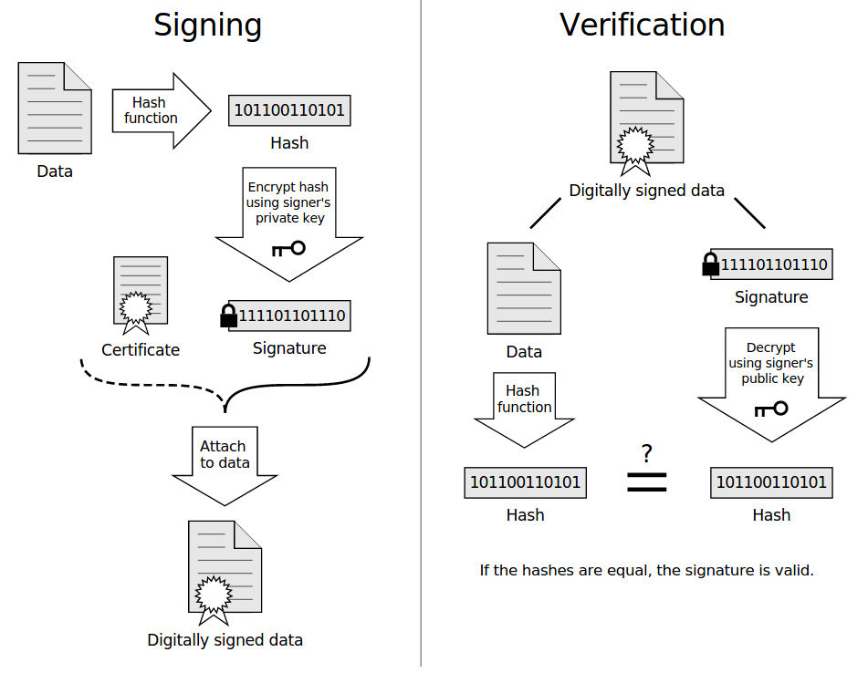
Digital Signature Mechanism :
Fig 1: Mechanism [1]

Slide 5
Advantages of Digital Signatures:
Non-Repudiation :
When a person digitally signs a document, he cannot later deny being the sender of it.
Imposter Prevention :
No one can copy your digital signature and pretend or submit any digitally signed document on your behalf, pretending to be you.
Time-stamp:
As digital signatures incorporate a time-stamping mechanism, it will keep a record of when the document was signed.
Security :
If the message has been altered in transit, it will create a different message digest on the receiver’s end and hence any fraudulent activity can be detected.

Slide 6
Disadvantages of Digital Signatures :
Compatibility :
Existence of many different digital signature standards, and most of them being incompatible with each other complicates the task of sharing digitally signed documents.
Certificates :
In order to exploit the advantage of digital signatures, both the sender and recipients may have to buy digital certificates from trusted C.A.

Slide 7
A New Efficient Digital Signature Scheme Algorithm based on Block cipher :
This paper proposes a new variant of digital signatures which is constructed upon the two hard problems namely prime factorization and discrete logarithms.
It has been proved that to break this algorithm one has to solve both of the above mentioned problems simultaneously.
It does not need any prime number for its working.

Slide 8
Proposed Technique
Part 1: Key Generation
1) Private key is denoted by “d”
2) Public keys are denoted by “n” and “e”.
Step 1: Here value of n is fixed to 37.
Step 2: Choose any invertible matrix “k”. An invertible matrix means a matrix “k” for which an inverse”k⁻¹” exists. i.e. (k * k⁻¹ )mod 37= I (Identity matrix).
Step 3: Select any integer value and multiply it with “k”. This is the private key. i.e. d=(integer_value * k) mod 37.
Step 4: Find: (integer)⁻¹ and k⁻¹. Then e= (integer)⁻¹ * k^{-1.}
Announce “n” and “e” as public keys and “d” as private key.
Part 2 : Signature=(m*private_key)mod n.

Slide 9

Example : Part 1: Generating Keys.
1) n = 37
2) integer =3
3) Matrix k= $\begin{matrix}2 & 1 \\ 4 & 5\end{matrix}$
4) Private key: d=integer * matrix = 3 * $\begin{matrix}2 & 1 \\ 4 & 5\end{matrix}$ = $\begin{matrix}6 & 3 \\ 12 & 15\end{matrix}$
5) Inverse of 3 is 25. Verify: (3)*(25)mod 37 =1.
6) Inverse of Matrix:
K⁻¹ = $\begin{matrix}7 & 6 \\ 24 & 25\end{matrix}$
Verify : $\begin{matrix}2 & 1 \\ 4 & 5\end{matrix}$ * $\begin{matrix}7 & 6 \\ 24 & 25\end{matrix}$ mod 37 = $\begin{matrix}38 & 37 \\ 148 & 149\end{matrix}$ mod 37 =$\begin{matrix} 1 & 0 \\ 0 & 1\end{matrix}$
7) Calculate e :
e = (integer)⁻¹ * (k)⁻¹
e = $\begin{matrix}7 & 6 \\ 24 & 25\end{matrix}$ * 25 mod 37 = $\begin{matrix}27 & 2 \\ 8 & 33\end{matrix}$

Slide 10

Part 2 : Sending message ( Alice sends to Bob)
Sending String “ DEAN OMAR “ which has equivalent numerals as 4,5,1,14,15,13,1,18.
We have a 2*2 matrix, therefore we are blocking entire message in two characters each block.
For 4,5 : $\begin{matrix}2 & 1 \\ 4 & 5\end{matrix}$ * $\begin{matrix}4 \\ 5\end{matrix}$ mod 37 = $\begin{matrix}39 \\ 123\end{matrix}$ mod 37 = $\begin{matrix}2 \\ 12\end{matrix}$
Similarly, other values have been calculated 2,12,11,0,18,5,23,23.
Bob verifies Alice’s signature using public key and message.
$\begin{matrix}2 \\ 12\end{matrix}$ * $\begin{matrix} 27 & 2 \\ 8 & 33\end{matrix}$ mod 37 = $\begin{matrix} 78 \\ 412\end{matrix}$ mod 37 = $\begin{matrix}4 \\ 5\end{matrix}$ ….. Equivalent to “DE”.
Similarly he derives others using public key 4,5,1,14,15,13,1,18. Now received message and signature are same. Therefore his message has been verified and accepted.

Slide 11
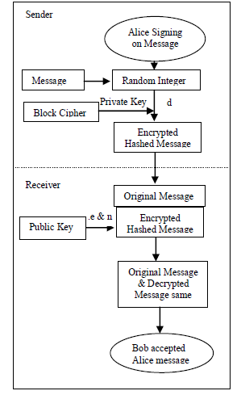
Flow Diagram of the Proposed Algorithm:
Fig 2: Flowchart [2]

Slide 12
Performance Comparison :
Algorithm | No. of Characters | Execution Time
RSA Digital Signature | 100 | 5.6 seconds
Elgamal Digital Signature | 100 | 6.2 seconds
Elliptic Curve | 100 | 5.4 seconds
MD5 | 100 | 5.2 seconds
Proposed DSS | 100 | 5.2 seconds
Table 1: Proposed Algorithm comparison [2]

Slide 13
Public Key Infrastructure (PKI):
PKI is a set of standards, procedures, software, and people for implementing authentication using public key cryptography.
It also provides other things such as authenticating users, producing and distributing certificates, maintaining, managing and revoking certificates.

Slide 14
Traditional PKI Working:
Step 1) Application server sends the document to be signed to the client server (user) for Digital Signature.
Step 2) The user inserts the card/ token/ pen drive / perform the biometrics as given & instructed by Certificate Authority (C.A. )
Step 3) The user follows the instructions given by C.A. and the Digital Signature is created.
Step 4) This digital signature is then sent to the “time-stamp” server for stamping date, time etc.
Step 5) Application server, from time to time, uses OCSP protocol for look-up and follows up.

Slide 15
Problems with traditional PKI :
1) Cost Factor:
Cost of Smartcard/ USB token, cost of deployment etc.
2) High overheads:
Massive Logistics, Helpdesk support, Cost of certificates etc.
3) Lack of Mobility:
Conventional PKI is designed for a computer, not for mobiles.

Slide 16
The OTPK Concept:
The main idea of OTPK is utilization of a one-time password.
For every transaction or communication, user will always generate a new Private Key and register securely with the C.A. so that it can be issued a digital certificate.
Instead of being allotted a smartcard to contain a one-year certificate, each user is first authenticated with strong metrics(e.g. biometrics) and then request for certificates, each time a digital signature is required.
Once the private key has been used, or if it expires, the Private key is erased and discarded.

Slide 17
OTPK Working :
Phase 1 : Registration
User is first allotted a 2FA OTP token. The OTP can be sent through SMS, email etc. If required a face-to-face verification will take place.
If everything works well, i.e. if it’s a genuine user, he will be granted access to the C.A. for certificate issue.
Phase 2 : Signing
When a digital signature is required, the user has to download an OTPK module.
The OTPK module will generate a public-private key pair.
The OTPK module will send the certificate request to CA, which in turn issues short term certificate.
OTPK module then returns the digital signature of the transaction and discard the private key.
User now possesses certificate and digital signature without any private key.

Slide 18
Advantages of OTPK
1) No need of smart cards/USB :
Since the Private key is only generated only when needed and discarded after use, the use of smart cards/USB is not required for storage and protection of private keys.
2) Smaller chances of being compromised:
Firstly, new private key is generated every-time a new message is to communicated. Secondly, the duration of validity of Private Key is extremely short after which it is erased.
3) Security:
A strong 2-factor authentication is ensured to the C.A.

Slide 19
Issues with OTPK :
1) Online C.A. :
As the C.A. issues certificates in real-time and for every transaction, it may be overloaded/flooded by fake-certificate requests.
2) Secure Private Key Deletion :
In traditional PKI, proof of private key destruction is by destruction of smartcard/USB itself.
In OTPK, a properly designed software complying with FIDS(Federal Information Processing Standards) enforcement is a must.

Slide 20
Conclusion :
Digital Signature provides security from imposters pretending to be you and sending documents on your behalf.
Digital Signatures framework provides a promise that no person can deny being the sender of a document if it contains his digital signature.
PKI has its own disadvantages such as mobility, cost etc. and OTPK can be an alternate to it.

Slide 21
References :
Wikipedia
“A New Efficient Digital Signature Scheme Algorithm based on Block cipher”, Saeed Q Y Al-Khalidi, Mohammed Appa.
“Digital Signature on-line, One Time Private Key [OTPK]”, Vinod Vaze.
“Survey on Techniques Developed using Digital Signature: Public key Cryptography “, Shivendra Singh, Arunima Jaiswal.

Slide 22
THANK YOU!

