Slide 1


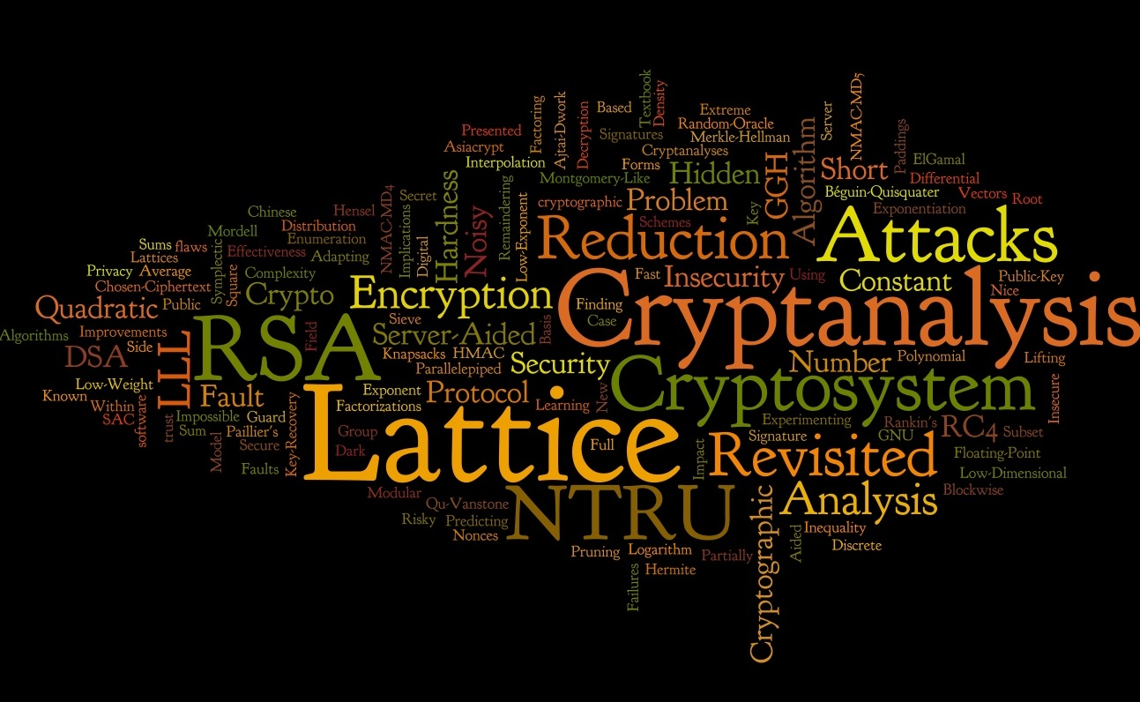
Message Authentication Codes
A comparative study

Slide 2
Message Authentication Code
Used for maintaining integrity of data, that is, detect any unauthorized tampering or modification.
Most commonly used for securing important files on system or maintaining integrity of communication over the network
Concept is somewhat similar to CRC (Cyclic Redundancy Check) checksums (insecure MAC)
Secure MACs can only be verified by parties that share a secret information (MAC Key)
Some common types of MAC -
CBC-MAC
NMAC
HMAC

Slide 3
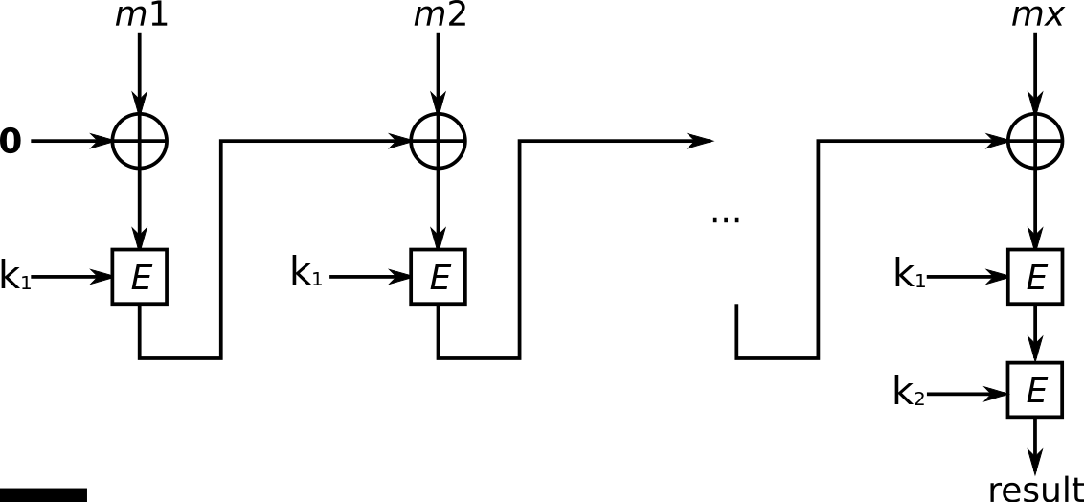
CBC-MAC
Encrypted Cipher Block Chaining – Message Authentication Code (also called ECBC-MAC)
Operation similar to CBC mode of encryption
CBC-MAC mode of operation. (Source: Wikipedia)

Slide 4
CBC-MAC
Advantages
Underlying function used is secure (PRFs ?).
Requires only two keys.
Disadvantages
Sequential execution
Requires padded dummy blocks

Slide 5
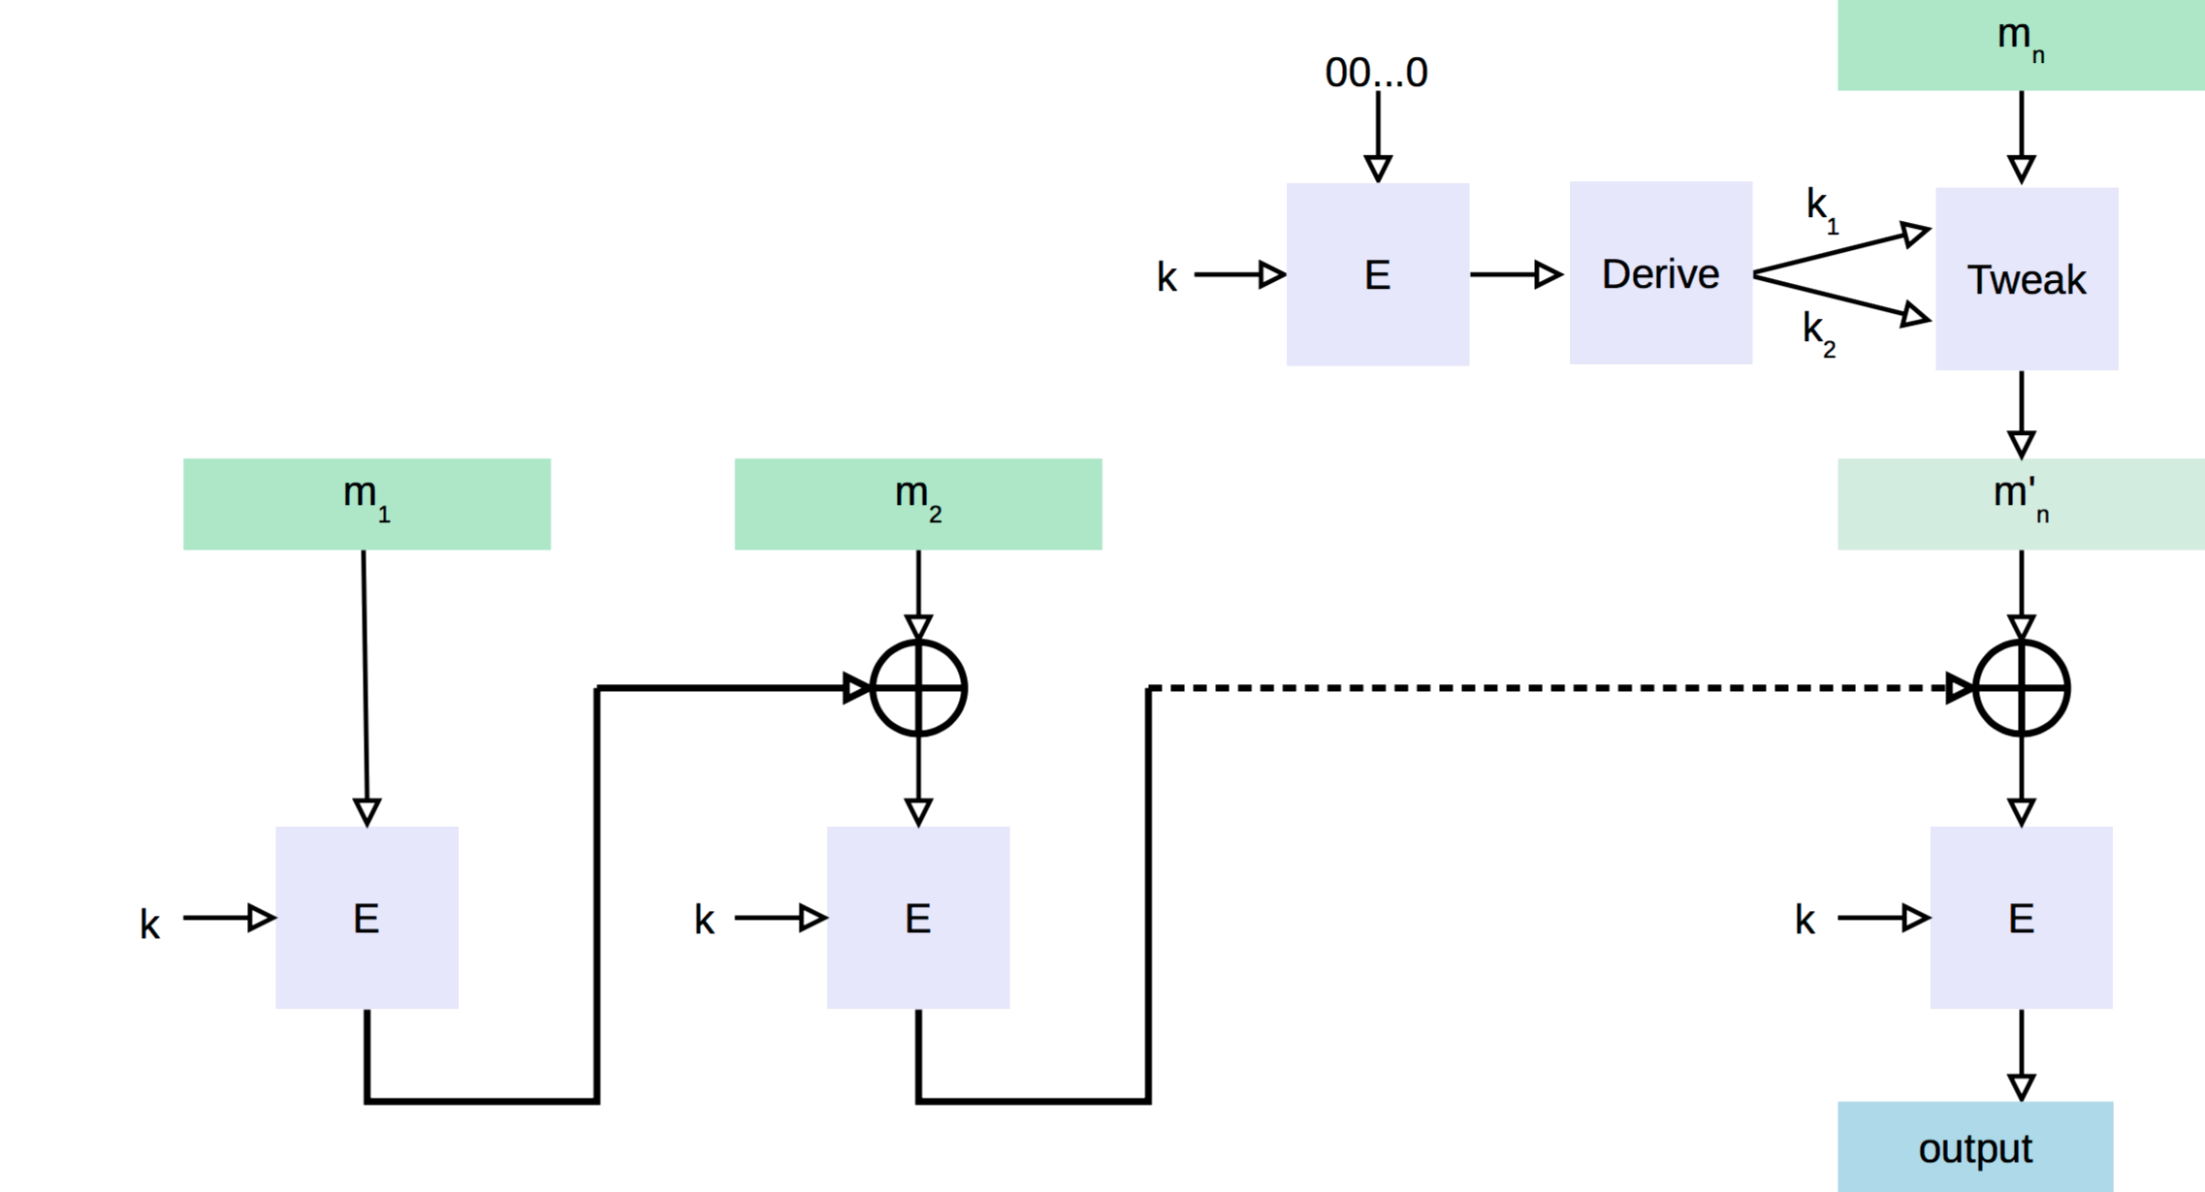
CMAC
Figure: CMAC mode of
Operation (Source: Wikipedia)
A modification of CBC-MAC (Also called OMAC-1)
Uses two extra keys, that are derived from k (original key)
Advantages over CBC-MAC
Eliminates the need of padded dummy block
Eliminates the extra step (last) used in CBC mode of operation

Slide 6
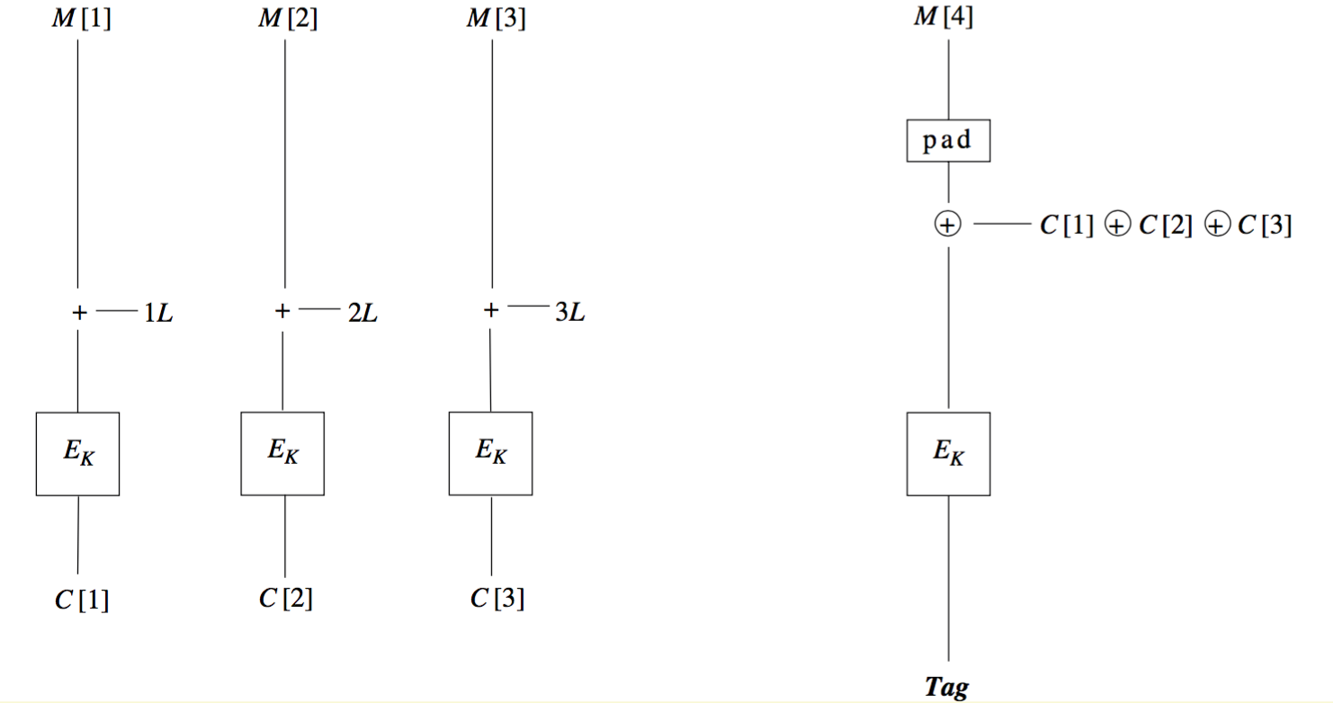
PMAC
Parallelizable Message Authentication Code
Parallel execution of each block of message
Incremental when the underlying function is PRP (invertible)
Figure: PMAC mode of
Operation^{[3]}

Slide 7
PMAC
Advantages
Underlying function used is secure.
Parallel computation possible
Incremental if the underlying function is a PRP (Invertible)

Slide 8
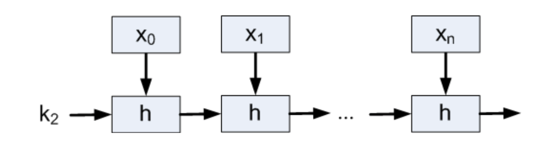
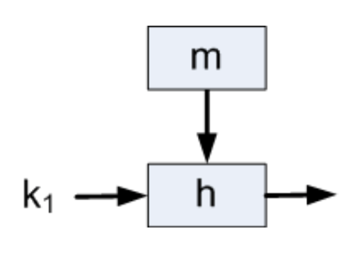
NMAC
Nested Message Authentication Code
Uses two keys instead of one
Message is first compressed using cascading hash function and then this output is fed to another hash function with the second key
Figure: NMAC mode of operation^{[4]}

Slide 9
NMAC
Advantages
As compared to CBC, output of each block is of the size of key
Disadvantages
Requires two keys
Requires extra block of padding (if message is a direct multiple of block size)

Slide 10
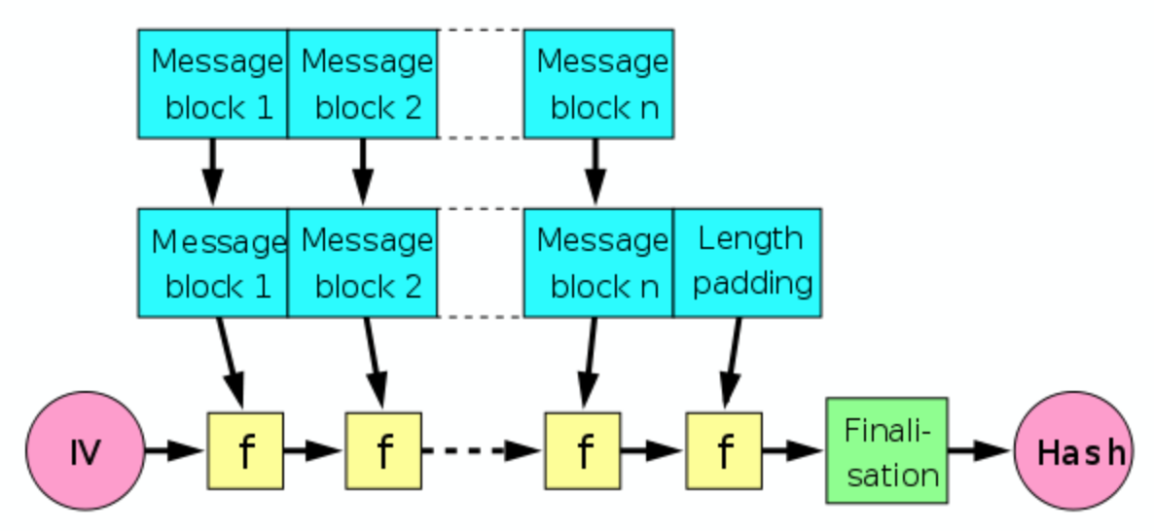
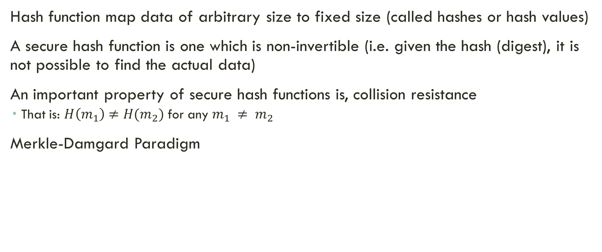
Collision Resistance & Hash functions
Hash function map data of arbitrary size to fixed size (called hashes or hash values)
A secure hash function is one which is non-invertible (i.e. given the hash (digest), it is not possible to find the actual data)
An important property of secure hash functions is, collision resistance
That is: $H\left(m_{1}\right)≠H(m_{2})$ for any $m_{1} ≠ m_{2}$
Merkle-Damgard Paradigm
If each hash function ‘f’ is collision resistant, then the entire chain/construct is collision resistance.

Slide 11
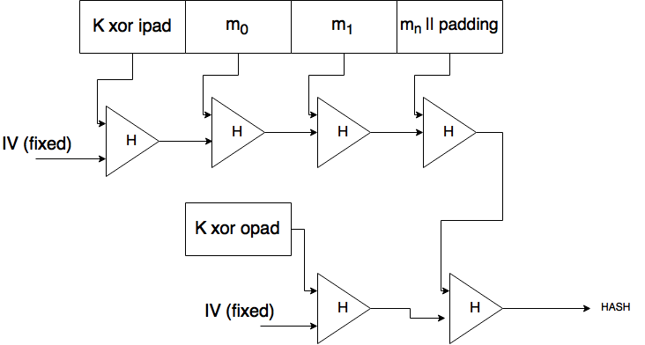
Hash-Based MAC (HMAC)
The standardized implementation uses two pads (ipad & opad) which are constants and a fixed IV

Slide 12
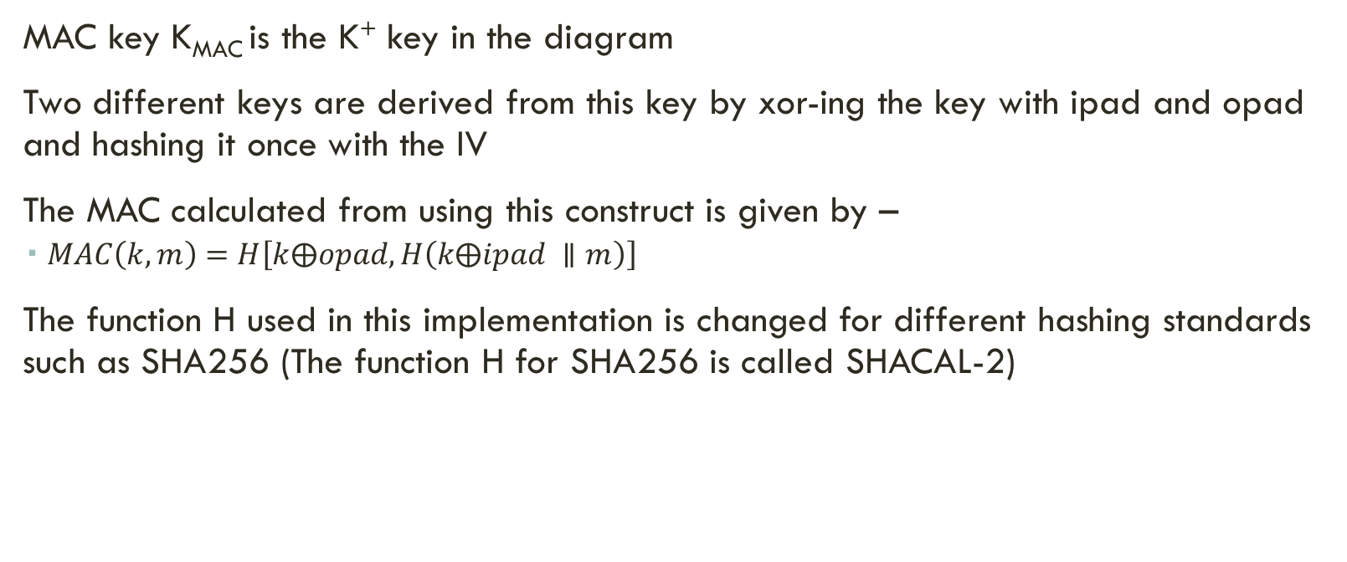
HMAC
MAC key K_{MAC} is the K⁺ key in the diagram
Two different keys are derived from this key by xor-ing the key with ipad and opad and hashing it once with the IV
The MAC calculated from using this construct is given by –
$MAC\left(k,m\right)=H\left[k⨁opad, H\left(k⨁ipad ∥m\right)\right]$
The function H used in this implementation is changed for different hashing standards such as SHA256 (The function H for SHA256 is called SHACAL-2)

Slide 13
MD5
An implementation of HMAC
Input block size 512 bits; Output block size 128 bits.
Modes of operation-
Prefix Approach
MD(k.m) – Key is added as a prefix to the message and the passed to the Merkel-Damgard chain
Two key approach
MD(k1 . MD(k2 . m)) – k1 and k2 are two independent 128 bit keys
Padded approach
MD(k . p . m . k) – p is a 384 bit of padding
Derived Key Approach
MD(k1 . MD(k2 . m))
k1 = MD(k, α)
k2 = MD(k . β)

Slide 14
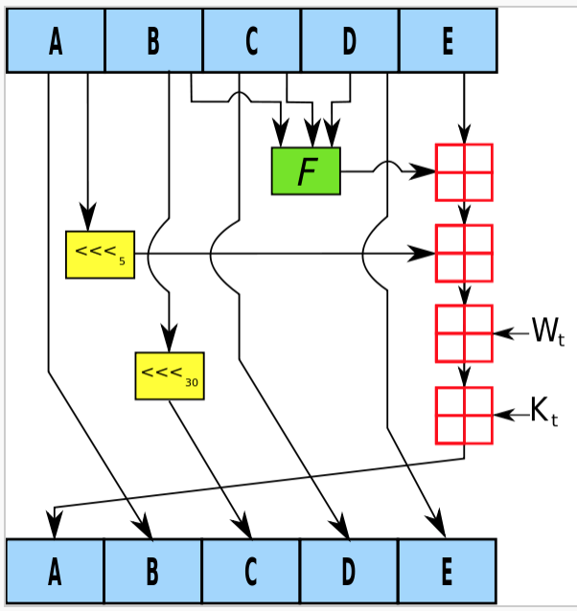
SHA-1
Input block size 512bits; Digest size 160 bits
The message is padded before digesting as described before.
It involves two buffers, each of which have five 32bit words.
It also involves a sequence of eighty 32bit words.
The words of the first 5-word buffer are named A,B,C,D and E.
The words of the second 5-word buffer are named H0,H1,H2,H3 and H4.
The words of the eighty word sequence are named W(0),W(1).......W(79).
To obtain the message digest, the individual message blocks of 512bits each processed in order.
After processing, the message digest is the 160bit string given by the 5 words H0 H1 H2 H3 H4 [4].
Figure: SHA-1 internal structure (Source: Wikipedia)

Slide 15
SHA-1
Advantages
More secure than MD5
Easily available
Disadvantages
Collisions have been found
Currently estimated cost of collision is between $75,000 - $120,000 using Amazon EC2 cloud^{[5]}

Slide 16
References
[1] A Review on Cryptographic Hashing Algorithms for Message Authentication by Nishant Sahni
[2] OMAC: One-Key CBC MAC by Tetsu Iwata and Kaoru Kurosawa
[3] PMAC: A Parallelizable Message Authentication Code by Phillip Rogaway
[4] Modern Cryptography Lecture on NMAC by Nitesh Saxena
[5] Freestat Collision for SHA-1 URL: https://sites.google.com/site/itstheshappening/

Slide 17
Thank You!
Akash Singh

