Slide 1

Emakia Project
LangChain Open AI
Corinne David - CEO, CTO and Founder Emakia
corinne@emakiatech.com
https://www.linkedin.com/in/corinnedavid/

Slide 2
Addressing Gaps in AI for Toxicity Detection
Toxicity Filtering: Similar to how spam is classified into your Spam folder, text classifiers can be used to filter out toxicity on social media platforms.
Real-World Application: Emakia is building an iPhone app using a Core ML text classifier to support users by filtering toxic content.
Lack of Validation: In both academia and industry
Enhancing AI Systems:
Expand datasets
Improve AI model knowledge
Validate model outputs using advanced tools:
Large Language Models (LLM)
Retrieval-Augmented Generation (RAG)

Slide 3
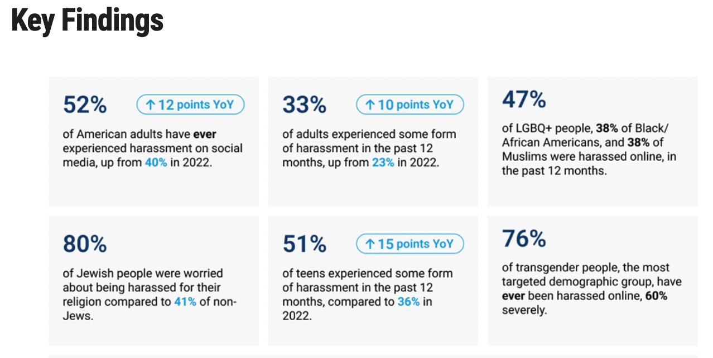
Inspiration
Emakia was inspired by the pressing need to combat online harassment and its detrimental effects on marginalized communities like women, people of color, and LGBTQI+ individuals. Addressing these challenges helps protect mental wellbeing and ensures freedom of expression in the digital space.
Anti-Defamatory League ADL organization 2023

Slide 4
Code & Data Resources
Code Repository: Emakia Project GitHub
Contains the code for Twitter search integration and Google Cloud toolkit setup.
Data Resource: Emakia Dataset on Kaggle
Access the dataset used for training and validating models.

Slide 6
Introduction to API Integration
Evaluate Labels with
Gemini
RAG and evaluate library
Facebook’s RoBERTa Hate Speech Model
OpenAI’s Moderation API
IBM’s MAX-Toxic-Comment-Classifier
Evaluate Labels with meta-llama/LLaMA-2
Google Vertex AI Text Classifier with Node.js
Deploying and running a model classifier on collected data.
Evaluating model predictions with various approaches.

Slide 7
Hackathon Participation - Devpost Women Techmakers
Event: Women Techmakers hackathon by Google
Project: Emakia Toxicity Filtering Validation on Devpost
Submission Date & Time: Nov 13, 2024 @ 12:00pm PST
Emakia Toxicity Filtering Validation on Devpost
Women Techmakers Devpost Nov 13, 2024 @ 12:00pm PST
Women Techmakers OnAir
Google AI
She Builds AI Studio Workshop
Google Gemini Cookbook on GitHub
Notes:
Mie

Slide 8
Hackathon Presentation Overview
Langchain with OpenAI
Approach 1: Analyze statements and respond with 'positive' or 'negative'.
Approach 2: Analyze statements and explain the sentiment.
Gemini
Apply similar approaches as Langchain and present comparative results and insights.

Slide 9
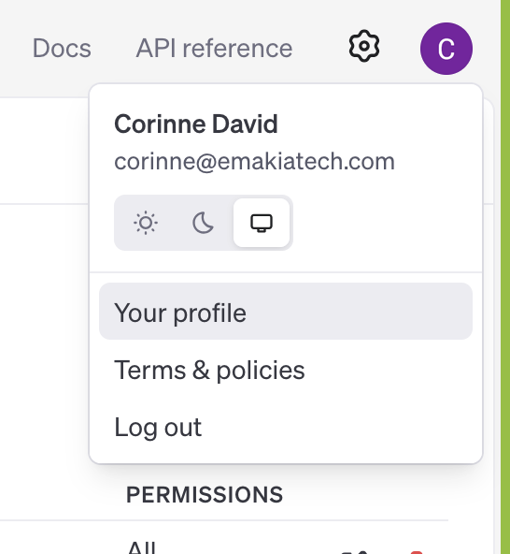
Accessing API Keys for OpenAI and Hugging Face
Open AI account
Open ai key needed
https://platform.openai.com/api-keys
https://platform.openai.com/docs/overview
Hugging Face account
Hugging Face tokens needed
https://huggingface.co/corinneDavidEmakia
https://huggingface.co/settings/tokens

Slide 10
Langchain_openai Integration
Description: OpenAI provides advanced AI models for various applications.
LangChain: An open source framework to simplify LLM application creation.
LangChain-OpenAI: Enhances capabilities by chaining multiple LLM calls.

Slide 11
Configuring the Environment and Virtual Setup
.env File: Set up environment variables
OPENAI_API_KEY=...
LANGCHAIN_TRACING_V2="true"
export LANGCHAIN_PROJECT=default
Virtual Environment Setup Create: python3 -m venv env
Activate: source env/bin/activate
Install: pip install langchain_openai

Slide 12
Evaluation Scripts and data
evaluateLabelswithLangchain.py
resultsfromLabelValidation.py
evaluate-with-lexicon.py
tweets-labels.csv
Explanation-evaluateLabelswithLangchain.docx
https://github.com/Emakia-Project/emakia/tree/main/LLM-RAG-Toxicity-Evaluator/lang-chain-openai

Slide 13
Performance Analysis
True Positive (TP): 31.50%
True Negative (TN): 41.68%
False Negative (FN): 24.68%
False Positive (FP): 2.12%
Accuracy: 73.18% correct, 26.8% mislabeled or not predicted correctly .
Analysis of Mislabeling
False Positive (FP) Snippet: Review content that appears correctly labeled despite being predicted as neutral.
False Negative (FN) Snippet: Evaluate offensive or problematic language classified as positive.

Slide 14
Code Explanation: Importing Libraries
langchain.prompts.PromptTemplate: Used to create prompt templates for language models.
langchain_core.runnables.base.RunnableSequence: Used to create sequences of runnables.
langchain_openai.OpenAI: Used to interact with OpenAI’s API.

Slide 15
Initializing OpenAI API Key and Client Setup
Accessing and Printing the API Key:
api_key = os.getenv("OPENAI_API_KEY")
Retrieves the OpenAI API key from the environment variables.
Initializing the OpenAI Client:
llm = OpenAI(temperature=0, openai_api_key=api_key)
Initializes the OpenAI client with the API key and sets the temperature to 0 (deterministic responses).

Slide 16
Prompt Template for Sentiment Analysis
template = """You are a sentiment analyst. Analyze the following statement and respond with either "positive" or "negative".
Statement: {content}
YOUR RESPONSE:
"""
prompt_template = PromptTemplate(input_variables=["content"], template=template)
Creates a prompt template for sentiment analysis, where {content} will be replaced with the actual content to analyze.

Slide 17
Summary: Efficient Search and Data Storage
Code Snippet: Sentiment Analysis with LangChain
content_chain = prompt_template | llm
review = content_chain.invoke({"content": content}).strip('"')
This code combines a prompt template and the OpenAI client into a sequence to perform sentiment analysis.

Slide 18
RunnableSequence in LangChain
A RunnableSequence in LangChain is a series of components where each output serves as the input for the next. This structure is essential for building complex workflows, like sentiment analysis pipelines.
Purpose of RunnableSequence:
Streamlines the execution of multiple tasks in a defined order.
Ensures each step receives the necessary input from the previous step.
Simplifies managing and executing complex workflows.

Slide 19
Any Questions? Thank you, for your time.

