Slide 1
Game Theory-based Strategic Approach To Ensure Reliable Data Transmission In Mobile Ad-hoc Networks
Emmanuel Joshy
4NM20CS069

Slide 2
Introduction
Mobile Ad hoc Networks (MANETs) are decentralized wireless networks with mobile nodes that move independently and self-organize.
Research in MANETs focuses on reliable data transmission, especially in the presence of unreliable radio links.
A mechanism is needed to encourage nodes to forward packets even through unreliable links.
The proposed mechanism combines game theory and trust-based reputation evaluation to increase packet forwarding utility.
Performance metrics include energy efficiency, throughput, network burden, and successful packet forwarding rate.

Slide 3
Problem Statement
Mobile Ad hoc Networks (MANETs) are characterized by their dynamic and decentralized nature, making them challenging for reliable data transmission and efficient network operation. In these networks, nodes are often self-centered and may not cooperate readily.
The problem is exacerbated by the presence of unreliable communication links and limited energy and memory resources in mobile nodes.
Thus, the primary problem is to design a strategic approach that leverages game theory principles to incentivize nodes to cooperate in data transmission while considering energy constraints and network reliability in the context of evolving MANETs.

Slide 4
Literature Review
Evolutionary game theoretical concepts: Evolutionary game theory is a popular mathematical approach used to analyze strategic interactions among decentralized nodes in Mobile Ad hoc Networks (MANETs). It helps model and defend against different attack scenarios by considering these interactions as non-cooperative games. This approach has been applied to enhance security, particularly against severe threats, and to optimize communication in vehicular networks.

Slide 5
Literature Review
Incentive-based conceptual mechanism: Incentive-based mechanisms aim to encourage self-centered nodes to collaborate instead of hoarding resources. Regular nodes forward both their own and others' data packets, while self-centered nodes often drop packets to save resources for their own goals. This non-cooperation negatively impacts communication reliability and efficiency, making the network vulnerable to attacks. Incentive-based strategies fall into three categories: virtual currency, reputation-based, and game theory-based solutions. These approaches aim to promote cooperation and enhance network performance.

Slide 6
Methodology
System Overview:
The system considers dynamic nodes in a specified region with free movement.
It uses a one-hop data forwarding approach to enhance node interaction.
The system identifies nodes not willing to participate in packet forwarding.
It includes a re-transmission scheme and assesses packet dropping by non-cooperative nodes.
Trustworthiness of nodes and their unreliable links is checked to determine the retransmission plan.
Game theory modeling enforces cooperation among mobile nodes.
The main goal is to increase successful data packet transmission with low network burden.
Timestamps are set for packet re-transmission to improve energy utilization during route formation.

Slide 7
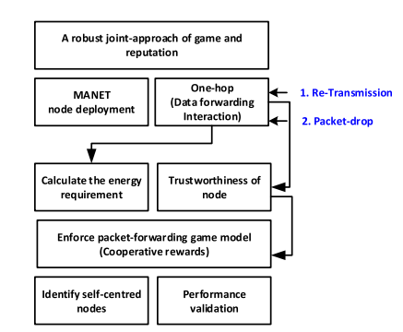
Methodology

Slide 8
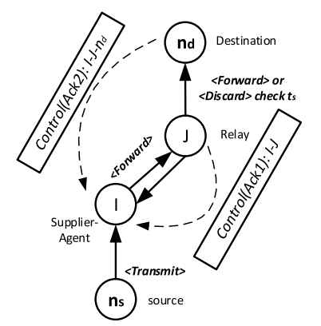
Methodology
Data transmission modelling with cooperative forwarding:
This adopts one-hop data transmission modelling, where game theory is applied to assess the intention of self-centered nodes that have connectivity with the unreliable radio-links.
Figure shows a scenario to showcase the data transmission modelling between two different nodes: source node (ns) and destination node (nd) though intermediate relays I and J.

Slide 9
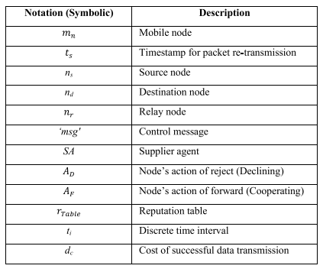
Methodology
Data transmission modelling with cooperative forwarding:
Figure illustrates how through two intermediate relays where one relay node (nr) acts as supplier-agent (SA) the communication takes place in terms of both control (Ack1) data packet and control (Ack2) data packet.
Both the packets are control signal carrying information corresponding to the acknowledgement. Here, J is I’s 1-hop neighbour when the destination node is considered within the formulated route.

Slide 10
Methodology
Game strategy to stimulate packet forwarding:
Input: Receive input parameters including source node (ns), destination node (nd), the network area (A), and a timestamp (ts).
Output: The algorithm aims to achieve cooperative message transmission.
Start: Initiates the algorithm.
Perform MANET node deployment within the specified area (A), where node density is defined by ρ(v,e).
Enable mobility modeling to simulate node movement.

Slide 11
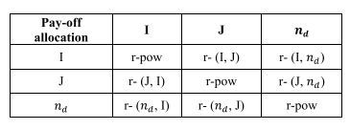
Methodology
Game strategy to stimulate packet forwarding:
For each time instance (ti):
a. Select a subset of mobile nodes (-→mn).
b. Examine the routing table <ns, nd> (rTable) to establish a path.
c. If energy of the relay node (nr) is above a defined cut-off:
i. Set a counter (p) and transmit the message until the p-th interval.
ii. Ensure the reception of control signals (Ack1 and Ack2).
iii. If successful, relay the message (msg).
iv. Update the routing tables of supplier-agent SA(I) and relay node Relay(J).
d. If control signal (Ack1) is not received, increment the counter (p) until it reaches the timestamp (ts).
e. If control signal (Ack2) is not received, drop the relayed packet and update the routing table of Relay (J)
f. If all control signals are received successfully, end transmission.
End: Concludes the algorithm.

Slide 12

Methodology
Game strategy to stimulate packet forwarding:
The successful transmission probability for the maximum limit of ts can be computed using :
The study also indicated the cost of successful data transmission with dc and that could be computed with respect to the number of packet retransmission count with 1 ≤ p ≤ ts . Here, the dc can be derived using :
From above, it can be stated that with one interaction, if a packet does not reach the intended destination within a specified time interval, then the failure cost arises as p × ts. Here, Φ indicates the probability of the events that might occur, and a flag F < 0|1 > is used to indicate the success or failure of the event.

Slide 13

Methodology
Game strategy to stimulate packet forwarding:
The pay-off calculation is done depending upon the probability of each node and their respective gain gpay−off. If both I and J opt the AF, then, in that case, the total pay-off can be computed using:
Here, k indicates a positive integer and its value lies in the range 0 ≤ k ≤ 4. Similarly, the pay-off for every gain of normal and self-centered nodes is calculated.

Slide 14
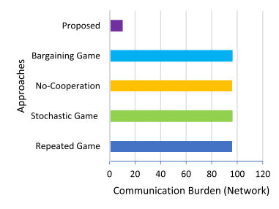
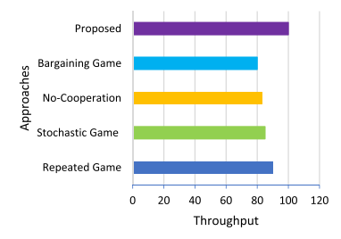
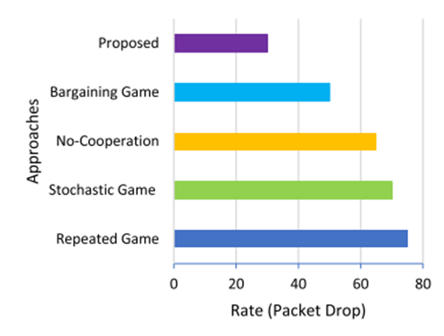
Results and Discussion
Figure 1 illustrates comparative communication burden outcomes, with the proposed system showing reduced network burden through reputation updating and assessment, efficient utilization of computational and network resources, and bandwidth.
Figure 2 and 3 showcase throughput and rate of packet drops, with the proposed approach achieving approximately 30% improvement in throughput performance and lower packet drop rates compared to existing methods.

Slide 15
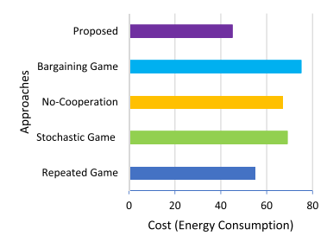
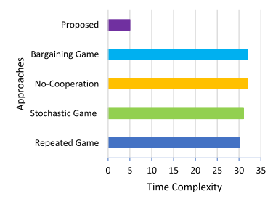
Results and Discussion
Figure 1 presents the cost of energy consumption, demonstrating that the proposed approach significantly reduces energy consumption compared to other conventional baseline models, with approximately 50 J of energy consumption.
Figure 2 indicates the execution time of the proposed algorithm, which is 4 seconds, demonstrating efficient computational and communication performance.

Slide 16
Results and Discussion
Baseline game theoretical approaches such as the Bargaining game approach refers to a simple two player game where negotiation factor is involved during packet transmission with bargaining interactions.
No-cooperation game means not a single individual relay node will cooperate during packet transmission and it is a game-based approach where competition between individual players can be seen.
Stochastic game modeling refers to a dynamic game modeling where probabilistic transitions take place by different individual players in progressive stages.
Repeated game is a well-studied two-person game which employs repetition factors of different base-games.

Slide 17
Conclusion
In conclusion, emphasizes the importance of maximizing packet forwarding in MANETs, even when dealing with unreliable radio links.
It recognizes the challenges posed by resource-constrained, self-configuring mobile nodes in MANETs, where network topology dynamically changes without centralized control.
To address these challenges, the study introduces an intelligent packet forwarding approach based on an evolutionary one-hop packet forwarding game model.

Slide 18
References
[1] U. I. Khan, R. F. Olanrewaju, F. Anwar, A. R. Najeeb, and M. Yaacob, ‘‘A survey on MANETs: Architecture, evolution, applications, security issues and solutions,’’ Indonesian J. Electr. Eng. Comput. Sci., vol. 12, no. 2, pp. 832–842, 2018, doi: 10.11591/ijeecs.v12.i2.pp832-842.
[2] R. F. Olanrewaju, B. U. I. Khan, F. Anwar, B. R. Pampori, and R. N. Mir, ‘‘MANET security appraisal: Challenges, essentials, attacks, countermeasures & future directions,’’ Int. J. Recent Technol. Eng. (IJRTE), vol. 8, no. 6, pp. 3013–3024, 2020, doi: 10.35940/ijrte.E6537.038620.
[3] G. H. Raghunandan, G. H. Chaithanya, and R. Hajare, ‘‘Independent robust mesh for mobile adhoc networks,’’ in Proc. 4th Int. Conf. Electron. Commun. Syst. (ICECS), Coimbatore, India, Feb. 2017, pp. 125–128, doi: 10.1109/ecs.2017.8067852.
[4] S. Kumar, M. L. Saini, and S. Kumar, ‘‘A survey: Swarm based routing algorithm toward improved quality of service in MANET,’’ Int. J. Manage., Technol. Eng., vol. 8, no. 5, pp. 311–322, 2018.
[5] T. Jamal and S. A. Butt, ‘‘Malicious node analysis in MANETS,’’ Int. J. Inf. Technol., vol. 11, no. 4, pp. 859–867, Dec. 2019, doi: 10.1007/s41870-018-0168-2.

