Slide 1
COURSE PROJECT
Inside Airbnb
A Multi-City Data Analytics Journey — Paris · London · Hong Kong
OUR TEAM
HE
EA
H
M
SE
Helana Emad
Eman Abdelnasser
Hager
Manar
Sohaila Elnagdy
Under the supervision of Eng. Shimaa Daowd
Inside Airbnb | Multi-City Analytics
1

Slide 2
THE DATASET
About the Data
Source: Inside Airbnb — a public, independently-run project publishing detailed Airbnb listing, calendar, and review data for cities worldwide.
Coverage: three major, geographically distinct markets — Paris, London, and Hong Kong.
Cleaning: removed missing values and duplicate records, and standardized column formats across the three raw city files.
Integration: merged the three cleaned city datasets into a single unified dataset, making cross-city comparison and analysis far simpler.
Paris
Cleaned
(nulls & duplicates removed)
London
Hong Kong
One Unified
Merged Dataset
Inside Airbnb | Multi-City Analytics
2

Slide 3
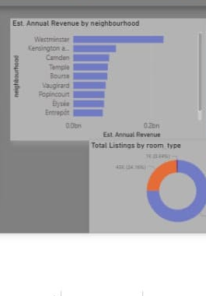
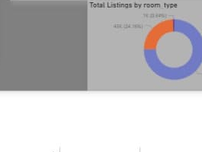
POWER BI · PAGE 1
Dashboard — Executive Overview
Built a 3-page interactive Power BI report on top of the unified dataset.
KPI cards summarize the full portfolio: 176K total listings, ~$2bn estimated annual revenue, $276.65 average price, 27% occupancy, and 20% superhosts.
A bar chart and donut chart break the portfolio down by neighbourhood revenue and room type mix.
Inside Airbnb | Multi-City Analytics
3

Slide 4
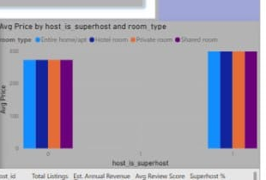
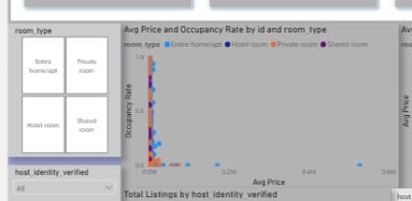
POWER BI · PAGE 2
Dashboard — Host Analysis
Zooms in on the 108K+ hosts behind the listings: average review score (4.74) and superhost share (20%).
Compares average price against occupancy rate, and average price by superhost status, across all four room types.
Inside Airbnb | Multi-City Analytics
4

Slide 5
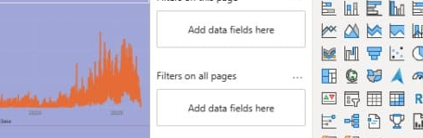
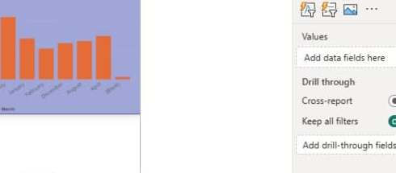
POWER BI · PAGE 3
Dashboard — Time Series & Seasonality
Tracks 931K total reviews over time as a practical proxy for booking demand, since raw booking data isn't published.
The estimated annual revenue trend highlights steady long-term growth in the Airbnb market across all three cities.
The monthly review breakdown reveals clear seasonality — busier and quieter months stand out immediately.
Inside Airbnb | Multi-City Analytics
5

Slide 6
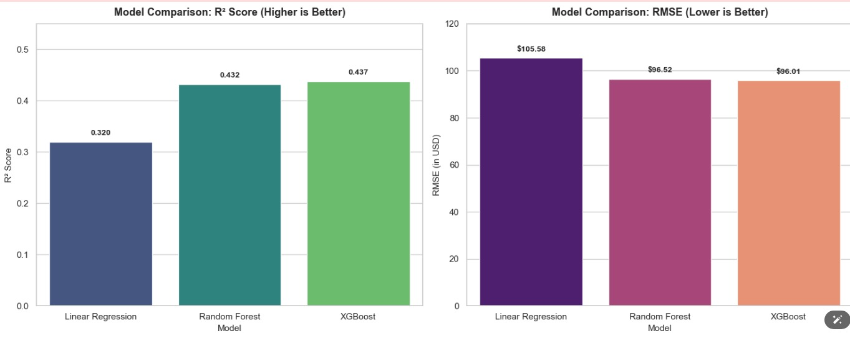
MACHINE LEARNING
Predicting Listing Price
Trained and compared three regression models to predict nightly price: Linear Regression, Random Forest, and XGBoost.
Evaluated each model with R² Score (higher is better) and RMSE in USD (lower is better).
XGBoost came out on top (R² = 0.437, RMSE = $96.01), narrowly ahead of Random Forest — both clearly outperform the simple Linear Regression baseline.
Inside Airbnb | Multi-City Analytics
6

Slide 7
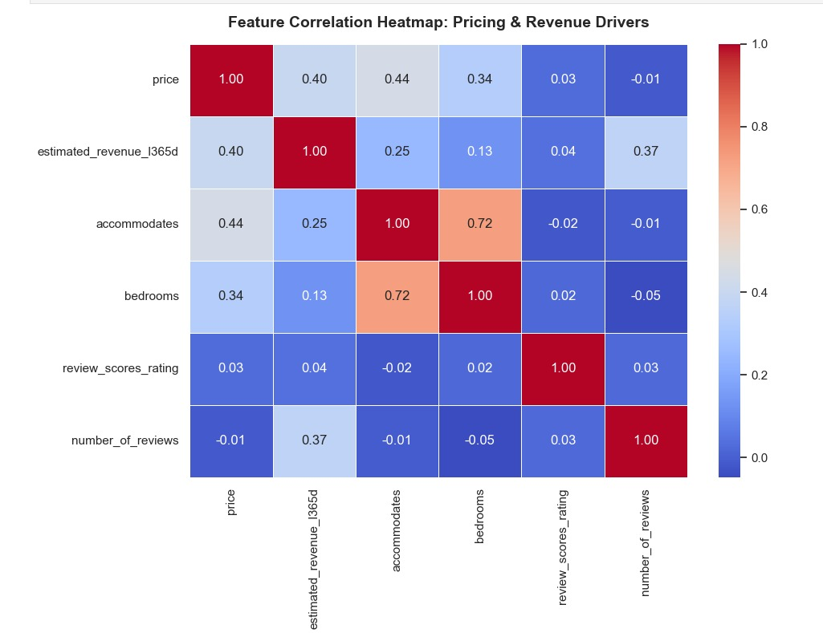
MACHINE LEARNING
What Drives Price & Revenue?
Correlation analysis across the key pricing and revenue features.
Accommodates (0.44) and bedrooms (0.34) show the strongest link to price — bigger listings simply cost more.
Review score and number of reviews are almost uncorrelated with price (≈ 0.03, − 0.01): guest ratings don't drive pricing.
Number of reviews correlates with revenue (0.37), since it reflects booking volume over time.
Inside Airbnb | Multi-City Analytics
7

Slide 8
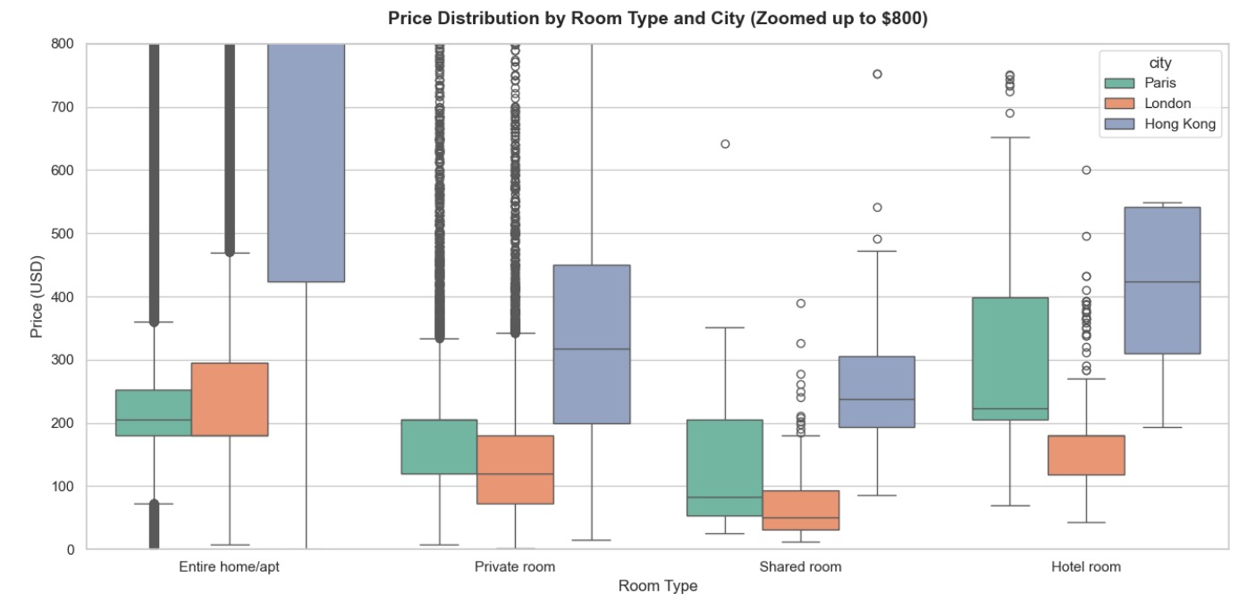
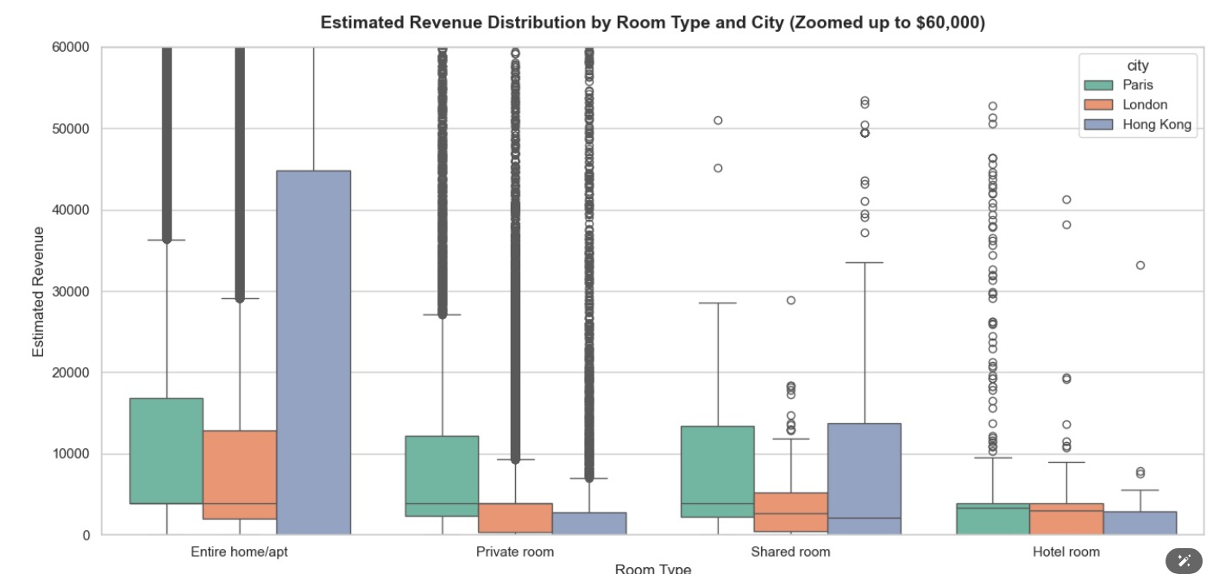
EXPLORATORY ANALYSIS
Price & Revenue by Room Type and City
Price distribution (USD)
Estimated revenue distribution
Hong Kong's entire homes/apartments command noticeably higher prices and revenue than equivalent listings in Paris and London.
All three cities show heavy-tailed, right-skewed distributions with many high-value outliers.
Inside Airbnb | Multi-City Analytics
8

Slide 9
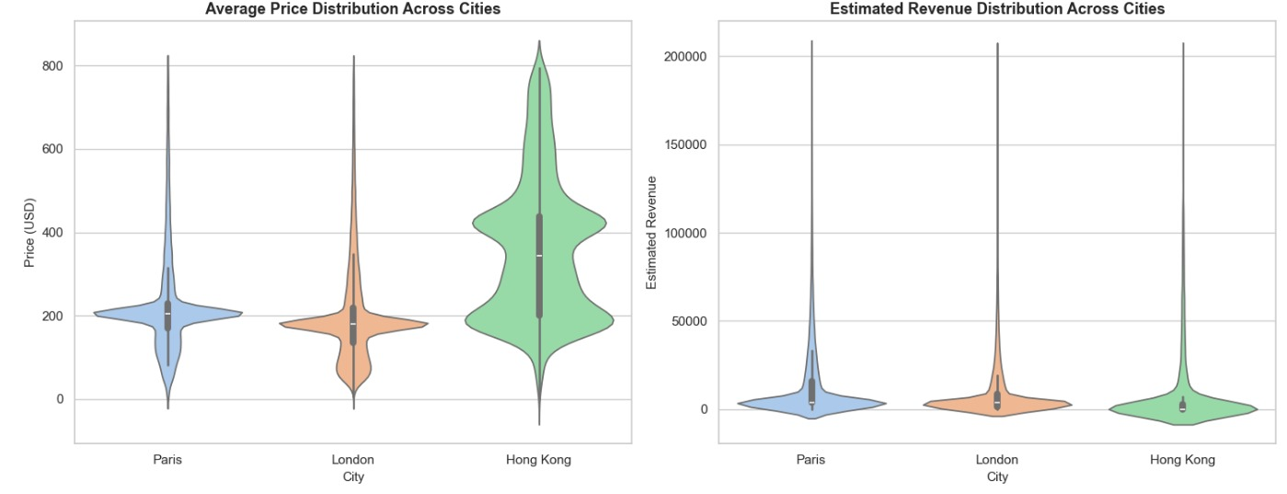
EXPLORATORY ANALYSIS
Price & Revenue Distribution Across Cities
Inside Airbnb | Multi-City Analytics
9

Slide 10
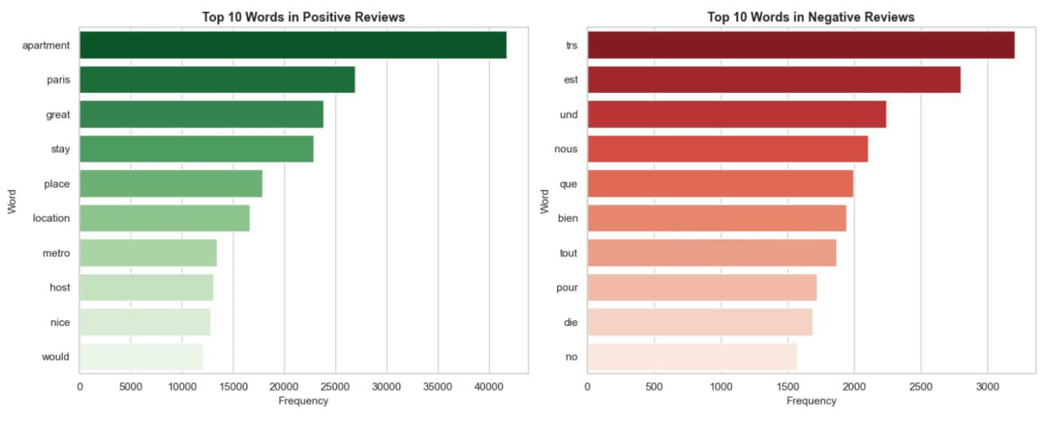
NLP · REVIEWS
What Are Guests Saying?
Applied NLP to the Reviews table to understand guest sentiment at scale.
Positive reviews are dominated by words like apartment, great, stay, place, and location — praising the space and its surroundings.
Many top "negative" words are simply French/German function words (très, est, und, nous) — a reminder that language mix, not necessarily complaints, shapes this view.
Inside Airbnb | Multi-City Analytics
10

Slide 11
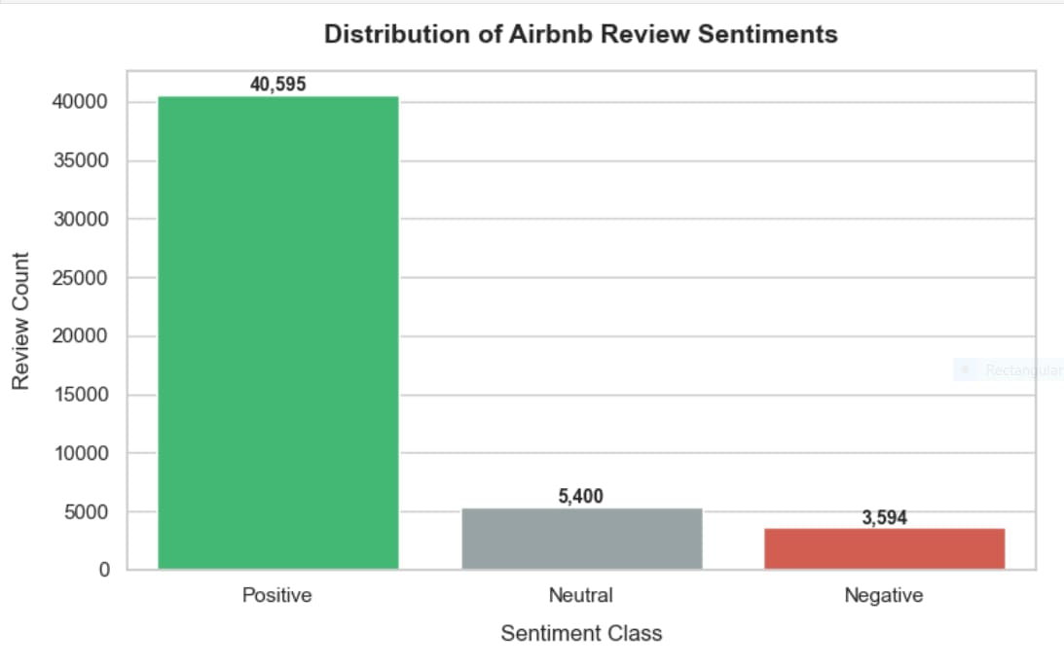
NLP · REVIEWS
Overall Sentiment Distribution
Scored 49,589 reviews with a sentiment analysis model.
40,595 Positive (82%), 5,400 Neutral (11%), 3,594 Negative (7%).
Confirms an overwhelmingly positive guest experience across all three cities.
Inside Airbnb | Multi-City Analytics
11

Slide 12
CONCLUSION
Key Takeaways
1
Hong Kong leads on price & revenue
2
Size beats reputation
But with far greater variability than Paris or London — a higher-risk, higher-reward market.
Accommodates and bedrooms drive price much more than review scores or review counts.
3
Tree-based models win
4
Guests are overwhelmingly happy
XGBoost and Random Forest clearly beat Linear Regression, though moderate R² shows price also depends on factors outside the dataset (location prestige, amenities, seasonality).
82% of reviews are positive across all three cities, reinforcing Airbnb's strong reputation.
Thank You
Inside Airbnb | Multi-City Analytics
12

