Slide 1
The safe

Slide 2
Introduction
Due to the advancement of science and technology throughout the world, there may be a consequent growth inside the fee and sophistication of crime. As an end result, it is important to make certain safety of oneself and one’s treasured belongings. In spite of the usage of mechanical locks, the crime price still has multiplied due to the truth that those locks are effortlessly damaged. Consequently, there may be a want for other varieties of locks like electronic locks

Slide 3
What is the Purpose of making a digital safe
The purpose of this project is to create a security system. it’s an automated tool that integrates various features, including the storage of important data such as home documents or other documents. The security of the files is ensured by passwords, like a real safe. which asks for a password before opening, the safe only opens if the password matches the correct password.

Slide 4
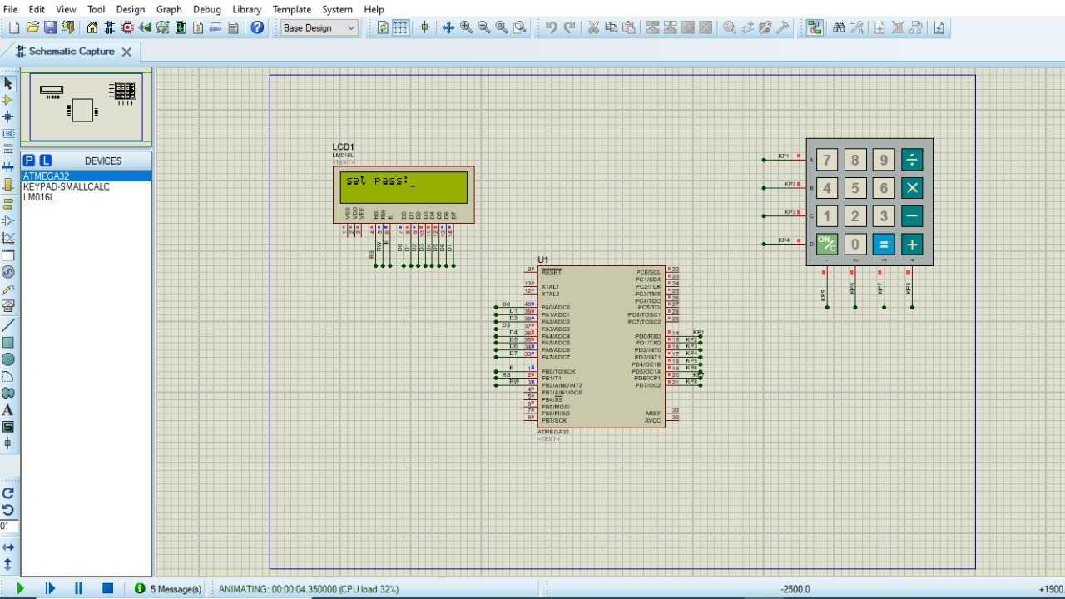
What is the components
-ATMega32 microcontroller
-2x16 lcd
-basic calculator Keypad
Keypad and lcd are connected with microcontroller to make an easy man-machine interface to make the system capable of performing the desired function

Slide 5
How it works
ATMega32 microcontroller: this is the brain of system which is programmed to take input from user through keypad, perform the desired operation and the display the appropriate messages on the provided 2x16 LCD.
Basic keypad: this is a 4x4 keypad which is interfaced with microcontroller with it’s each key assigned a specific number defined in the program .
2x16 LCD: this is the liquid crystal display module capable of displaying 32 characters in two rows. Microcontroller displays characters on it while taking inputs from user and to display the appropriate messages to user.

Slide 6
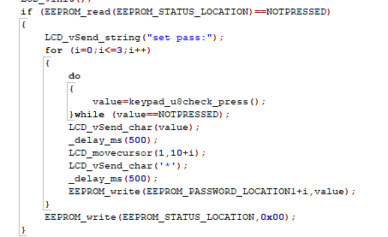
In the first step, we set password to a safe.

Slide 7
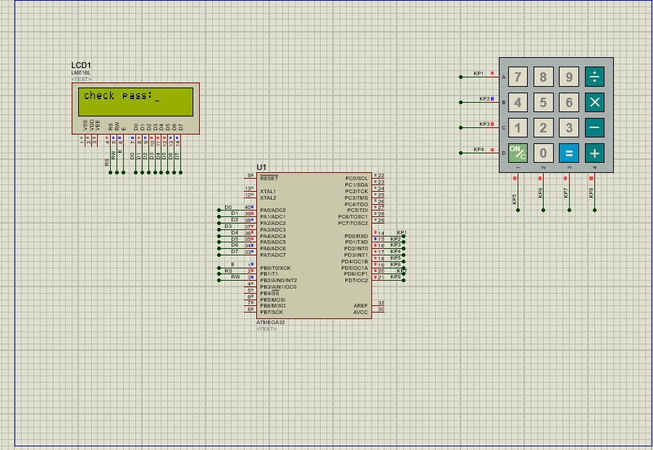
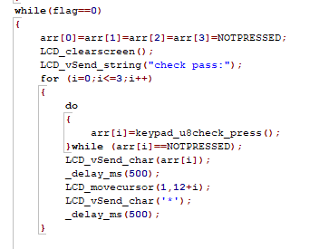
The second step, you enter the password you set before.

Slide 8
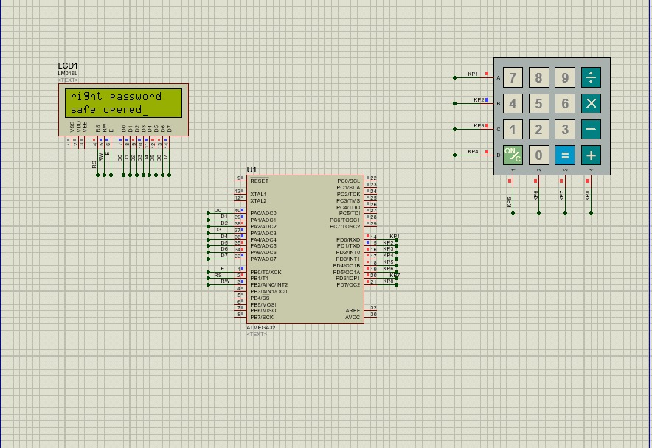
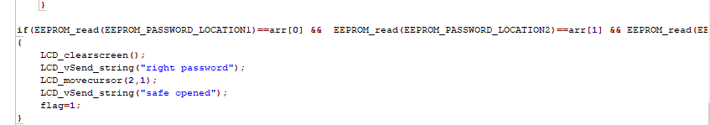
If the password you entered matches the stored password this message will appear to you.

Slide 9
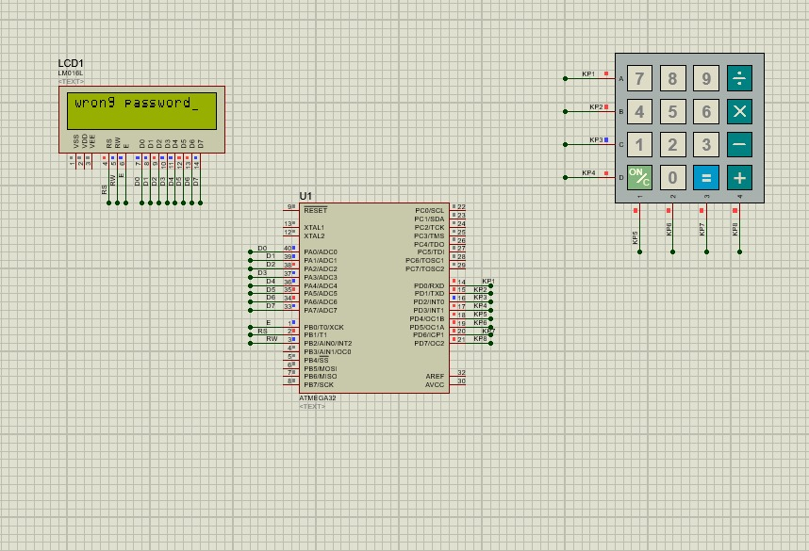
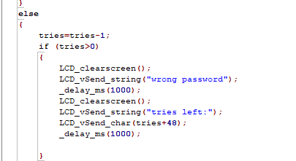
If the password isn’t match the stored password, this message will appear.

Slide 10

We set a maximum tries is 3 and each time you enter a wrong password the tries left will decrease by 1.

Slide 11
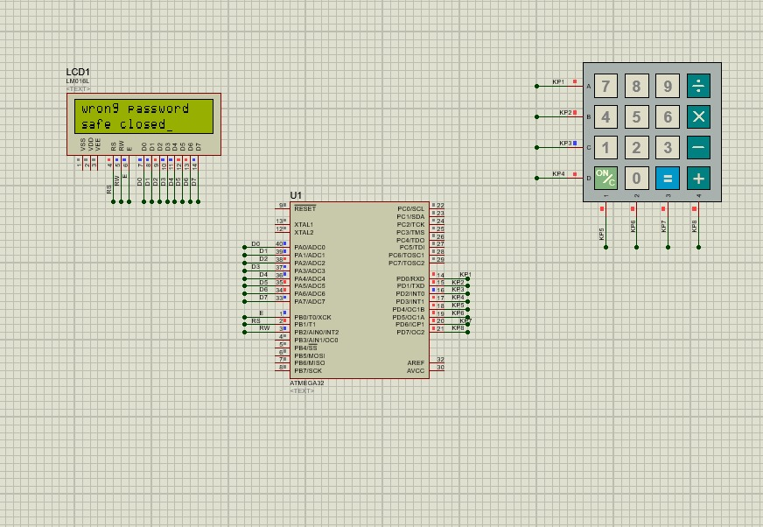
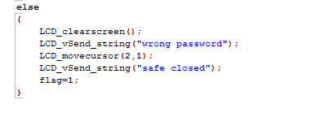
If the tries reached to 0 the safe is closed.

Slide 12
In an ever-changing world, technological advances can work to our advantage or disadvantage, and this is certainly true when it comes to modern features and security safes and gun safes. Here are the advantages and disadvantages of moving forward in the future with an electronic safe installation.
Advantages:
Ease of Operation:
Digital locking devices are the most user-friendly types of locks available. They are easy to use and alleviate the need to keep track of a key or remember a combination.
Reliability:
Electronic locks tend to be subjected to less wear and tear and last longer than traditional locks. They have also evolved a lot over the years and have become just as reliable as traditional mechanical safe locks.
Never get locked out ever again:
One of the most frustrating experiences is finding yourself locked out of your home. Smart keyless locks eliminate this possibility.
One key for the entire household.
Easy to customize.

Slide 13
Disadvantages
More expensive.
Battery replacement.
Poor resistance to water and chemical damage.

