Slide 1

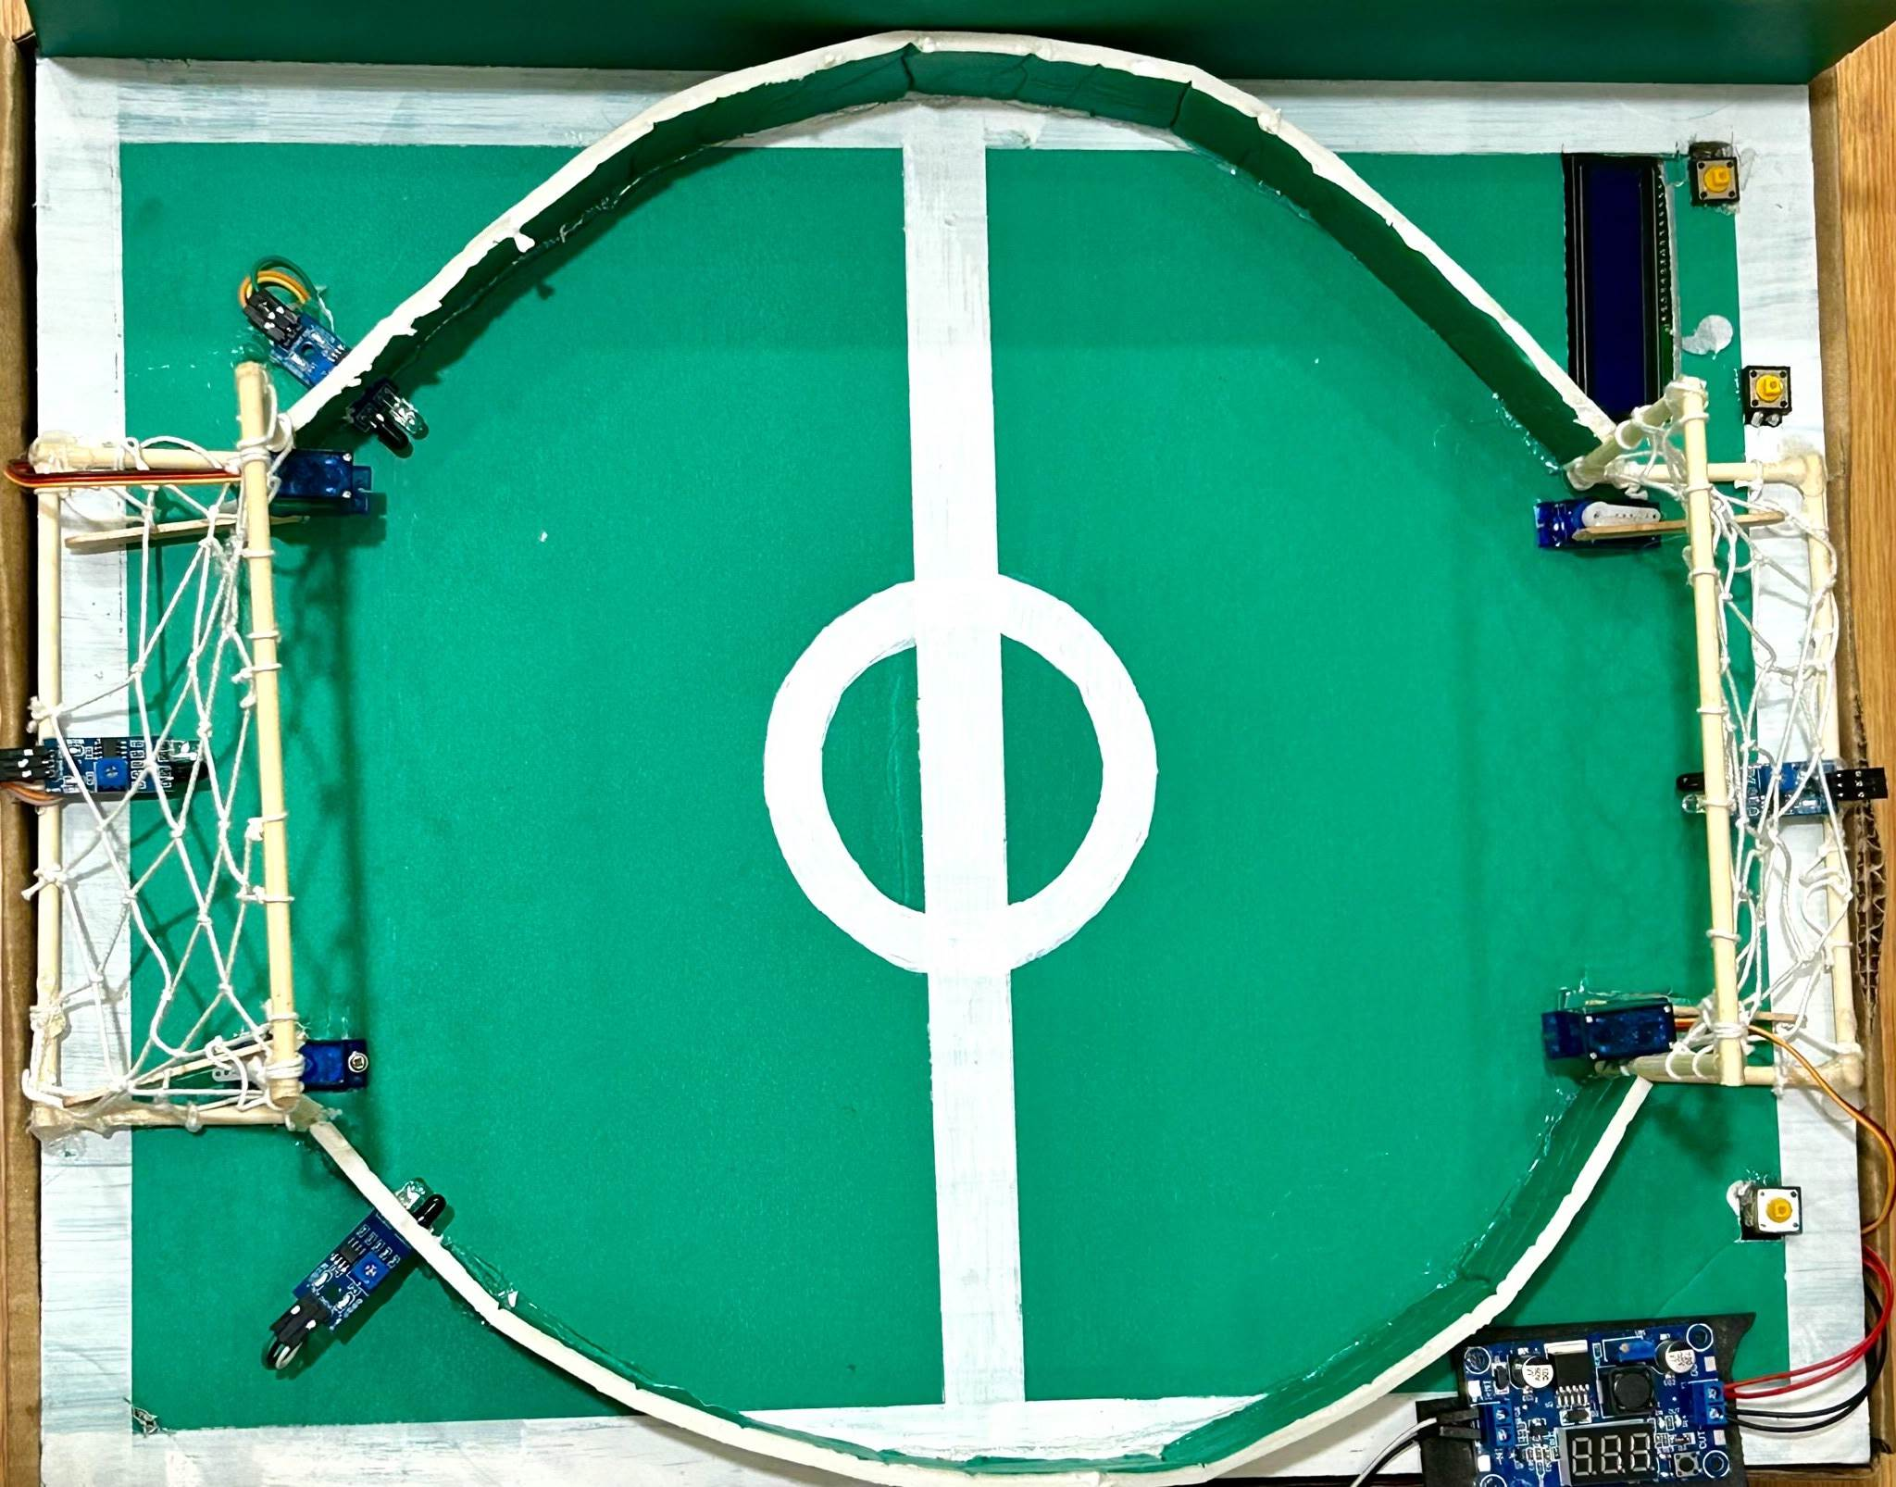
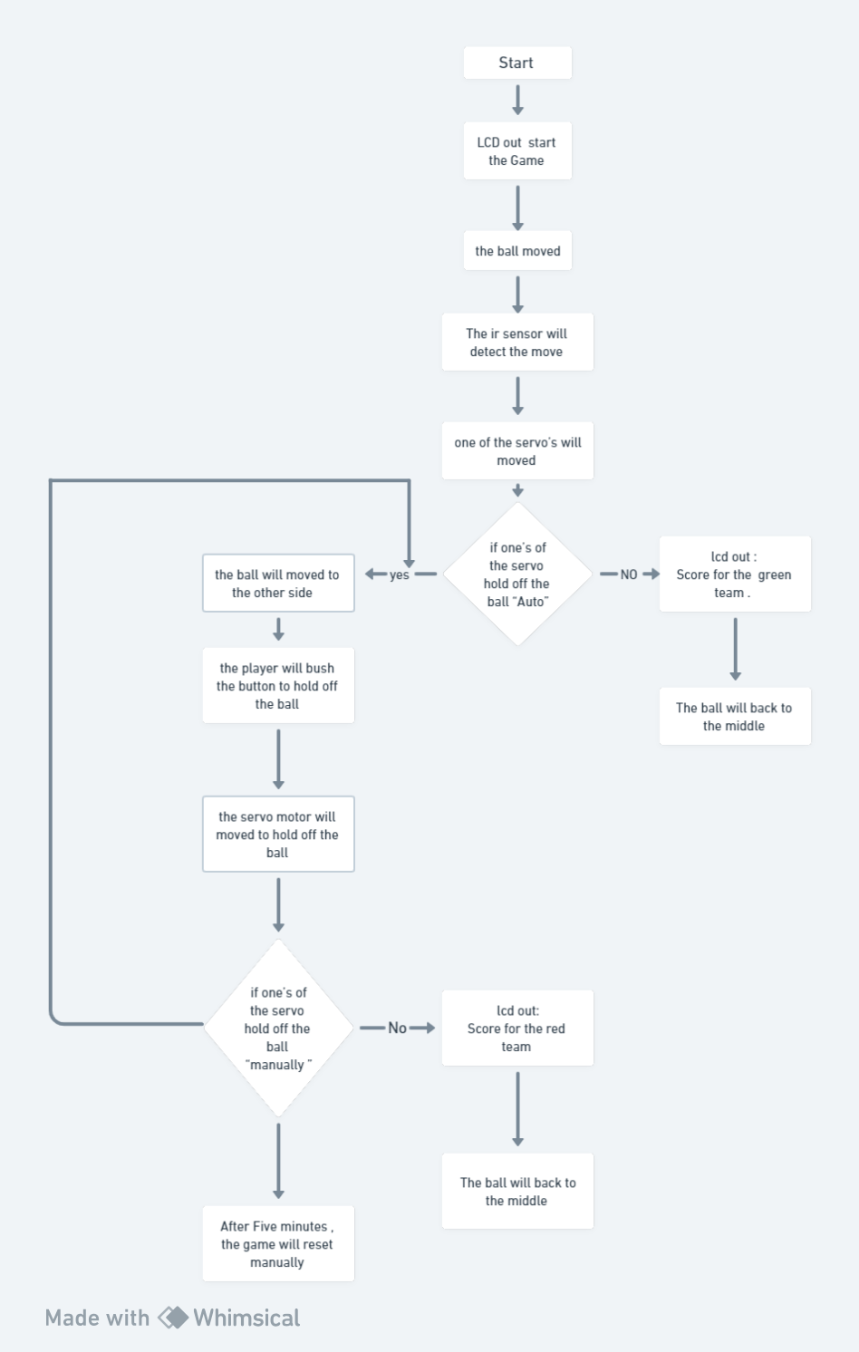
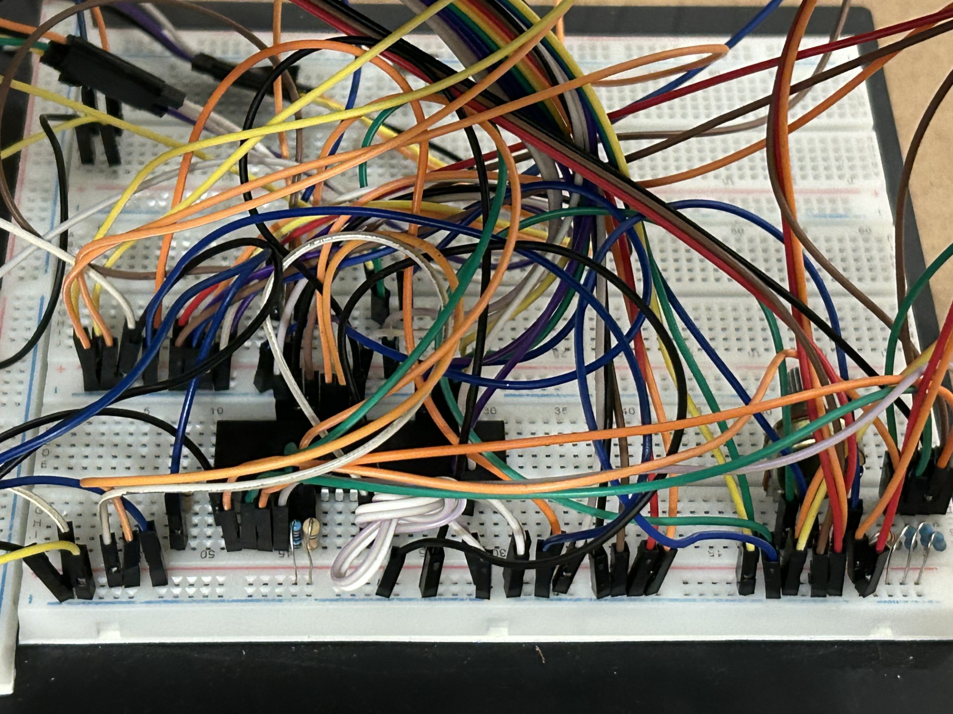
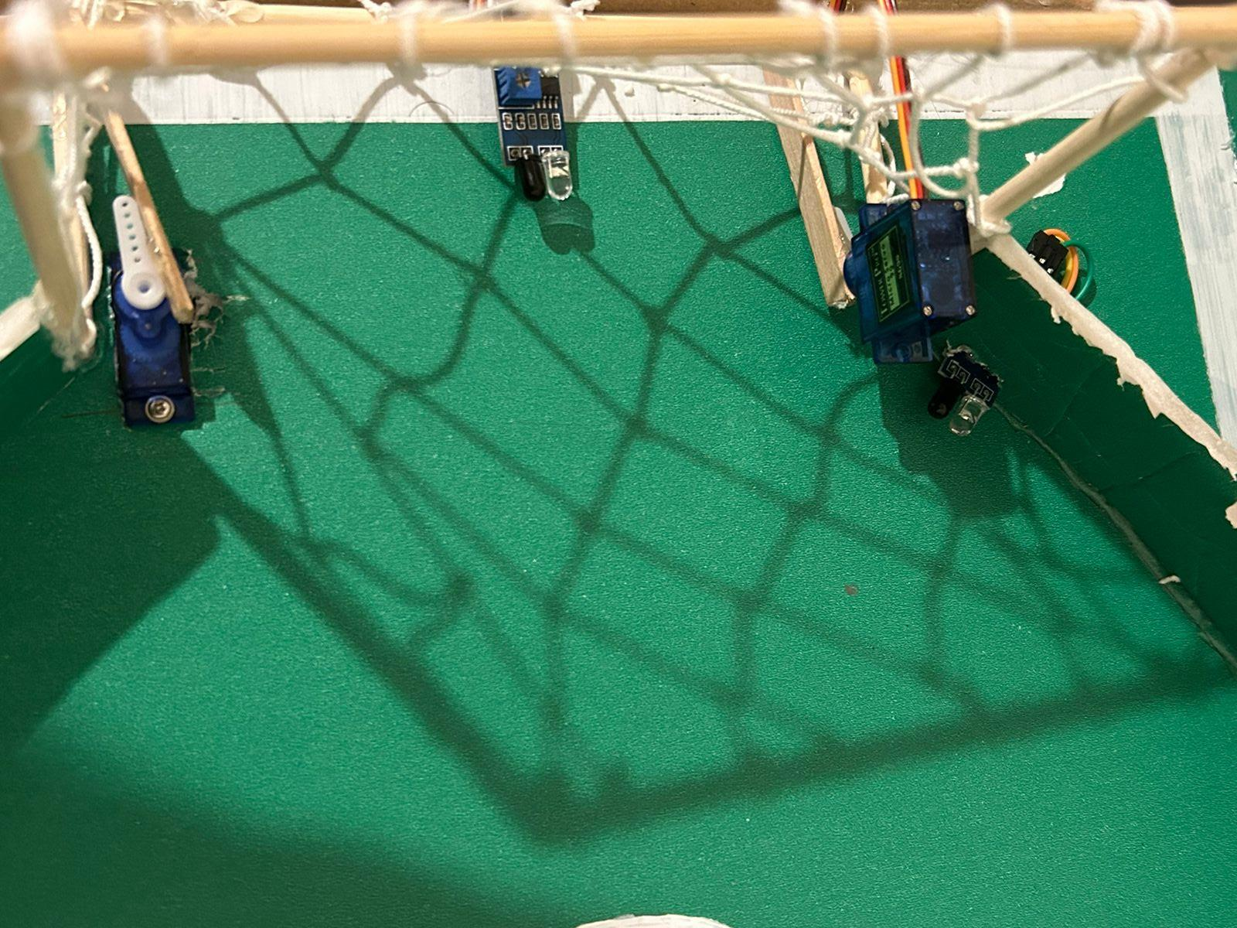
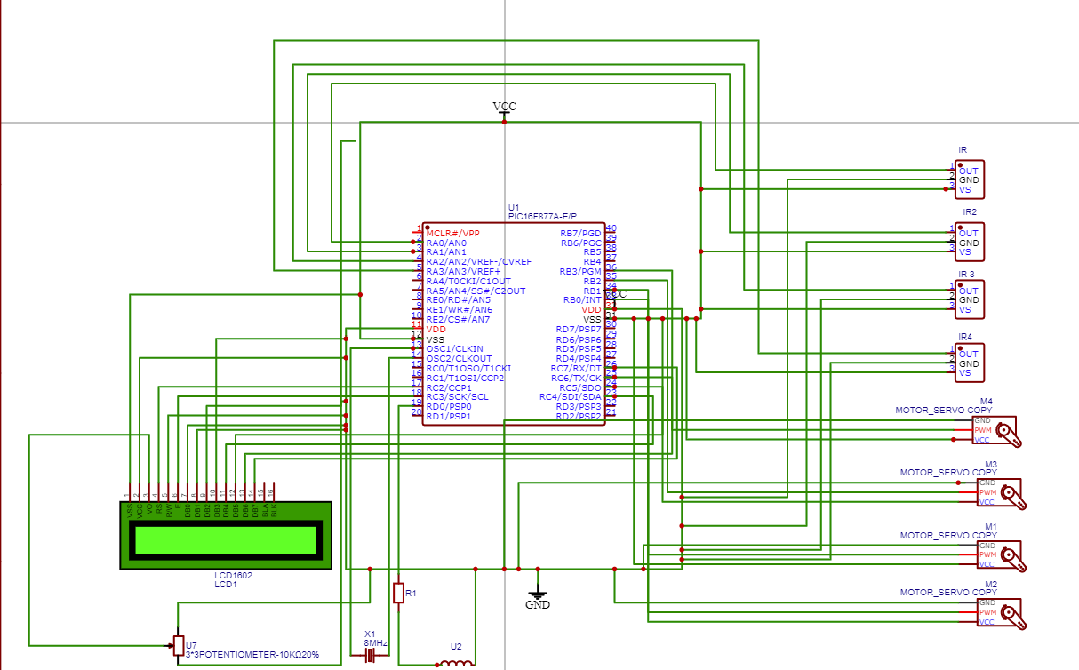
Football game Machine
E.Odeh , H.BenAli , M.Dahleh
Supervisor: Dr. Belal Sababha
Embedded Systems Final Design Project, Spring 2023
King Abdullah II School of Engineering
Princess Sumaya University for Technology
Introduction
The aim of this project is to design an autonomous football game machine using 16F877A microcontroller. Two IR sensors are used to detect the running ball in case of moving towards the handlers, which are provided with two servo motors to lead their movement , On the other hand, there is a push button for manual play. The job of the IR sensor here in the goal, is to detect the ball whenever it hits the obstacle, and hence, sends a signal to the LCD screen to display the increased score. Overall, this project combines embedded systems with sensors technology to construct a modern, football game machine.
Results
The following figures depict the final results after connecting the circuits and designing the Football game Machine.
figure 1: top view of the prototype
Figure 2: circuit connections for the machine
Figure 3 : The main components
The proposed idea was to automate the game “Football” and design it in more recently technological form, which was achieved through using IR sensors to detect the ball as it approaches the goal, servo motor to move the ball, and an LCD screen that displays the Displays the last score for each player.
Design
In the following, the flowchart of this project that demonstrates how our football game machine works according to our code flow:
Figure 1: Football game Machine flow chart
Follows, is the designed circuit of the system we are seeking to construct:
Figure 2: schematic design
Conclusion
This project demonstrated how different technologies work together. Embedded systems, coupled with advanced sensor technology, showcase their prowess in the development of diverse autonomous machines proficient in executing a myriad of tasks
In our case, synchronizing between the IR sensors and the servo motors - achieved through code -, helped achieving a meaningful functionality and movement of the game handlers, changing the score and displaying it on the LCD screen accordingly depending on the IR sensors.

