Slide 1
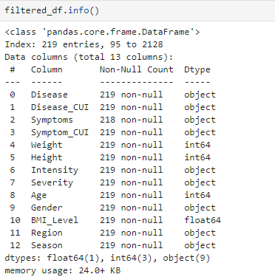
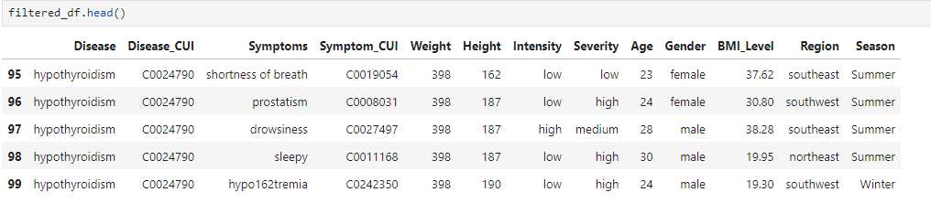
Tableau Specific Data Cleaning:
We conducted data engineering before uploading OHAS (Occupational Health and Safety) CSV dataset into Tableau and found no duplicates or nulls, but one missing value as shown below.
After cleaning, our dataset has 218 rows and 13 columns.

Slide 2
Discussion of the three dashboards:
The first dashboard, Symptoms and Diseases Overview provides insights into the frequency of symptoms and the prevalence of different diseases within the dataset. For example, shortness of breath, asthenia, and fever are more commonly reported across various diseases.
Hypothyroidism had the highest count of 23, indicating it is the most predominant disease in the dataset, while migraine had the lowest count of 7.
The Regional Disease Trends, the second dashboard, highlights key insights such as regional disease prevalence, the prominence of chronic diseases, and gender-based differences in disease distribution across different regions. For example, the Southeast region had the highest disease prevalence with 75 diseases, while the Southwest region had a lower prevalence with 44 diseases. Chronic diseases were the most predominant, affecting 95 out of 218 individuals. Across all regions, males experienced more chronic diseases than females, with males at 52 and females at 43, except in the Southwest where females had 11 chronic diseases compared to males with 9.
The third dashboard, the Severity Factors Comparison dashboard delves into health metrics and demographic variables in medical analysis. It reveals that BMI and weight are influential factors in disease severity, with higher values indicating increased severity, especially in individuals classified as overweight or obese. Also, the analysis shows that males tend to experience higher disease severity than females, particularly noticeable in younger age groups.
Motivation for the dashboards:
The motivation for these three dashboards for our HEALTHhOUSE: A dISEASE Discovery Tool project is to encourage users to delve into the story to gain a holistic understanding of the symptoms, diseases, and severity factors being analyzed. Exploring these visualizations in conjunction, users can uncover valuable insights and trends that may not be immediately apparent when viewing each dashboard independently.

Slide 3
Results:
Hypothyroidism emerged as the most predominant disease, with the most at 23, while migraine was the least, at 7. The symptoms of shortness of breath, asthenia, and fever were the most prevalent.
The Southeast region exhibited the highest disease prevalence, with 75 diseases, while the Southwest region had a relatively lower prevalence, with 44 diseases. Notably, chronic diseases were the most predominant, affecting 95 out of 218 individuals, underscoring the need for region-specific healthcare strategies. Males suffered more chronic diseases in all regions, males at 52 and females at 43, except in the Southwest, females at 11 and males at 9.
The impact of health metrics and demographic factors on disease severity was also notable. BMI and weight were found to affect disease severity, with higher values correlating to higher severity. The higher the BMI, the individual is either overweight (BMI 25-29.9) or obese (BMI 30 or higher), the higher the disease severity. Males were found to suffer from a higher severity of diseases than females, more notably in younger males.
Conclusions:
The prevalence of diseases varied across regions, with chronic diseases being predominant, emphasizing the importance of region-specific healthcare strategies.
Gender differences in disease prevalence and severity were observed, with males generally experiencing higher severity, particularly noticeable in younger age groups.

