Slide 1
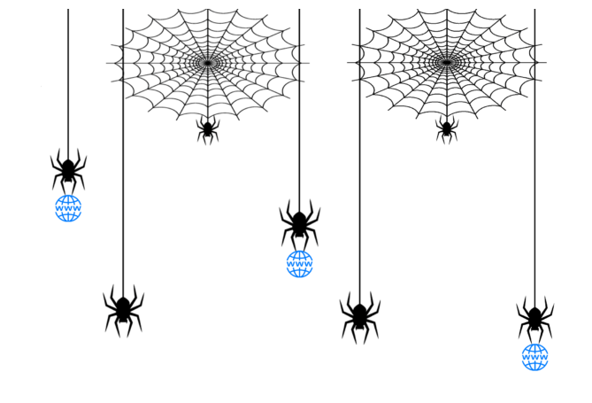



Data Exploration and Preparation
Session2
Prepared by: Eman Raslan

Slide 2
Session 2 Learning Outcomes
The following topics will be Covered:
REST services Basics
Dealing with remote json content fetching.
Connecting to websites and fetching raw content.
Connect to websites using selenium.
Integration is performed through Orange studio.

Slide 3
What is REST API?
REpresentational State Transfer, a SW architecture standard for communication between web services.
REST API can be used by any site or application no matter what language it is written in because the requests are based on the universal HTTP protocol, and the information is usually returned in the JSON format that almost all of the programming languages can read.
Notes:
The term REST stands for REpresentational State Transfer. It is an architectural style that defines a set of rules in order to create Web Services. In a client-server communication, REST suggests to create an object of the data requested by the client and send the values of the object in response to the user. For example, if the user is requesting for a movie in Bangalore at a certain place and time, then you can create an object on the server-side.
So, over here, you have an object and you are sending the state of an object. This is why REST is known as Representational State Transfer.
The architectural style of REST helps in leveraging the lesser use of bandwidth to make an application more suitable for the internet. It is often regarded as the “language of the internet” and is completely based on the resources.

Slide 4
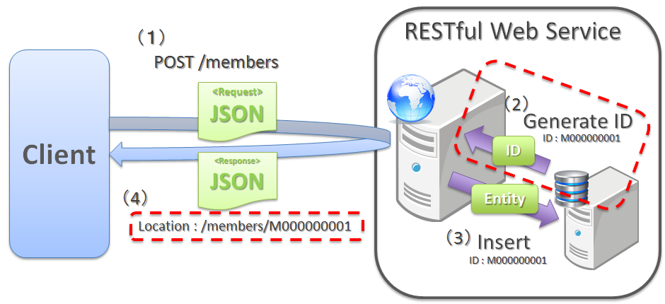
What is REST API?
Notes:
The term REST stands for REpresentational State Transfer. It is an architectural style that defines a set of rules in order to create Web Services. In a client-server communication, REST suggests to create an object of the data requested by the client and send the values of the object in response to the user. For example, if the user is requesting for a movie in Bangalore at a certain place and time, then you can create an object on the server-side.
So, over here, you have an object and you are sending the state of an object. This is why REST is known as Representational State Transfer.
The architectural style of REST helps in leveraging the lesser use of bandwidth to make an application more suitable for the internet. It is often regarded as the “language of the internet” and is completely based on the resources.

Slide 5
Application Programming Interface (API)
Corona Virus API :
https://postman-toolboxes.github.io/covid-19/#featured-collections
https://documenter.getpostman.com/view/10808728/SzS8rjbc
https://speeding-resonance-9003.postman.co/workspace/My-Workspace~c724726d-a67a-4703-85dd-677f28816bc0/request/10461336-744b5638-18a5-4f91-8479-5ae0104e8e4b

Slide 6
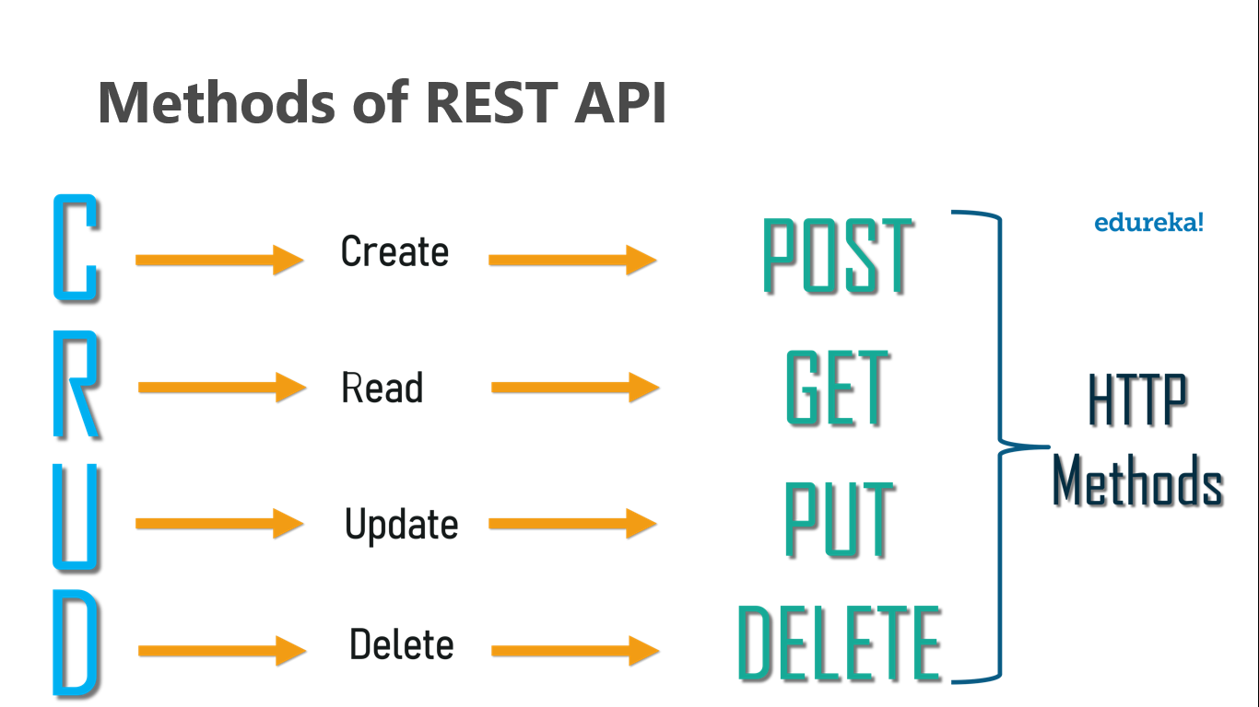
HTTP Methods of REST API

Slide 7
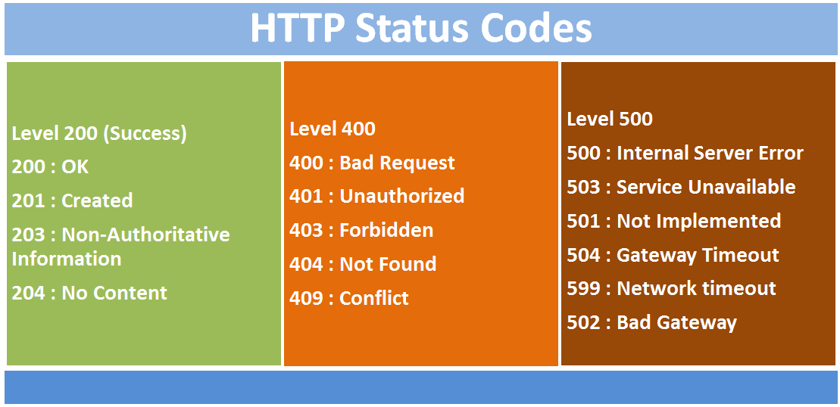
HTTP Response Status

Slide 8
AJAX
AJAX stands for Asynchronous JavaScript And XML.
AJAX is not a programming language.
AJAX just uses a combination of:
A browser built-in XMLHttpRequest object (to request data from a web server)
JavaScript and HTML (to display or use the data)
AJAX applications might use XML to transport data, but it is equally common to transport data as plain text or JSON text.
Notes:
The XMLHttpRequest object can be used to exchange data with a web server behind the scenes. This means that it is possible to update parts of a web page, without reloading the whole page.

Slide 9
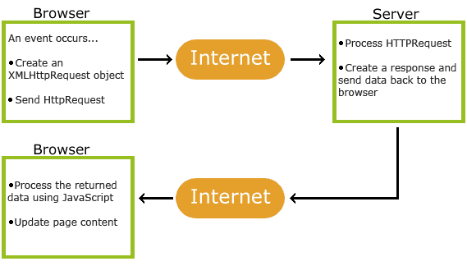
How AJAX Works
1. An event occurs in a web page (the page is loaded, a button is clicked)
2. An XMLHttpRequest object is created by JavaScript
3. The XMLHttpRequest object sends a request to a web server
4. The server processes the request
5. The server sends a response back to the web page
6. The response is read by JavaScript
7. Proper action (like page update) is performed by
JavaScript
Notes:
Read data from a web server - after the page has loaded
Update a web page without reloading the page
Send data to a web server - in the background

Slide 10
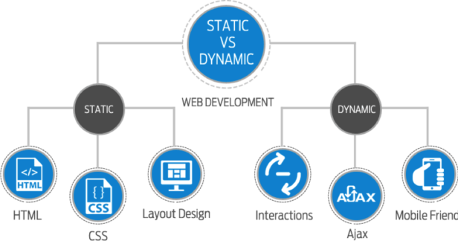
Static vs Dynamic Websites
Static websites are ones that are fixed and display the same content for every user, usually written exclusively in HTML.
A dynamic website, on the other hand, is one that can display different content and provide user interaction, by making use of advanced programming and databases in addition to HTML.
Notes:
Nothing is stored but the actual pages of a static site. There are:
No users
No comments
No blog posts
No interactivity
Dynamic site examples include:
E-commerce sites
Blogs
Calendars, or to-do sites
Any site with information that must be updated regularly

Slide 11
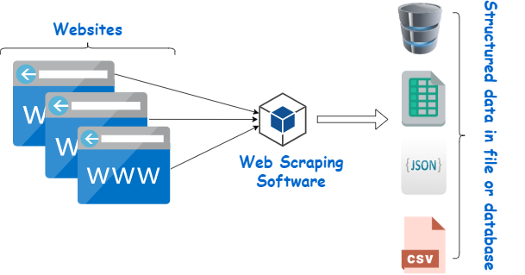
Web Scraping
Web Scraping also termed Screen Scraping, Web Data Extraction, Web Harvesting.
Is a technique employed to extract large amounts of data from websites whereby the data is extracted and saved to a local file in your computer.
Machine learning need a large volume of data to build a robust & reliable machine learning model for such business problems.
Notes:
Data displayed by most websites can only be viewed using a web browser. They do not offer the functionality to save a copy of this data for personal use. The only option then is to manually copy and paste the data - a very tedious job which can take many hours or sometimes days to complete. Web Scraping is the technique of automating this process, so that instead of manually copying the data from websites, the Web Scraping software will perform the same task within a fraction of the time.

Slide 12
Applications of web scraping
Gathering resume of candidates with a specific skill.
Extracting tweets from twitter with specific hashtags.
Scraping product details and reviews from e-commerce websites.
Notes:
Apart from the above use-cases, web scraping is widely used in natural language processing for extracting text from the websites for training a deep learning model.

Slide 13

Crawler
A crawler is a computer program that automatically searches documents on the Web.
Crawlers are primarily programmed for repetitive actions so that browsing is automated.
Search engines use crawlers most frequently to browse the internet and build an index.
Notes:
43things

Slide 14
Web Scraping Techniques
API
Using software
Writing code
Notes:
Web Scraping software falls under 2 categories. First, which can be locally installed in your computer and second, which runs in cloud

Slide 15
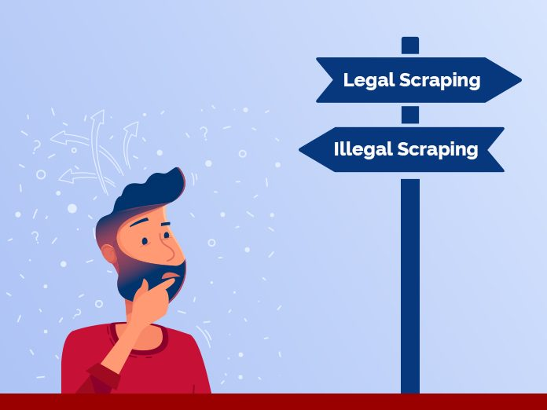
Notes:
1. Respect the Robots.txt
2. Do Not Hit The Websites Too Frequently 3. It is Better if You Scrape Data During Off-Peak Hours
https://www.promptcloud.com/blog/is-web-scraping-legal-2/

Slide 16
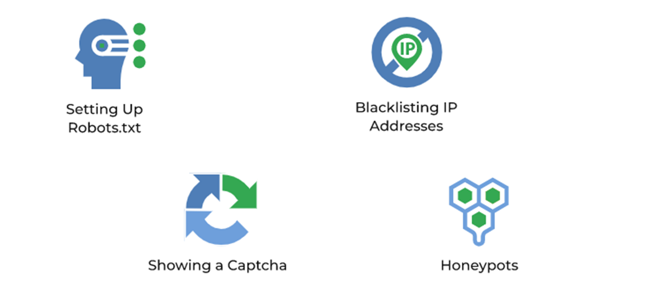
Anti-Scraping Techniques

Slide 17


https://selenium-python.readthedocs.io/
Notes:
Selenium is an open-source web-based automation tool. Selenium primarily used for testing in the industry but It can also be used for web scraping.

Slide 18
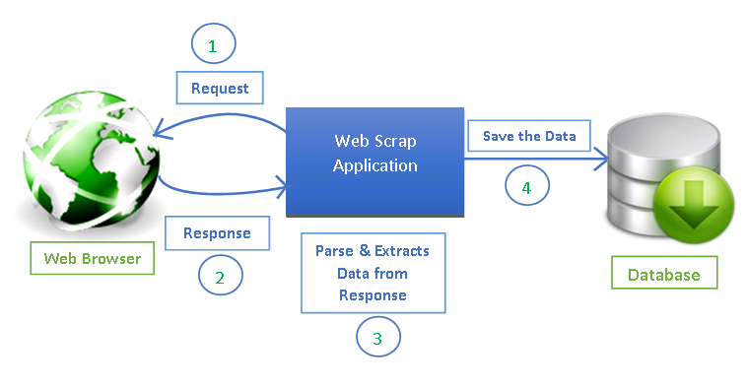
Scraping Process steps

Slide 19
Scraping Process steps
To extract data using web scraping with python, you need to follow these basic steps:
Find the URL that you want to scrape
Inspecting the Page
Find the data you want to extract
Write the code
Run the code and extract the data
Store the data in the required format

Slide 20
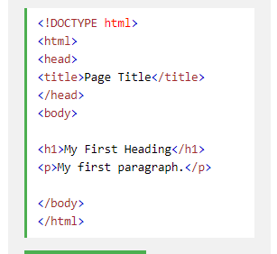
HTML Basics
HTML stands for Hyper Text Markup Language
HTML is the standard markup language for creating Web pages
HTML describes the structure of a Web page
HTML consists of a series of elements
HTML elements tell the browser how to display the content

Slide 21
Demo
Install Selenium package: You can install selenium package using the following command
!pip install selenium
Download Chrome driver: Please install the latest version of chromedriver from here.
Importing packages: from selenium import webdriver
Create Chrome driver Instance:
driver = webdriver.Chrome('Path in your computer where you have installed chromedriver')
Fetch webpage:
driver.get(‘URL')
Parse webpage using Xpath:
Data = driver.find_elements_by_xpath(‘Xpath’)
Notes:
'https://egypt.souq.com/eg-en/samsung/mobile-phones-33%7Csmart-watches-511%7Ctablets-94%7Cfitness-technology-498%7Cpower-banks-562/samsung/a-t-7/s/?_=1500309575629&sortby=sr&ref=nav&section=2&page=1'

Slide 22
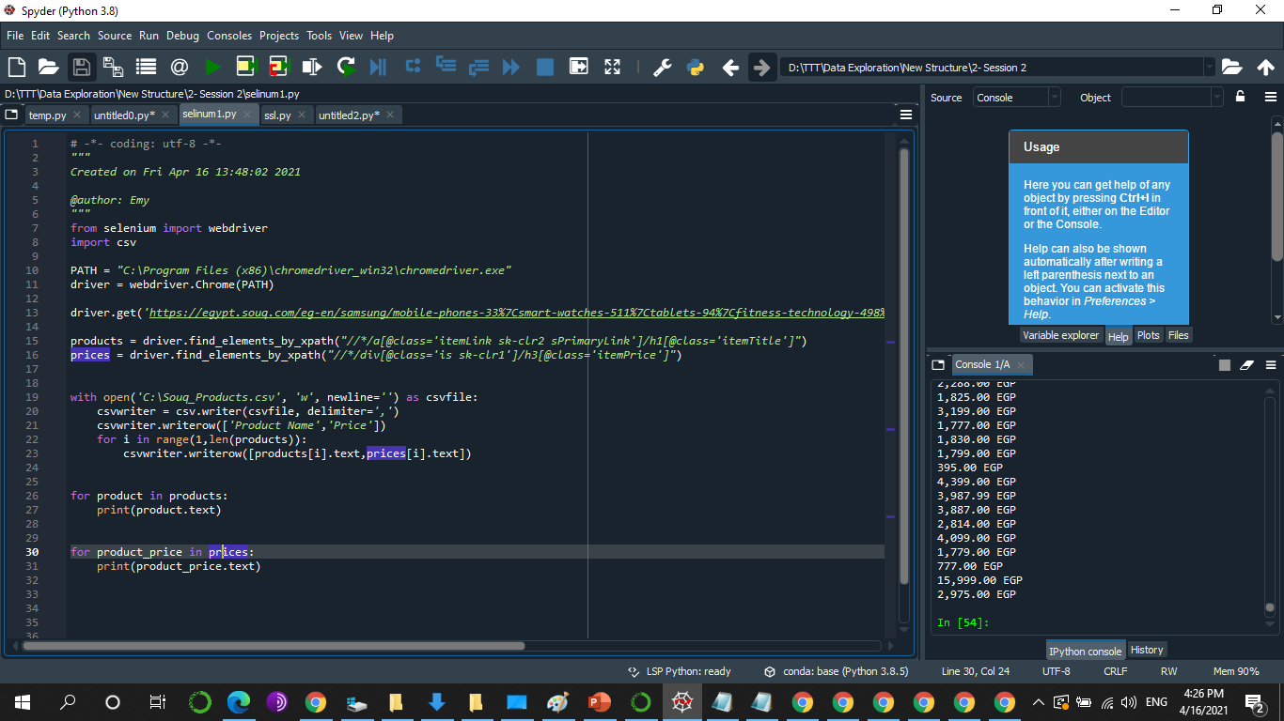
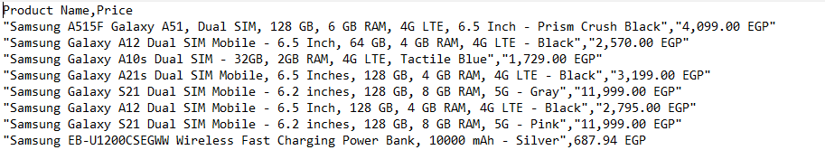
Sel.py
Notes:
from selenium import webdriver
import csv
PATH = "C:\Program Files (x86)\chromedriver_win32\chromedriver.exe"
driver = webdriver.Chrome(PATH)
driver.get('https://egypt.souq.com/eg-en/samsung/mobile-phones-33%7Csmart-watches-511%7Ctablets-94%7Cfitness-technology-498%7Cpower-banks-562/samsung/a-t-7/s/?_=1500309575629&sortby=sr&ref=nav&section=2&page=1')
products = driver.find_elements_by_xpath("//h1[@class='itemTitle']")
prices = driver.find_elements_by_xpath("//h3[@class='itemPrice']")
with open('C:\Souq_Products.csv', 'w', newline='') as csvfile:
csvwriter = csv.writer(csvfile, delimiter=',')
csvwriter.writerow(['Product Name','Price'])
for i in range(1,len(products)):
csvwriter.writerow([products[i].text,prices[i].text])

Slide 23
Integrate with Orange studio

Slide 24
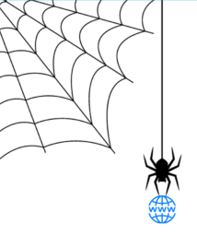


Slide 25

Homework

Slide 26

Homework
Scrap books title, and prices from https://www.amazon.in/gp/bestsellers/books/ webpage and save it as a CSV file.
03/01/2022

Slide 27

Install PostgreSQL

Slide 28
References
https://www.bestproxyreviews.com/web-scraping-tools/
https://selenium-python.readthedocs.io/

