Slide 1


Lab 3
Eman Raslan

Slide 2
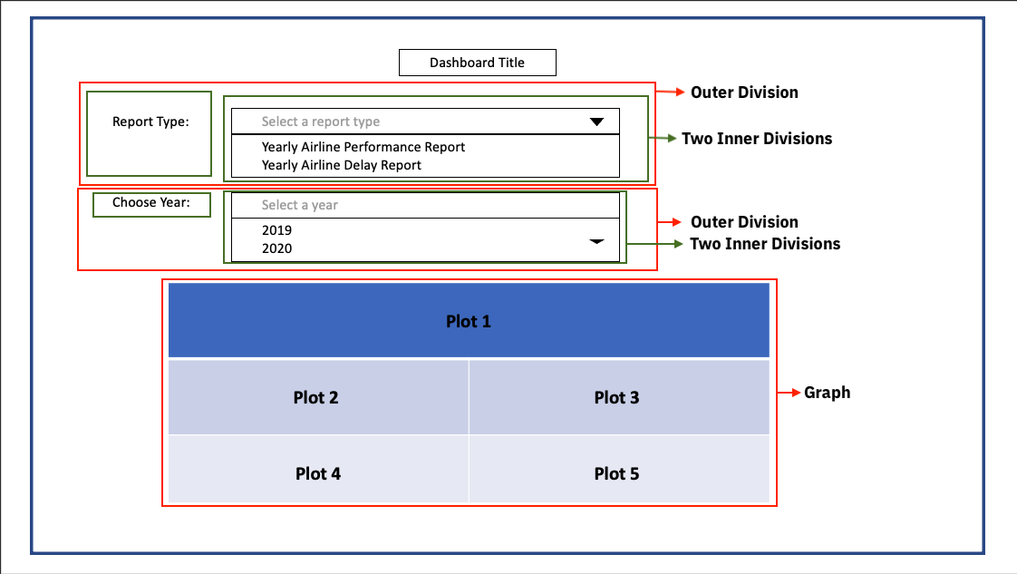
Airline Performance Dashboard

Slide 3
Dash DAQ
Dash DAQ comprises a robust set of controls that make it simpler to integrate data acquisition and controls into your Dash applications.
Dash DAQ | Dash for Python Documentation | Plotly
Notes:
https://www.youtube.com/watch?v=lVYRhHREkGo

Slide 4
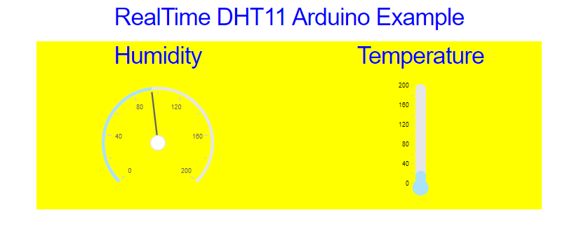
Dash DAQ: Real-Time Dashboard
Using Arduino+DHT11 Sensor

Slide 5
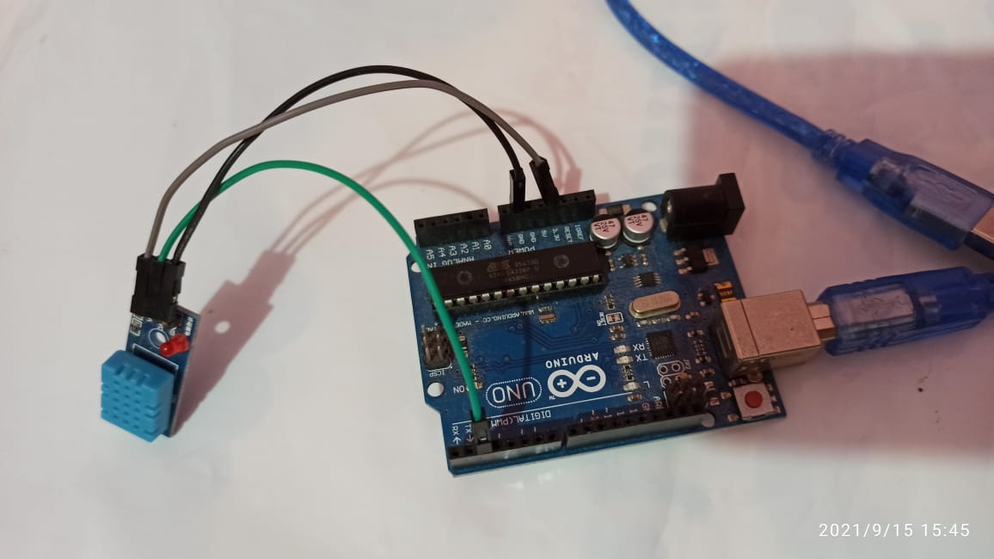
Dash DAQ: Real-Time Dashboard

Slide 6
Deploy Flask Dash App to Heroku in Python
Notes:
https://www.youtube.com/watch?v=b-M2KQ6_bM4&feature=youtu.be

Slide 7

Thank You

