Slide 1

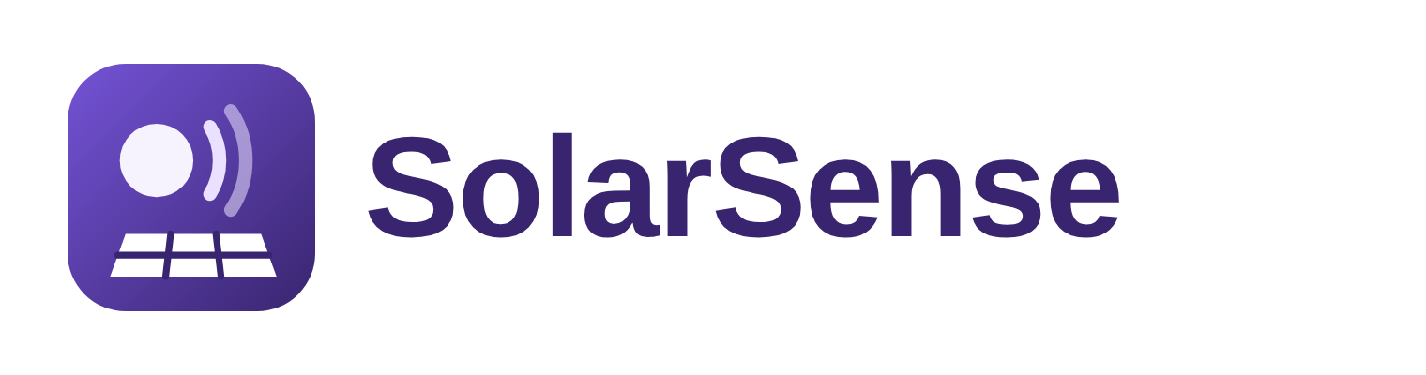

Team Details
  Team name: TechVerz
  Team leader name: Syed Mohammed Bin Khalid
  Problem Statement: Sustainability & Social Impact

Slide 2
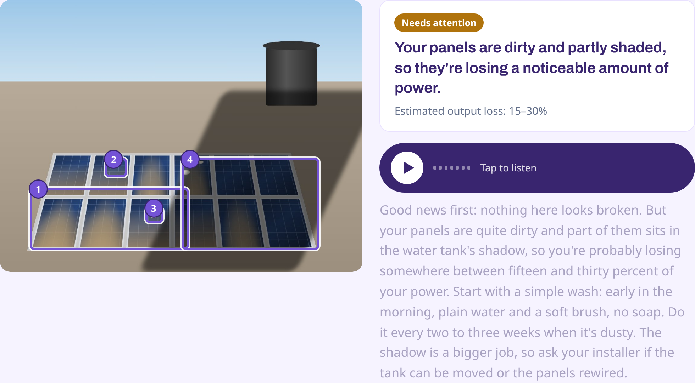
Brief about the idea
SolarSense is a talking AI solar technician.
Rooftop solar is everywhere now: 282 GW of distributed solar was added worldwide in 2025, 41% of all new solar, on homes, shops, farms and factories. But when a system underperforms or shows a fault, its owner usually can't tell what's wrong, how much it's costing them or whether it's safe.
Show it. Hear what's wrong.
The owner picks their language, then photographs the panels, inverter screen or wiring (up to 4 photos). Gemini diagnoses it like a senior technician, boxes each problem, gives the evidence and the risk, and explains it out loud and in writing in English, Urdu, Hindi, Chinese, Indonesian or Arabic. A screenshot of the inverter app shows how much money the system is losing each month, in the owner's currency, and why.
Track: Sustainability & Social Impact. For: home and small-business solar owners, and the installers who serve them.

Slide 3
Opportunities
How is it different?
Inverter apps show numbers, not answers: no verdict, no cause, no comparison with the weather, mostly English.
AI monitoring platforms exist for solar companies and need data connections, not for an owner with a phone.
SolarSense needs only a phone camera and works in the owner's own language.
How does it solve the problem?
Gemini inspects up to 4 photos together, finds dust, shade, cracks, hotspots, burnt cables and error codes, and marks them.
It speaks the diagnosis and shows it as text, with safe steps and a clear 'call a technician' when needed.
Real local sunshine turns an app screenshot into money lost per month.
USP
Show it, hear it: a voice agent you can talk back to.
6 languages incl. Urdu and Arabic, chosen on the very first screen.
Problems boxed on your own photo.
Loss shown in your own currency.
Safety first: risky jobs always go to a technician.
A PDF report the technician can act on.

Slide 4
List of features offered by the solution
Language first
English, Urdu, Hindi, Chinese, Indonesian or Arabic; the whole app, answers, voice and captions follow it.
Expert inspection
Up to 4 photos from the camera or gallery; each problem gets location, evidence, cause, risk and confidence.
Problems marked on the photo
Numbered boxes around each issue, with severity from minor to danger.
Voice plus text
Tap to hear the diagnosis while captions follow, with a written card for each issue.
Ask by voice
Ask a follow-up in any language; the answer looks at your photos and says what to check.
Performance check
Inverter app screenshots plus location: actual vs expected output from real local sunshine.
Money lost and why
Loss per month in your currency, with likely causes, the evidence and how to check each.
Technician report
A PDF for the installer: findings, evidence, what to do; shared on WhatsApp in one tap.

Slide 5
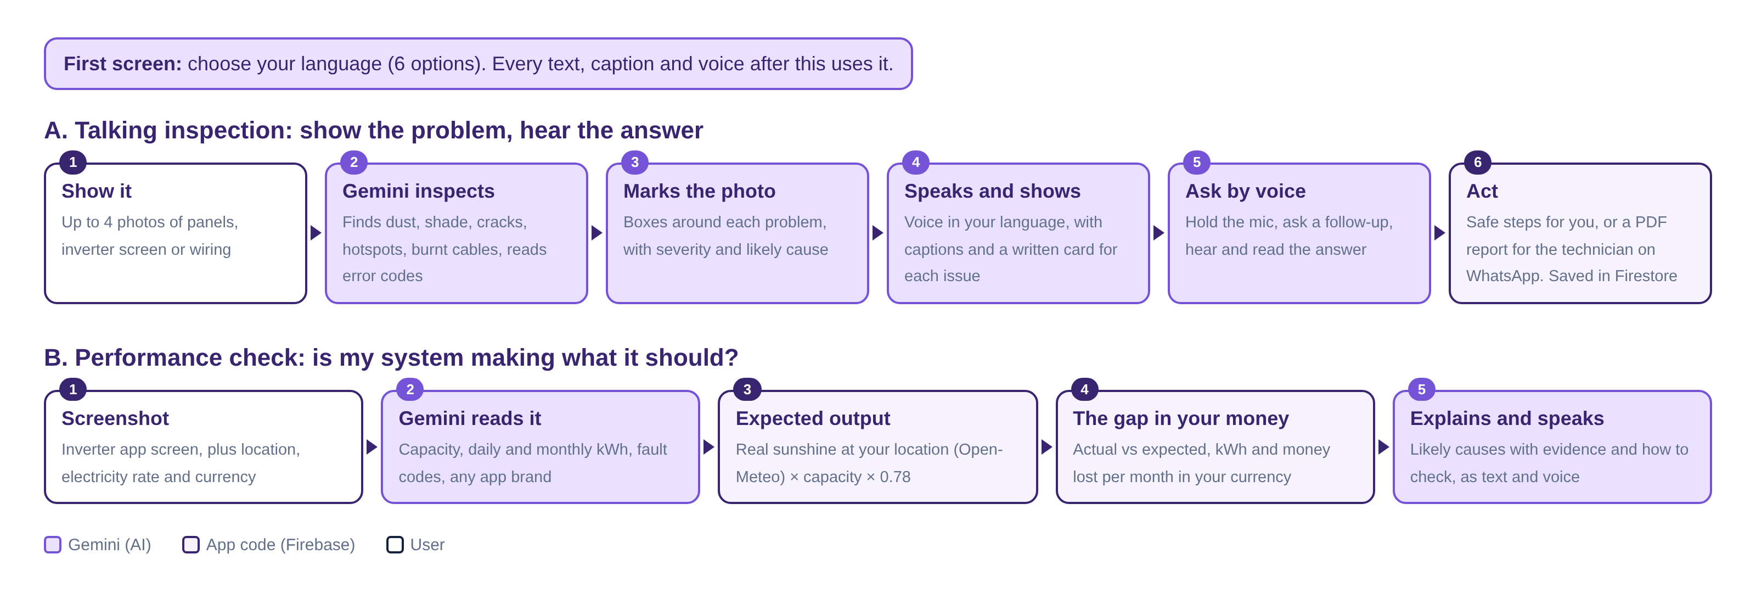
Process flow diagram or Use-case diagram

Slide 6
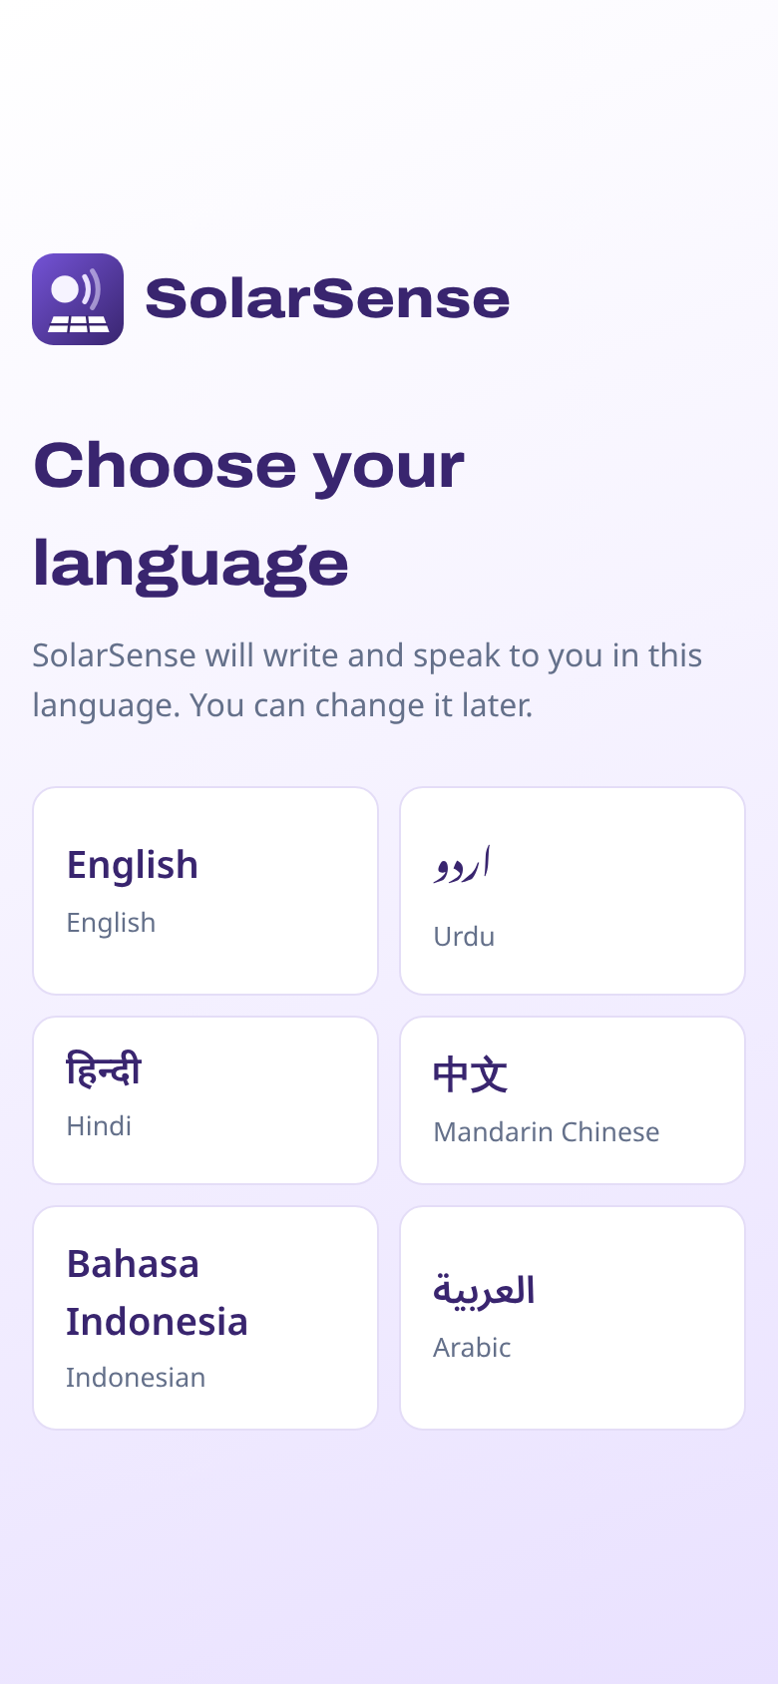
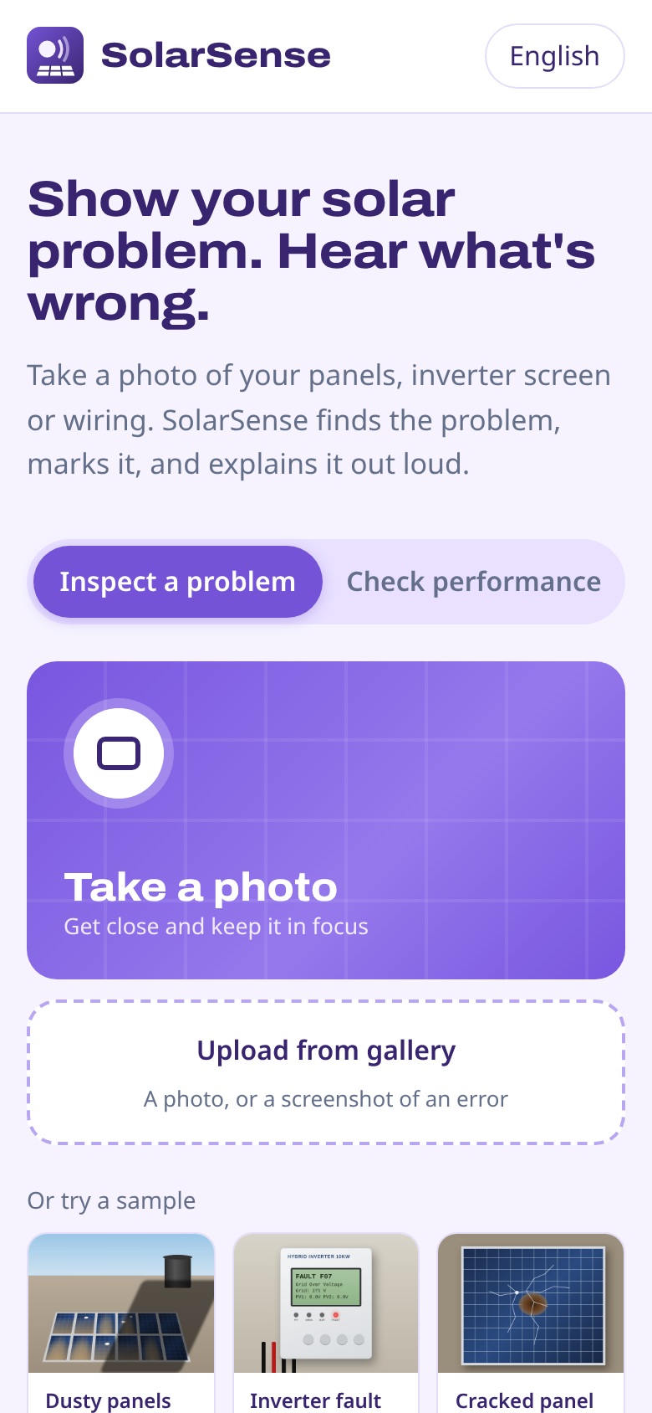
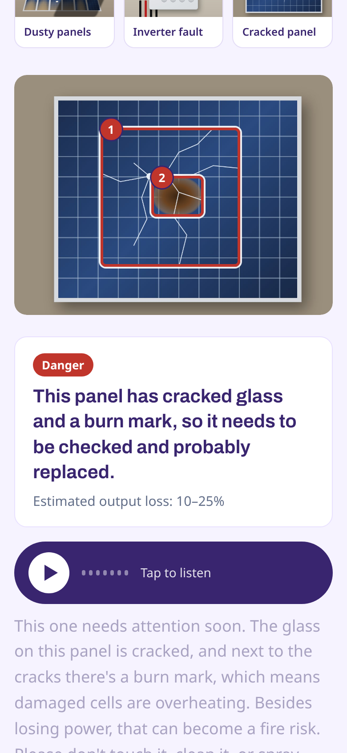
Wireframes/Mock diagrams of the proposed solution (optional)
Built for a phone
1. Pick a language. Everything after this uses it.
2. Take or upload up to 4 photos, or try a sample.
3. See the problem boxed, hear the explanation, read the captions and issue cards, then ask a follow-up by voice.
Urdu and Arabic read right to left.

Slide 7
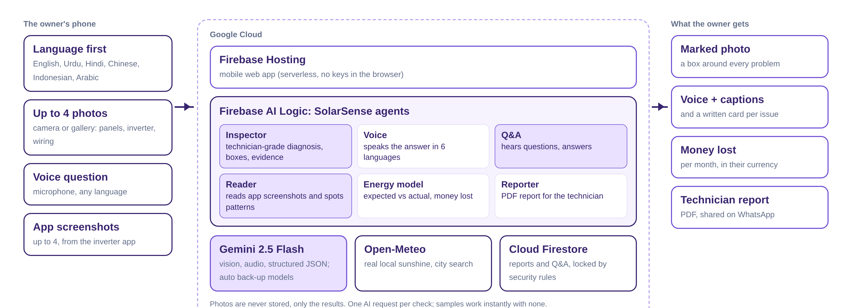
Architecture diagram of the proposed solution

Slide 8
Technologies to be used in the solution
Layer | Technology | How SolarSense uses it
AI: seeing | Gemini 2.5 Flash | Technician-grade diagnosis of up to 4 photos: boxes, severity, evidence, cause and risk as structured JSON
AI: reading | Gemini 2.5 Flash | Reads any inverter app screenshot (kWh, kW, fault codes) and finds the cause of low output from the pattern
AI: listening | Gemini 2.5 Flash | Understands typed or spoken follow-up questions in any language, and looks at the photos to answer
AI access | Firebase AI Logic | Calls Gemini securely from the app with no API keys in code; rotates to back-up models if one is busy
Database | Cloud Firestore | Reports and follow-up Q&A, protected by security rules; photos are never stored
Frontend | Firebase Hosting | Mobile web app with camera, microphone, voice and PDF reports; 6 languages built in
Data | Open-Meteo, OpenStreetMap | Real daily sunshine and city search for any location in the world

Slide 9
Estimated implementation cost (optional)
$0
to build and run the prototype: Firebase Spark plan, Gemini free tier, free weather and map data
< 1 cent
Gemini cost per photo check on paid usage (Gemini 2.5 Flash list prices)
1 request
per check, however many photos; samples and maths need no AI at all
Business model
Free for owners. Installers and solar companies pay a small monthly fee to receive SolarSense reports from their customers before a visit, which saves wasted trips. Panel and inverter brands could offer it to customers as a support channel.
Estimates use Gemini 2.5 Flash list prices ($0.30 per million input tokens, $2.50 per million output tokens) and the free tiers of Firebase Hosting and Firestore. Verify against current pricing.

Slide 10
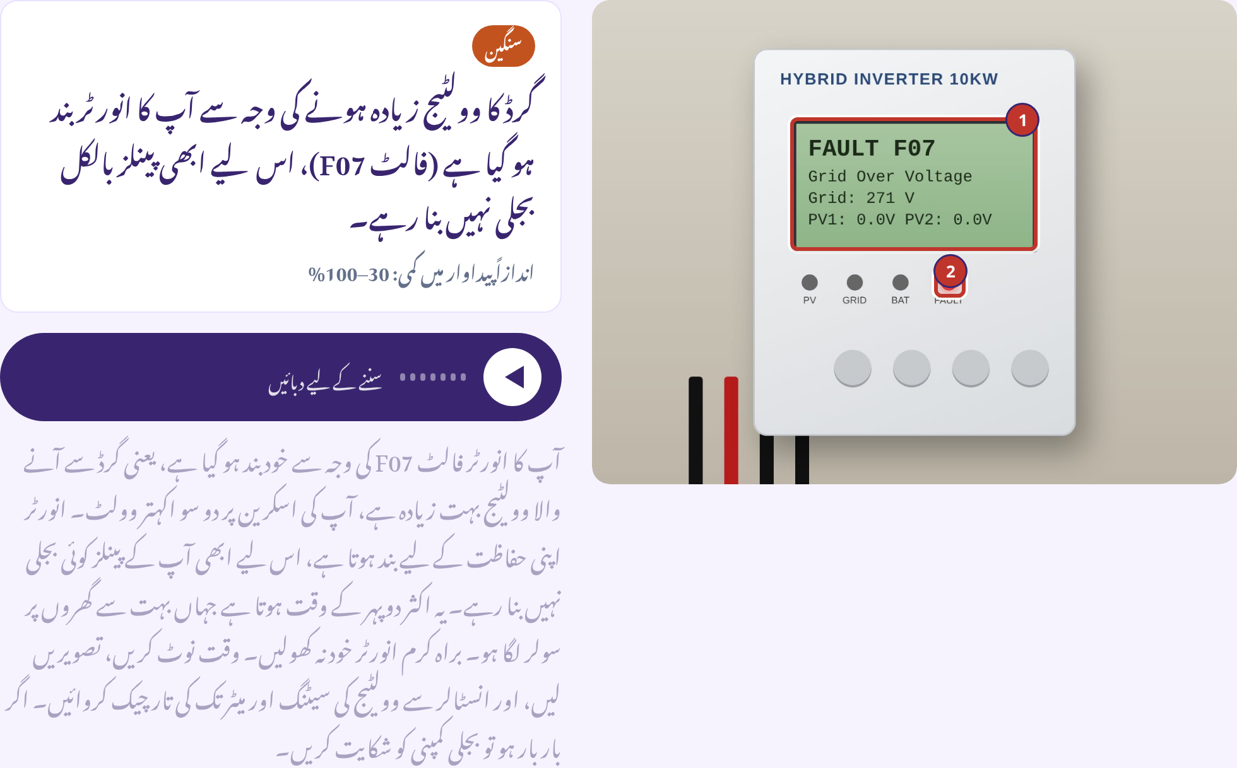
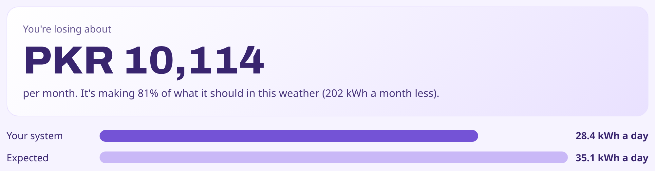
Snapshots of the prototype

Slide 11
Prototype Performance report/Benchmarking
Check | Result | How it's checked
Automated tests | 4 of 4 passing | pytest: languages, money maths, sample results, API flow
End-to-end browser tests | All passing | Playwright: 6 languages, samples, camera, photo tray, PDF report, performance
Languages | 6, fully translated | Interface, diagnosis, answers, captions and PDF in each language; Urdu and Arabic right to left
AI requests per check | 1 (samples: 0) | Up to 4 photos or screenshots analysed in a single request
Typical answer time | about 8 to 15 s | Fast model first, automatic switch to a back-up model if one is slow
Safety rule | Always enforced | Isolators, breakers and anything electrical on a damaged system go to a technician
Free-tier resilience | 6 models rotated | If one model's daily allowance is used, the next one answers

Slide 12
Additional Details/Future Development (if any)
Next 3 months
Accuracy test on real rooftop photos, reviewed by solar technicians
Live video mode with Gemini Live: point the camera and talk
Pilot with installers in two countries
6 to 12 months
Connect inverter cloud accounts for automatic daily checks and alerts
Installer dashboard to receive reports and book visits
Thermal photo support for hotspots
Beyond
Warranty claim packs for panel and inverter brands
Fleet view for schools, clinics and small factories
More languages and Android/iOS apps

Slide 13
Provide links to your:
GitHub Public Repository: https://github.com/EmanRohail/solarsense
Demo Video Link (3 Minutes): https://youtu.be/YOUR-VIDEO-ID
Final Product Link: https://solarsense-6280c.web.app
The live app includes three sample photos and a sample inverter screenshot, so judges can try every feature without a solar system.

Slide 14
Impact
282 GW
of rooftop and other distributed solar added worldwide in 2025, 41% of all new solar
100M+
households expected to rely on rooftop solar by 2030, up from about 25 million (IEA)
6
languages, including Urdu and Arabic, so owners hear the answer in the language they think in
Who benefits
Owners: protect a big investment, cut wasted power and avoid unsafe repairs.
Installers: arrive knowing the problem, with photos and error codes in hand.
The planet: every rooftop system kept healthy is more clean energy actually produced.
Sources: IEA PVPS via TaiyangNews (2026); IEA (2022).

Slide 15


