Slide 1
Telecom_Task
File created on: 6/10/2023 3:34:16 PM

Slide 2
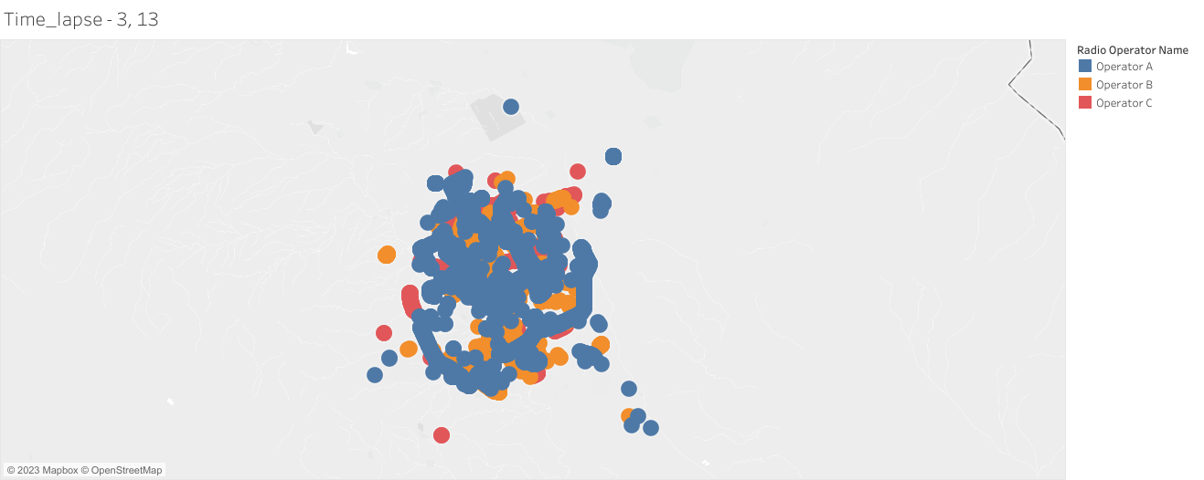

Slide 3
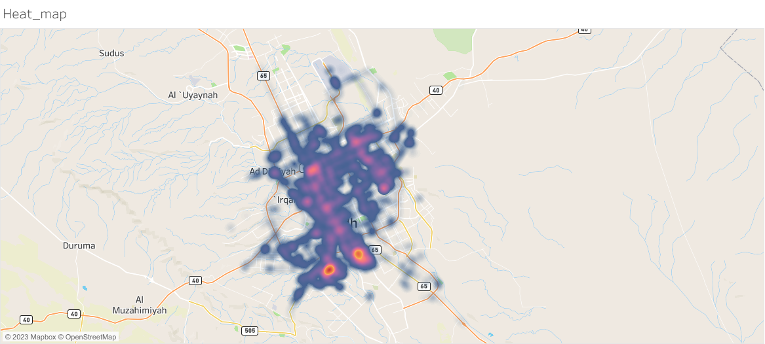

Slide 4
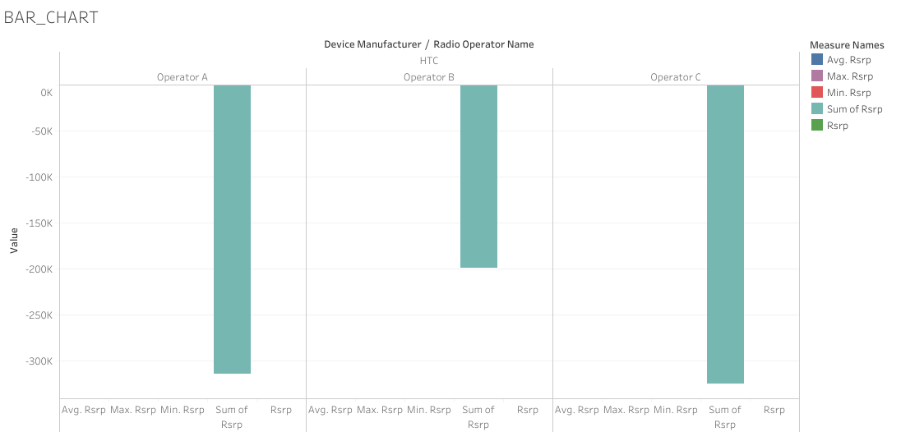

Slide 5
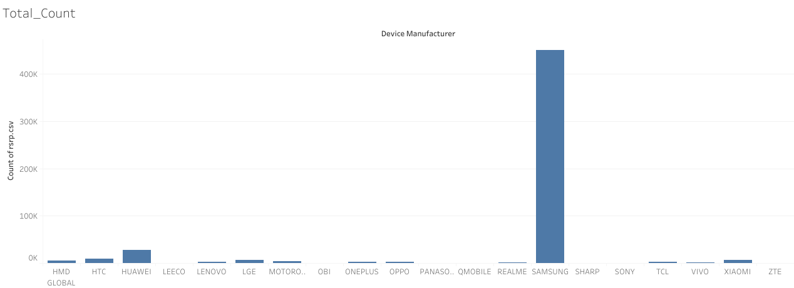

Slide 6
