Slide 1
FIBONACCI NUMBERS
A Mathematical Marvel in Nature and Beyond

Slide 2
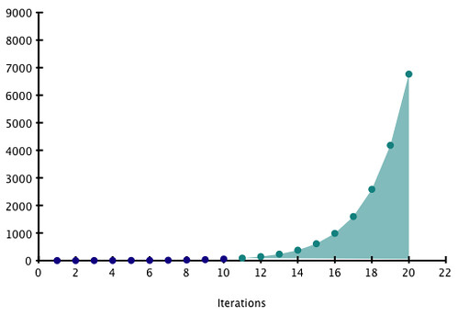
INTRODUCTION
Definition: A sequence where each term is the sum of previous two numbers.
Sequence: Begins 0,1,1,3,5,8,13,21....
Origin: It was introduced by Leonardo Fibonacci in 2012 in Liber Abaci.
.

Slide 3

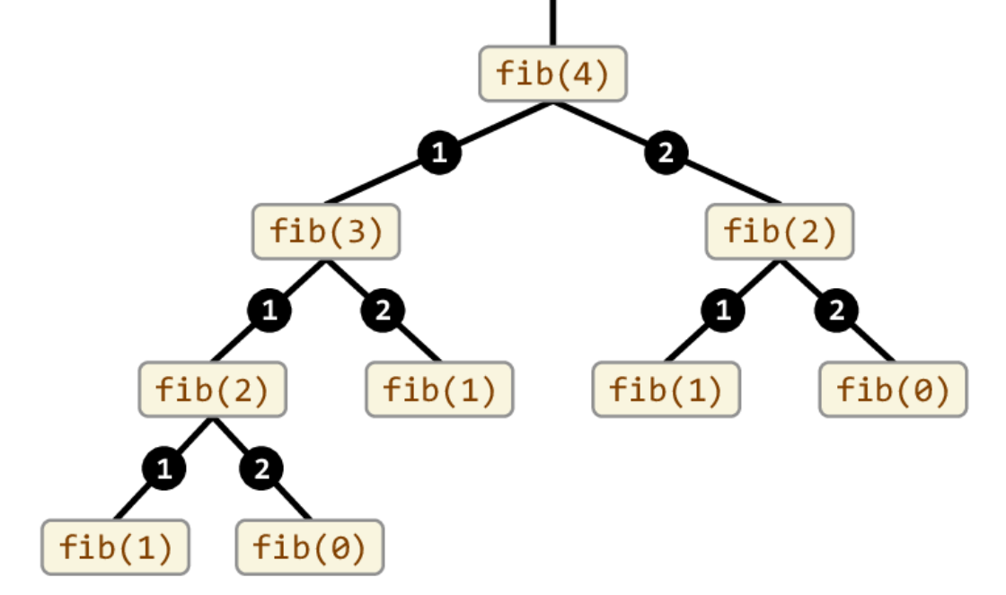
RECURSION METHOD
Advantages: The recursive definition
reflects the natural growth pattern
observed in many natural phenomena,
and recursive algorithms.
Drawback: The recursive approach
has a time complexity of O(2^n).
For each function call, it makes two more
recursive calls, leading to an exponential
growth in the number of calls as n
increases. This is highly inefficient for
large n.

Slide 4


BINET'S FORMULA
Advantage: Binet's formula calculates F(n) directly, without needing prior terms. This makes it highly
efficient, especially for large F(n).The formula involves
the golden ratio φ≈1.618.
Disadvantage: Since Binet's formula relies on
irrational numbers and square roots, it is more
theoretical. In practice, for large n, floating-point
precision limits its accuracy.

Slide 5
WHAT IS GOLDEN RATIO?
Introduction: Golden ratio is an irrational number, roughly
1.61803...,which has been of interest to mathematicians, artists and
architects for centuries.
Uses: This special ratio appears in natural phenomena , arts ,
architecture and human anatomy. It is known for creating aesthetically
pleasing proportions. Like it can be found in Parthenon and pattern of
branches.

Slide 6






UNDERSTANDING GOLDEN RATIO
A simple way to understand golden ratio is through a line segment.
If you divide a line in two parts such that the ratio of the whole line to the longer part is the same the ratio of the longer part to the shorter part, this ratio is called Golden ratio.
Mathematically:
Visual Representation:
Where L is AC +AB

Slide 7

FINDING THE GOLDEN RATIO OF FACIAL SYMMETRY
1- Measure the Vertical proportions of the Face.
2- Measure the Horizontal proportions of the Face.
3-Calculate using the formula.
4-If the result is close to 1.618, the face is said to have proportions
that approximate the Golden Ratio, it is often associated with beauty.

Slide 8
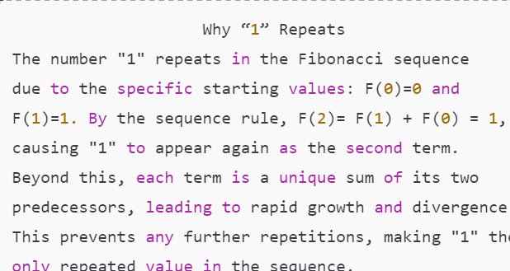
WHY THE FIBONACCI SEQUENCE NEVER REPEATS
Unique Formation of Terms: The sequence is generated by adding the two preceding terms, beginning with 0
and 1.where each number is a unique result of the two previous values, so the exact repetition of values doesn’t
occur after the initial terms.
Exponential Growth and Divergence: Each new term grows rapidly and diverges from earlier ones, making
cycles impossible.
Infinite Expansion: The sequence is infinite,
expanding endlessly without repeating values.
Mathematical Proof Against Repetition
Modular arithmetic shows exact value
repetition would require a loop, which is
impossible due to the sequence’s structure.

Slide 9
APPLICATION OF THE FIBONACCI SEQUENCE
Natural Patterns: Appears in leaf arrangements, flower petals, and spiral shells, representing efficient growth
in nature.
Art and Aesthetics: Guides design, art, and photography, leveraging proportions near the Golden Ratio for
visual appeal.
Financial Analysis: Used in stock market analysis for Fibonacci retracement levels, helping predict support
and resistance points.
Architecture and Design: Inspires proportions in buildings and layouts, adding balance and harmony to
Structures.
Computer Science: Optimizes algorithms in sorting, searching, and data structures, enhancing
computational efficiency.
Mathematics and Theory: Used to study numerical properties and patterns, contributing to number
theory and mathematical proofs..

Slide 10
EXAMPLES OF FIBONACCI SEQUENCE
Nature’s Patterns
Found in leaf arrangements, flower petals, and pine cones for efficient growth.
Human Anatomy
Ratios in finger bones and facial features reflect Fibonacci proportions.
Stock Market
Fibonacci retracement levels help predict support and resistance points.
Computer Science
Optimizes algorithms and data structures for efficiency.
Medical Imaging
Guides spiral scanning in MRI and CT for effective imaging.

Slide 11
PROOF BY CASES:
For n = 2
Formula:
F(n)=F(n−1)+F(n−2)
Solution:
F(2)=F(2−1)+F(2−2)
F(2)=F(1)+F(0)
1st Fib num = 1
So,
F(2)=1
For n = 4
Formula:
F(n)=F(n−1)+F(n−2)
Solution:
F(4)=F(4−1)+F(4−2)
F(4)=F(3)+F(2)
2nd Fib num = 1 , 3rd Fib num = 2
So,
F(4)=1 + 2 = 3
F(4) = 3
F

Slide 12
PROOF BY COUNTER
Example 1:
Claim: "All Fibonacci numbers are odd"
We have to prove this statement false
Clearly, the number F(0)=0F(0) = 0F(0)=0 is even, and therefore not odd.
Example 2:
Claim: "The square of every Fibonacci numbers is even"
We have to prove this statement false
F(3)=2, and 22=42^2 = 422=4
4 is even, Therefore, the statement is false.

