Slide 1
BUSINESS ANALYSIS TEAM PROJECT
99 Bikes
DSBA/MBAD 6276 - Strategic Business Analytics
by Eric Chaves, Gavin Ciganek, Lara Kretschmer, Joshua Nguyen, Jessica Ricks

Slide 2





AGENDA
Background
S.W.O.T Analysis
Managerial Question and
Research Objectives
Data, Analysis, and Results
Recommendations

Slide 3
BACKGROUND
BACKGROUND

Slide 4

99 Bikes is an Australian bike retailer selling four types of bikes and other bike accessories.
They have 45 stores open across the country.
The data we will be analyzing is transaction and customer demographic data collected in 2017.

Slide 5
S.W.O.T.
ANALYSIS
S
W
O
T

Slide 6

S.W.O.T.
ANALYSIS
Strengths
S
Cycling experts on staff
Large high quality selection
W
O
T

Slide 7

S.W.O.T.
ANALYSIS
Strengths
S
Weaknesses
W
Cycling experts on staff
Large high quality selection
S
Expensive products
Limited marketing budget
O
T

Slide 8

S.W.O.T.
ANALYSIS
Strengths
S
Weaknesses
W
S
Cycling experts on staff
Large high quality selection
S
W
Expensive products
Limited marketing budget
Opportunities
O
T
Increased cycling interest
Online shopping

Slide 9

S.W.O.T.
ANALYSIS
Strengths
S
Weaknesses
W
S
S
S
W
Cycling experts on staff
Large high quality selection
W
Expensive products
Limited marketing budget
O
T
Opportunities
O
Threats
Increased cycling interest
Online shopping
Sports superstores
Economic downturns

Slide 10
RESEARCH QUESTION

Slide 11
RESEARCH QUESTION
“How can we adjust our marketing strategy based on our 2017 sales data to increase sales?

Slide 12
RESEARCH QUESTION

Slide 13
RESEARCH QUESTION
“What trends do we see in our bike sales data for 2017?”

Slide 14
RESEARCH QUESTION
RESEARCH OBJECTIVES
“What trends do we see in our bike sales data for 2017?”

Slide 15
RESEARCH QUESTION
RESEARCH OBJECTIVES
“What trends do we see in our bike sales data for 2017?”
Analyze seasonal trends in products.

Slide 16
RESEARCH QUESTION
RESEARCH OBJECTIVES
“What trends do we see in our bike sales data for 2017?”
Analyze seasonal trends in products.
Analyze customer demographics to see any trends with gender, age, and job industry.

Slide 17
BACKGROUND
DATA

Slide 18
Customer Demographics Data

Slide 19
Customer Demographics Data
Gender
F
M

Slide 20
Customer Demographics Data
Age Group
Gender
<18
Child
18-29
Young Adult
F
30-64
Adult
M
65+
Senior

Slide 21
Customer Demographics Data
Age Group
Gender
Owns
Car
>18
18-29
F
Yes
30-64
M
65+
No

Slide 22
Customer Demographics Data
Age Group
Job Industry
Gender
Owns
Car
Entertainment
>18
Agriculture
18-29
Health
Financial Services
F
Yes
IT
30-64
Retail
M
Manufacturing
65+
No
Property
Telecommunications
Other

Slide 23
Customer Demographics Data
Age Group
Job Industry
Gender
Owns
Car
Tenure
>18
18-29
F
Yes
30-64
M
65+
No

Slide 24
TRANSACTION
transaction_date
list_price
DATA
brand
product_line
standard_cost
online_order

Slide 25
TRANSACTION
transaction_date
list_price
DATA
brand
product_line
standard_cost
online_order

Slide 26
TRANSACTION
transaction_date
list_price
DATA
brand
product_line
standard_cost
online_order

Slide 27
TRANSACTION
transaction_date
list_price
DATA
brand
product_line
standard_cost
online_order

Slide 28
TRANSACTION
transaction_date
list_price
DATA
brand
product_line
standard_cost
online_order

Slide 29
TRANSACTION
transaction_date
list_price
DATA
brand
product_line
standard_cost
online_order

Slide 30
TRANSACTION
transaction_date
list_price
DATA
brand
product_line
standard_cost
online_order

Slide 31
BACKGROUND
ANALYSIS

Slide 32
SEASONAL TRENDS

Slide 33
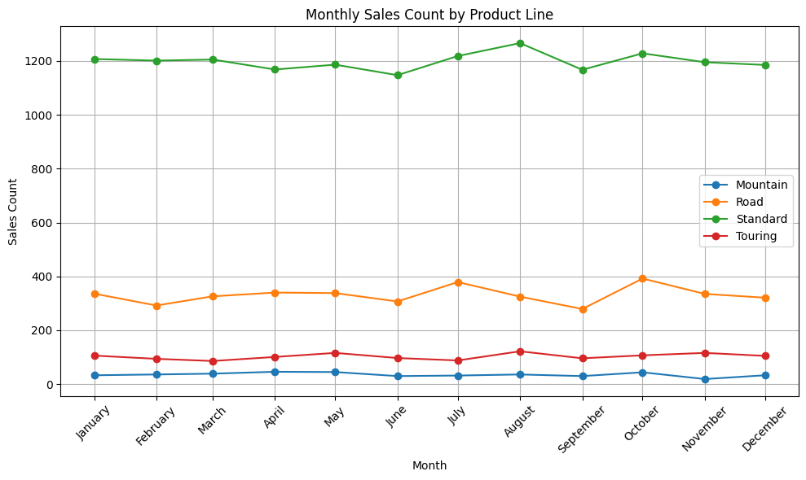

Slide 34
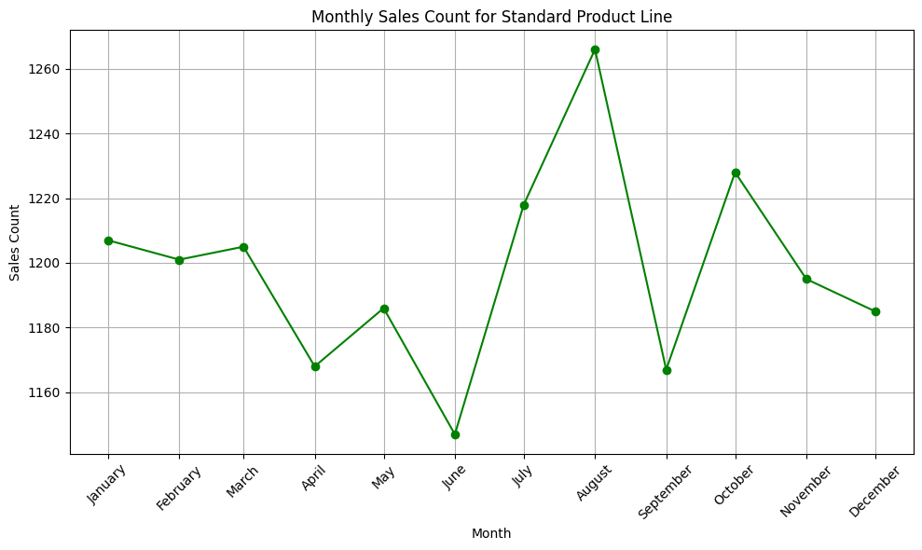

Slide 35
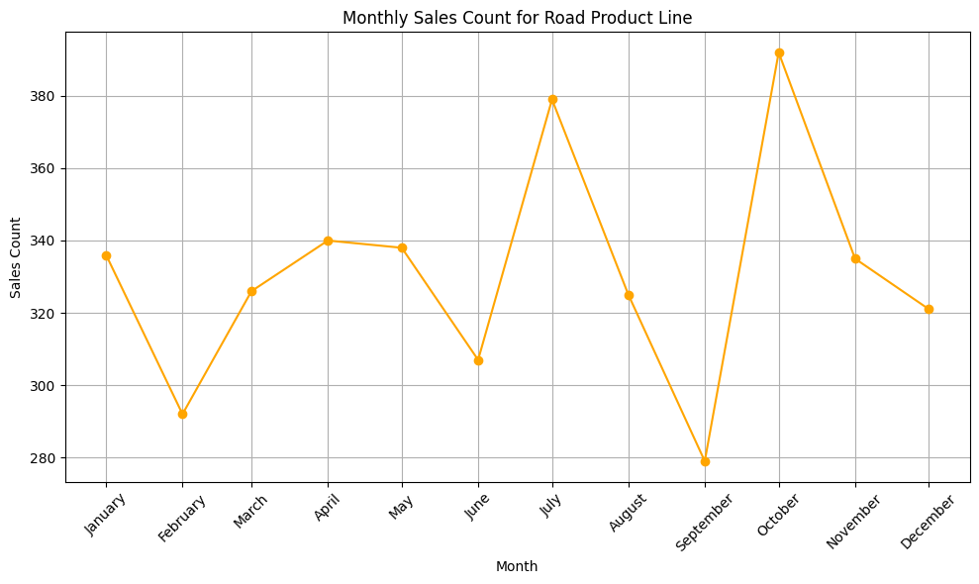

Slide 36
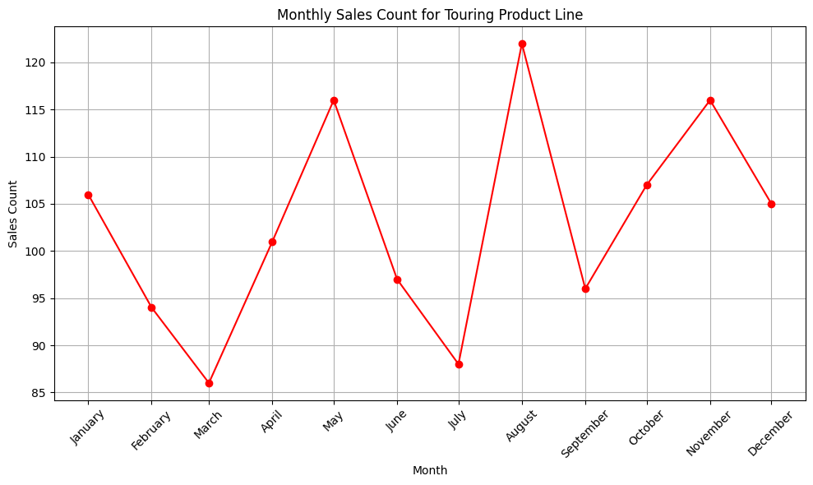

Slide 37
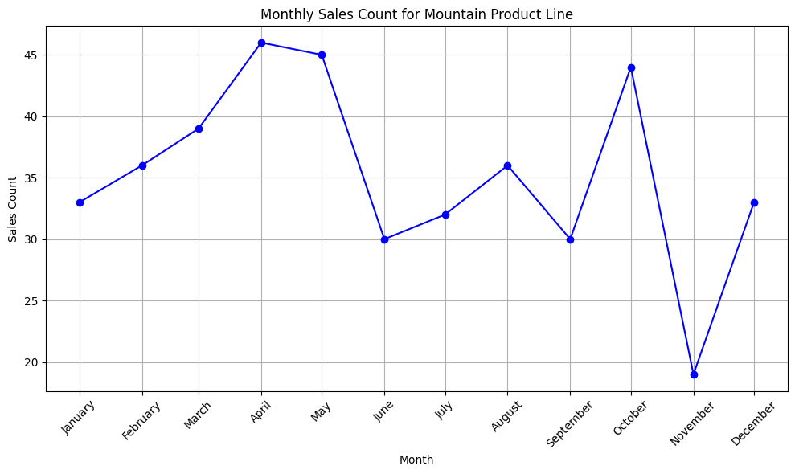

Slide 38
CLUSTER ANALYSIS
—
Customer Demographics

Slide 39
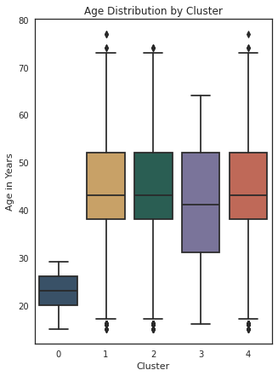
Age Distribution

Slide 40
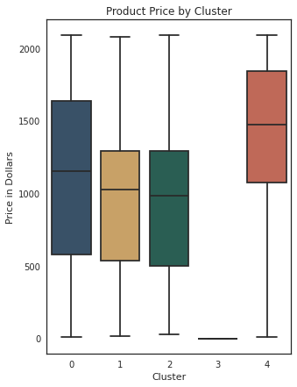
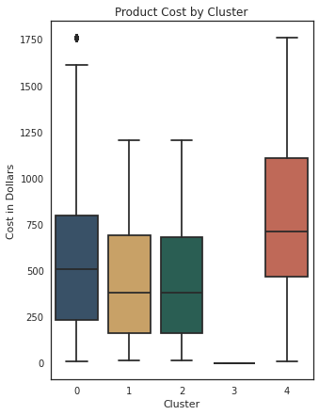
Product Price & Cost

Slide 41
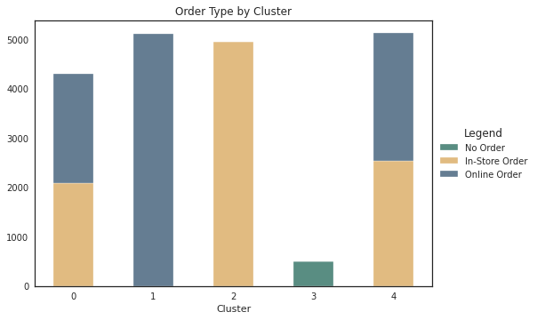
Order Type

Slide 42
Cluster Analysis - Summary
Cluster 0
Cluster 2
Cluster 4
Age < 30
In-Store Order
High Profit
Cluster 1
Cluster 3
Online Order
No recent Order

Slide 43
DECISION TREE ANALYSIS
—
Customer Demographics

Slide 44
PROFIT GROUP
LOW
MEDIUM
HIGH
between 25th and 50th percentile
Below 25th
Percentile
Top 50th Percentile

Slide 45
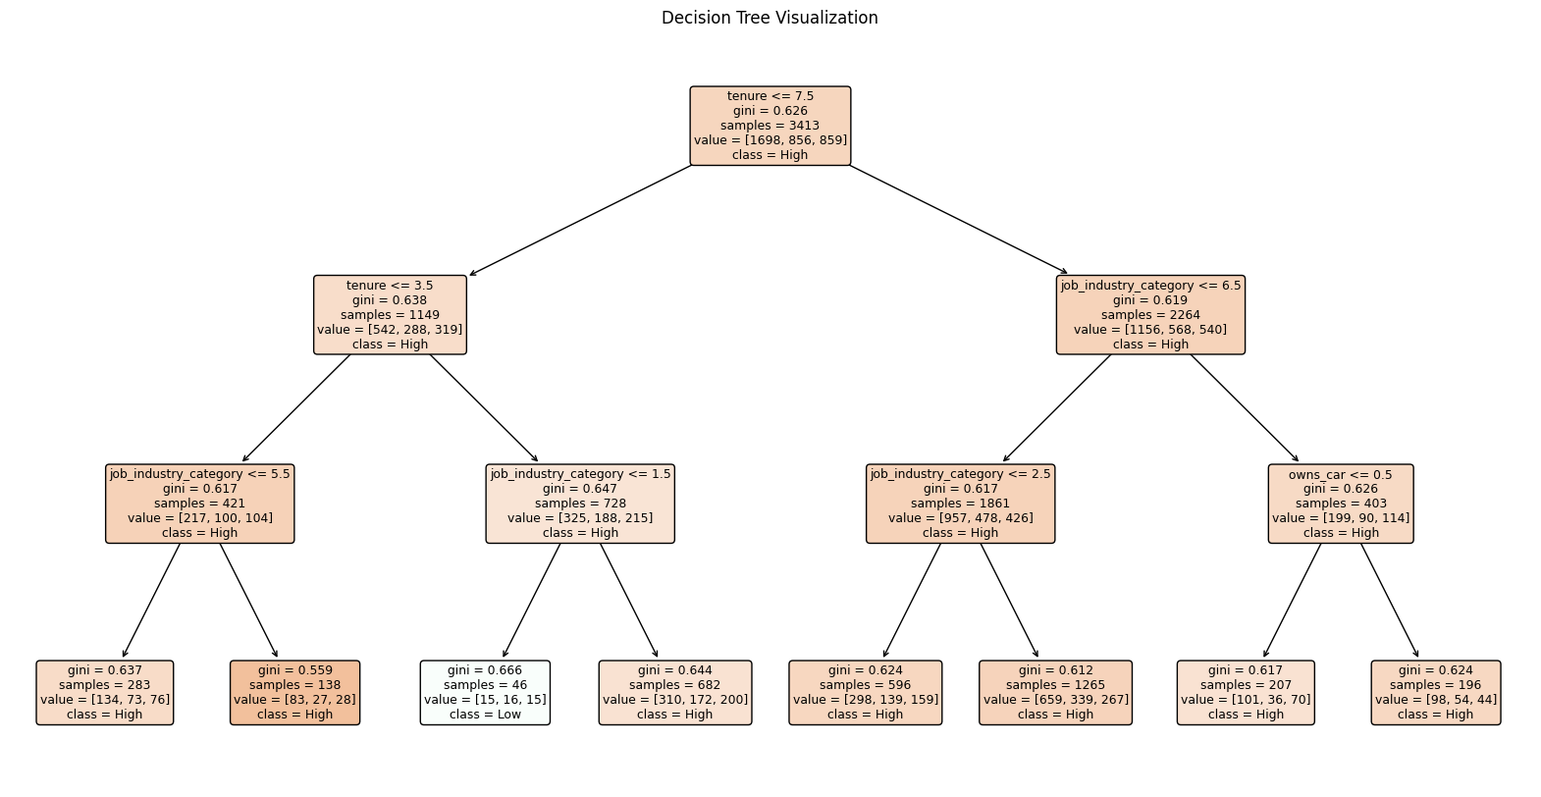

Slide 46
TENURE
<= 3.5 years
> 7.5 years
> 3.5 years
High Value Customer
Non car owners
Job Industry significant
Notes:
<= 3.5 years: Immediately classified as high value, indicating newer customers bring in more profits, newer customers need more equipment
> 3.5 years: Job industry played a significant role. Those in the Manufacturing and Financial sector contributed the most to the years profits
> 7.5 years: Those that do not own a car are more likely to be high value customers over time.

Slide 47
DECISION TREE
RESULTS

Slide 48
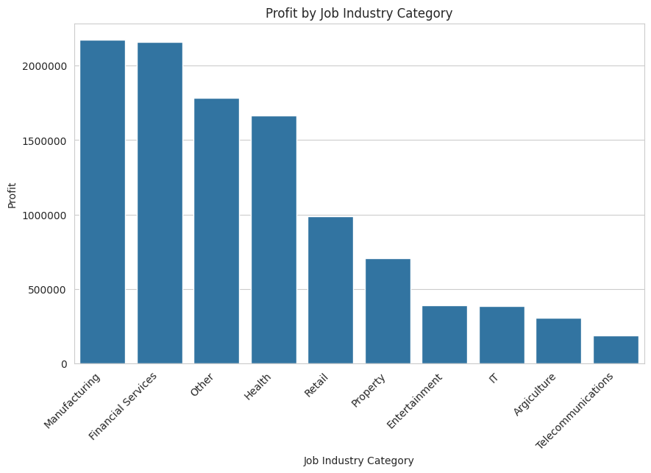

Slide 49
Gender is not a primary indicator of a customer’s value and any marketing plans should be gender-neutral and inclusive.
Adults were identified as significant in some splits indicating they are a demographic with high profitability

Slide 50
RECOMMENDATIONS
Decision Tree Analysis
Seasonal Trends
Cluster Analysis

Slide 51
RECOMMENDATIONS

Slide 52
RECOMMENDATIONS
Start promotions for specific bike types leading up to their spike in sales.

Slide 53
RECOMMENDATIONS
Start promotions for specific bike types leading up to their spike in sales.
Consider introducing New Customer Benefits and Loyalty programs

Slide 54
RECOMMENDATIONS
Start promotions for specific bike types leading up to their spike in sales.
Consider introducing New Customer Benefits and Loyalty programs
Tailor marketing campaigns to high-value customers

Slide 55
RECOMMENDATIONS
Start promotions for specific bike types leading up to their spike in sales.
Consider introducing New Customer Benefits and Loyalty programs
Tailor marketing campaigns to high-value customers
Use clustering results to better understand your targeting group and expand your customer-base.
Notes:
Start promotions for specific bike types leading up to their spike in sales.
Consider introducing New Customer Benefits and Loyalty programs
Tailor marketing campaigns to high-value customers and those in the financial and manufacturing industries
If you would like to expand your customer-base, use the clustering results to understand who you are targeting

Slide 56
Q & A

