Slide 1
Group 4
Deep Learning Project
Group Members:
Eric Chaves
Kwame Sefa-Boateng
Jordyn Dolly
Han Zhang

Slide 2

The Problem
The primary goal of the model is to use consumer credit features to predict if a borrower will repay the loan.
This is useful in the area of finance when a financial institution like a bank or investment company is determining whether to finance a loan.
We deploy the deep learning models such as Deep Neural Network (DNN), Multilayer Perceptron (MLP), and Wide & Deep Neural Network models to aid the prediction of possible default of loan.

Slide 3
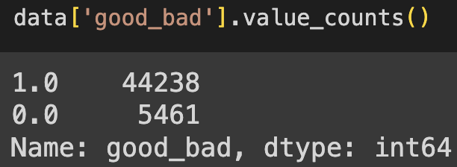
The Dataset
This is a publicly available dataset with loan information between the years of 2007 through 2014
Our dataset consists of 395,932 loan samples and 31 parameters
Parameter examples
Loan amount, annual income, debt to income ratio, number of open accounts, revolving balance, employment length, etc..
Our target variable is ‘good_bad’
‘good_bad’ = 1 when the borrower repays the loan
‘good_bad’ = 0 when the loan is not repaid

Slide 4
Deep Learning Models

Slide 5
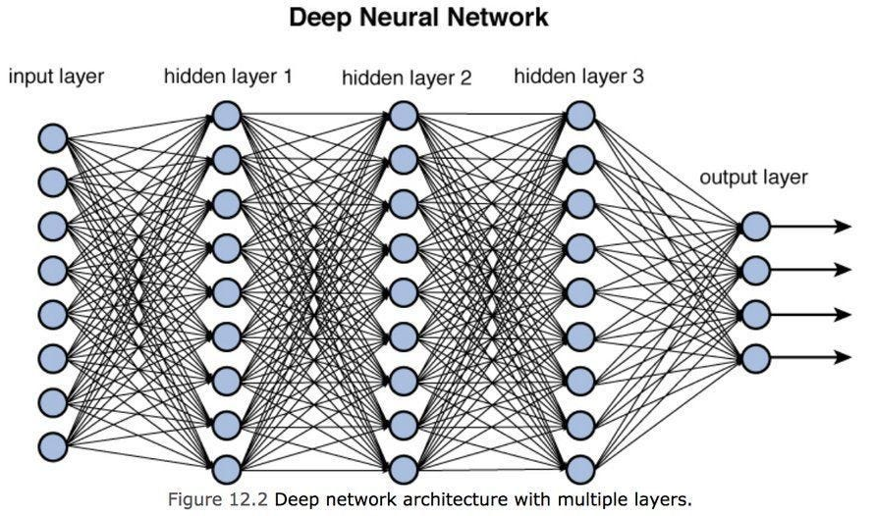
Deep Neural Network Model
A DNN can be extremely useful in determining if an individual will likely default on a loan repayment.
Ability to learn non-linear relationships
Automatically learn the hierarchical representations of features
Handles high dimensional data well
High flexibility by experimenting with number of layers, number of neurons, and activation functions
DNN’s allow for end to end learning. Therefore the model can learn directly from the raw data to the final predictions.
However, DNN’s can be more difficult to interpret and can experience the vanishing gradient.
Image sourced from https://towardsdatascience.com/training-deep-neural-networks-9fdb1964b964

Slide 6
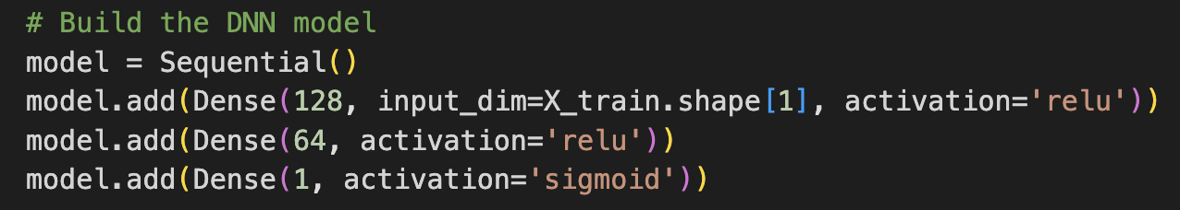
DNN Implementation
When compiling the model for training:
Optimizer (optimizer='adam'):
The optimizer is responsible for updating the weights of the neural network during training. We used 'adam' as it has an adaptive learning rate and is efficient.
Loss Function (loss='binary_crossentropy'):
The loss function is a measure of how well the model is performing. We used'binary_crossentropy' as it calculates the binary cross-entropy between predicted probabilities and true labels.
Metrics (metrics=['accuracy']):
We used 'accuracy' to measure the proportion of correctly predicted instances as it is a simple metric to compare across multiple models.
To gain a basic understanding of the model and to not overfit, a simple three layer model was used.
When building the DNN model:
The first layer introduces the Dense Layer with 128 neurons. Additionally, for the activation function we had chosen a rectified linear unit (ReLU). The activation function introduces nonlinearity to the data.
The second layer is another Dense Layer with 64 neurons to continue transforming the data.
The final layer has a single neuron, indicating that the network is designed for binary classification. The activation function used for the output layer is the sigmoid function, which places the output between 0 and 1.

Slide 7
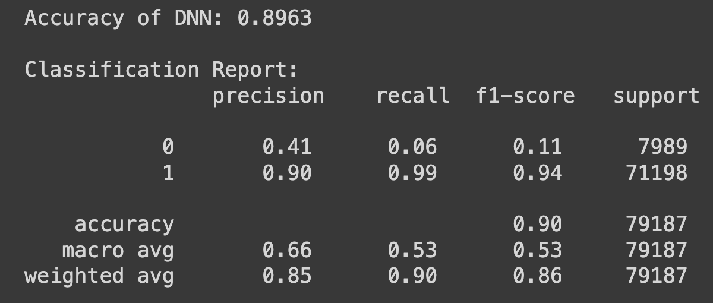
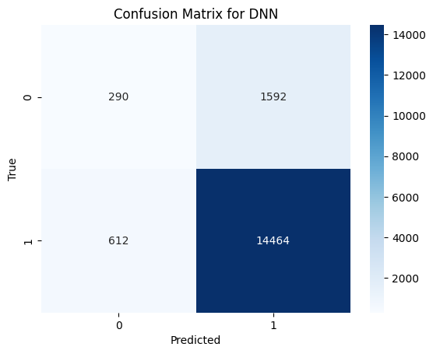
DNN Evaluation
The basic DNN model produced a relatively high accuracy of 0.8963
The precision of 0 or when a loan is not repaid is low. This is one indication that our model has a high number of false positives.
The recall appears very good for our loan repayment group showing almost no false negatives
Knowing that false positives may be an issue we created a Confusion Matrix
False Negative: 290
False Positive: 1,592
True Negative: 612
True Positive 14,664

Slide 8
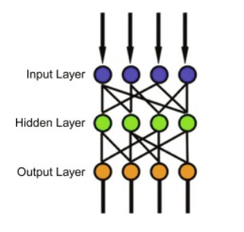
MLP (Multilayer Perceptron)
Components of an MLP
Input layer - receives the input signal to be processed
Hidden layers - neurons that apply a weighted sum on their inputs
Output layer - one neuron for binary classification
Activation Functions - allow the model to learn more complex relationships
Weights and Biases - neuron in hidden and output layer has weights and bias. Weight represent strength of connection between neurons
How MLP Works
Forward Propagation - data fed into input layer. Each neuron in the subsequent layers takes the weighted sum of its inputs and applies an activation function. Continues until output layer is reached
Backpropagation and optimization - the models prediction is compared with the target using a loss function. The weights and biases of the neurons are adjusted to minimize loss.
Learning - The process of forward propagation, loss calculation, back propagation, and optimizing weights is repeated over the epochs.
Image sourced from https://www.sciencedirect.com/topics/computer-science/multilayer-perceptron#:~:text=The%20input%20layer%20receives%20the,computational%20engine%20of%20the%20MLP.

Slide 9
MLP Implementation
Model Settings
Start with a dense layer of 64 neurons and uses relu activation function
dropout layer with a dropout rate of 0.5, used to prevent overfitting
Second dense layer of 64 neurons with relu activation
Second dropout layer with dropout rate of 0.5
The final dense layer with 1 neuron uses a sigmoid activation function suitable for binary classification
Model is compiled with the adam optimizer
Training Strategy
Dataset is split into training and testing sets with an 80-20 split
Trained for 10 epochs with a batch size of 32
A validation split of 20% is used during training to monitor the model’s performance on a validation set

Slide 10
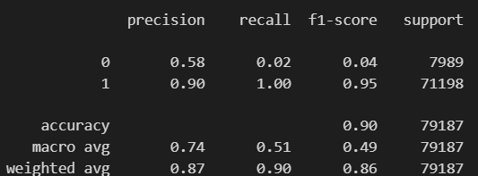
MLP Results
Accuracy ≅ 0.90
F1-score
Class 0 model has very low performance
Class 1 model has very high performance
Low recall for class 0 indicates model fails to identify a significant portion of actual bad loans.
Class 0 precision of .58 indicates the model is correct a little over half the time when predicting a loan will default.

Slide 11
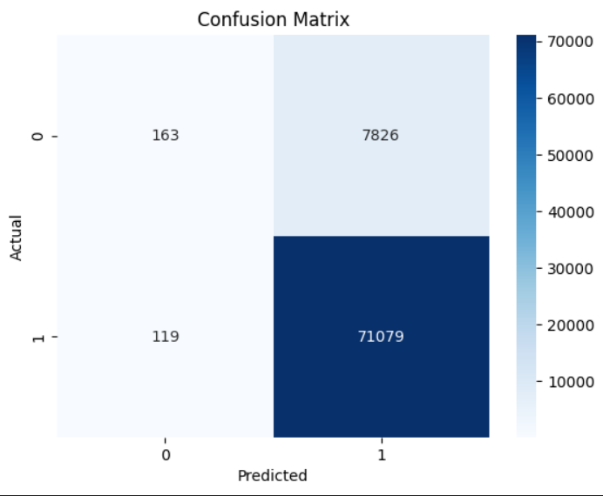
MLP Results
True positive = 71079
True negative = 163
False Positive = 7826
False Negative = 119
Sensitivity 99.83%
Specificity 2.04%
Precision 90.08%
Error Rate 10.03%
The model is very accurate in identifying positive cases (loan repayment), but struggles to identify negative cases (loan default).

Slide 12
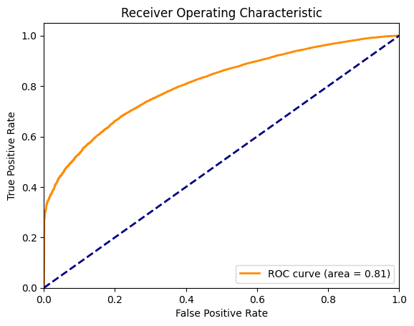
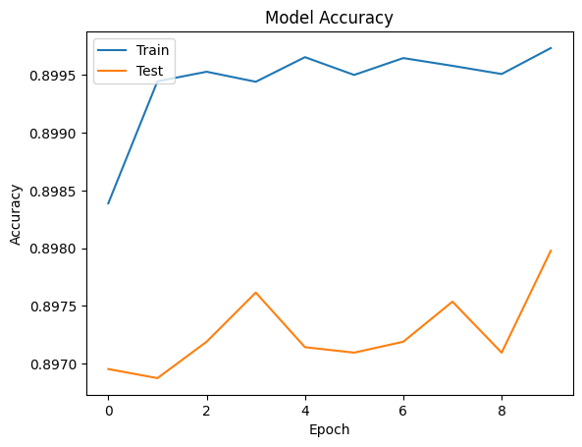
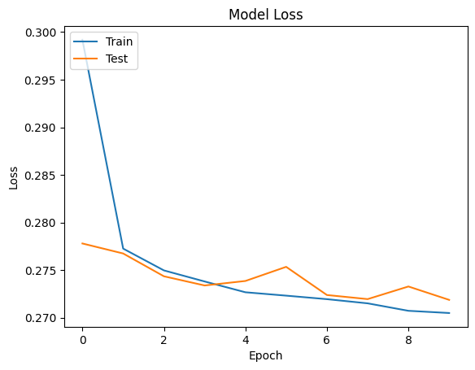
MLP Results
ROC Curve
The area under the curve is 0.81 which suggests the model has a good discriminative ability
Model Loss & Accuracy
Shows signs of possible overfitting
The training metrics are consistently better than the testing metrics
There is a variance in the testing accuracy which does not improve with more epochs

Slide 13
Wide & Deep Neural Network Model
The key idea is to combine the memorization capability of a wide model with the generalization ability of a deep model.
Deep Component:
Construct using Dense layers.
Utilize ReLU activation function for learning complex patterns in the deep neural network.
Wide Component:
Integrate a linear model for memorizing rule-based patterns.
Combining Components:
Merge the deep and wide components to create a comprehensive model structure.
Output Layer:
Implement Sigmoid activation for binary classification tasks.

Slide 14
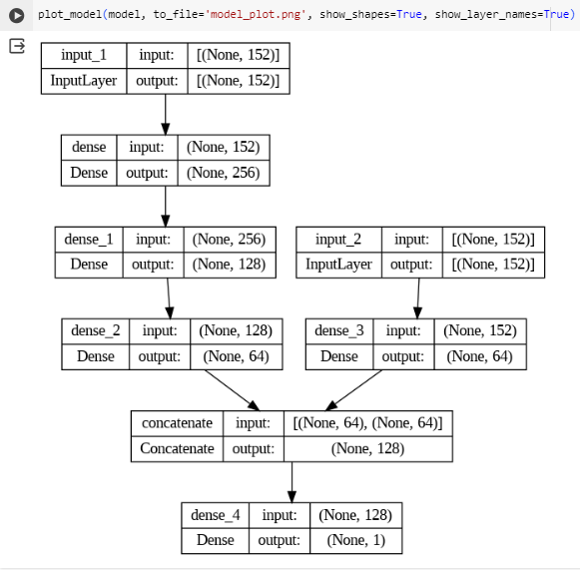
Wide & Deep Neural Network Model Implementation
Overall, this model architecture diagram indicates a Deep & Wide model suitable for binary classification tasks with tabular data. The deep part of the model is designed to learn complex patterns through multiple layers of transformation, while the wide part can capture simple, rule-based information. The final output is structured to provide a binary classification decision.

Slide 15
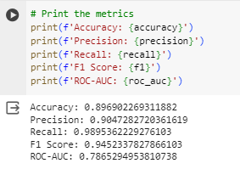
Wide & Deep Neural Network Model Evaluation
The high F1 score implies that the model is performing well in terms of precision and recall, while the ROC-AUC value suggests that the model has a fair classifying ability. These results would typically be considered good for the model.

Slide 16
Conclusion
DNN
A simple model that appeared to be overfitting the data due to the imbalance of 0’s and 1’s in the data
Accuracy score of 0.8963 with a recall of 0.99
MLP
Versatile and can be used for various tasks
Particularly useful for structured data such as our dataset
The model is highly accurate at 0.89967 with perfect recall
Deep & Wide NN
Combined the memorization capability of a wide model with the generalization ability of a deep model
The model accuracy was high at 0.8960 with a recall of 0.99
While all the models are highly accurate and have extremely high recall values, the MLP model is superior. The combination of its versatility and simplicity allowed us to reach the highest accuracy and recall scores.

