Slide 1

Honduras
A guide for future visitors!

Slide 2
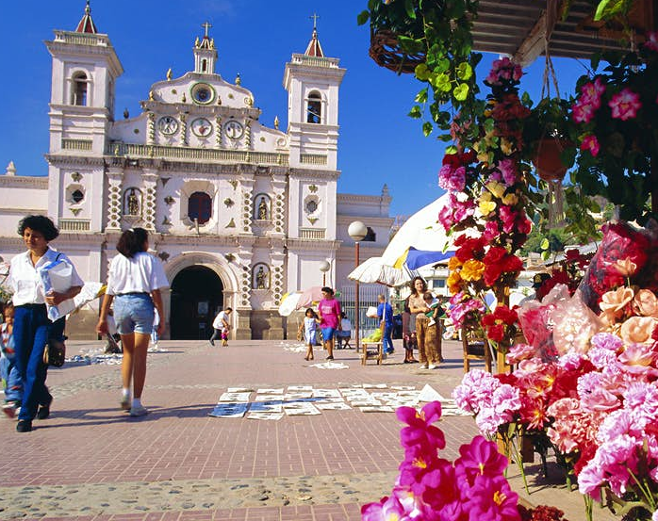
General Information
Test
Test
Test
Test
Test
Test
Test
Test
Test

Slide 3

Tourist Attractions
Attr1
Attr2
Attr3

Slide 4
Attraction 1

Slide 5
Attraction 2

Slide 6
Culture

