Slide 1
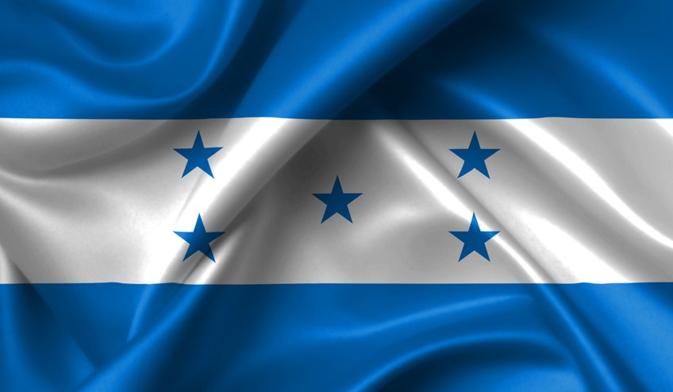
Honduras
A brief overview for future visitors!

Slide 2
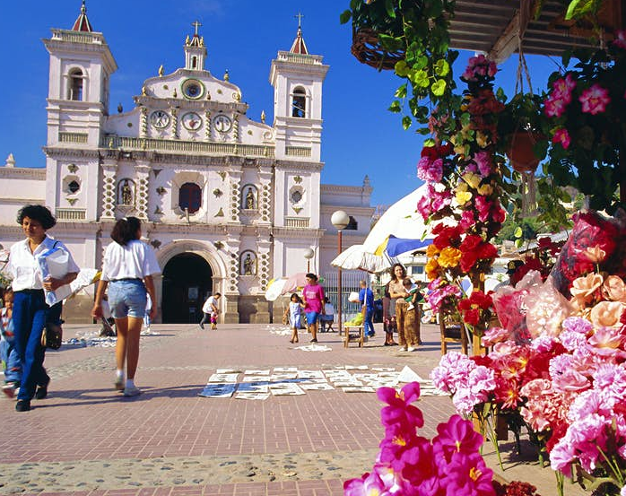
General Information
Located in Central America
Capital is Tegucigalpa
Climate varies depending on region
Population of 9.75m
Currency – Honduran Lempira
Economy – Agriculture Based
Most Popular Tourism Site – West Bay Beach
Notes:
Economy: Accounts for 14% of the GDP
Significant Exports: Bananas, shrimps, coffee.
Has extensive forests, mines and minerals

Slide 3
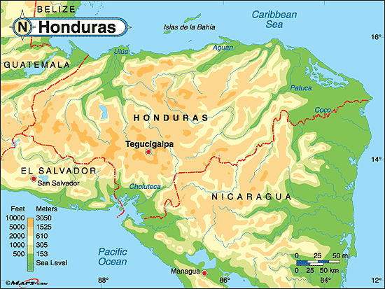
Climate
Caribbean lowlands:
Tropical wet climate
High temperatures
Recurring rainfall
Pacific lowlands:
Tropical dry climate
High temperature
Dry season
Interior Highlands:
Tropical dry climate
Temperature vary depending on altitude
Notes:
North - Caribbean Sea
South - Pacific Ocean
Middle - Highlands

Slide 4
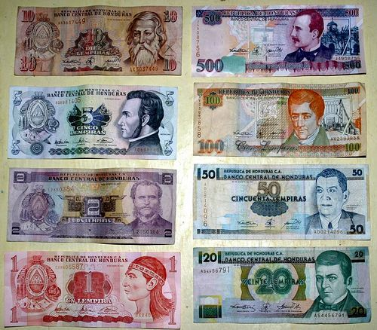
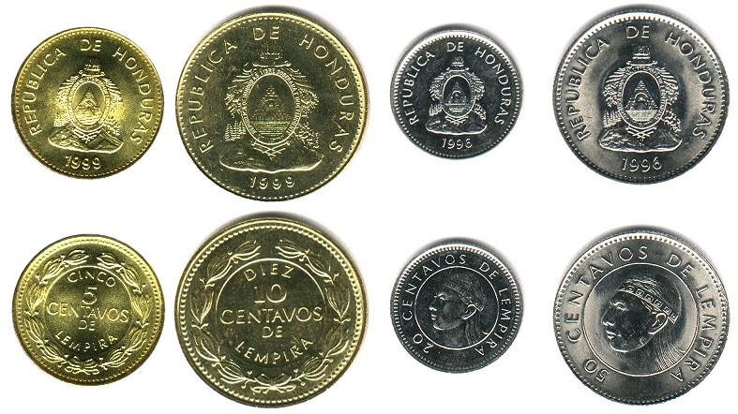
Honduran Lempira
1 CAD = 19.10 HNL
Notes:
Honduran Lempira 1, 2, 5, 10 , 20, 50, 100, 500
Centavos DE Lempira

Slide 5
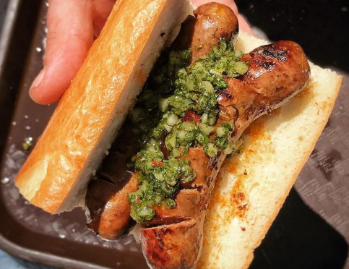


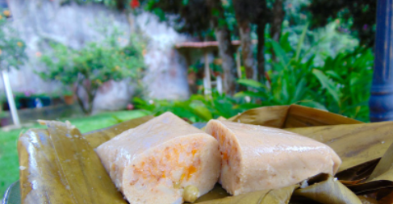
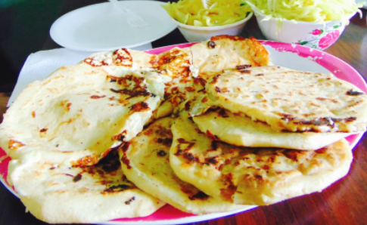
Traditional foods
Choripan
Baleadas
Horchata
Tamales
Pupusas
Notes:
From left to right in order. Two Favorites:
The Honduran baleadas are a classic, made up of refried beans, mantequilla, cheese, avocado, scrambled eggs and chorizo or steak, all folded into flour handmade tortillas, they are simply the best delicacy around
Tamales: shaped and wrapped in plantain leaves, made of corn dough and filled with chicken, pork, and beans

Slide 6
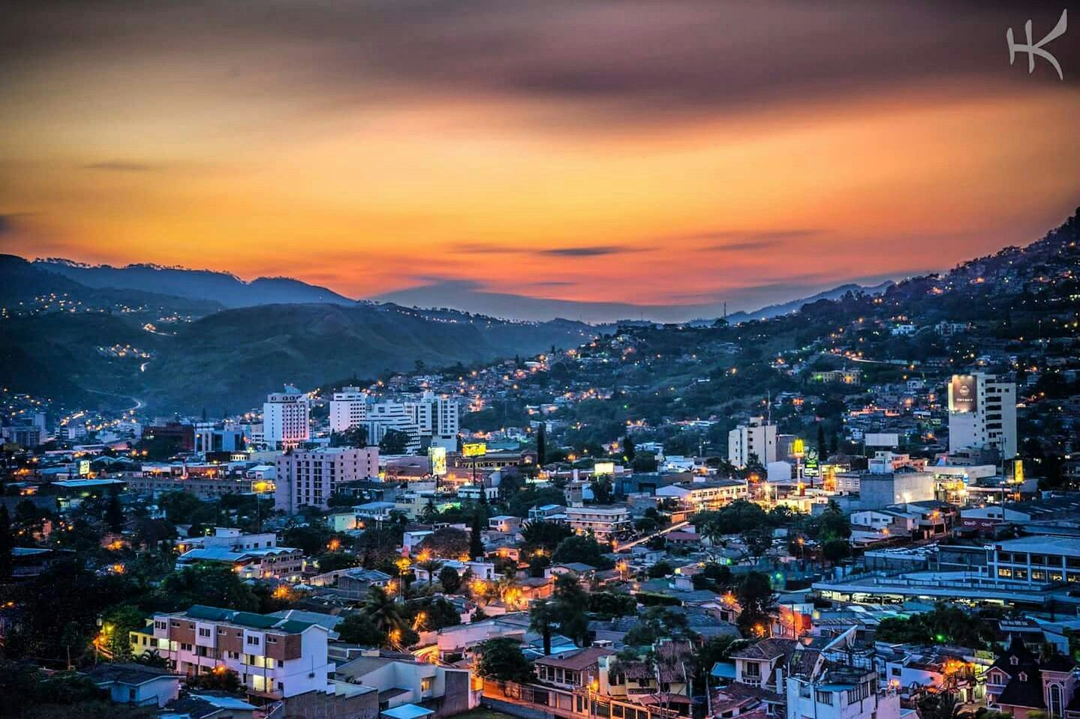
Capital - Tegucigalpa
Population: 1.16 million (11.9% of total)
Area: 1,502km² (1.34% of total)
Notes:
More modernized than its surrounding.
Concentrated Population

Slide 7
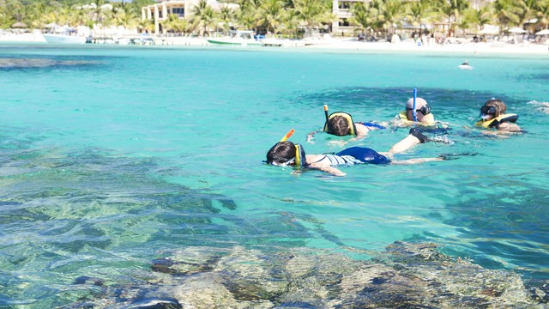
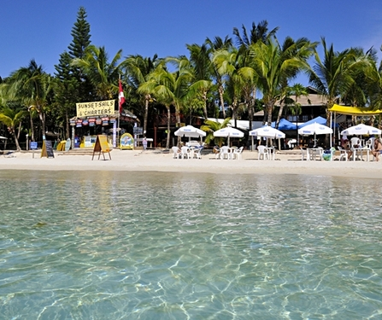
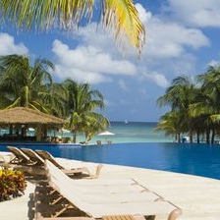
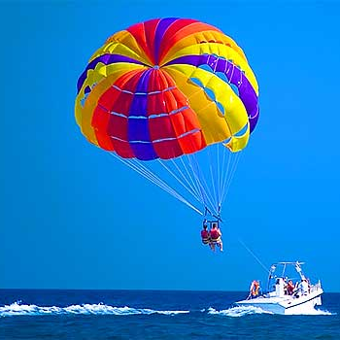
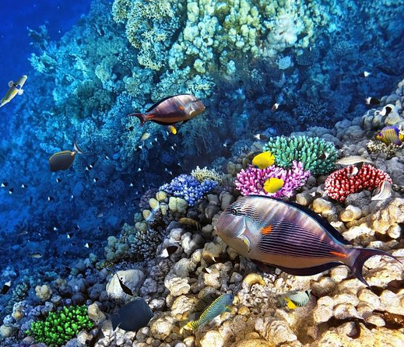
West Bay Beach
Unique Activities:
Scuba Diving
Snorkeling
Fishing
Parasailing
Notes:
Cruises
Fun for the whole family
Everyone will find an activity they love

Slide 8
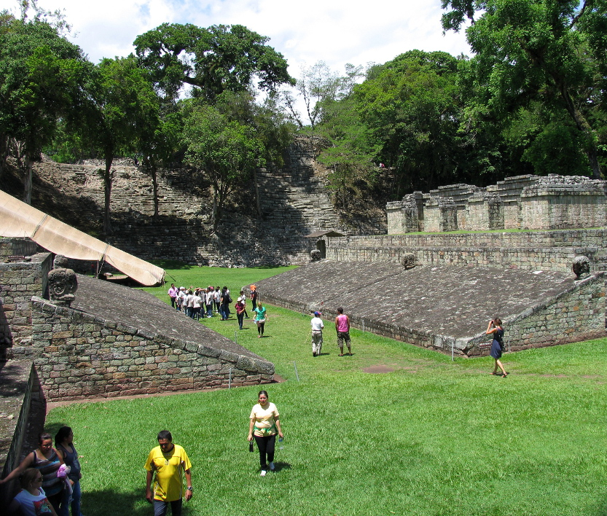
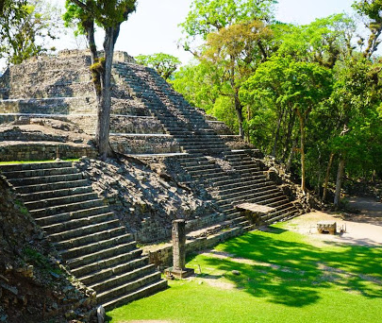
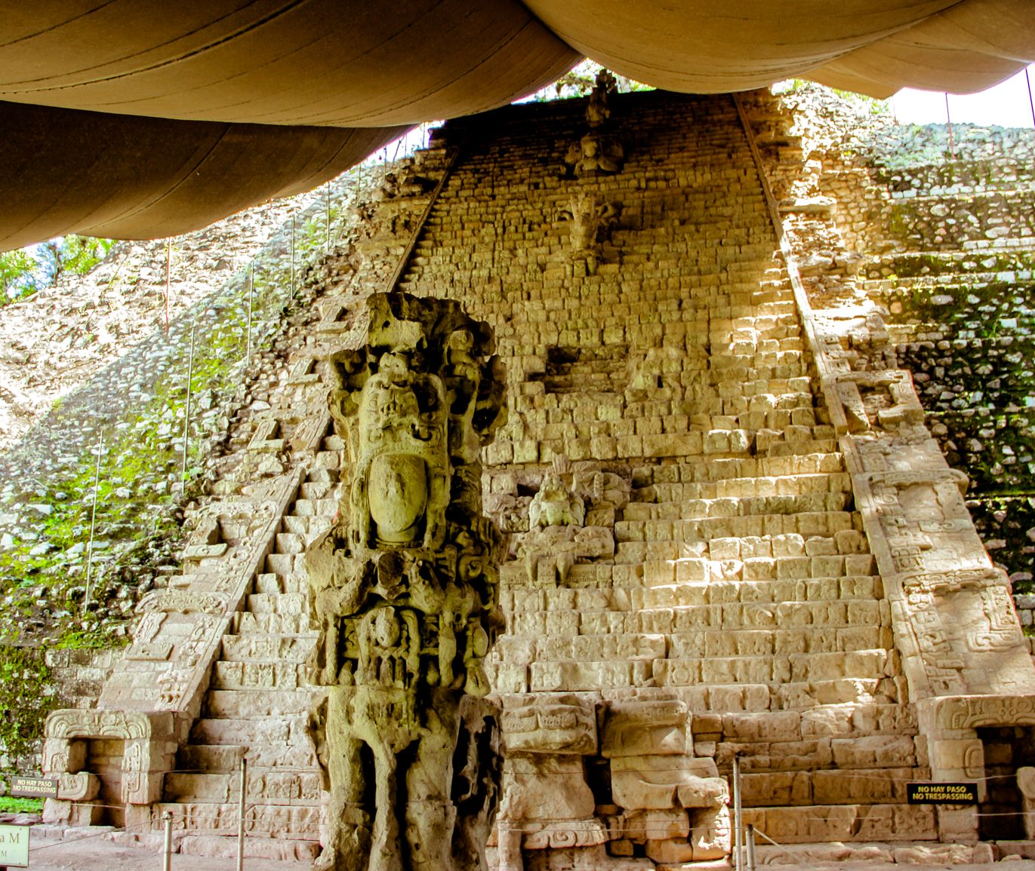
Copán Ruins Archeological Site
Mayan City Ruin
Dates back nearly 2000 years
UNESCO World Heritage Site
Unique cultural opportunities to observe:
Stelae and Altars
Immense Plaza
Ball Court
Hieroglyphic Stairway
Notes:
Whether you’re an archeologist enthusiast, a history lover, a culture seeker, or just want to see beautifully ingeniered structures.

Slide 9
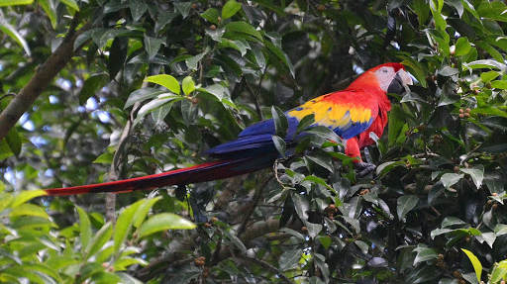
Adios!
Notes:
Thank you for listening to my presentation.
I hope that you have come to adore Honduras more and see it for what it is.
Adios!

