Slide 1
kathara lab
basic IPv6 configuration, ping, traceroute and ICMPv6
Version | 1.0
Author(s) | L. Ariemma, T. Caiazzi, G. Di Battista
E-mail | contact@kathara.org
Web | http://www.kathara.org/
Description | basic IPv6 configuration commands, IPv6 stateless auto-configuration, usage of ping and traceroute, ICMPv6 behaviour

Slide 2
copyright notice
All the pages/slides in this presentation, including but not limited to, images, photos, animations, videos, sounds, music, and text (hereby referred to as “material”) are protected by copyright.
This material, with the exception of some multimedia elements licensed by other organizations, is property of the authors and/or organizations appearing in the first slide.
This material, or its parts, can be reproduced and used for didactical purposes within universities and schools, provided that this happens for non-profit purposes.
Information contained in this material cannot be used within network design projects or other products of any kind.
Any other use is prohibited, unless explicitly authorized by the authors on the basis of an explicit agreement.
The authors assume no responsibility about this material and provide this material “as is”, with no implicit or explicit warranty about the correctness and completeness of its contents, which may be subject to changes.
This copyright notice must always be redistributed together with the material, or its portions.

Slide 3
content of the lab
© Computer Networks Research Group Roma Tre
there are two routers, called r1 and r2, and three hosts, called pc1, pc2, and pc3
they are connected via three LANs
we force their MAC addresses to be easily readable
we will learn how to:
administratively assign an IPv6 address and a netmask to the interface of a system
administratively assign a default gateway to the interface of a system
set the IPv6 addresses of a group of end-systems using the MAC-address-based stateless-auto configuration
set the routing table of a router
we will use the ping and traceroute commands
we will observe the behavior of ICMPv6

Slide 4
lab configuration

Slide 5
network topology – high level view
pc2
pc3
pc1
r1
r2

Slide 6




network topology – MAC addresses
pc1
pc2
pc3
0:1
eth0
eth0
0:2
0:3
eth0
A
C
0:a1
eth0
B
eth0
0:c1
r1
r2
eth1
eth1
0:b1
0:b2

Slide 7
network topology – IPv6 address plan
Will be assigned using SLAAC (StateLess Address Auto-Configuration)
pc1
pc2
pc3
0:1
eth0
eth0
0:2
0:3
eth0
A
C
2001:0:0:1::/64
2001:0:0:3::/64
0:a1
.1
eth0
B
eth0
.1
0:c1
r1
r2
eth1
2001:0:0:2::/64
eth1
0:b1
.1
.2
0:b2

Slide 8
a quick look at the lab
lab.conf
lab.conf
r1[0]="A"
r1[1]="B"
r1[image]="kathara/base"
r1[ipv6]=“True"
r2[0]="C"
r2[1]="B"
r2[image]="kathara/base"
r2[ipv6]=“True"
pc1[0]="A"
pc1[image]="kathara/base"
pc1[ipv6]="True"
pc1[sysctl]="net.ipv6.conf.eth0.accept_ra=2"
pc2[0]="C"
pc2[image]="kathara/base"
pc2[ipv6]="True"
pc2[sysctl]="net.ipv6.conf.eth0.accept_ra=2"
pc3[0]="C"
pc3[image]="kathara/base"
pc3[ipv6]="True"
pc3[sysctl]="net.ipv6.conf.eth0.accept_ra=2"
wireshark[bridged]=true
wireshark[port]="3000:3000"
wireshark[image]="lscr.io/linuxserver/wireshark"
wireshark[num_terms]=0

Slide 9
a quick look at the lab
lab.conf
lab.conf
r1[0]="A"
r1[1]="B"
r1[image]="kathara/base"
r1[ipv6]=“True"
r2[0]="C"
r2[1]="B"
r2[image]="kathara/base"
r2[ipv6]=“True"
pc1[0]="A"
pc1[image]="kathara/base"
pc1[ipv6]="True"
pc1[sysctl]="net.ipv6.conf.eth0.accept_ra=2"
pc2[0]="C"
pc2[image]="kathara/base"
pc2[ipv6]="True"
pc2[sysctl]="net.ipv6.conf.eth0.accept_ra=2"
pc3[0]="C"
pc3[image]="kathara/base"
pc3[ipv6]="True"
pc3[sysctl]="net.ipv6.conf.eth0.accept_ra=2"
wireshark[bridged]=true
wireshark[port]="3000:3000"
wireshark[image]="lscr.io/linuxserver/wireshark"
wireshark[num_terms]=0
Accept router advertisements on eth0

Slide 10
a quick look at the lab
pc1.startup
ip link set dev eth0 address 00:00:00:00:00:01
ip link set dev eth0 down
ip link set dev eth0 up
pc2.startup
ip link set dev eth0 address 00:00:00:00:00:02
ip link set dev eth0 down
ip link set dev eth0 up
pc3.startup
ip link set dev eth0 address 00:00:00:00:00:03
ip link set dev eth0 down
ip link set dev eth0 up

Slide 11
a quick look at the lab
to eth0 a MAC address is assigned, different from the default one
pc1.startup
ip link set dev eth0 address 00:00:00:00:00:01
ip link set dev eth0 down
ip link set dev eth0 up
pc2.startup
ip link set dev eth0 address 00:00:00:00:00:02
ip link set dev eth0 down
ip link set dev eth0 up
pc3.startup
ip link set dev eth0 address 00:00:00:00:00:03
ip link set dev eth0 down
ip link set dev eth0 up

Slide 12
a quick look at the lab
pc1.startup
the eth0 interface is set down and then up to force the stateless auto-configuration to rely on the new MAC address
ip link set dev eth0 address 00:00:00:00:00:01
ip link set dev eth0 down
ip link set dev eth0 up
pc2.startup
ip link set dev eth0 address 00:00:00:00:00:02
ip link set dev eth0 down
ip link set dev eth0 up
pc3.startup
ip link set dev eth0 address 00:00:00:00:00:03
ip link set dev eth0 down
ip link set dev eth0 up

Slide 13
a quick look at the lab
pc1.startup
ip link set dev eth0 address 00:00:00:00:00:01
ip link set dev eth0 down
ip link set dev eth0 up
no command is given to configure an IPv6 address or a default gateway, since they are obtained from the stateless auto-configuration
pc2.startup
ip link set dev eth0 address 00:00:00:00:00:02
ip link set dev eth0 down
ip link set dev eth0 up
pc3.startup
ip link set dev eth0 address 00:00:00:00:00:03
ip link set dev eth0 down
ip link set dev eth0 up

Slide 14
a quick look at the lab
r1.startup
ip link set dev eth0 address 00:00:00:00:00:a1
ip link set dev eth1 address 00:00:00:00:00:b1
ip link set dev eth0 down
ip link set dev eth0 up
ip link set dev eth1 down
ip link set dev eth1 up
ip address add 2001:0:0:1::1/64 dev eth0
ip address add 2001:0:0:2::1/64 dev eth1
ip route add 2001:0:0:3::/64 via fe80::200:ff:fe00:b2 dev eth1
chmod o-rw /etc/radvd.conf
systemctl start radvd

Slide 15
a quick look at the lab
to eth0 and eth1 a MAC address is assigned different from the default one
r1.startup
ip link set dev eth0 address 00:00:00:00:00:a1
ip link set dev eth1 address 00:00:00:00:00:b1
ip link set dev eth0 down
ip link set dev eth0 up
ip link set dev eth1 down
ip link set dev eth1 up
ip address add 2001:0:0:1::1/64 dev eth0
ip address add 2001:0:0:2::1/64 dev eth1
ip route add 2001:0:0:3::/64 via fe80::200:ff:fe00:b2 dev eth1
chmod o-rw /etc/radvd.conf
systemctl start radvd

Slide 16
a quick look at the lab
r1.startup
ip link set dev eth0 address 00:00:00:00:00:a1
ip link set dev eth1 address 00:00:00:00:00:b1
ip link set dev eth0 down
ip link set dev eth0 up
ip link set dev eth1 down
ip link set dev eth1 up
ip address add 2001:0:0:1::1/64 dev eth0
ip address add 2001:0:0:2::1/64 dev eth1
ip route add 2001:0:0:3::/64 via fe80::200:ff:fe00:b2 dev eth1
chmod o-rw /etc/radvd.conf
systemctl start radvd
the eth0 and eth1 interfaces are set down and then up to force the stateless auto-configuration to rely on the new MAC addresses

Slide 17
a quick look at the lab
r1.startup
ip link set dev eth0 address 00:00:00:00:00:a1
ip link set dev eth1 address 00:00:00:00:00:b1
ip link set dev eth0 down
ip link set dev eth0 up
ip link set dev eth1 down
ip link set dev eth1 up
ip address add 2001:0:0:1::1/64 dev eth0
ip address add 2001:0:0:2::1/64 dev eth1
ip route add 2001:0:0:3::/64 via fe80::200:ff:fe00:b2 dev eth1
chmod o-rw /etc/radvd.conf
systemctl start radvd
a static IPv6 address is given to eth0 and to eth1
consequently, the corresponding LANs are considered directly connected

Slide 18
a quick look at the lab
r1.startup
ip link set dev eth0 address 00:00:00:00:00:a1
ip link set dev eth1 address 00:00:00:00:00:b1
ip link set dev eth0 down
ip link set dev eth0 up
ip link set dev eth1 down
ip link set dev eth1 up
ip address add 2001:0:0:1::1/64 dev eth0
ip address add 2001:0:0:2::1/64 dev eth1
ip route add 2001:0:0:3::/64 via fe80::200:ff:fe00:b2 dev eth1
chmod o-rw /etc/radvd.conf
systemctl start radvd
the routing table is set;
a row is added to the routing table on how to reach a LAN that is not directly connected; the nexthop is a link-local address

Slide 19
a quick look at the lab
r1.startup
ip link set dev eth0 address 00:00:00:00:00:a1
ip link set dev eth1 address 00:00:00:00:00:b1
ip link set dev eth0 down
ip link set dev eth0 up
ip link set dev eth1 down
ip link set dev eth1 up
ip address add 2001:0:0:1::1/64 dev eth0
ip address add 2001:0:0:2::1/64 dev eth1
ip route add 2001:0:0:3::/64 via fe80::200:ff:fe00:b2 dev eth1
chmod o-rw /etc/radvd.conf
systemctl start radvd
the correct privileges for radvd.conf are set
and the radvd service is started

Slide 20
a quick look at the lab
radvd.conf
this configuration file, of the radvd daemon, is in the /etc directory of r1
interface eth0
{
AdvSendAdvert on;
MinRtrAdvInterval 3;
MaxRtrAdvInterval 9;
AdvDefaultLifetime 27;
prefix 2001:0:0:1::/64 {};
};

Slide 21
router advertisement
radvd is a daemon
it is used to send router advertisement messages
the configuration of radvd is specified in the radvd.conf file

Slide 22
a quick look at the lab
radvd.conf
interface eth0
{
AdvSendAdvert on;
MinRtrAdvInterval 3;
MaxRtrAdvInterval 9;
AdvDefaultLifetime 27;
prefix 2001:0:0:1::/64 {};
};
interface of the router where the advertisements are sent

Slide 23
a quick look at the lab
radvd.conf
interface eth0
{
AdvSendAdvert on;
MinRtrAdvInterval 3;
MaxRtrAdvInterval 9;
AdvDefaultLifetime 27;
prefix 2001:0:0:1::/64 {};
};
the announced prefix

Slide 24
a quick look at the lab
advertisements are sent
radvd.conf
interface eth0
{
AdvSendAdvert on;
MinRtrAdvInterval 3;
MaxRtrAdvInterval 9;
AdvDefaultLifetime 27;
prefix 2001:0:0:1::/64 {};
};
time interval for default gateway validity
minimum interval between consecutive advertisements
maximum interval between consecutive advertisements

Slide 25
a quick look at the lab
r1.startup
ip link set dev eth0 address 00:00:00:00:00:a1
ip link set dev eth1 address 00:00:00:00:00:b1
ip link set dev eth0 down
ip link set dev eth0 up
ip link set dev eth1 down
ip link set dev eth1 up
ip address add 2001:0:0:1::1/64 dev eth0
ip address add 2001:0:0:2::1/64 dev eth1
ip route add 2001:0:0:3::/64 via fe80::200:ff:fe00:b2 dev eth1
chmod o-rw /etc/radvd.conf
systemctl start radvd
similar configuration for router r2

Slide 26
start the lab
start the lab
user@localhost:~$ cd kathara-lab_basic-ipv6
user@localhost:~/kathara-lab_basic-ipv6$ lstart

Slide 27
useful commands

Slide 28
check the IPv6 addresses
on r1, and r2
perform the ip address command, to check the addresses assigned to the interfaces
the ip -6 address command shows only the IPv6 addresses
look at eth and loopback interfaces

Slide 29
check the IPv6 addresses
r1
loopback
IPv4: 127.0.0.1/8
IPv6: ::1/128
root@r1:/# ip address
1: lo: <LOOPBACK,UP,LOWER_UP> mtu 65536 qdisc noqueue state UNKNOWN group default qlen 1000
link/loopback 00:00:00:00:00:00 brd 00:00:00:00:00:00
inet 127.0.0.1/8 scope host lo
valid_lft forever preferred_lft forever
inet6 ::1/128 scope host
valid_lft forever preferred_lft forever
11: eth0: <BROADCAST,MULTICAST,UP,LOWER_UP> mtu 1500 qdisc fq_codel state UP group default qlen 1000
link/ether 00:00:00:00:00:a1 brd ff:ff:ff:ff:ff:ff
inet6 2001:0:0:1::1/64 scope global
valid_lft forever preferred_lft forever
inet6 fe80::200:ff:fe00:a1/64 scope link
valid_lft forever preferred_lft forever
12: eth1: <BROADCAST,MULTICAST,UP,LOWER_UP> mtu 1500 qdisc fq_codel state UP group default qlen 1000
link/ether 00:00:00:00:00:b1 brd ff:ff:ff:ff:ff:ff
inet6 2001:0:0:2::1/64 scope global
valid_lft forever preferred_lft forever
inet6 fe80::200:ff:fe00:b1/64 scope link
valid_lft forever preferred_lft forever
eth0
global unicast: 2001:0:0:1::1/64
link-local: fe80::200:ff:fe00:a1/64
eth1
global unicast: 2001:0:0:2::1/64
link-local: fe80::200:ff:fe00:b1/64

Slide 30
check the router routing table
on r1 and r2
perform the routel -6 command, to check the routing table

Slide 31
check the router routing table
r1
Lan A
root@r1:/# routel -6
Dst Gateway Prefsrc Protocol Scope Dev Table
::1 kernel lo
2001:0:0:1:: kernel eth0
2001:0:0:1::1 kernel eth0
2001:0:0:1::/64 kernel eth0
2001:0:0:2:: kernel eth1
2001:0:0:2::1 kernel eth1
2001:0:0:2::/64 kernel eth1
2001:0:0:3::/64 fe80::200:ff:fe00:b2 eth1
fe80:: kernel eth0
fe80:: kernel eth1
fe80::200:ff:fe00:a1 kernel eth0
fe80::200:ff:fe00:b1 kernel eth1
fe80::/64 kernel eth0
fe80::/64 kernel eth1
ff00::/8 kernel eth0
ff00::/8 kernel eth1
Lan B
Lan C
link-local addresses on A and B
R2 link local address on B
general multicast prefix

Slide 32
check auto-configured IPv6 addresses
on pc1, pc2, pc3
perform the ip address command, to check the IPv6 addresses assigned to the interfaces by the stateless auto-configuration
possibly, perform the ip -6 address command
look at eth and loopback interfaces

Slide 33
check auto-configured IPv6 addresses
loopback
IPv4: 127.0.0.1/8
IPv6: ::1/128
pc1
root@pc1:/# ip address
1: lo: <LOOPBACK,UP,LOWER_UP> mtu 65536 qdisc noqueue state UNKNOWN group default qlen 1000
link/loopback 00:00:00:00:00:00 brd 00:00:00:00:00:00
inet 127.0.0.1/8 scope host lo
valid_lft forever preferred_lft forever
inet6 ::1/128 scope host
valid_lft forever preferred_lft forever
7: eth0: <BROADCAST,MULTICAST,UP,LOWER_UP> mtu 1500 qdisc fq_codel state UP group default qlen 1000
link/ether 00:00:00:00:00:01 brd ff:ff:ff:ff:ff:ff
inet6 2001::1:200:ff:fe00:1/64 scope global dynamic mngtmpaddr
valid_lft 86394sec preferred_lft 14394sec
inet6 fe80::200:ff:fe00:1/64 scope link
valid_lft forever preferred_lft forever
eth0
global unicast: 2001::1:200:ff:fe00:1/64
link-local: fe80::200:ff:fe00:1/64

Slide 34
check the default route
on pc1, pc2, and pc3
perform the routel -6 command, to check the presence of a default route

Slide 35
check the default route
on pc1, pc2, and pc3
perform the routel -6 command, to check the presence of a default route
r1
root@pc1:/# routel -6
Dst Gateway Prefsrc Protocol Scope Dev
::1 kernel lo
2001:0:0:1:: kernel eth0
2001::1:200:ff:fe00:1 kernel eth0
2001:0:0:1::/64 kernel eth0
fe80:: kernel eth0
fe80::200:ff:fe00:1 kernel eth0
fe80::/64 kernel eth0
ff00::/8 kernel eth0
default fe80::200:ff:fe00:a1 ra eth0
loopback prefix
learned by a router advertisment
default route by r1
link-local address of r1 on A

Slide 36
sniff the traffic
connect the wireshark device to collision domain C
open any browser on the host machine
on localhost:3000
sniff eth1
user@localhost:~/kathara-lab_basic-ipv6$ kathara lconfig -n wireshark --add C

Slide 37
ping from pc3 to pc2 and related ICMPv6 behaviour

Slide 38
on pc3
inspect the neighbor cache
execute a ping command towards pc2
inspect again the neighbor cache
give a look at the packets captured by Wireshark

Slide 39
inspecting the neighbor cache
similar to the IPv4 ARP cache
link-local address of r2 on C
pc3
root@pc3:/# ip neigh
fe80::200:ff:fe00:c1 dev eth0 lladdr 00:00:00:00:00:c1 router STALE
fe80::200:ff:fe00:2 dev eth0 lladdr 00:00:00:00:00:02 STALE
link-local address of pc2

Slide 40
ping and inspect the neighbor cache
pc3
root@pc3:/# ping 2001::3:200:ff:fe00:2
PING 2001::3:200:ff:fe00:2(2001::3:200:ff:fe00:2) 56 data bytes
64 bytes from 2001::3:200:ff:fe00:2: icmp_seq=1 ttl=64 time=1.50 ms
64 bytes from 2001::3:200:ff:fe00:2: icmp_seq=2 ttl=64 time=0.585 ms
64 bytes from 2001::3:200:ff:fe00:2: icmp_seq=3 ttl=64 time=0.775 ms
^C
--- 2001::3:200:ff:fe00:2 ping statistics ---
3 packets transmitted, 3 received, 0% packet loss, time 2040ms
rtt min/avg/max/mdev = 0.585/0.953/1.500/0.394 ms
root@pc3:/# ip neigh
2001::3:200:ff:fe00:2 dev eth0 lladdr 00:00:00:00:00:02 router REACHABLE
fe80::200:ff:fe00:c1 dev eth0 lladdr 00:00:00:00:00:c1 router STALE
fe80::200:ff:fe00:2 dev eth0 lladdr 00:00:00:00:00:02 DELAY
global IPv6 address of pc2

Slide 41
inspecting the neighbor cache
traffic within the same network does not traverse routers
pc1
pc2
pc3
.7
eth0
eth0
.3
C
200.1.1.0/24
eth0
.1
r1
r2

Slide 42
inspecting the neighbor cache
communications are usually bi-directional
the receiver of the neighbor solicitation learns the mac address of the other party
global IPv6 address of pc3
pc2
root@pc2:/# ip neigh
fe80::200:ff:fe00:3 dev eth0 lladdr 00:00:00:00:00:03 router STALE
2001::3:200:ff:fe00:3 dev eth0 lladdr 00:00:00:00:00:03 router STALE
fe80::200:ff:fe00:c1 dev eth0 lladdr 00:00:00:00:00:c1 router STALE

Slide 43
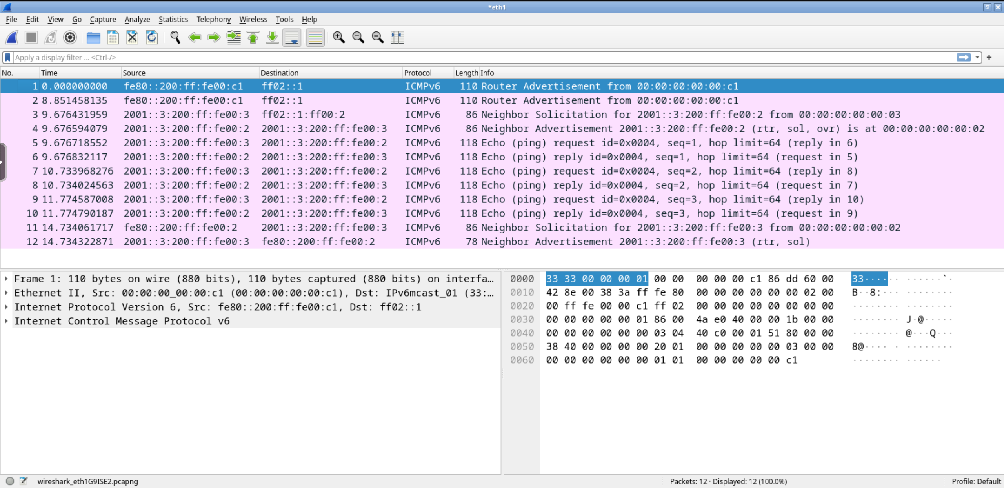
wireshark
periodic router advertisments

Slide 44
wireshark
neighbor solicitation

Slide 45
wireshark
neighbor solicitation
neighbor advertisment

Slide 46
wireshark
neighbor solicitation
neighbor advertisment
At the end of the ping a unicast neighbor solicitation/advertisment dialogue takes place

Slide 47
ping from pc2 to pc1 and related ICMPv6 behavior

Slide 48
sniff the traffic
connect the wireshark host to collision domain B
open any browser on the host machine
on localhost:3000
sniff eth2
user@localhost:~/kathara-lab_basic-ipv6$ kathara lconfig -n wireshark --add B

Slide 49
on pc2
execute a ping command towards pc1
pc2
root@pc2:/# ping 2001::1:200:ff:fe00:1
PING 2001::1:200:ff:fe00:1(2001::1:200:ff:fe00:1) 56 data bytes
64 bytes from 2001::1:200:ff:fe00:1: icmp_seq=1 ttl=62 time=2.58 ms
64 bytes from 2001::1:200:ff:fe00:1: icmp_seq=2 ttl=62 time=1.52 ms
--- 2001::1:200:ff:fe00:1 ping statistics ---
2 packets transmitted, 2 received, 0% packet loss, time 3011ms
rtt min/avg/max/mdev = 1.267/1.880/2.575/0.515 ms

Slide 50
inspecting the neighbor cache
pc1
pc2
pc3
0:1
eth0
eth0
0:2
0:3
eth0
A
C
2001:0:0:1::/64
2001:0:0:3::/64
0:a1
.1
eth0
B
eth0
.1
0:c1
r1
r2
eth1
2001:0:0:2::/64
eth1
0:b1
.1
.2
0:b2

Slide 51
inspecting the neighbor cache
when IP traffic is addressed outside the local network, the sender needs the mac address of the router
ICMPv6 ND requests can get replies only within the local network
pc2
root@pc2:/# ip neigh
fe80::200:ff:fe00:c1 dev eth0 lladdr 00:00:00:00:00:c1 router STALE
fe80::200:ff:fe00:3 dev eth0 lladdr 00:00:00:00:00:03 STALE
mac address of eth0 on r2

Slide 52
inspecting the neighbor cache
what about routers?
routers perform ND too (hence have neighbor caches)
r2 (eth1)
r1
root@r1:/# ip neigh
fe80::200:ff:fe00:b2 dev eth1 lladdr 00:00:00:00:00:b2 router STALE
fe80::200:ff:fe00:1 dev eth0 lladdr 00:00:00:00:00:01 router STALE
2001::1:200:ff:fe00:1 dev eth0 lladdr 00:00:00:00:00:01 router STALE
fe80::200:ff:fe00:a1 dev eth0 lladdr 00:00:00:00:00:a1 router STALE
pc1
pc1
r1 (eth1)
r2
root@r2:/# ip neigh
fe80::200:ff:fe00:c1 dev eth0 lladdr 00:00:00:00:00:c1 router STALE
fe80::200:ff:fe00:3 dev eth0 lladdr 00:00:00:00:00:03 router STALE
fe80::200:ff:fe00:b1 dev eth1 lladdr 00:00:00:00:00:b1 router STALE
2001::3:200:ff:fe00:2 dev eth0 lladdr 00:00:00:00:00:02 router STALE
fe80::200:ff:fe00:2 dev eth0 lladdr 00:00:00:00:00:02 router STALE
pc2
pc2

Slide 53
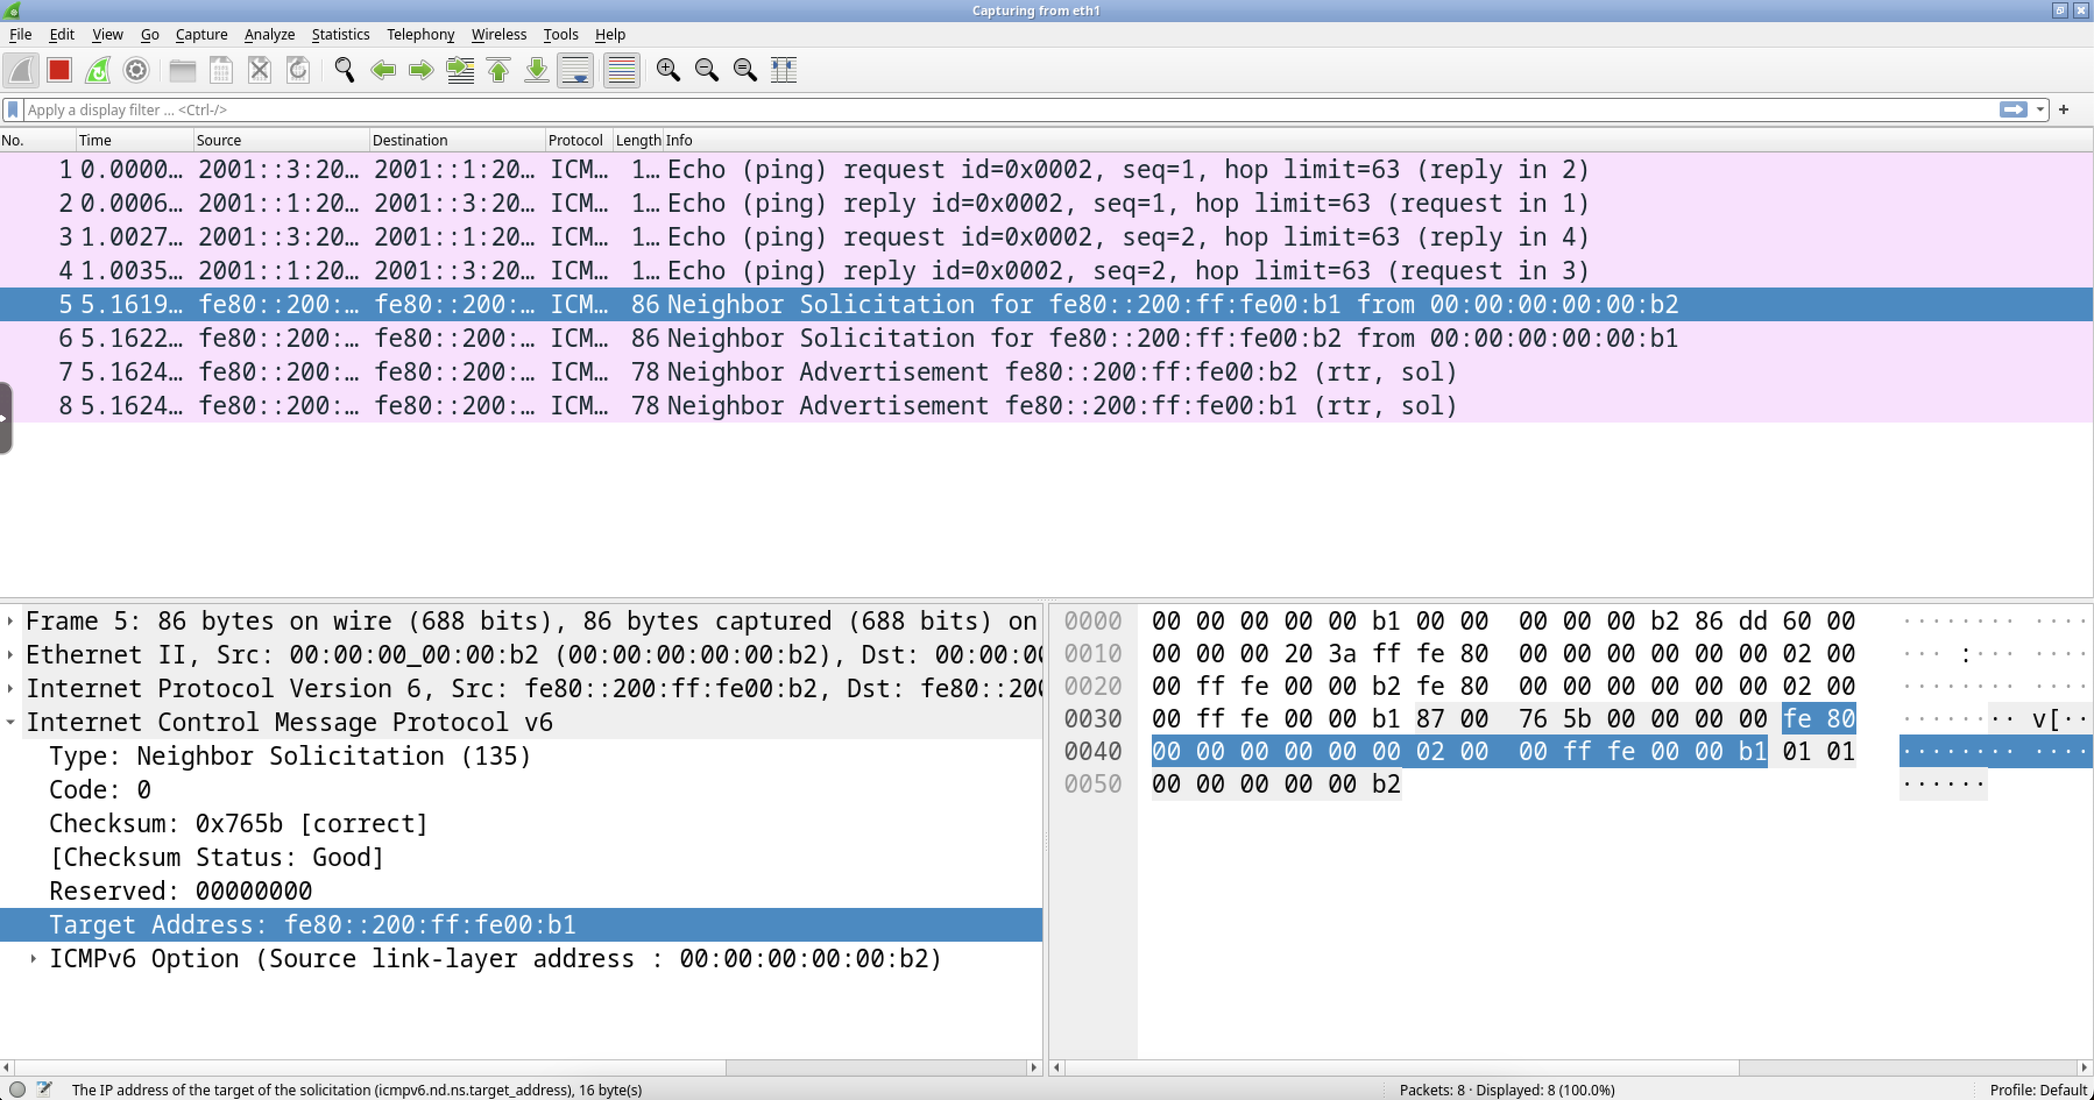
wireshark
which is the mac address of r1

Slide 54
understanding the whole picture
A
B
C
pc1
r1
r2
pc2
ICMP NS
ICMP NA
icmp echo req
ICMP NS
time
ICMP NA
icmp echo req
ICMP NS
ICMP NA
icmp echo req
icmp echo reply
icmp echo reply
icmp echo reply

Slide 55
traceroute from pc2 to pc1 and related ICMPv6 behaviour

Slide 56
sniff the traffic
the wireshark host is already connected to collision domain C
open any browser on the host machine
on localhost:3000
sniff eth1

Slide 57
on pc2
execute a traceroute command towards pc1
Minimal time (sec. if ≤10, ms if >10) interval between probes (default 0)
eth0 of r2
pc2
root@pc2:/# traceroute 2001::1:200:ff:fe00:1 -z 1
traceroute to 2001::1:200:ff:fe00:1 (2001::1:200:ff:fe00:1), 30 hops max, 80 byte packets
1 2001:0:0:3::1 (2001:0:0:3::1) 0.442 ms 0.580 ms 0.602 ms
2 2001:0:0:2::1 (2001:0:0:2::1) 0.878 ms 1.175 ms 0.751 ms
3 2001::1:200:ff:fe00:1 (2001::1:200:ff:fe00:1) 1.078 ms 1.434 ms 1.708 ms
root@pc2:/#
eth1 of r1
eth0 of pc1

Slide 58
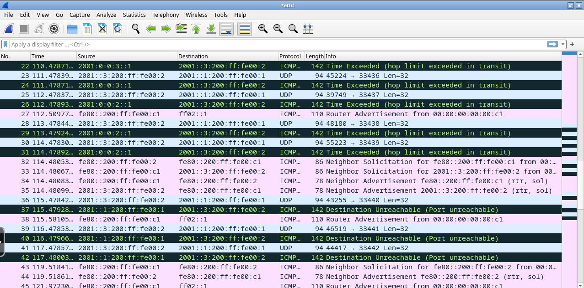
wireshark
udp packet and corresponding ICMP Time-to-live exceeded
Time to live: 1

Slide 59
proposed exercises
check the different error messages obtained by trying to ping an unreachable destination in the case of
local destination
non-local destination
which packets are exchanged in the local collision domain in the two cases?

