Slide 1
Kathará lab
two computers
Version | 2.0
Author(s) | L. Ariemma, T. Caiazzi
E-mail | contact@kathara.org
Web | http://www.kathara.org/
Description | A lab with two directly connected device with the goal of teaching how to change a MAC address and to sniff a Kathará collision domain

Slide 2
Copyright notice
All the pages/slides in this presentation, including but not limited to, images, photos, animations, videos, sounds, music, and text (hereby referred to as “material”) are protected by copyright.
This material, with the exception of some multimedia elements licensed by other organizations, is property of the authors and/or organizations appearing in the first slide.
This material, or its parts, can be reproduced and used for didactical purposes within universities and schools, provided that this happens for non-profit purposes.
Information contained in this material cannot be used within network design projects or other products of any kind.
Any other use is prohibited, unless explicitly authorized by the authors on the basis of an explicit agreement.
The authors assume no responsibility about this material and provide this material “as is”, with no implicit or explicit warranty about the correctness and completeness of its contents, which may be subject to changes.
This copyright notice must always be redistributed together with the material, or its portions.

Slide 3
topology
pc1
eth0
A
eth0
pc2
0:1
0:2

Slide 4
the lab.conf
pc1 has one interface (“eth0”) connected on collision domain A.
Its MAC address is set to 00:00:00:00:00:01
lab.conf
pc1[0]=“A/00:00:00:00:00:01”
pc1[image]="kathara/base"
pc1[ipv6]="false"
pc2[0]=“A/00:00:00:00:00:02”
pc2[image]="kathara/base"
pc2[ipv6]="false"

Slide 5
the lab.conf
lab.conf
pc1[0]=“A/00:00:00:00:00:01”
pc1[image]="kathara/base"
pc1[ipv6]="false"
pc2[0]=“A/00:00:00:00:00:02”
pc2[image]="kathara/base"
pc2[ipv6]="false"
pc1 will use image "kathara/base"
ipv6 networking is disabled

Slide 6
MAC addresses and Kathará
In this lab the MAC addresses of interfaces are specified in the “lab.conf” file. If not specified, Kathará assigns random MAC addresses to network interfaces
the obtained MAC addresses are difficult to remember
it is possible to change the assigned MAC addresses once a device is running

Slide 7
change the default MAC address
the MAC address can be changed with command
root@pc1:~$ ip link set dev eth0 address 00:00:00:00:00:01
command from iproute2
what needs to be set: the layer 2 address (e.g., the MAC address)
operate at Layer 2
the new MAC address
the device to be set = eth0

Slide 8
remarks
the used image is "kathara/base"
contains basic networking tools
IPv6 is used in specific labs
get used to add the flag so it won't create problems when IPv6 is used

Slide 9
question
two computers on the same LAN; can communicate?

Slide 10
question
how?

Slide 11
ethernet frames
ethernet frames (Layer 2 frames) can be sent on a LAN just knowing the destination MAC address
Linux has no default utilities for sending such packets
we'll use the python library scapy

Slide 12
a small reminder
the commands executed inside a console can also be inserted into the .startup file of the corresponding device
startup commands are executed at device startup
in this lab this is not needed, since we set the MAC addresses in the lab.conf file, so that interfaces are created with the assigned MAC addresses

Slide 13
the lab – a second version
An example of an equivalent version of the lab where MAC addresses are set in the .startup files.
The only difference is that interfaces are created with random MAC addresses, which are changed by startup commands when devices start up.
lab.conf
pc1.startup
pc1[0]=A
pc1[image]="kathara/base"
pc1[ipv6]="false"
pc2[0]=A
pc2[image]="kathara/base"
pc2[ipv6]="false"
ip link set dev eth0 address 00:00:00:00:00:01
pc2.startup
ip link set dev eth0 address 00:00:00:00:00:02

Slide 14
let's start the lab

Slide 15
scapy
a versatile Python tool for crafting, analyzing, and sniffing network packets; it supports numerous protocols and offers an interactive shell for real-time network manipulation
comes with an interactive shell
allows you to craft custom packets with any field values

Slide 16
entering the scapy shell
to enter the scapy shell use command
root@pc1:~$ scapy
aSPY//YASa
apyyyyCY//////////YCa |
sY//////YSpcs scpCY//Pp | Welcome to Scapy
ayp ayyyyyyySCP//Pp syY//C | Version 2.5.0
AYAsAYYYYYYYY///Ps cY//S |
pCCCCY//p cSSps y//Y | https://github.com/secdev/scapy
SPPPP///a pP///AC//Y |
A//A cyP////C | Have fun!
p///Ac sC///a |
P////YCpc A//A | Wanna support scapy? Star us on
scccccp///pSP///p p//Y | GitHub!
sY/////////y caa S//P | -- Satoshi Nakamoto
cayCyayP//Ya pY/Ya |
sY/PsY////YCc aC//Yp
sc sccaCY//PCypaapyCP//YSs
spCPY//////YPSps
ccaacs
>>>

Slide 17
exiting the scapy shell
to quit the scapy shell use command
>>> exit()

Slide 18
crafting an ethernet frame
to craft a layer 2 frame, use command
>>> p=Ether(dst='00:00:00:00:00:0B', src='00:00:00:00:00:0A')
save this packet into a variable p
create a new instance of the Ether class (used to craft Ethernet frames)
destination MAC address
source MAC address

Slide 19
sending an ethernet frame
to send a layer 2 frame, use command
>>> sendp(p, iface='eth0')
send a packet
the name of the variable holding the packet
the network interface through which the packet will be sent

Slide 20
BEWARE
this commands are typed into the scapy interactive shell
those are NOT system commands; this means that can NOT be written into a .startup file
moreover, it doesn't make sense to automate the sending

Slide 21
what after sending?
the frame has been sent, but a few questions arise:
how do we know if it was received?
how do we know if the data we set (src and dest MAC addresses) were correctly written?
how do we know if Kathará is not a complete scam?

Slide 22
a packet sniffer
A packet sniffer, a.k.a. network analyzer, is a tool that captures ("sniffs") network traffic as it transits over a network segment
It allows users to see the content of packets being transmitted or received over a network
Packet sniffers are used for network diagnostics, performance analysis, and cybersecurity purposes to detect vulnerabilities or malicious activities

Slide 23
wireshark
A widely-used, open-source packet analyzer
It captures and displays the data traveling into and out of network devices in real-time
With its powerful filtering and analysis tools, Wireshark is invaluable for network troubleshooting, protocol development, and cybersecurity investigations

Slide 24
using wireshark in Kathará
is it very easy to use Wireshark inside a Kathará lab
there is an official guide available here
https://github.com/KatharaFramework/Kathara-Labs/tree/main/tutorials/capture-packets
we need to add a dedicated device with the sole goal of running wireshark

Slide 25
add the wireshark device to a lab
to add a device (called wireshark) running Wireshark to a Kathará lab, add the following lines to the lab.conf file
connect a device called wireshark to the host network
lab.conf
....
wireshark[bridged]=true
wireshark[port]="3000:3000"
wireshark[image]="lscr.io/linuxserver/wireshark"
wireshark[num_terms]=0
map port 3000 of the host to port 3000 of the guest
do not open any terminals
use a dedicated image

Slide 26
restart the lab
after the lab.conf is changed, the lab needs to be restarted in order to apply the new configuration
user@localhost:kathara-lab_two-computers$ kathara lrestart

Slide 27
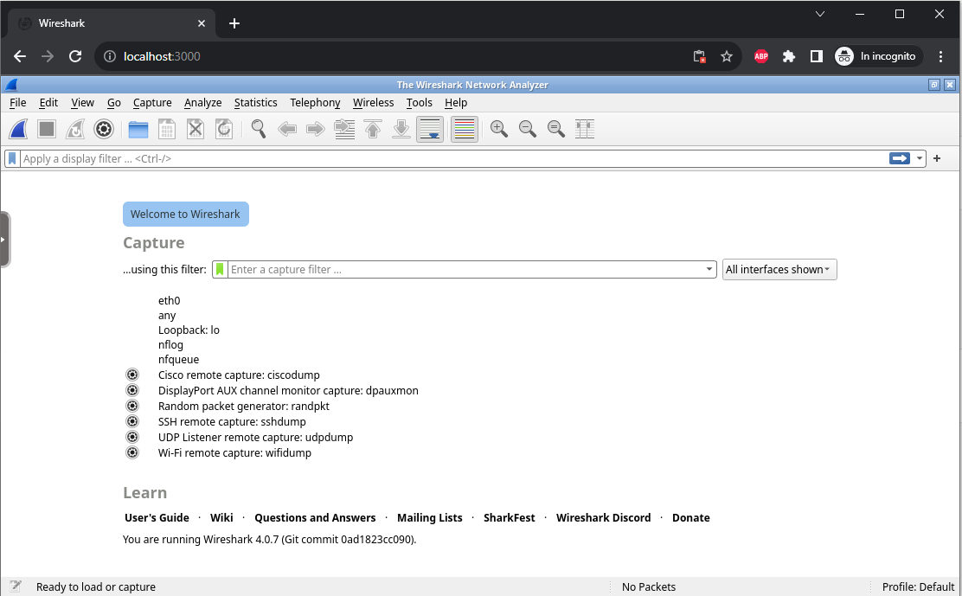
open Wireshark
open a browser in your host and go to
http://localhost:3000

Slide 28

topology with Wireshark
pc1
eth0
A
eth0
pc2
0:1
0:2
wireshark

Slide 29
connect wireshark to the CD
to connect the wireshark device to the collision domain to be sniffed, use this command
user@localhost:kathara-lab_two-computers$ kathara lconfig –n wireshark --add A
specify the name (n) of the device to modify
manage the network interfaces of a running lab
.... connected to collision domain A
add a network interface ....

Slide 30
topology with Wireshark – 2nd version
PC1
eth0
A
eth0
PC2
0:1
0:2
eth1
BEWARE!
See next slide for details
wireshark

Slide 31
notice about the wireshark device
the wireshark device is created connected to the host
the eth0 interface is connected to the host
when it is connected to a collision domain to be sniffed, an interface is added
the interface connected to the collision domain will be eth1

Slide 32
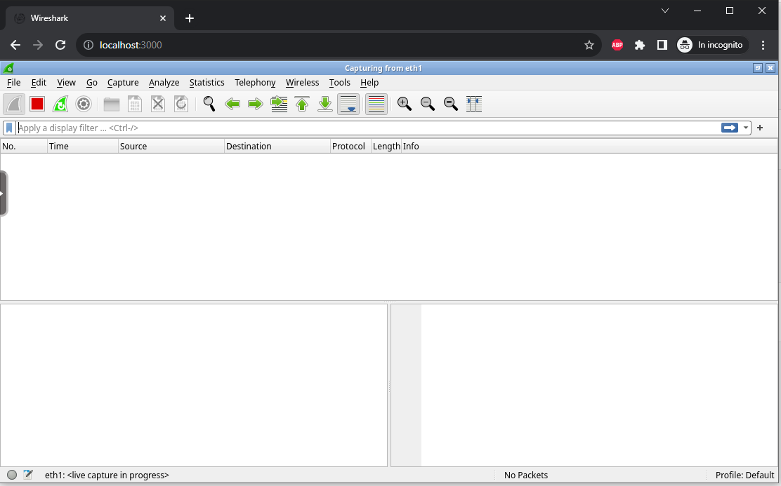
sniffing the first packet – part 1
reload the wireshark web page
open the eth1 interface by double clicking on it

Slide 33
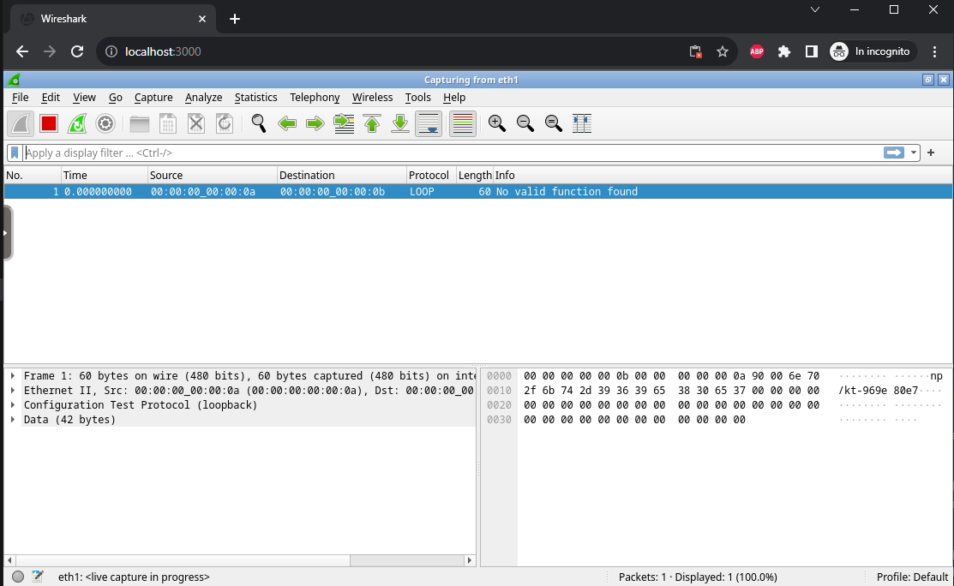
sniffing the first packet – part 2
send a new packet with scapy
a wild packet appeared

Slide 34
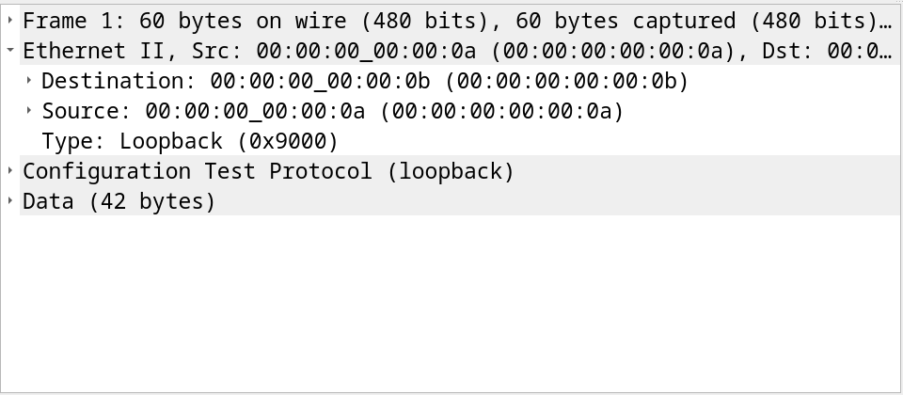
sniffing the packet – part 3
use the wireshark functions to see the packet contents

Slide 35
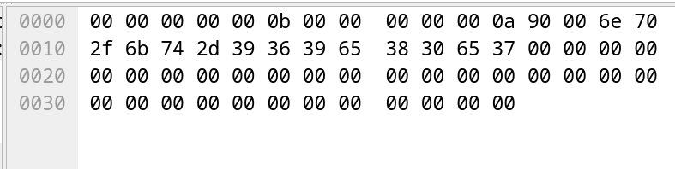
sniffing the packet – part 4
give a look also at the hex dump of the packet
why it ends with a lot of zeros?

Slide 36
exercises
try to send different ethernet frames and sniff them
try to send a frame from pc2 to pc1
try to send a frame to a MAC address that's not on the LAN
try to add other devices to the LAN

