Slide 1

Natural Language Processing
Episode 7 ‘2021
Model compression & acceleration
Yandex
Research

Slide 2
Chapter 1: why should you care?

Slide 3
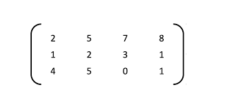
Case study: text classification
“I saw a cat”
“I f*** your mom”
prepare
batch
(0) Normal tweet
(1) Should ban
model

Slide 4

Case study: text classification
“I saw a cat”
“I f*** your mom”
prepare
batch
(0) Normal tweet
(1) Should ban
model
Three kinds of efficiency:
Model Size
(mega)bytes

Slide 5

Case study: text classification
“I saw a cat”
“I f*** your mom”
prepare
batch
(0) Normal tweet
(1) Should ban
model
Three kinds of efficiency:
Model Size
(mega)bytes
Throughput
samples/second

Slide 6

Case study: text classification
“I saw a cat”
“I f*** your mom”
prepare
batch
(0) Normal tweet
(1) Should ban
model
Three kinds of efficiency:
Model Size
(mega)bytes
Throughput
samples/second
Latency
ms@percentile

Slide 7








Scenario 1: inference server

Slide 8
Scenario 1: inference server
input (raw text)
Inference Server
CPU / GPU / FPGA
predictions

Slide 9
Scenario 1: inference server
input (raw text)
Inference Server
CPU / GPU / FPGA
predictions
+ relatively easy to deploy
+ you control model & inference
+ clients don’t run compute

Slide 10
Scenario 1: inference server
input (raw text)
Inference Server
CPU / GPU / FPGA
predictions
+ relatively easy to deploy
+ you control model & inference
+ clients don’t run compute
– you pay for each inference
– clients can’t work offline
– network latency

Slide 11
Scenario 1: inference server
input (raw text)
Inference Server
CPU / GPU / FPGA
predictions
+ relatively easy to deploy
+ you control model & inference
+ clients don’t run compute
– you pay for each inference
– clients can’t work offline
– network latency
Which is the most important?
?
?
?

Slide 12
Scenario 1: inference server
input (raw text)
Inference Server
CPU / GPU / FPGA
predictions
+ relatively easy to deploy
+ you control model & inference
+ clients don’t run compute
– you pay for each inference
– clients can’t work offline
– network latency
Priorities:
Note: smaller model = you can fit more models in the same memory

Slide 13

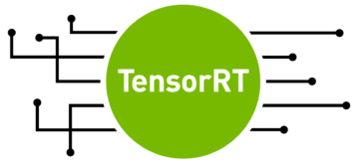
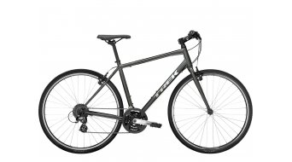
Scenario 1: inference server
Group inputs into batches (e.g. by length)
  improves throughput at the cost of latency
Multiple servers with load balancing
improves throughput at the cost of your budget :)
Popular frameworks: priorities
TensorFlow Serving efficiency ≪ developer time
TensorRT Inference Server (Triton) efficiency ≈ developer time
Custom model-dependent code efficiency ≫ developer time

Slide 14
Scenario 1: inference server
Group inputs into batches (e.g. by length)
  improves throughput at the cost of latency
Multiple servers with load balancing
improves throughput at the cost of your budget :)
Popular frameworks: priorities
TensorFlow Serving efficiency ≪ developer time
TensorRT Inference Server (Triton) efficiency ≈ developer time
Custom model-dependent code efficiency ≫ developer time

Slide 15
Scenario 2: local inference
Preload model onto a dedicated device, infer locally using that device
Typical use cases:
  Parallel speech recognition
  “Smart” cameras
  Autonomous drones
  Self-driving cars
Priorities:

Slide 16
Scenario 3: web/smartphone app
Load model weights on the fly and infer locally
Model size is critical for both you and the user

Slide 17
Scenario 3: web/smartphone app
Load model weights on the fly and infer locally
Model size is critical for both you and the user
Autonomous machine translation ( tinyurl.com/yandex-translate-app )
Pix2pix demo in a browser ( https://affinelayer.com/pixsrv )
Priorities:

Slide 18



Scenario 3: web/smartphone app
Load model weights on the fly and infer locally
Model size is critical for both you and the user
Autonomous machine translation ( tinyurl.com/yandex-translate-app )
Pix2pix demo in a browser ( https://affinelayer.com/pixsrv )
Priorities:
Popular frameworks: Platform
TensorFlow.js All modern browsers
CoreML iOS devices
NNAPI Android devices

Slide 19
Chapter 2: how do I improve my model?

Slide 20
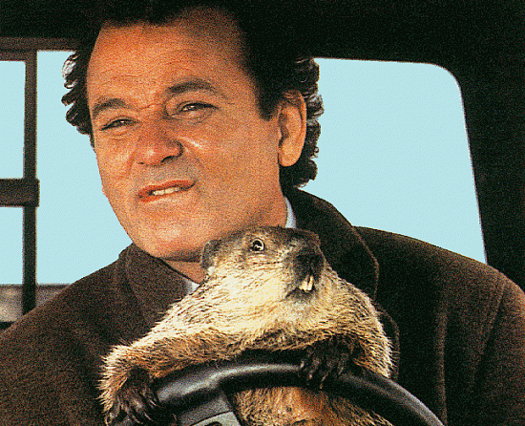
Compression by Distillation
Distillation…
Heard that word before?

Slide 21


Compression by Distillation
teacher
First, get the best
performing model
regardless of size
Then, train a more compact model to
approximate it!

Slide 22
Compression by Distillation
Training
batch
X
batch
teacher

Slide 23
Compression by Distillation
Training objective:
Kullback-Leibler divergence
or MSE/MAE for regression
Training
batch
X
batch
teacher
D_{KL}
Loss

Slide 24
Compression by Distillation
Training objective:
Kullback-Leibler divergence
or MSE/MAE for regression
Training
batch
X
batch
teacher
D_{KL}
Loss
Note: distillation can
train on unlabeled data!

Slide 25
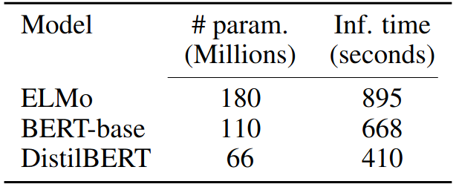
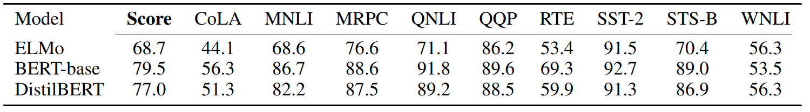
Compression by Distillation
Student architecture choices:
Naïve: same but smaller, less layers / hidden units
e.g. DistillBERT: https://arxiv.org/pdf/1910.01108.pdf
  Same as BERT-base, but
  with half as many layers
(and ≈1.5 times faster)

Slide 26
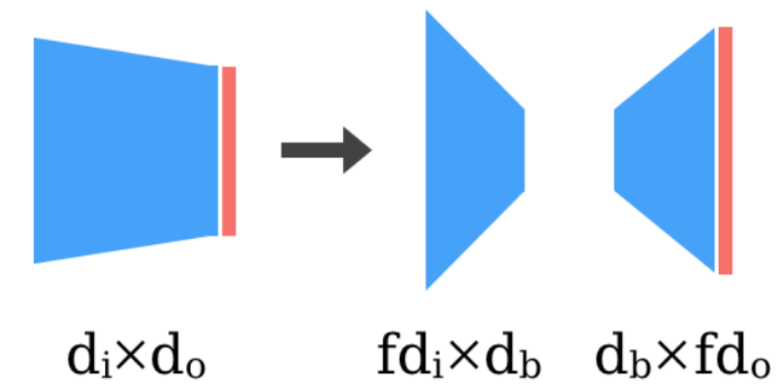
Compression by Distillation
Student architecture choices:
Naïve: same but smaller, less layers / hidden units
Factorized: product of smaller matrices or tensors
Images: https://openreview.net/pdf?id=_zx8Oka09eF

Slide 27
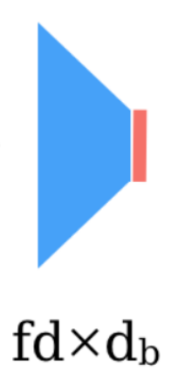
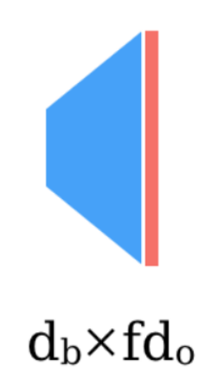
Compression by Distillation
Student architecture choices:
Naïve: same but smaller, less layers / hidden units
Factorized: product of smaller matrices or tensors
nonlinearity
OR
Images: https://openreview.net/pdf?id=_zx8Oka09eF

Slide 28
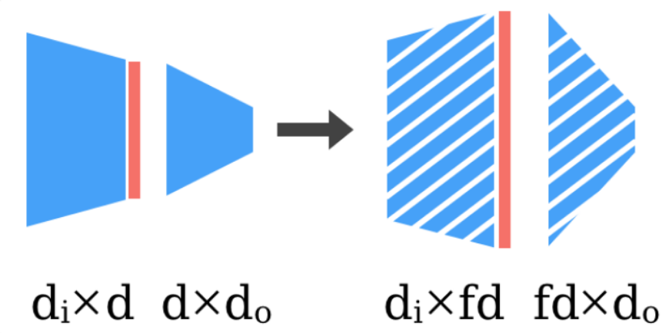
Compression by Distillation
Student architecture choices:
Naïve: same but smaller, less layers / hidden units
Factorized: product of smaller matrices or tensors
Sparse: only a small (random) subset of weights are nonzero
Images: https://openreview.net/pdf?id=_zx8Oka09eF

Slide 29
Compression by Distillation
Student architecture choices:
Naïve: same but smaller, less layers / hidden units
Factorized: product of smaller matrices or tensors
Sparse: only a small (random) subset of weights are nonzero
Q: how to store sparse weights?
Images: https://openreview.net/pdf?id=_zx8Oka09eF

Slide 30
Compression by Distillation
Student architecture choices:
Naïve: same but smaller, less layers / hidden units
Factorized: product of smaller matrices or tensors
Sparse: only a small (random) subset of weights are nonzero
Storage: only store random seed
and nonzero weights.
Compute: sparse matrix multiply
Images: https://openreview.net/pdf?id=_zx8Oka09eF

Slide 31
Compression by Distillation
Student architecture choices:
Naïve: same but smaller, less layers / hidden units
Factorized: product of smaller matrices or tensors
Sparse: only a small fraction of weights are nonzero
Read more: https://openreview.net/pdf?id=_zx8Oka09eF
Also: factorized embeddings https://arxiv.org/abs/1901.10787
Also also: small-world sparse weights graphs for RNNs
              https://tinyurl.com/openai-blocksparse

Slide 32
Compression by Distillation
Student architecture choices:
Naïve: same but smaller, less layers / hidden units
Factorized: product of smaller matrices or tensors
Sparse: only a small fraction of weights are nonzero
Read more: https://openreview.net/pdf?id=_zx8Oka09eF
Also: factorized embeddings https://arxiv.org/abs/1901.10787
Also also: https://tinyurl.com/openai-blocksparse
More distillation tricks:
  Ensemble distillation https://arxiv.org/abs/1702.01802
  Dropout distillation http://proceedings.mlr.press/v48/bulo16.pdf
  Co-distillation https://arxiv.org/abs/1804.03235

Slide 33


Compression by quantization
model
model
model
INT8
8 BITS

Slide 34
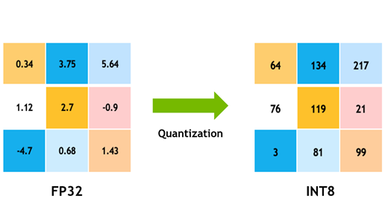
Linear quantization
1) Scale inputs and parameters into uint8 range
2) Multiply in uint8, accumulate to int32
3) Un-scale multiplication results in float32

Slide 35
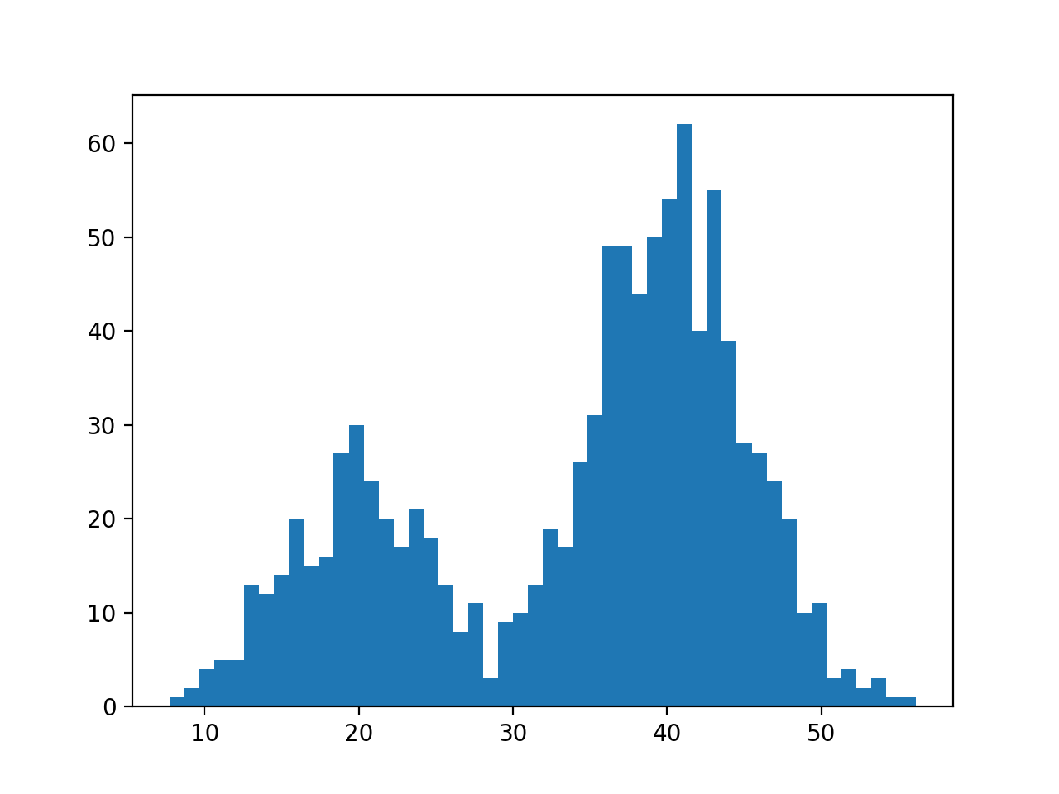
Non-linear quantization
Consider weights as a distribution

Slide 36
Non-linear quantization
Consider weights as a distribution

Slide 37
Non-linear quantization
Consider weights as a distribution

Slide 38
Non-linear quantization
Compute a grid of percentiles

Slide 39
Non-linear quantization
percentiles (32-bit)
Index (4- or 8-bit) of
nearest percentile
for each weight
Store each weight as its nearest percentile

Slide 40
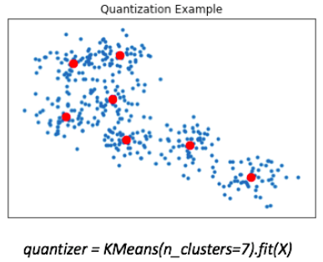
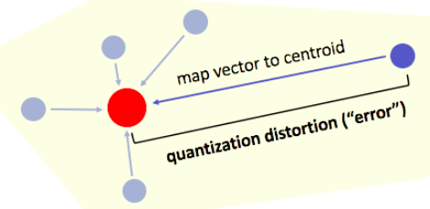
High-dimensional case
Quantize entire vectors as K-means
Images: Jeremy Jordan

Slide 41
OPQ, AQ, LSQ
Product Quantization
Split vectors into chunks, quantize each chunk separately
Orthogonal Product Quantization
First run orthogonal transform, then product quantization
http://kaiminghe.com/publications/cvpr13opq.pdf
More:
Additive Quantization https://tinyurl.com/babenko-aq-pdf
Local Search Quantization https://tinyurl.com/martinez-lsq-pdf
Images: Jeremy Jordan

Slide 42
Low-precision training!
Training with 8-bit params:
https://arxiv.org/abs/1812.08011
https://arxiv.org/abs/1805.11046
Compressing gradients to 1 bit and beyond
https://arxiv.org/abs/2102.02888
https://arxiv.org/abs/1905.13727
Training with 8-bit optimizers:
https://www.youtube.com/watch?v=IxrlHAJtqKE
https://arxiv.org/abs/2110.02861

Slide 43
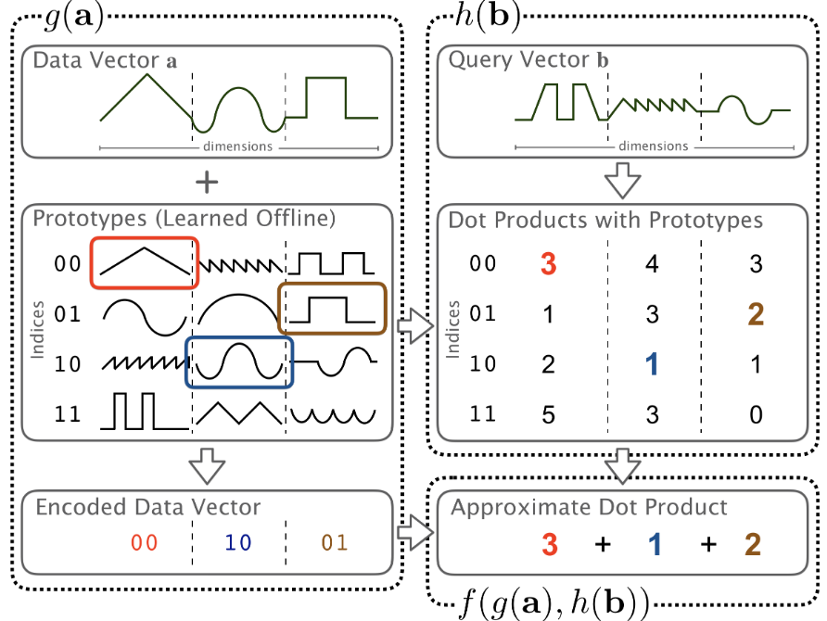
Quantization + pre-computation
Source: https://arxiv.org/abs/2106.10860
product-quantize weights
“quantize” inputs via LSH
pre-compute dot products
  all inputs x all codes
“multiply” by looking up
pre-computed products

Slide 44
Acceleration by cascading
Positive
OR
Negative
X
batch
Model

Slide 45
Acceleration by cascading
Positive
OR
Negative
X
batch
Model
Do we really need every layer
all the time?

Slide 46
Acceleration by cascading
Predict
early
Positive
OR
Negative
X
batch
Layer
Layer
1) Positive
2) Negative
3) More layers!

Slide 47
Acceleration by cascading
Only if “more layers”
Positive
OR
Negative
X
batch
...
Layer
Layer
Layer
Layer
1) Positive
2) Negative
3) More layers!

Slide 48
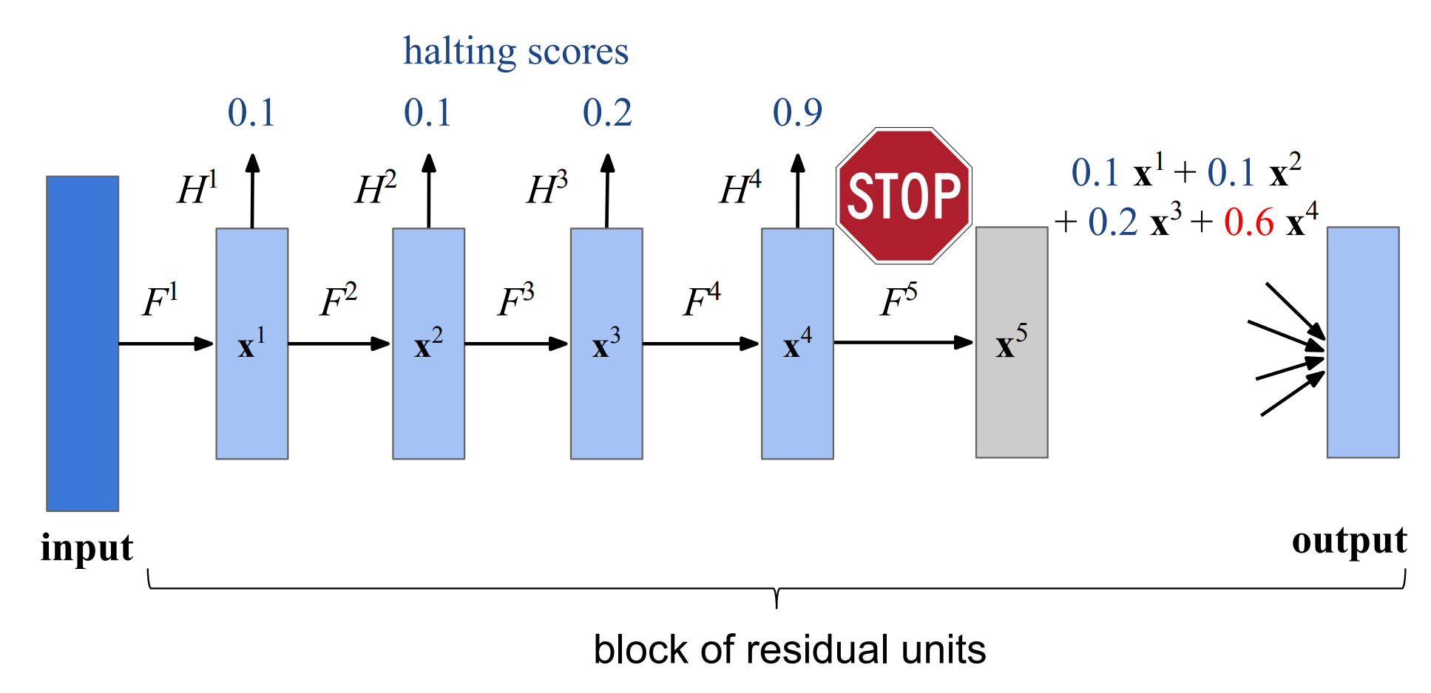
Adaptive Computation Time
Origina ACTl (for RNN)
https://arxiv.org/abs/1603.08983
ACT Transformers
https://arxiv.org/abs/1807.03819
Spatial ACT (conv)
https://tinyurl.com/sact-pdf

Slide 49
Compression by sparsification
Do we really need all D by D weights?

Slide 50
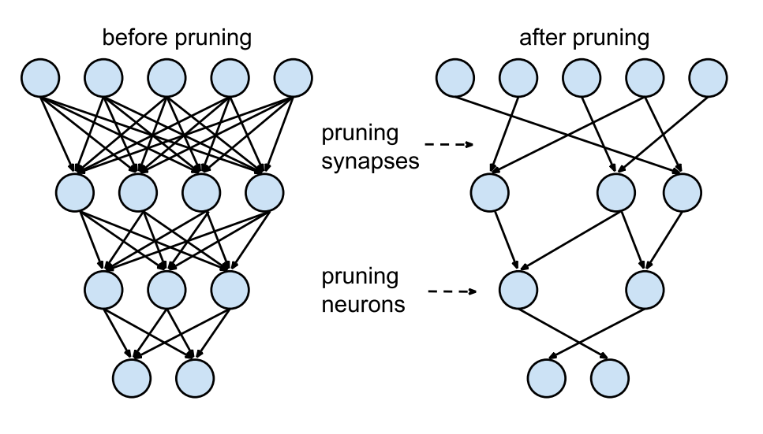
Compression by pruning
Do we really need all D by D weights?
pruning
weights
pruning
neurons

Slide 51
Magnitude pruning
Drop ~5% smallest weights
from each layer every 1000 steps
(and keep training)
Reminds you of something?

Slide 52
Magnitude pruning
Drop ~5% smallest weights
from each layer every 1000 steps
(and keep training)
Reminds you of something?
See ML course, Optimal Brain Damage

Slide 53
Pruning with L₀ regularization
Add a special regularizer that encourages
dropping unnecessary weights
Whiteboard time!
Read more: https://arxiv.org/abs/1712.01312
Alternative: https://arxiv.org/abs/1701.05369

Slide 54
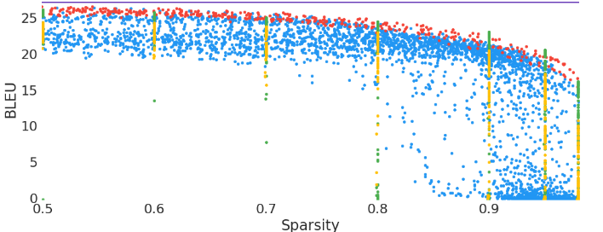
Which one works best?
Transformer BLEU
Source https://arxiv.org/abs/1902.09574

Slide 55
Pruning with L₀ regularization
Add a special regularizer that encourages
dropping unnecessary weights
Whiteboard time!

Slide 56
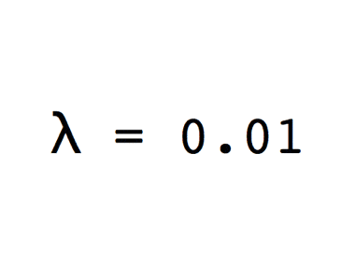
Pruning with L₀ regularization
Add a special regularizer that encourages
dropping unnecessary weights
Can prune
    individual weights
    Individual neurons
    attention heads
    entire layers!
Pruning heads: https://lena-voita.github.io/posts/acl19_heads.html

Slide 57
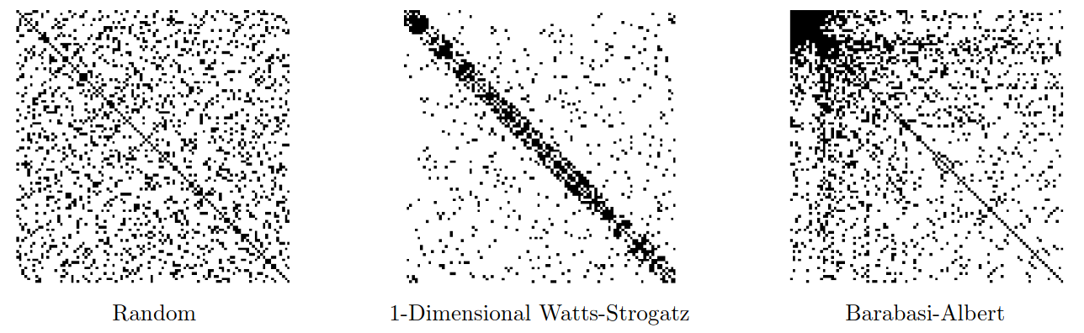
Sparse training
https://cdn.openai.com/blocksparse/blocksparsepaper.pdf

Slide 58
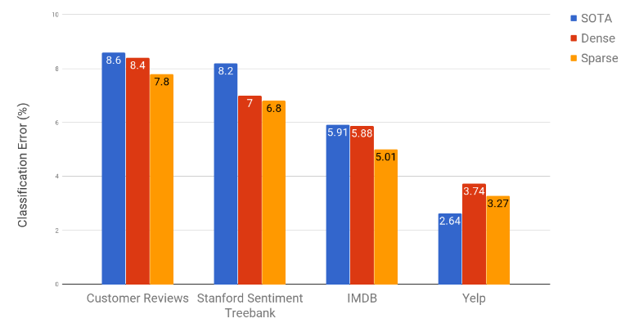
Sparse training
https://cdn.openai.com/blocksparse/blocksparsepaper.pdf

Slide 59
What did we learn?

