Slide 1
SOFTWARE ENGINEERING · UNIVERSITY OF GENOA
Text Quality
Analyzer & Rewriter
An intelligent writing assistant that corrects grammar,
detects pleonasms, and rewrites Italian texts.
Emanuela Ibra · Yakup Gürer

Slide 2
Problem Statement
Traditional Tools
Example
✗ Correct grammar only
✗ Ignore redundancy
✗ Miss pleonasms
✗ Don't reduce repetition
✗ No global quality improvement
BEFORE
Collaborare insieme è molto importante.
Il risultato finale è stato positivo.
▼
AFTER
Collaborare è molto importante.
Il risultato è stato positivo.

Slide 3
Project Objectives
Create an intelligent writing assistant for Italian texts
✓
Grammar Correction
✓
Repetition Detection
Detect & fix grammatical, spelling, punctuation errors
Lexical, lemma-based, and synonym repetition
✓
Pleonasm Detection
✓
Semantic Redundancy
JSON-based knowledge base for Italian pleonasms
Sentence-level similarity analysis with spaCy
✓
Text Rewriting
✓
Google Docs Integration
Rule-based and AI-powered (Ollama) rewriting
Native sidebar integration into Google Docs

Slide 4
System Architecture
User
→
Google Docs
→
FastAPI
→
WritingService
Analysis Pipeline
Grammar
Correction
Repetition
Analysis
Pleonasm
Detection
Redundancy
Analysis
Pre-Merging
Strategy
→
→
→
→
↓
Rule-Based
Rewriter
→
AI Rewriter
(Ollama)
Final Text Output

Slide 5
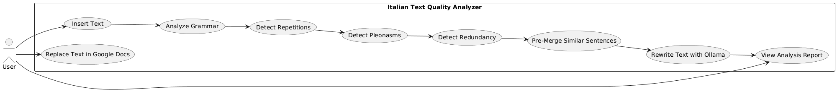
Use Case Diagram

Slide 6
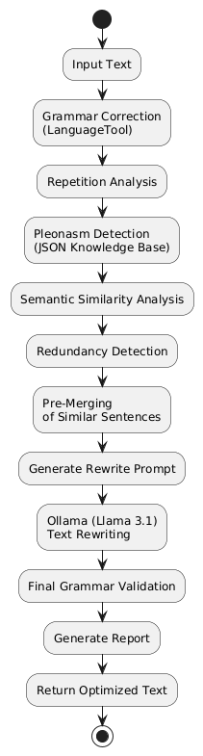
Activity Diagram

Slide 7
Grammar Correction Module
LanguageTool
Example
What It Detects
INPUT (grammar error):
Gli studenti va a scuola.
✓ Grammatical errors
↓ corrected
✓ Spelling mistakes
Gli studenti vanno a scuola.
✓ Punctuation issues

Slide 8
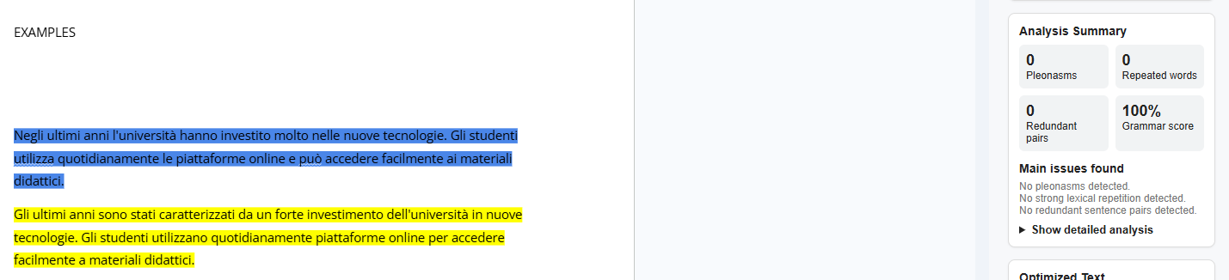
Grammar Correction Module

Slide 9
Repetition Analysis
Lexical Repetition
progetto progetto progetto
Same word repeated multiple times in close proximity
Lemma Repetition
migliora · migliorato · miglioramento
Different forms of the same root word repeated
Synonym Repetition
importante · significativo · fondamentale
Semantically equivalent words used redundantly

Slide 10
Pleonasm Detection
Examples
JSON Knowledge Base
Pleonasm | Corrected
risultato finale | risultato
regalo gratuito | regalo
pianificazione futura | pianificazione
collaborare insieme | collaborare
scendere giù | scendere
Instead of hardcoding pleonasms in Python:
PLEONASMS = {...}
A dedicated JSON file is used:
italian_pleonasms.json
Matching is lemma-based, NOT exact-string.

Slide 11
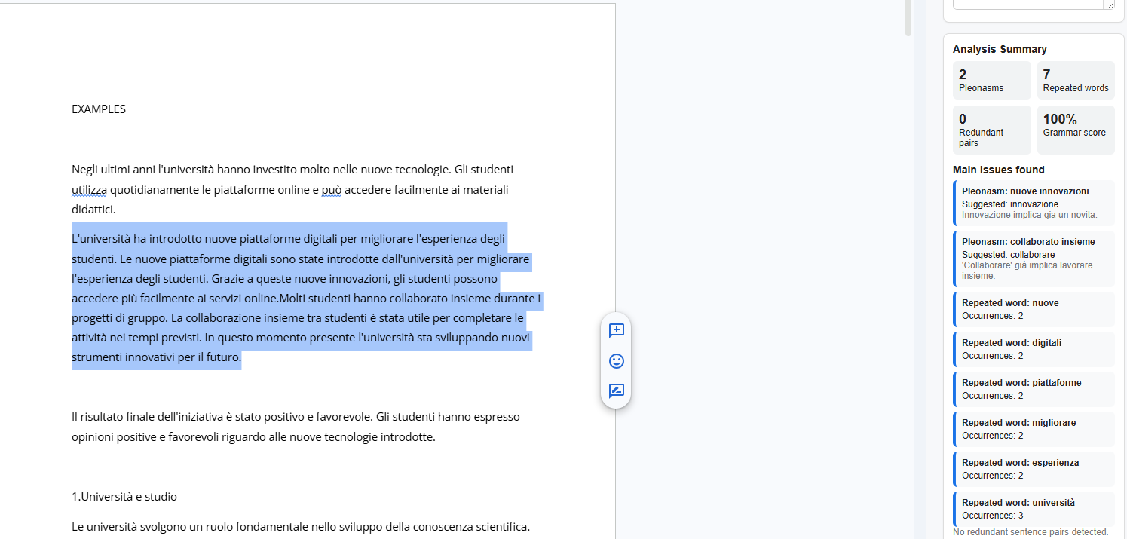
Repetition And Pleonasm

Slide 12
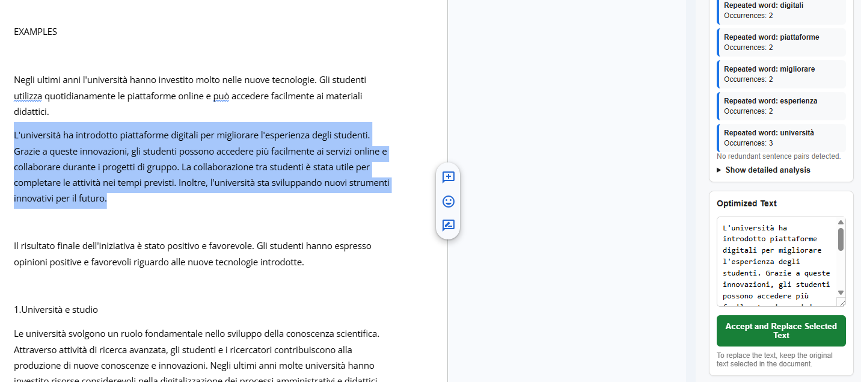
Repetition And Pleonasm
Result of corrected format

Slide 13
Redundancy Detection
Semantic Similarity Analysis
Example
The system uses spaCy word vectors to compute sentence-level semantic similarity.
When two sentences exceed a similarity threshold, they are flagged as potentially redundant.
Le vendite sono diminuite nel terzo trimestre.
SIMILAR MEANING
spaCy Vectors
Nel terzo trimestre le vendite hanno registrato un calo.
Word embedding similarity
Sentence Similarity
Similarity > threshold
Cosine similarity scoring
→ Flagged as redundant
Threshold Filtering
Configurable cutoff point

Slide 14
Pre-Merging Strategy
Why is this needed? If we directly pass both sentences to the AI, information may be lost.
Sentence Pair
↓
Similarity Score (spaCy)
↓
Score > Delete
Threshold
Merge < Score <
Delete Threshold
Score < Merge
Threshold
↓
↓
↓
Remove Duplicate
Send as Merge
Candidate
Keep Unchanged

Slide 15
Rewriting Engine
AI Mode (Ollama)
1. Collect analysis results
2. Build prompt with context
3. Send to local LLM (Ollama)
4. Parse model output
5. Return rewritten text
🤖 Better quality · Context-aware · Natural output

Slide 16
Google Docs Integration
Select Text
Sidebar Opens
1
2
User selects text in Google Docs
Extension sidebar opens automatically
Sent to API
Analysis Displayed
3
4
Text is sent to FastAPI backend
Errors, pleonasms, and issues shown
User Reviews
Text Replaced
5
6
User reviews suggestions & accepts
Original text replaced with improved version

Slide 17
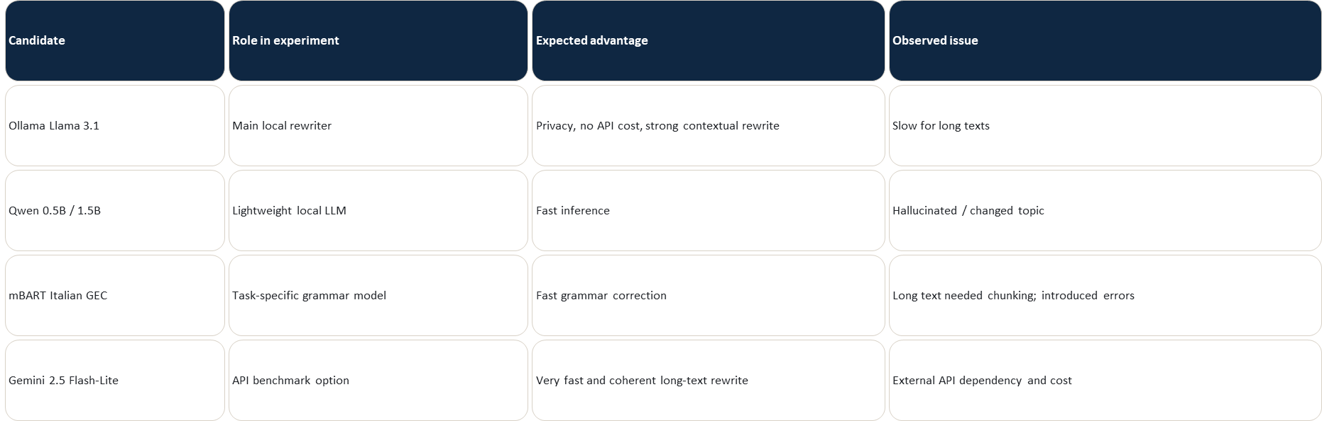
Model Candidates Tested

Slide 18
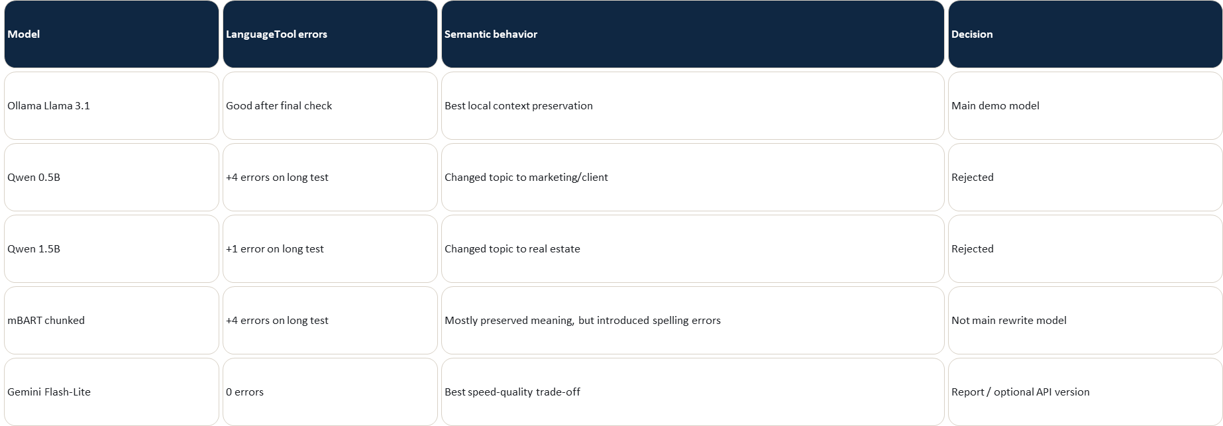
How we compared alternatives

Slide 19
Conclusion
A complete Italian writing assistant
✓
Italian grammar correction (LanguageTool)
✓
Repetition detection (lexical, lemma, synonym)
✓
Pleonasm detection (JSON knowledge base)
✓
Semantic redundancy analysis (spaCy)
✓
Pre-merging strategy (3-case decision logic)
✓
Rule-based rewriting (fast & deterministic)
✓
AI rewriting (Ollama — high quality)
✓
Google Docs integration (real application)
Thank You

