Slide 1

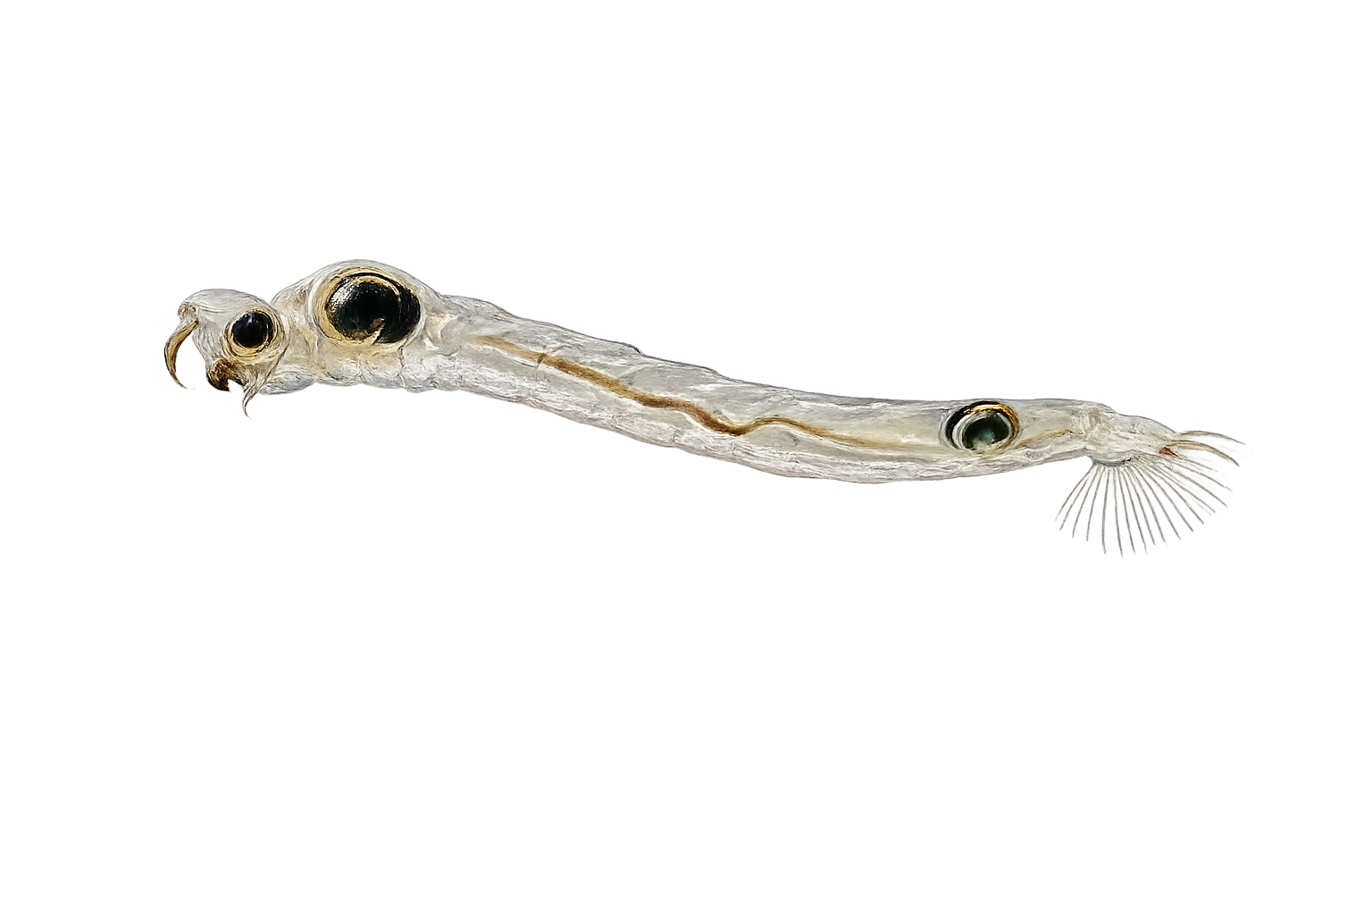

Low-quality toxic
50% Microcystis aeruginosa
50% Tetradesmus obliquus
Low-quality
50% Synechococcus elongatus
50% Tetradesmus obliquus
High-quality
100% Nannochloropsis limnetica
High-quality
100% Nannochloropsis limnetica
Lysed Microcystis aeruginosa

Slide 2

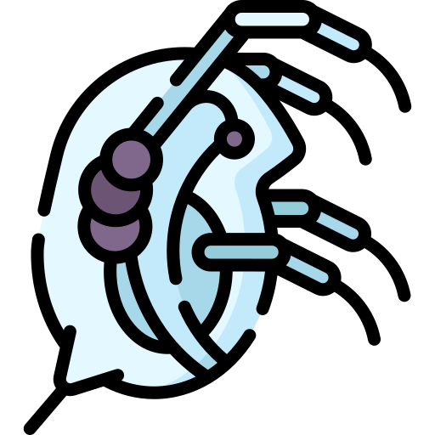

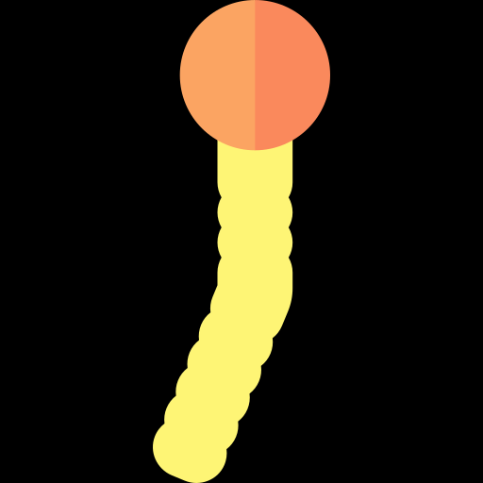

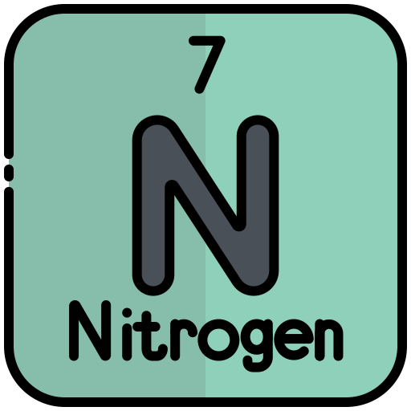
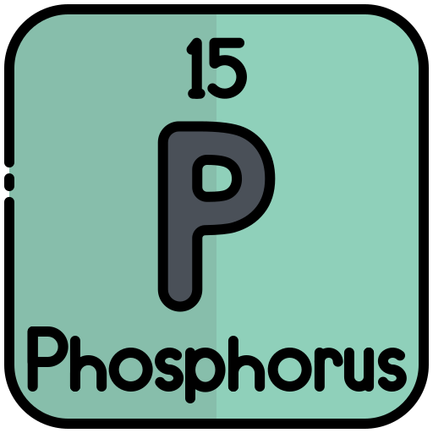

Throughout experiment
Raise Daphnia
on different diets
Assemble
Add
Sample emerged Chaoborus
Emerged
Quantity
Body size
Toxicity
Quality
Lipids
Stoichiometry
Time to emerge
Timing
Time

