Slide 1
Why does this matter?
Productivity
Isolated
Connected
Patch size
S
M
L

Slide 2
Productivity
?
Patch size

Slide 3
Productivity
Patch size

Slide 4
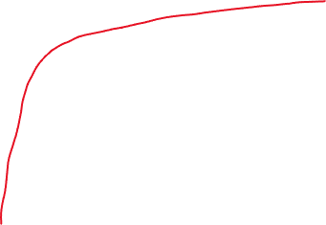
Biodiversity
Isolated
Less biodiversity at a regional level
Connected
More biodiversity at a regional level
Patch size
s
m
l

