Slide 1
FELyX – The Finite Element library eXperiment
Tutorial / Overview
May 2005
EVEN – Evolutionary Engineering AG
Leonhardstr. 25, LEC B14
CH-8092 Zurich
Switzerland
Phone : +41 (0)44 633 3532
Fax : +41 (0)44 632 1702
Mail: info@even-ag.ch
WWW: www.even-ag.ch

Slide 2
Contents
Session 1:
  Get to know the entire development environment
  Using StructObject to solve a structural FE-Problem, the first application using the built in functionalities FELyX
Session 2:
  How different FE-disciplines are can be implemented in FELyX (FelyxObject, StructObject...)
  The specialzation of a DisciplineObject class to solve specific FE-Problems (Ducati-Frame)
Session 3:
  STL introduction using the std::vector as container and some algorithms which are often used in FELyX
  Building an own rectangular FE-Model from scratch

Slide 3
Contents
Session 4
  Finishing the rectangular FE-Model
  Adding a function to the custom-built FE-Object
  Writing data to a text file
Session 5
  Introduction to boost::spirit
  Reading data from a text file
  Include a function in the custom-built object to read nodes and elements from a text file

Slide 4
Session 1 - Contens
The structural finite element problem
  The problem to be solved (Winschhebel)
Installation
  What products are needed
  Which ones are recommended
  How to install them
Using StructObject in a Program
  Building a first executable which solves a FE-Problem with the built in FELyX functions

Slide 5
Session 1
The Problem to solve:
  A cantilever beam under the shown loadings
  The model is fully defined within ANSYS and written to a database using
      Preprocessor >> Archive Model >> Write
What is to be done:
  Write the nodal deformations to a text file
  Write a file to visualize the solutions with tecplot

Slide 6
Session 1
Installation
  The following tools and libraries are required
    CVS
    GNU build tools
    Boost libraries version 1.32
  The easiest to get these things (using SUSE linux 9.3):
    Install SUSE linux 9.3
    Include the development tools of SUSE 9.3
    Include boost 1.32
    Install linCVS from lincvs.org
Get the FELyX sources
  Under http://sourceforge.net/projects/felyx/ is all the information regarding the project
  Type the following on the commandline or use lincvs to get the sources
  cvs -z3 -d:pserver:anonymous@cvs.sourceforge.net:/cvsroot/felyx co -P felyx

Slide 7
Session 1
KDevelop – the programming environment
First application
  Start KDevelop and build a hello_world project
Starting with FELyX
  FELyX is organized as a KDevelop project
  Build the project
  Build the documentation
  Build a new target within the tutorial folder and add a file to the target
  Add the used libraries

Slide 8
Session 1
Solving the problem of the cantilever – beam using StructObject
  The Object StructObject is the base object for all structural calculation, it is derived from FelyxObject
  The needed functionality is
    Load the ANSYS database file
    Solve the problem
    Write some output to the screen / a file
  Example : MyFirstFELyXApp

Slide 9
Session 2 - Contens
Handling different FE-disciplines in FELyX
Organization of Finite Element entities
Example of a derived StructObject for the analysis of a steel trellis motorcycle frame
  Definition of the load cases
  Example in ../felyx/apps/ducati-frame/DucFrameFEA.cpp

Slide 10


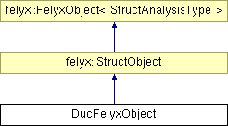

Session 2:
Handling different physical disciplines in FELyX
Implemented as derived FELyX objects
Parameterized by a AnalysisType class

Slide 11
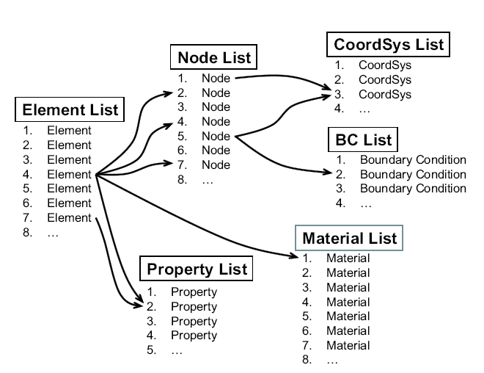
Session 2:
Organization Finite Element entities in FELyX

Slide 12
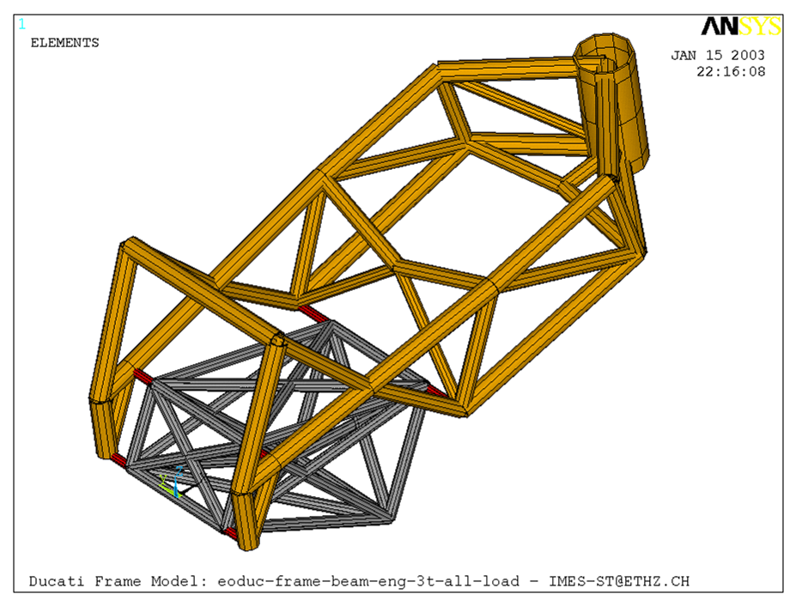
Session 2:
Implementation of a derived StructObject for the analysis of a ducati frame
Tasks:
  Implement a custom FELyX object to analyze the ducati frame
  Eval mass of frame
  Vary tube dimensions of frame
  (PropertySets 0-14)
  Evaluate maximum stress in
  frame for a braking loadcase
  Evaluate torsion stiffness of frame
Key values of original frame:
Weight = 7.4 kg
Torsion stiffness = 1310 Nm / degree
Max. stress for braking = 450 N/mm2
Element reference sets:
1: Variable frame tubes
2: Fix steering head tubes

Slide 13
Session 2:
Definition of braking loadcase
( 785 , 0 , 44 )
( 785 , 0 , 226.5 )
y
Fb
-Fb
Fb = Mb/d = 4256000 Nmm / 182.5 mm
z
x

Slide 14
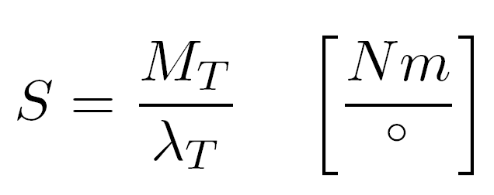
Session 2:
Definition of torsion loadcase / stiffness
(785 , 0 , 135)
Mx=700000Nmm
( 0, -134 , 0 )
( 0, 134 , 0 )
( 785 , 0 , 44 )
( 785 , 0 , 226.5 )
Torsion stiffness:
Moment divided by twist angle between rear fork axis and steering head axis
y
z
x

Slide 15
Session 3 - Contens
Introduction to the stl libraries - containers and algorithms
Example using std::vector<int>
  Example in felyx/tutorial/stl_exercise.cpp
Build an own application with vectors of a simple node class
  Example in felyx/tutorial/stl_exercise_2.cpp
Build the function MyStructObject::create_model() building the entire FE-model (Nodes, Elements, Materials, BCs) with loops

Slide 16
Session 4 - Contens
Finishing the function MyStructObject::create_model()
Introduction to the stream classes - www.cplusplus.org
Build a function writing the max. deformation to an ASCII file
  Example in felyx/tutorial/MyStructObject.h

Slide 17
Session 5 - Contens
Introduction to the boost::spirit library using its own documentation
  www.boost.org
Show a first parser using spirit and discuss its functionality
  felyx/tutorial/spirit_exercise.cpp
  felyx/tutorial/MyFirstNodeList.txt
Enhance the above example to read a more sophisticated ASCII file and write the information into std::vectors
  felyx/tutorial/spirit_exercise_2.cpp
  felyx/tutorial/SimpleFEModel.txt
Use the above parsers to build a new function in MyStructObject to create a FE-model from the above file ( MyStructObject::create_model_from_file(....) )
  felyx/tutorial/MyStructObject.*
  felyx/tutorial/SimpleFEModel.txt

