Slide 1

Data Mining and Text Mining Project
Authors:
Giacomo Bossi
Emanuele Chioso
Professor:
Pier Luca Lanzi

Slide 2

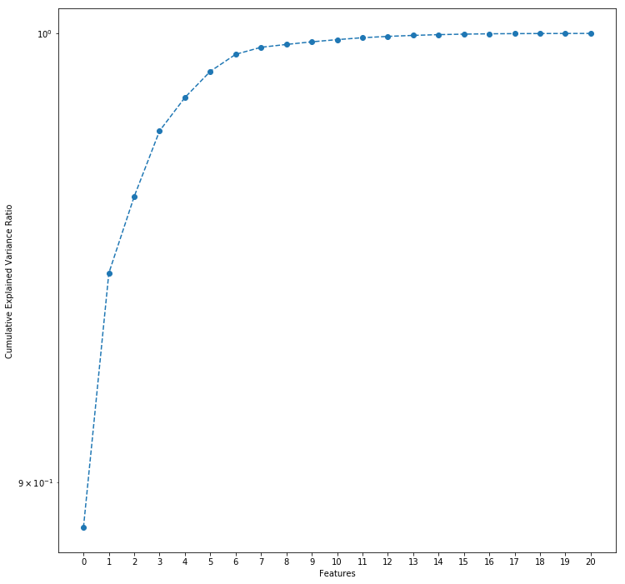
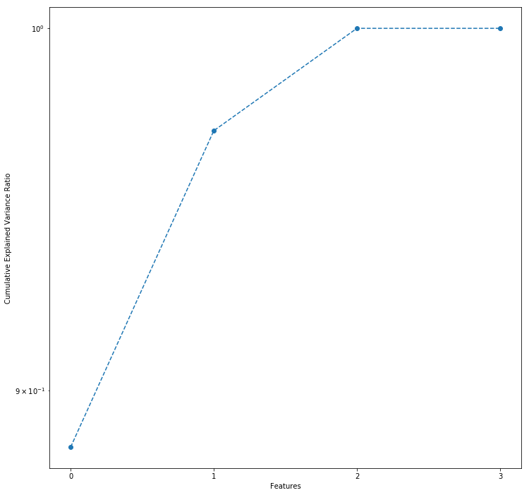
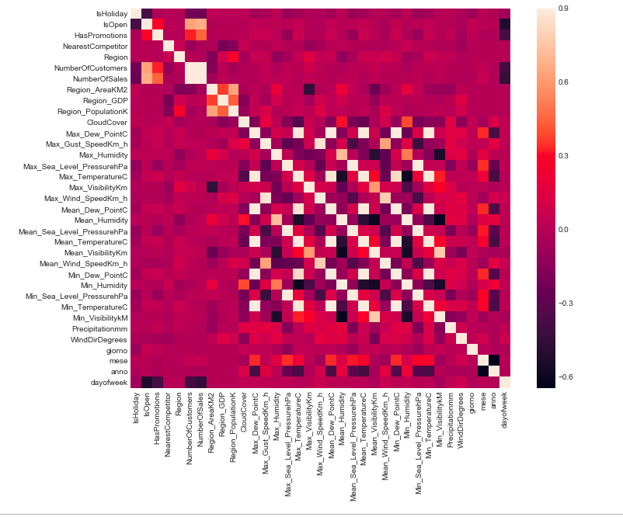
Preprocessing
Since there were too many parameters regarding the weather condition, we have applied a PCA to reduce the number of parameters form 20 to 4.
Even for the
PCA – Wheater Features
PCA – Region Features
4 components
2 components
Total Sum of Variance Ratio
~0,97
Total Sum of Variance Ratio
~0,96
22/06/2017

Slide 3
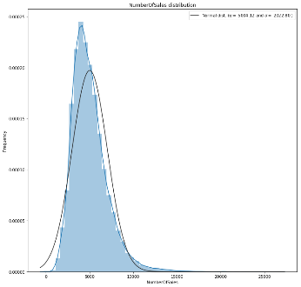
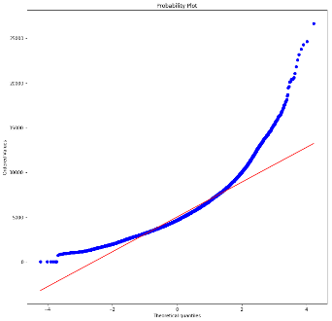

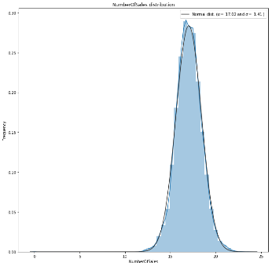
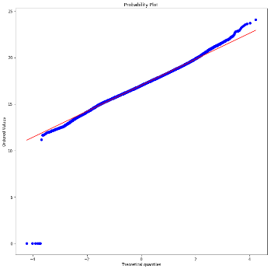
Preprocessing – Applying Logarithms
22/06/2017

Slide 4
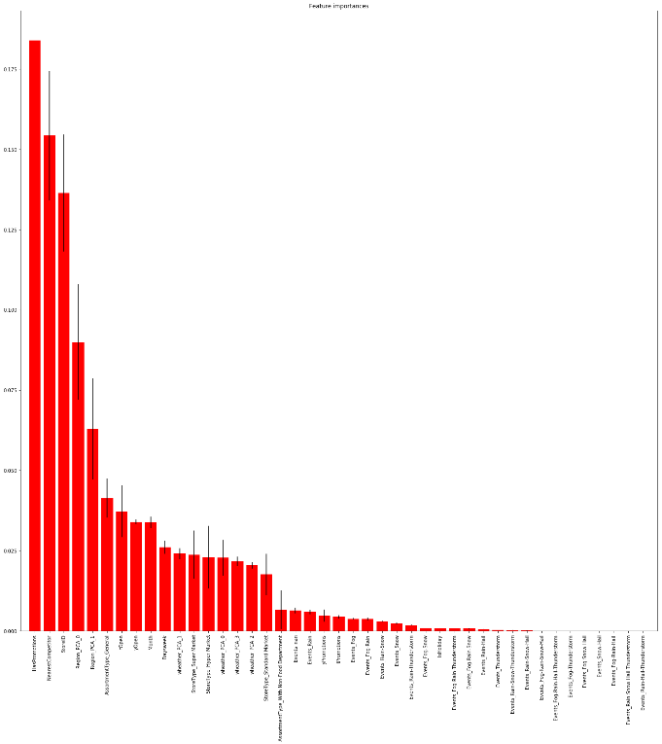

Features Selection
To select all the parameters we have used a Random Forest to classify the best parameter to use
22/06/2017

Slide 5
Results
R2 Score
*using logarithmic transformation of Num of Sales
The final model is the result of an ensemble of the single models.
The models performed very well with trainset created with a Random Sampling but in a more realistic approach, where we predicted two entire months, they have been outperformed by the ensembles.
In the end the best approach was the meta-model of XGBoost based on the following base models: RandomForest, LightGBM, XGBoost
R2 Score
MAE – Mean Absolute Error
Model | Random . Sampling * | Last two. . Months
Random Forest | 0,8686 | 0,8434
LightGBM | 0,9101 | 0,7724
XGBoost | 0,9189 | 0,7963
Mean | 0,9197 | 0,8491
Meta-Model | 0,9217 | 0,8524
Model | Last two Months
Random Forest | 530,64
LightGBM | 650,52
XGBoost | 630,89
Mean | 525,97
Meta-Model | 506,26
Model | Last two Months
Random Forest | 0,0440
LightGBM | 0,0495
XGBoost | 0,0473
Mean | 0,0396
Meta-Model | 0,0379
22/06/2017

