Slide 1

TOKYO 2021 OLYMPICS
Emanuele Regnani

Slide 2
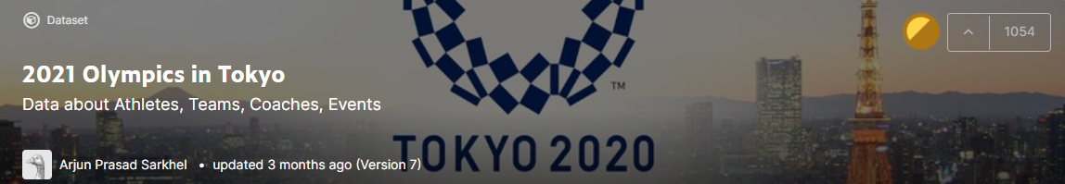
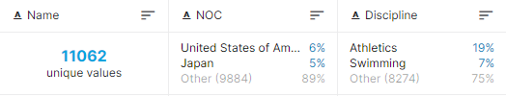
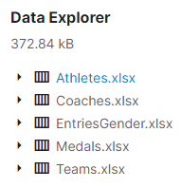
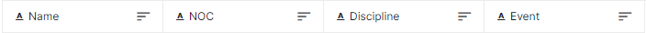
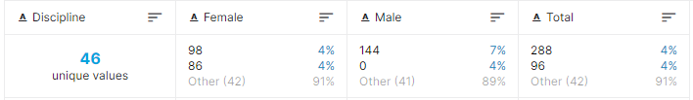
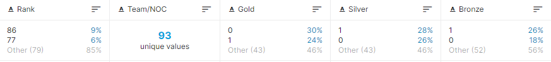

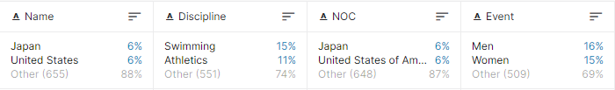
DATASET
STEP 1

Slide 3
Adjustments
“EntriesGender” Disciplines
“Medals” NOCs
Teams ≠ NOCs

Slide 4
Adjustments
“EntriesGender” Disciplines
“Medals” NOCs
Teams ≠ NOCs

Slide 5
Adjustments
“EntriesGender” Disciplines
“Medals” NOCs
Teams ≠ NOCs

Slide 6
Adjustments
“EntriesGender” Disciplines
“Medals” NOCs
Teams ≠ NOCs

Slide 7
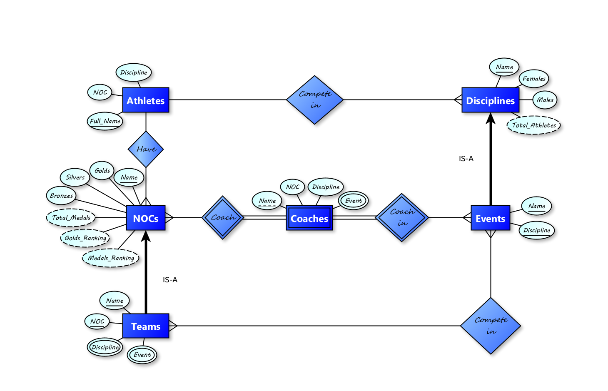
CONCEPTUAL DESIGN
STEP 2

Slide 8
Restructuration
Several derived attributes
Several multi-valued attributes
Weak nature of the entity “Coach”
“Discipline” entity only useful for gender data

Slide 9
Restructuration
Several derived attributes
Several multi-valued attributes
Weak nature of the entity “Coach”
“Discipline” entity only useful for gender data

Slide 10
Restructuration
Several derived attributes
Several multi-valued attributes
Weak nature of the entity “Coach”
“Discipline” entity only useful for gender data

Slide 11
Restructuration
Several derived attributes
Several multi-valued attributes
Weak nature of the entity “Coach”
“Discipline” entity only useful for gender data

Slide 12
Restructuration
Several derived attributes
Several multi-valued attributes
Weak nature of the entity “Coach”
“Discipline” entity only useful for gender data

Slide 13
LOGICAL DESIGN
STEP 3
NOCs (Name, Golds, Silvers, Bronzes)
DISCIPLINES (Name, Females, Males)
TEAMS (Name, NOC, Discipline, Event, Coach)
Foreign key: Teams[NOC] ⊆ NOCs[Name]
Foreign key: Teams[Discipline] ⊆ Discipline[Name]
ATHLETES (Full_Name, NOC, Discipline)
Foreign key: Athletes[NOC] ⊆ NOCs[Name]
Foreign key: Athletes[Discipline] ⊆ Discipline[Name]

Slide 14
QUERIES
STEP 4
Total amount of medals won by Italy
All events of the Athletics discipline
Number of events of the Athletics discipline
All teams competing in Beach Volleyball, ordered by NOC
Number of Beach Volleyball teams for each NOC
All disciplines with "Men" events and their respective male competitors
All disciplines with less than 100 male competitors among those with a "Men" event
The discipline with fewest male competitors among those with a "Men" event
Number of coaches per NOC
NOC with more than 5 coaches
NOCs, number of golds won, number of coaches
NOCs, total number of medals won, number of coaches

Slide 15
Query 1
Total amount of medals won by Italy
NOCs
Name | Golds | Silvers | Bronzes
...
Italy | 10 | 10 | 20
...
SELECT (Golds + Silvers + Bronzes)
FROM NOCs
WHERE Name = "Italy"
TOTAL

Slide 16
Query 2.1
All events of the Athletics discipline
TEAMS
Name | NOC | Discipline | Event | Coach
 |  | ... | ...
 |  | Athletics | 400 m
 |  | Athletics | 200 m
 |  | ... | ...
SELECT distinct Event
FROM Teams
WHERE Discipline = "Athletics"
EVENTS LIST

Slide 17
Query 2.2
Number of events of the Athletics discipline
TEAMS
Name | NOC | Discipline | Event | Coach
 |  | ... | ...
 |  | Athletics | 400 m
 |  | Athletics | 200 m
 |  | ... | ...
SELECT COUNT(*)
FROM
(SELECT distinct Event
FROM Teams
WHERE Discipline = "Athletics")
AS Disciplines
COUNT
# of EVENTS

Slide 18
Query 3.1
All teams competing in Beach Volleyball, ordered by NOC
TEAMS
Name | NOC | Discipline | Event | Coach
 |  | ...
 |  | Beach Volleyball
 |  | ...
SELECT Name, NOC
FROM Teams
WHERE Discipline = "Beach Volleyball“
ORDER BY NOC
TEAMS + NOCs
LIST

Slide 19
Query 3.2
Number of Beach Volleyball teams for each NOC
COUNT
TEAMS
Name | NOC | Discipline | Event | Coach
 |  | ...
 |  | Beach Volleyball
 |  | ...
SELECT NOC, COUNT(Name) AS c
FROM Teams
WHERE Discipline = "Beach Volleyball“
GROUP BY NOC
ORDER BY c DESC
# of TEAMS + NOCs
LIST

Slide 20
Query 4.1
Disciplines with "Men" events and their respective male competitors
TEAMS
DISCIPLINES
INNER JOIN
SELECT Disciplines.Name, Disciplines.Males
FROM
(SELECT distinct Discipline
FROM Teams
WHERE Event LIKE "%Men%") AS d
INNER JOIN
Disciplines
ON d.Discipline = Disciplines.Name
ORDER BY Disciplines.Males DESC
Name | ... | Discipline | Event | ...
 |  |  | %Men%
Name | ... | Males
DISCIPLINES + # of MALES
LIST

Slide 21
Query 4.2
Disciplines with less than 100 male competitors among those with a "Men" event
SELECT t.Name, t.Males
FROM
(SELECT Disciplines.Name, Disciplines.Males
FROM
(SELECT distinct Discipline
FROM Teams
WHERE Event LIKE "%Men%") AS d
INNER JOIN
Disciplines
ON d.Discipline = Disciplines.Name) AS t
WHERE t.Males < 100
ORDER BY t.Males
QUERY 4.1
DISCIPLINES + # of MALES < 100
LIST

Slide 22
Query 4.3
Discipline with fewest male competitors among those with a "Men" event
…WHERE t.Males = (SELECT MIN(j.Males)
FROM
(SELECT Disciplines.Name, Disciplines.Males
FROM
(SELECT distinct Discipline
FROM Teams
WHERE Event LIKE "%Men%") AS d
INNER JOIN Disciplines
ON d.Discipline = Disciplines.Name) AS j)
QUERY 4.1
DISCIPLINE + # of MALES

Slide 23
Query 5.1
Number of coaches per NOC
TEAMS
COUNT
Name | NOC | Discipline | Event | Coach
 | ...
 | ...
SELECT NOC, COUNT(Coach)
FROM Teams
GROUP BY NOC
ORDER BY COUNT(Coach) DESC
NOCs + # of COACHES
LIST

Slide 24
Query 5.2
NOCs with more than 5 coaches
TEAMS
Name | NOC | Discipline | Event | Coach
 | ...
 | ...
SELECT NOC
FROM Teams
GROUP BY NOC
HAVING COUNT(Coach) > 5
ORDER BY COUNT(Coach) DESC
NOCs with # of COACHES > 5
LIST

Slide 25
Query 5.3
NOCs, number of golds won, number of coaches
SELECT NOCs.Name, NOCs.Golds, gt0.c
FROM
(SELECT NOC, COUNT(Coach) AS c
FROM Teams
GROUP BY NOC
HAVING c > 0) AS gt0
JOIN
NOCs
ON gt0.NOC = NOCs.Name
GROUP BY NOCs.Name
ORDER BY NOCs.Golds DESC
JOIN
TEAMS
COUNT
NOCs
Name | NOC | ... | ... | Coach
Name | Golds | ... | ...
NOCs, # of GOLDS, # of COACHES
LIST

Slide 26
Query 5.4
NOCs, total number of medals won, number of coaches
SELECT NOCs.Name, (NOCs.Golds + NOCs.Silvers + NOCs.Bronzes) AS Total, gt0.c
FROM
(SELECT NOC, COUNT(Coach) AS c
FROM Teams
GROUP BY NOC
HAVING c > 0) AS gt0
JOIN
NOCs
ON gt0.NOC = NOCs.Name
GROUP BY NOCs.Name
ORDER BY Total DESC
QUERY 5.3
NOCs, # of MEDALS, # of COACHES
LIST

Slide 27
THANKS FOR YOUR ATTENTION!
Emanuele Regnani

