Slide 1

IDENTIFICATION OF USER POSITION ON A CHAIR
Emanuele Tinghi

Slide 2
Introduction
The samples comes from four testers (Leo, Lorenzo, Carlotta, Irene) and from three positions (Right, Left, Centered) in the form of csv files
From each file (time instant) we extract the peak frequency and the corresponding value of modulus and phase for each sensor
Some aggregate statistics of the 6 numerical characteristics are saved for each window together with the tester’s weight
The performance are evaluated with Leave-One-Subject-Out cross-validation
Notes:
How presentation will benefit audience: Adult learners are more interested in a subject if they know how or why it is important to them.
Presenter’s level of expertise in the subject: Briefly state your credentials in this area, or explain why participants should listen to you.

Slide 3
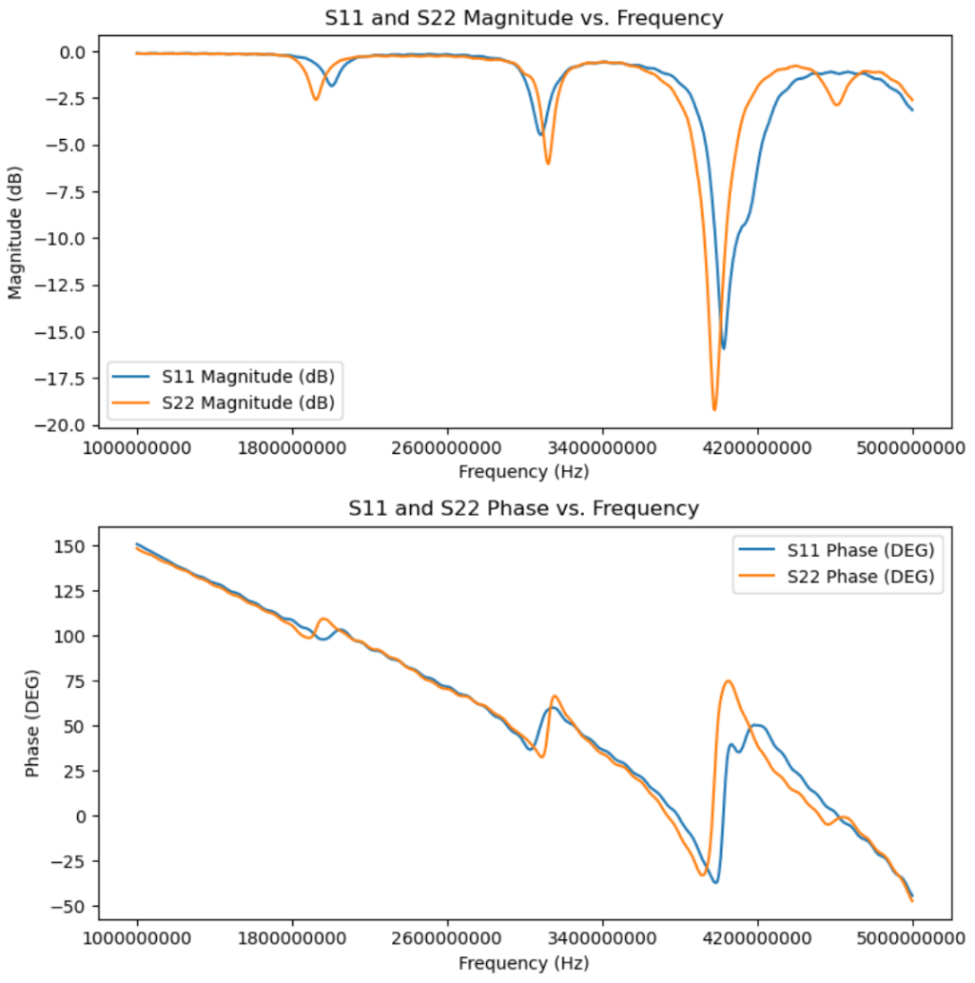
Visual representation of the single csv file
Notes:
Lesson descriptions should be brief.

Slide 4
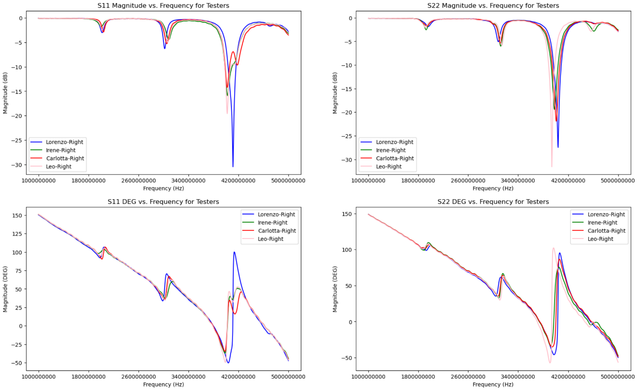
Visual representation of each tester files
Notes:
Lesson descriptions should be brief.

Slide 5
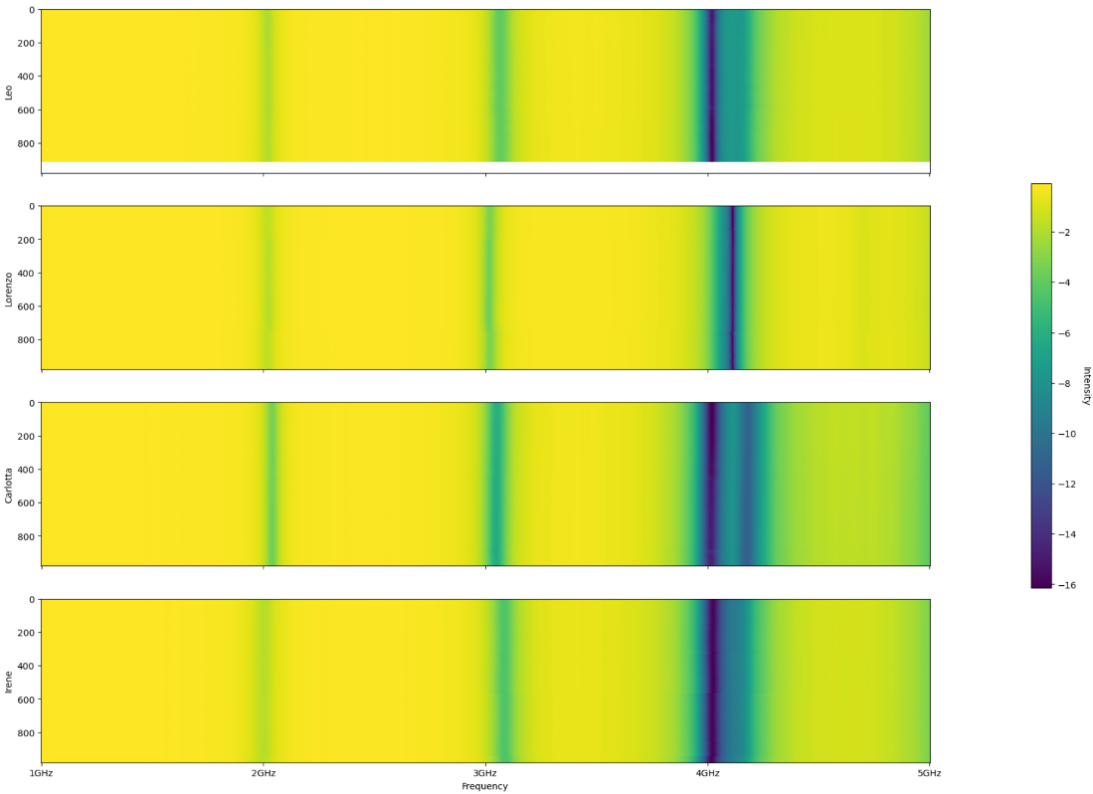
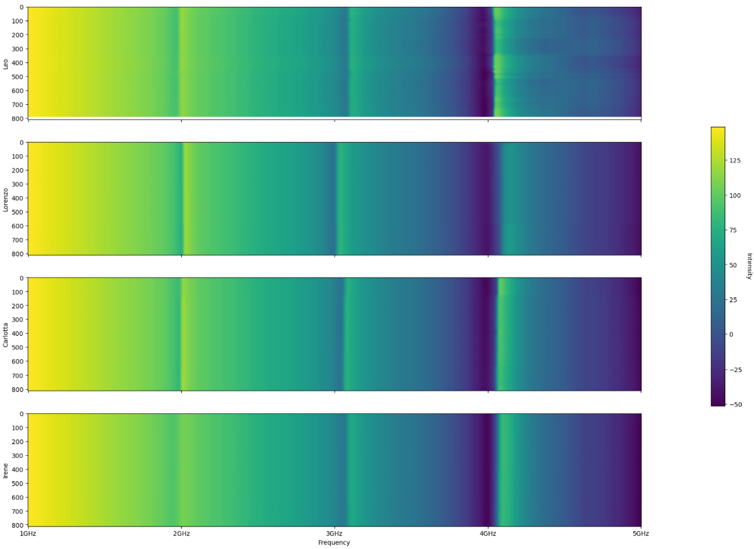
Heatmaps
Right - S11(DB)
Left – S22(DEG)
Notes:
Lesson descriptions should be brief.

Slide 6
Preprocessing (I)
Given a tester and a position, his/her list of csv files, relative to that position, are analysed.
For every file, the following steps are performed:
The signal is smoothed using E.M.A.
The peak of ‘S11(DB)’ is extracted, together with the corresponding values of phase and frequency
The peak of ‘S22(DB)’ is extracted, together with the corresponding values of phase and frequency
These values are saved in a dataframe (at the end there will be one of this dataframes for each possible position)
Notes:
Example objectives
At the end of this lesson, you will be able to:
Save files to the team Web server.
Move files to different locations on the team Web server.
Share files on the team Web server.

Slide 7
Preprocessing (II)
Given one of this dataframes, the following steps are performed:
The first 150 files from each tester-position pair are discarded
The data are aggregated using windows with width equal to 50 files and a step size of 10 (there is overlapping)
The mean and variance of every previously extracted features is saved
Every tester will end up with three datasets of windows data. These datasets are then merged to obtain the final dataset for the tester.
Notes:
Example objectives
At the end of this lesson, you will be able to:
Save files to the team Web server.
Move files to different locations on the team Web server.
Share files on the team Web server.

Slide 8
Lesson 1: Content
Add text here.
To add a picture, chart or other content in the right column, click the appropriate icon.
To add a slide, click New Slide on the Insert menu, or press CTRL+M.

Slide 9
Lesson 1: Wrap-up
Summarise important points.
Allow time for questions.

Slide 10
Lesson 2: Objectives
List the intended outcomes for this training session.
Each objective should be concise, should contain a verb, and should have a measurable result.

Slide 11
Lesson 2: Content
Add text here.
To add a picture, chart or other content in the right column, click the appropriate icon.
To add a slide, click New Slide on the Insert menu, or press CTRL+M.

Slide 12
Lesson 2: Wrap-up
Summarise important points.
Allow time for questions.

Slide 13
Lesson 3: Objectives
List the intended outcomes for this training session.
Each objective should be concise, should contain a verb, and should have a measurable result.

Slide 14
Lesson 3: Content
Add text here.
To add a picture, chart or other content in the right column, click the appropriate icon.
To add a slide, click New Slide on the Insert menu, or press CTRL+M.

Slide 15
Lesson 3: Wrap-up
Summarise important points.
Allow time for questions.

Slide 16
Summary of Training
List important points from each lesson.
Provide resources for more information on subject.
List resources on this slide.
Provide handouts with additional resource material.

Slide 17
Assessment and Evaluation
Prepare a quiz or challenge to assess how much information participants learned.
Survey participants to see if they found the training beneficial.

