Slide 1

IDENTIFICATION OF USER POSITION ON A CHAIR
Emanuele Tinghi

Slide 2
Introduction
The samples comes from four testers (Leo, Lorenzo, Carlotta, Irene) and from three positions (Right, Left, Centered) in the form of csv files. Each file contains the measurements of modulus and phase of the signals obtained from two sensors (S11, S22) in a spectrum of frequencies that goes from 1GHz to 5GHz
From each file (time instant) we extract the peak frequency and the corresponding value of modulus and phase for each sensor
Some aggregate statistics of the 6 numerical characteristics are saved for each window together with the tester’s weight
The performances of the models are evaluated with Leave-One-Subject-Out cross-validation

Slide 3
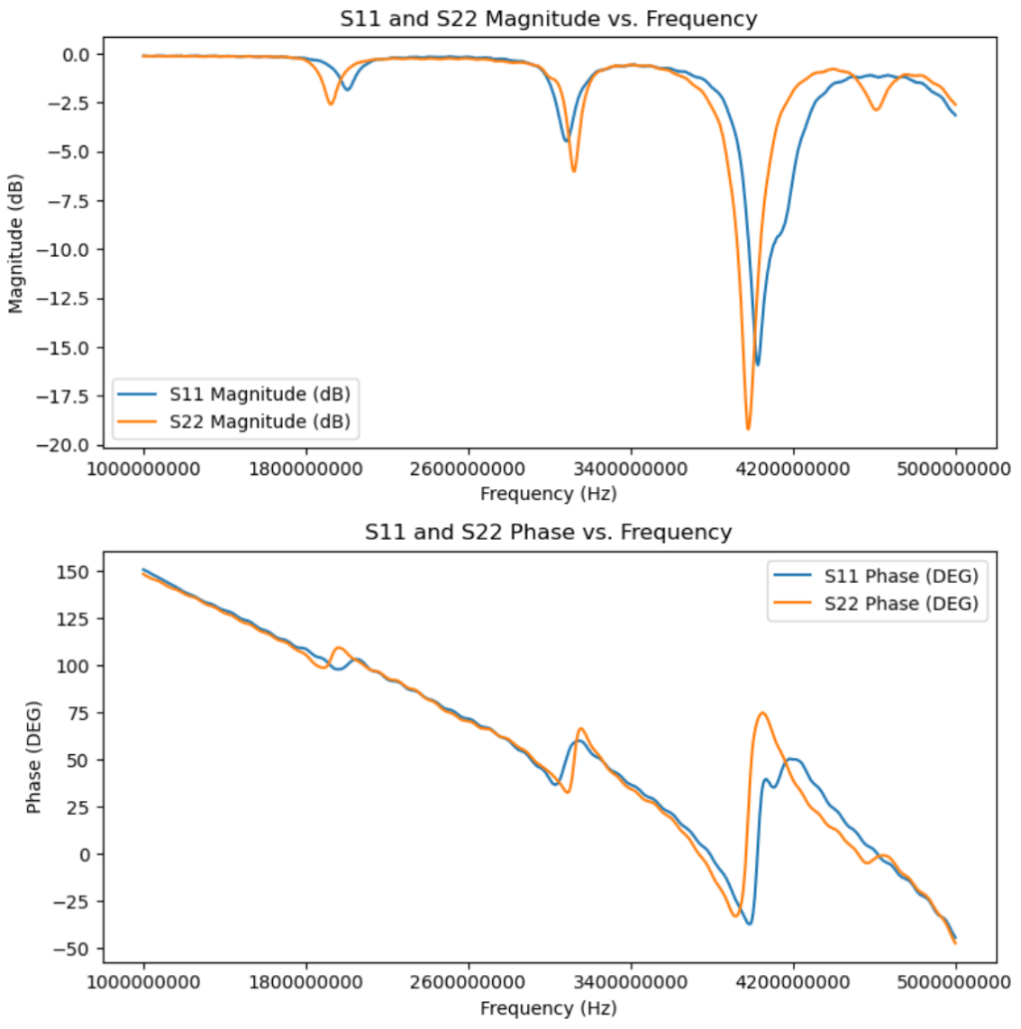
Visual representation of the single csv file

Slide 4
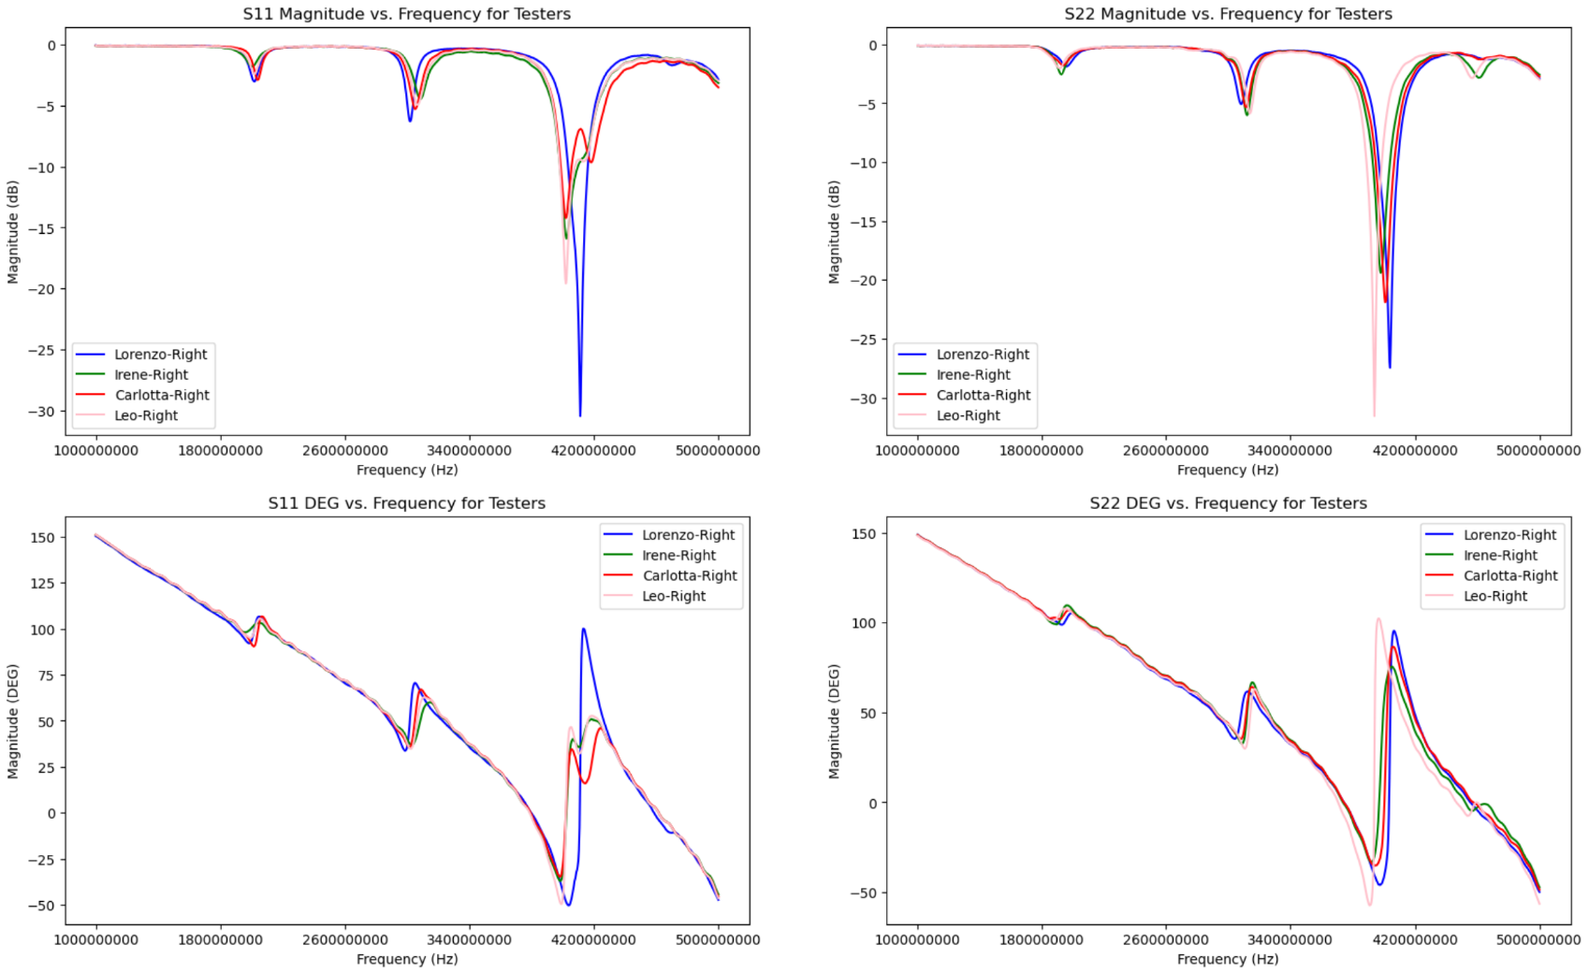
Visual representation of each tester files

Slide 5
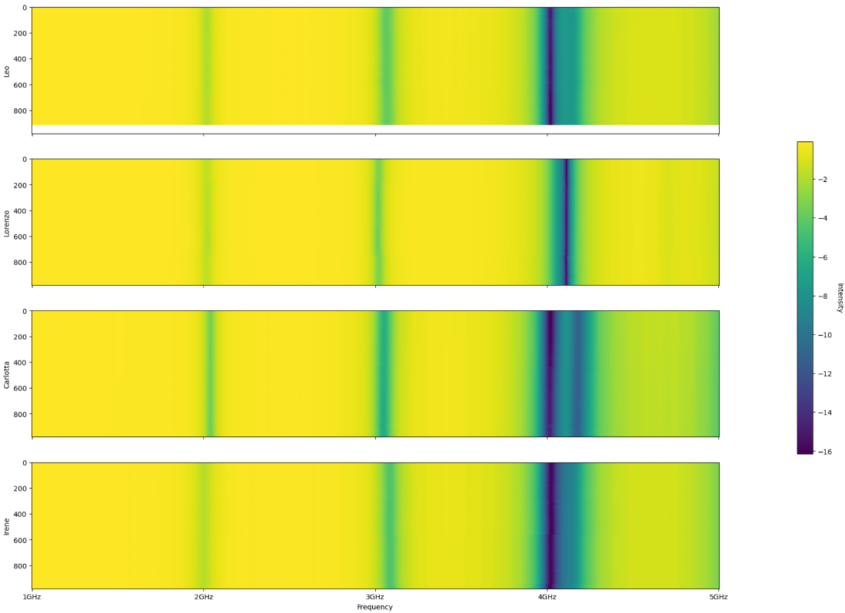
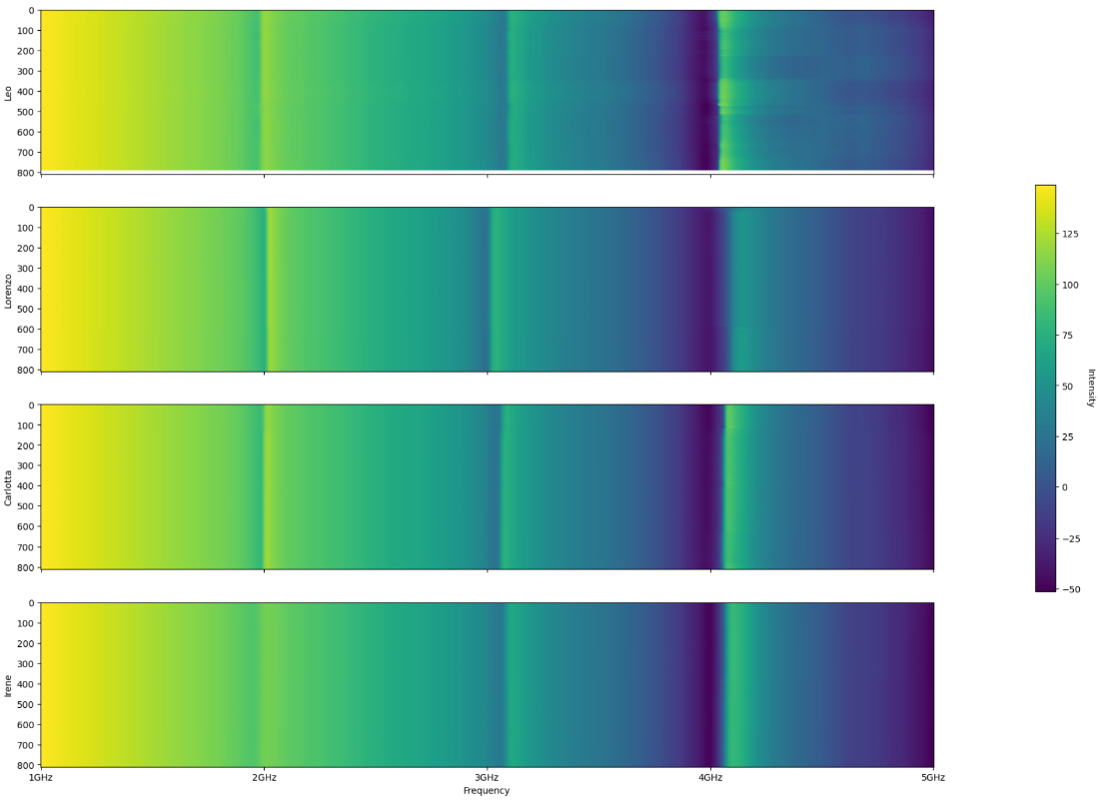
Heatmaps
Right - S11(DB)
Left – S22(DEG)

Slide 6
Preprocessing (I)
Given a tester and a position, his/her list of csv files, relative to that acquisition, are analysed.
For every file, the following steps are performed:
The signal is smoothed using E.M.A.
The peak of ‘S11(DB)’ is extracted, together with the corresponding values of phase and frequency
The peak of ‘S22(DB)’ is extracted, together with the corresponding values of phase and frequency
For every tester and position, these values are concatenated in a dataframe (at the end there will be one of this dataframes for each possible position for each tester)

Slide 7
Preprocessing (II)
Given one of this dataframes, the following steps are performed:
The first and last 150 files from each tester-position pair are discarded
The data are aggregated using windows with width equal to 50 files and a step size of 10 (there is overlapping)
The mean and variance of every previously extracted features is saved
Every tester will end up with three datasets of windows data. These datasets are then merged to obtain the final dataset for the tester.

Slide 8
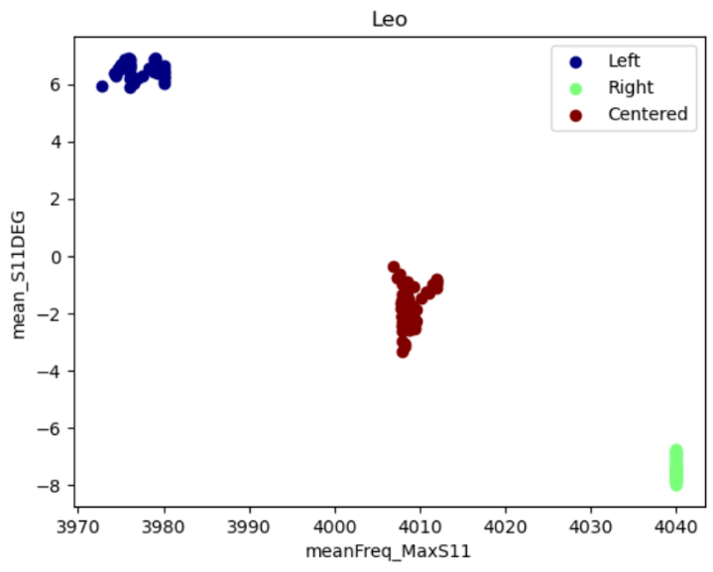
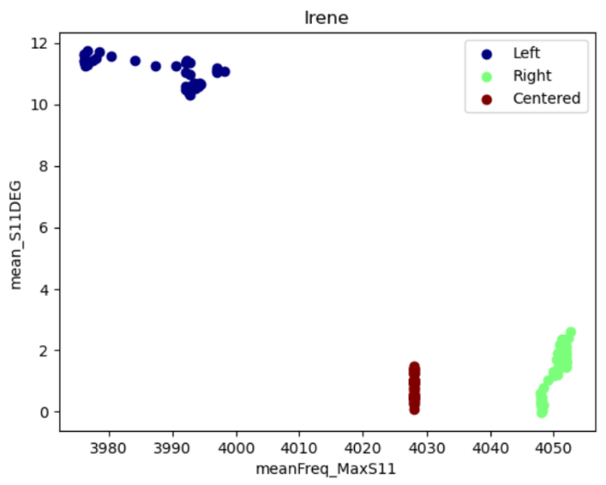
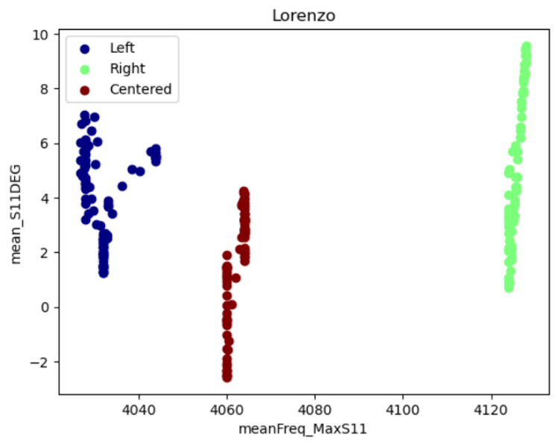
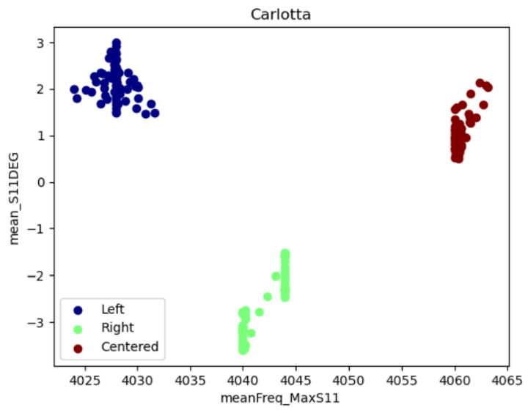
Preprocessing (III)

Slide 9
Leave-One-Subject-Out
As cross-validation method Leave-One-Subject-Out was chosen.
This type of validation consists in:
training the model using all but one subject
evaluating the model using the removed subject
This is useful in this project because, given the nature of the acquisitions (100-200 seconds of continuative monitoring), there may be correlation between consecutive windows.

Slide 10
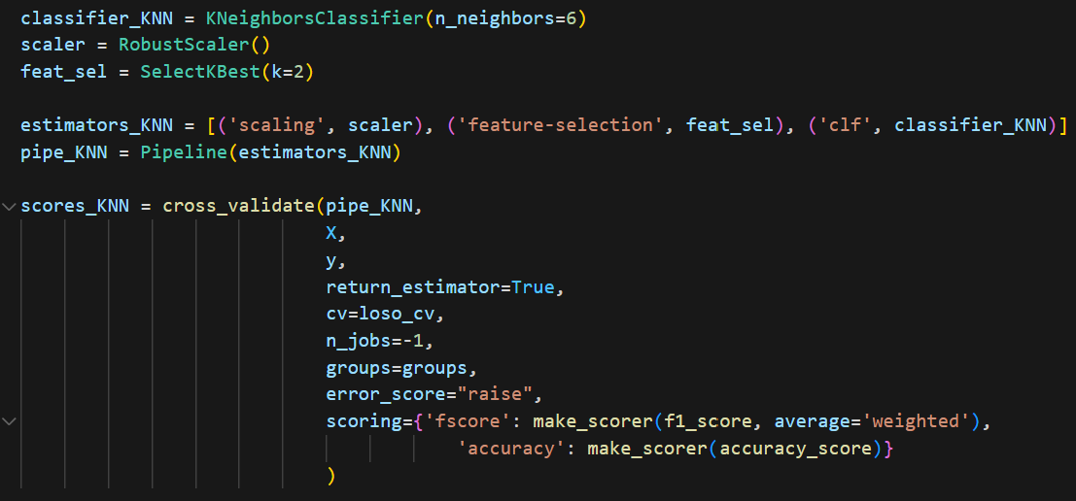

KNN-classifier
For what regards the KNN model a range of values from 1 to 80 neighbors has been tested.
The best value for the mean f-score has been found for n_neighbors equal to 6.
A pipeline is created using that model, RobustScaler as scaler and SelectKBest(k=2) as feature-selection method.

Slide 11
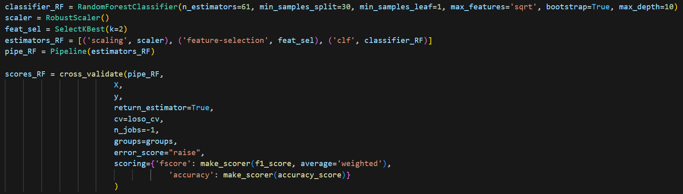

RF-classifier
For what regards the RF, different sets of values of n_estimators, min_samples_split and min_samples_leaf have been tested, obtaining the best results when n_estimators = 61, min_samples_split = 30 and min_samples_leaf = 1.
A pipeline is created using that model, RobustScaler as scaler and SelectKBest(k=2) as
feature-selection method.

Slide 12
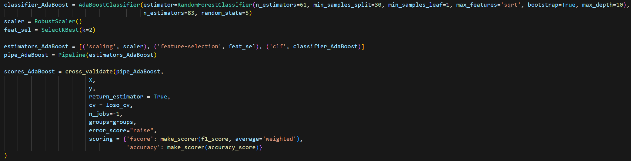

AdaBoost-classifier
As adaboost classifier estimator a series of 83 random forest classifier is chosen. The parameters of the random forest classifiers are chosen as before.
A pipeline is created using that model, RobustScaler as scaler and SelectKBest(k=2) as
feature-selection method.

Slide 13
Other Models
Other models were tested, such as:
SVC
GradientBoosting
SGD
SGD with RBFSampler
However, these models performed worse than the three previously shown, so they were discarded.

Slide 14
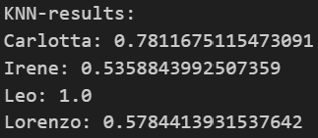
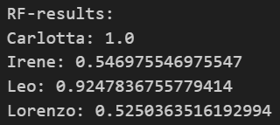
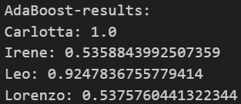
Model Results
The mean f-scores are all slightly less than 0.75, even if the performances are not constant between testers.
There are always some testers the perform well and others that perform not so well.

Slide 15
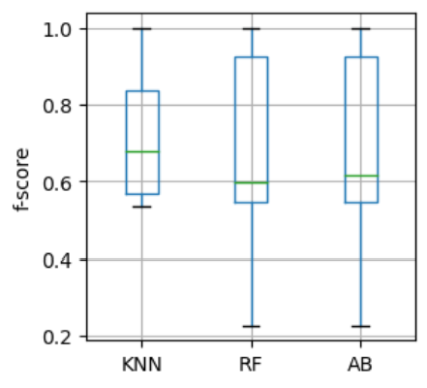
Performance evaluation (I)
The evaluation of the model was carried out using the Wilcoxon signed rank test.
The inputs for the test are the results of 200 iteration of each one of the best models (KNN, Random Forest, AdaBoost with Random Forest). This results in a total of 800 values for each model.

Slide 16
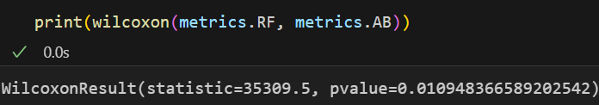

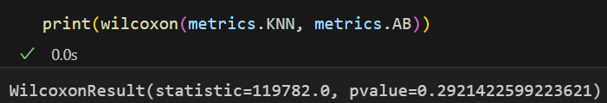
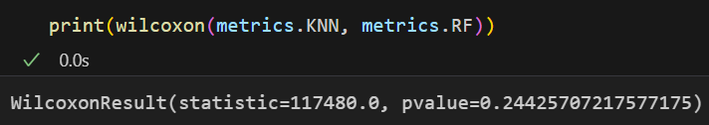
Performance Evaluation (II)
The Wilcoxon test tells that the difference between the performances of AdaBoost and Random Forest is significant. Given that the mean value of AdaBoost is higher than the one of Random Forest we can conclude that the first model is better.
As for the comparison with KNN, neither test provides significant
results. The null hypothesis cannot be rejected.

Slide 17
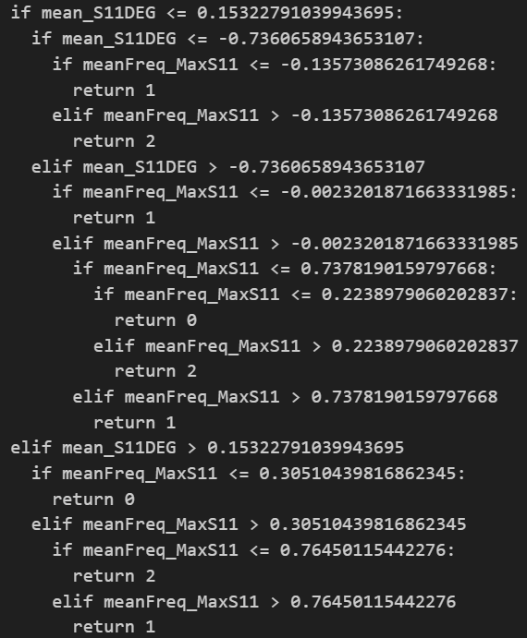
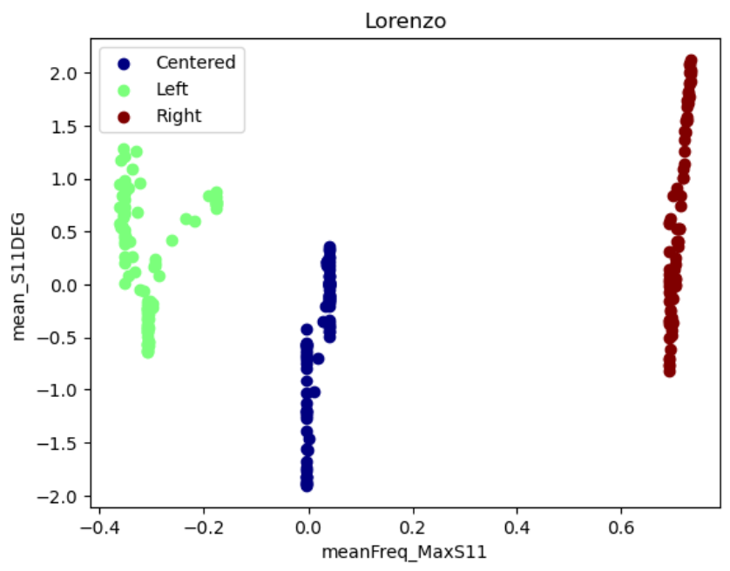
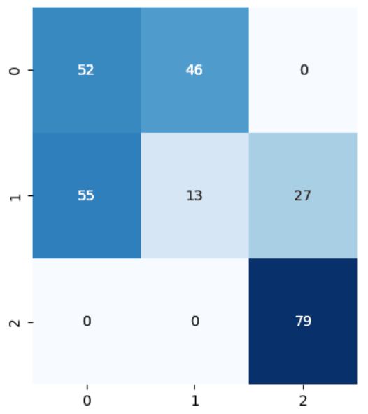
Rule analysis
It is possible to extract from the AdaBoost classifier the trees that it is composed of to understand why the performances for some testers are not good.
1
(1)
(0)
2
(2)
9
8
3
7
4
True Class
5
3
4
5
6
6
7
1
2
8
Predicted Class
9

Slide 18
Thank you for your attention

