Slide 1
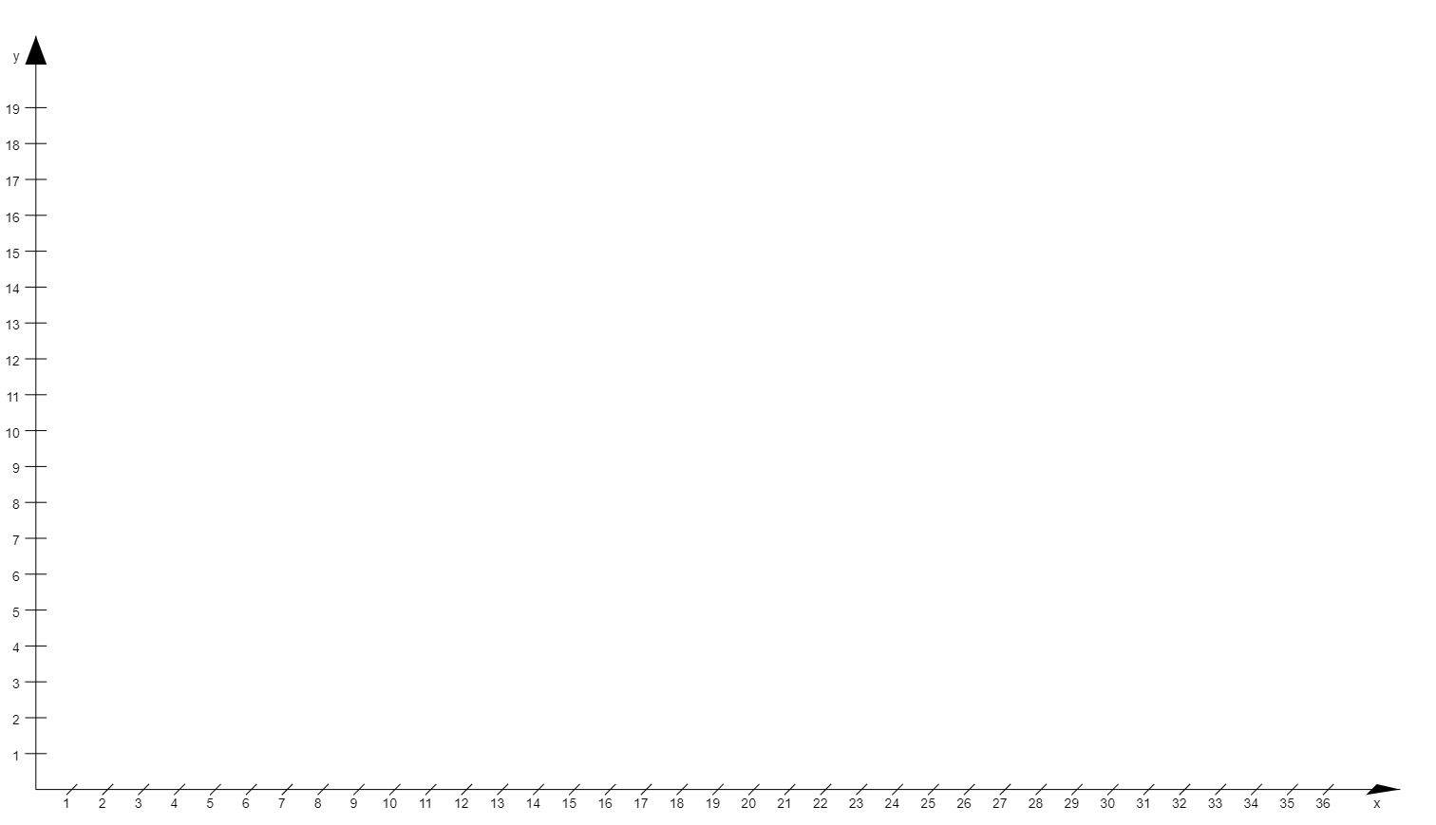
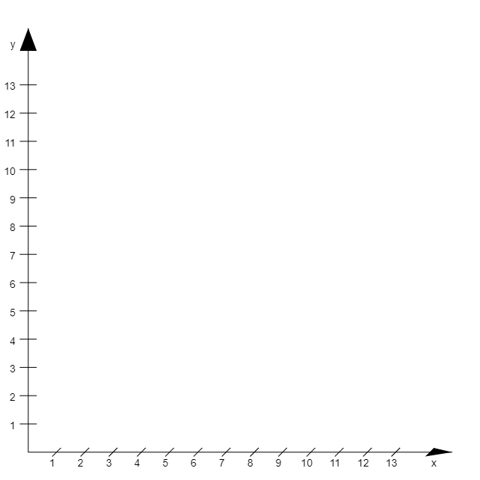
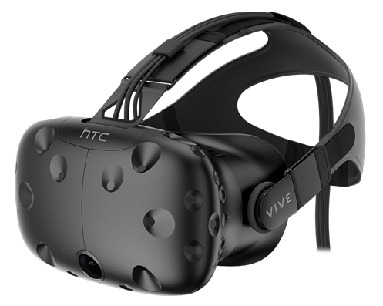
entire virtual scene
virtual camera rig/ real movement space

Slide 2
starting position
vecFromNodeToCamera
target position
node radius
teleport path
NodePos =
center of the node
cameraWorldPos =
rigWorldPos + cameraRigPos
vecFromNodeToNodeBorder
position of the rig in the scene

