Slide 1
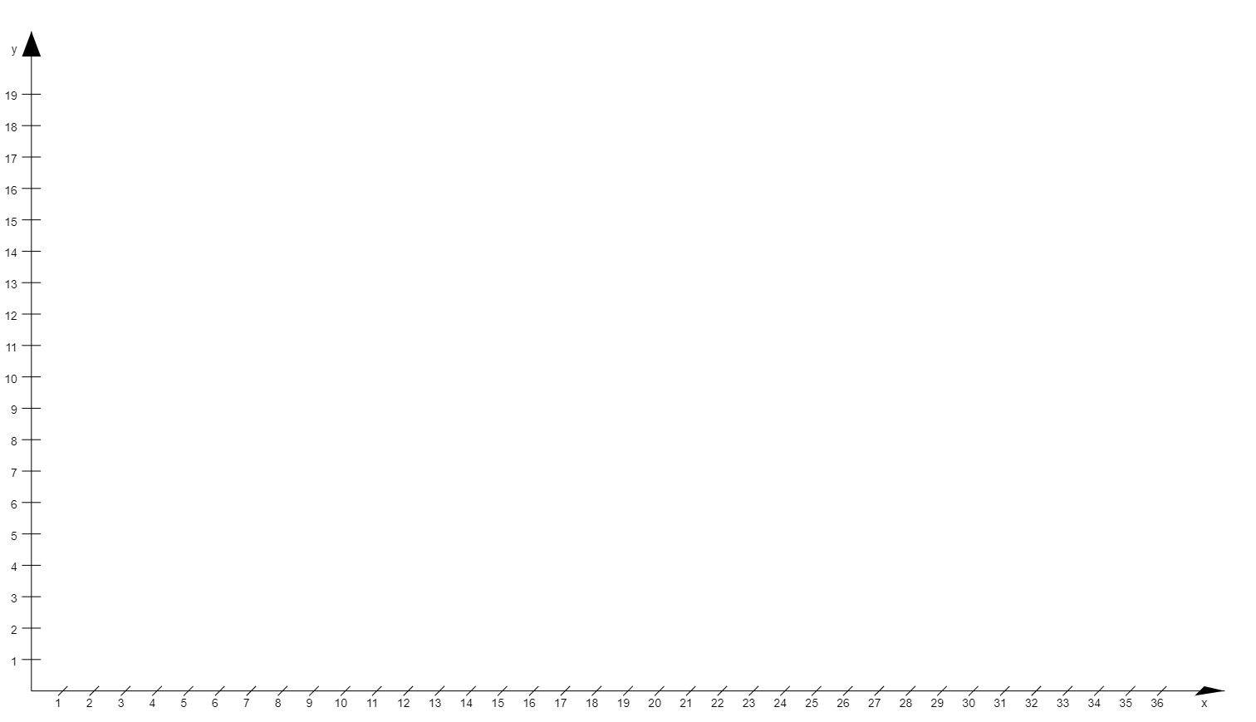
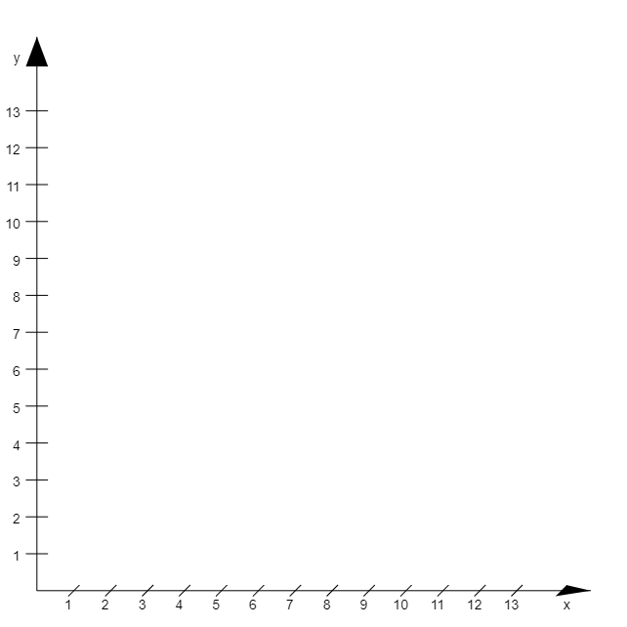
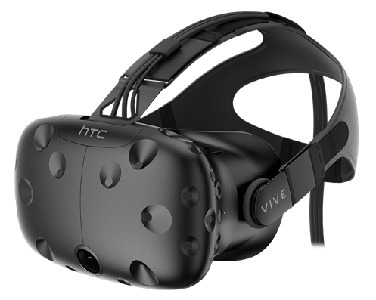
entire virtual scene
virtual camera rig/ real movement space

Slide 2
starting position
vecNodeToCamera
target position
node radius
teleport path
NodePos =
center of the node
cameraWorldPos =
rigWorldPos + cameraRigPos
vecCenterToNodeBorder
position of the rig in the scene

Slide 3
target position
starting position
vecNodeToCamera
center of the node

