Slide 1
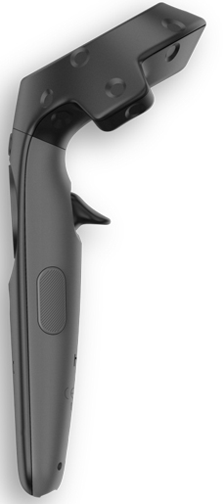
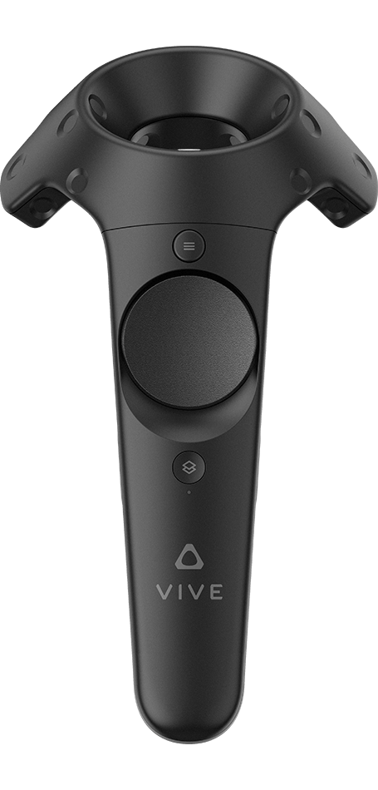
Left Controller
Right Controller
virtual laser pointer
menu button:
disable/enable automatic
link filtering
click top touchpad:
increase fly speed
filter links for pointed node
click top touchpad:
upscaling
start teleportation to the pointed node
click bottom touchpad:
decrease fly speed
middle click:
teleport to parent node
click left touchpad:
rotate camera left
click right touchpad:
rotate camera right
touchpad:
free flying
click bottom touchpad:
downscaling

