Slide 1
Implementation of a mobile application of a travelling company
Team MEMBERS:
BENEDICT OBED
MICHEL AKUA
ODETTE BANURA
DIEUDONNE ASSEA
PATRICIAN ASIFIWE
MESCHACK UMIRA

Slide 2
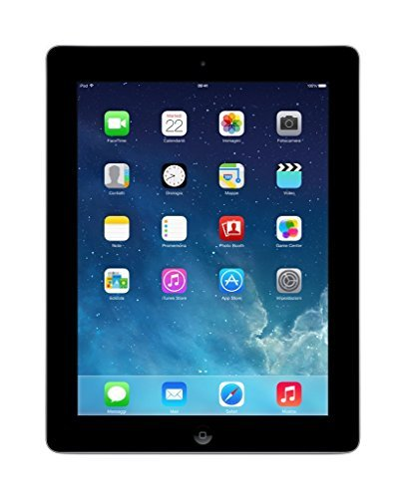
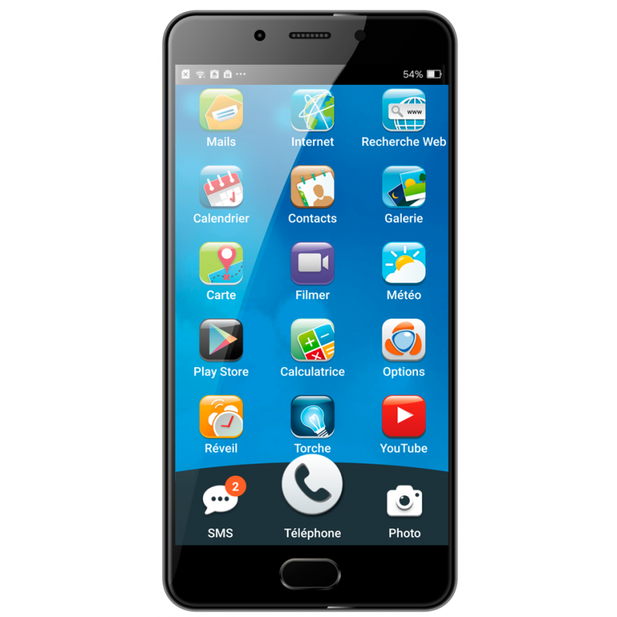
What is a mobile application?
Is a software designed to run on a mobile device, such as
Smartphone
Tablet Computer

Slide 3
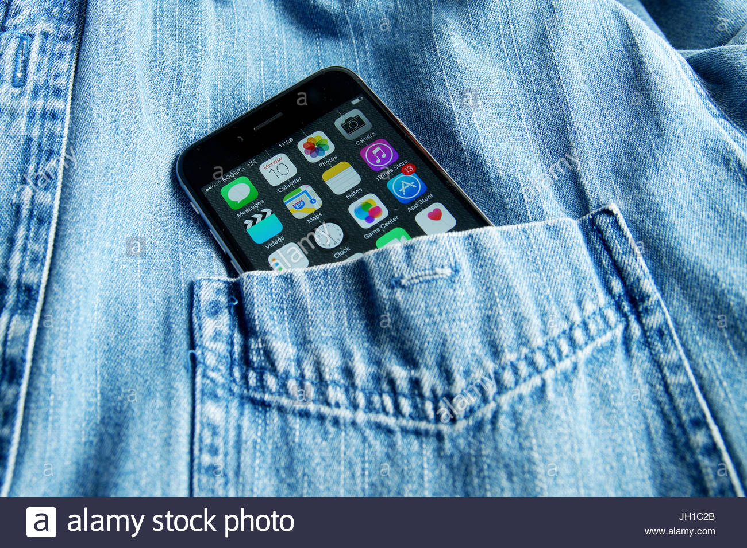
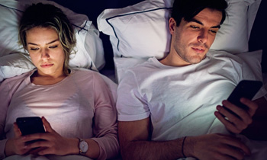
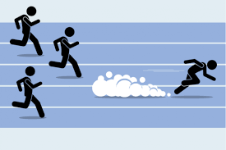
Why a mobile application?
1. A mobile application is always embedded in a smartphone which is transportable you can launch it wherever you go and whenever
3.Users Spend More Time on Apps
Mob App
Web site
2. Apps Can run (work) Faster Than Websites

Slide 4
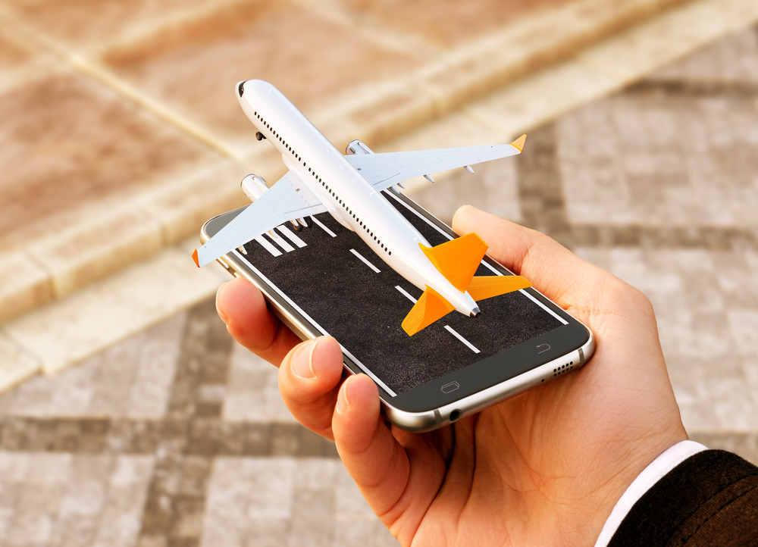
Why a mobile app is useful for a travelling company?
People can book wherever they are
2. They can’t loose much time to go to the Company site
3. They can book in few time just by simple clicks

Slide 5
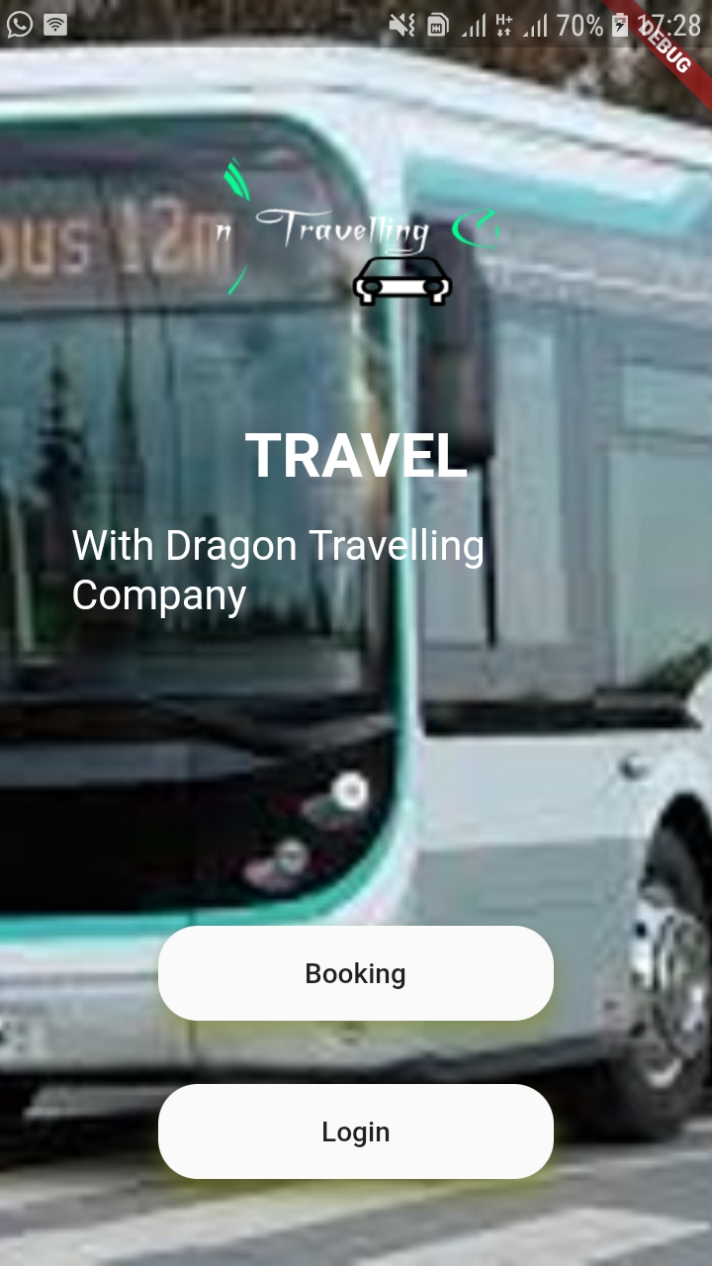
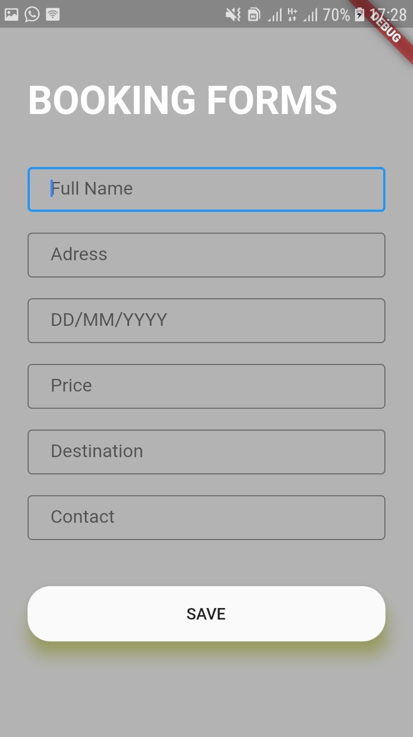
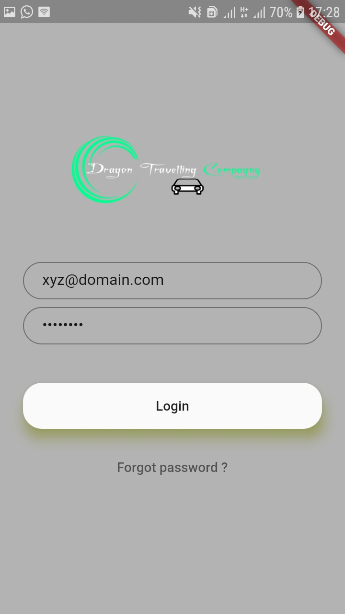
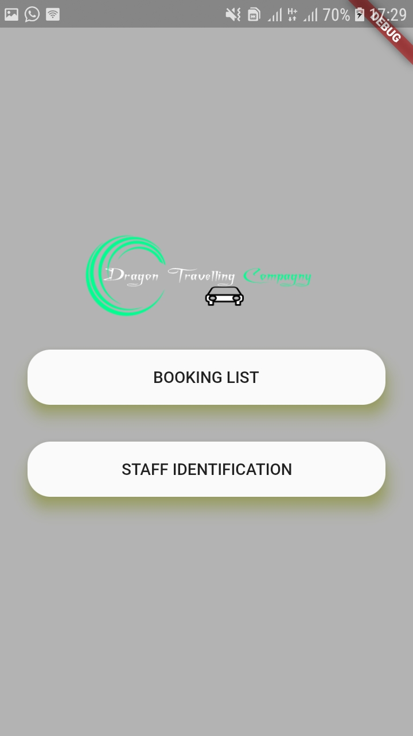
Mobile app
Home page
Booking form
Login
After signing in

Slide 6
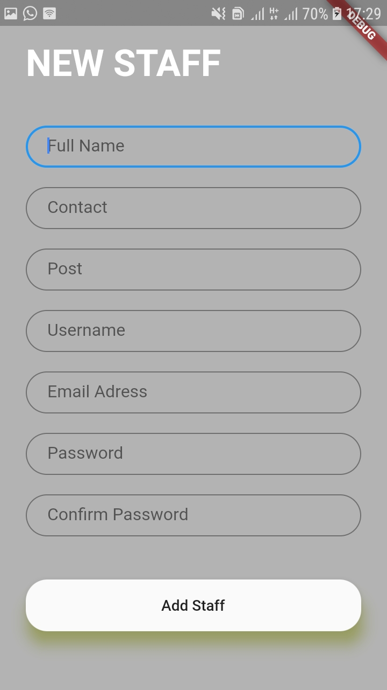

Mobile app
Thank you.
New staff identification
All bookings

