Slide 1

Predicting Campus Event Attendance Using Machine Learning
Emmanuel Nwite
Notes:
Welcome everyone. Today I’ll walk through my machine learning project where I built a predictive model to estimate event attendance at Augustana University. This ties my work as a Viking Advisor with neural networks and machine learning.

Slide 2

Introduction
Events are hard to plan when attendance is unpredictable
Goal: use ML to estimate attendance in advance
Helps with food ordering, space planning, and staffing
Applies directly to my work as an event planner
Notes:
In this slide I explain why this project matters. As an RA and student leader, I regularly plan events, and misjudging attendance can cause issues with supplies, space, and logistics. Machine learning offers a systematic solution to this problem.

Slide 3
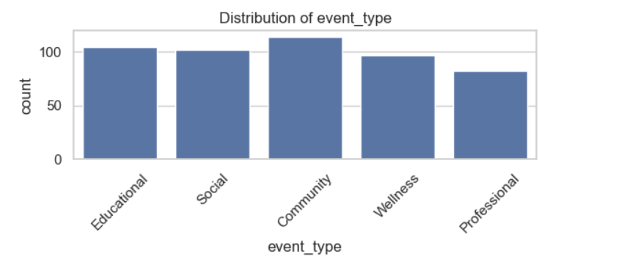
Dataset Overview
500 mostly realistic Augustana campus events
Features: event type, category, food, giveaways, promotion, weather
Temporal features: Day, Time, Month, Weekend
Target variable: actual attendance of people at each event.
Notes:
Here I describe the dataset. It's a realistically constructed dataset of 500 events with attributes that truly influence attendance. The target variable we predict is actual attendance.

Slide 4
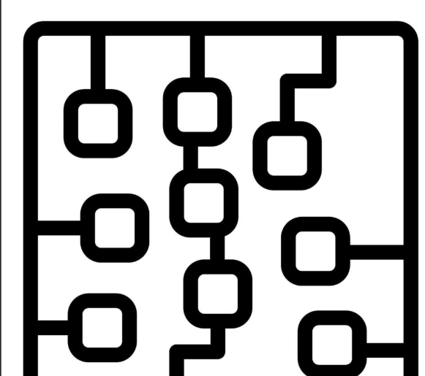
Methodology
Train/Test split (80/20)
Preprocessing: scaling and one-hot encoding
Models tested:
- Dummy baseline
- Linear Regression
- Decision Tree & Random Forest
- Neural Network
Notes:
This slide explains the workflow. We split data into training and testing. Categorical variables are one-hot encoded, numeric ones are scaled. We test several models ranging from simple to complex.

Slide 5
Feature Engineering/Findings
Weekend flag and weekend events tend to be higher
Time of day encoded numerically
Free food & giveaways treated as categorical features
All features passed through preprocessing pipeline
Numbers wee generated based on the dataset distribution.
Notes:
Feature engineering was important. Weekend events or events with food/giveaways have predictable boosts in attendance. Encoding these properly helped the models learn patterns.

Slide 6
Results: Model Performance
Dummy baseline R² ≈ 0
Linear Regression: R² ≈ 0.642
Decision Tree: R² ≈ 0.641
Random Forest: R² ≈ 0.649 (Best performer)
Neural Network: R² ≈ 0.55–0.75
Notes:
This slide shows how each model performed. The Random Forest achieved the best R² values, though the neural network also performed well. This demonstrates the predictive power of the dataset.

Slide 7
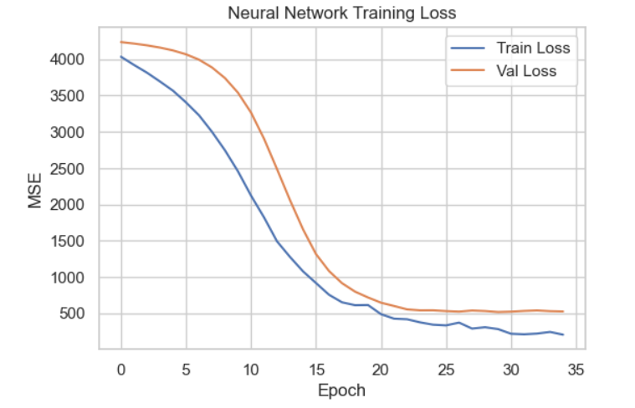
Neural Network Architecture
Layers: 128 → 64 → 32 units
ReLU activations and Batch Normalization
Adam optimizer with Early Stopping
Captures nonlinear relationships between features
Notes:
Here I explain the neural network used. It has multiple dense layers, batch normalization, and uses the Adam optimizer. It captures complex, nonlinear patterns that simpler models miss.

Slide 8
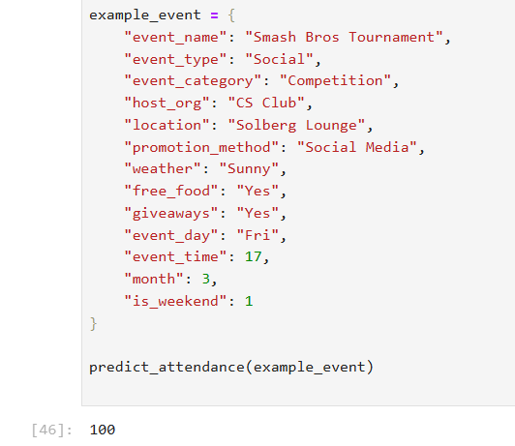
Code Walkthrough (Key Steps)
Load dataset using pandas (Excel file)
Build preprocessing pipeline (OneHotEncoder + StandardScaler)
Train baseline and tree models using sklearn pipelines
Prepare NumPy arrays for neural network training
Use Keras for model building, training, and evaluation
Notes:
This walkthrough explains the major components of the code. It ensures the audience understands how the preprocessing, training, and evaluation work together to build the final models.

Slide 9
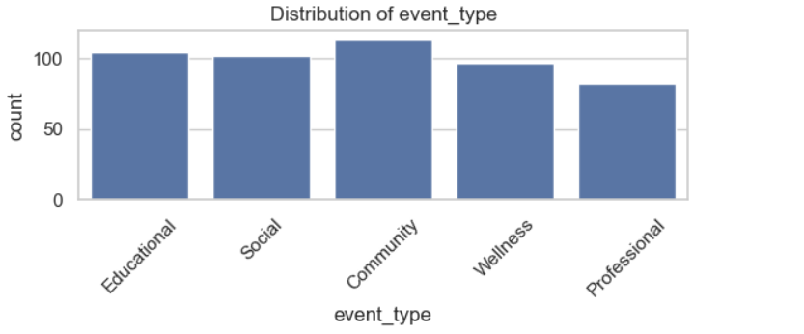
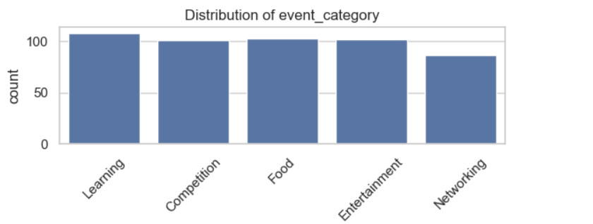
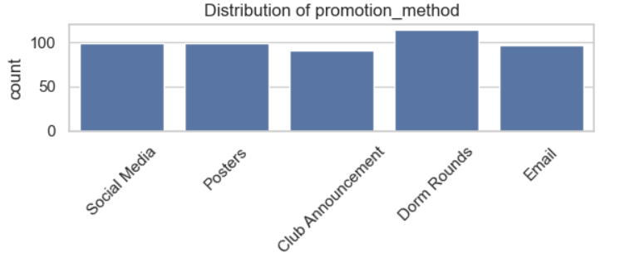
Insights & Interpretation
Free food strongly increases attendance
Social Media is the most effective promotion method
Competition and social events attract more students
Weekend events consistently draw higher turnout
Notes:
These are insights gained from the model results and feature importances. They reflect real-world intuition but are now supported by data.

Slide 10
Significance for ML & AI
Demonstrates applied machine learning on real-life data
Shows how feature engineering drives performance
Connects neural networks to a practical, everyday problem
Useful tool for VAs, clubs, and campus planners
Notes:
This highlights the broader significance. The project shows a real application of AI that improves campus operations and event planning.

Slide 11
Conclusion
Random Forest performed best overall
Neural Networks also delivered strong results
ML can support better event planning and logistics
Future work: RSVP data, weather APIs, larger datasets
Notes:
Final summary: the models worked well, especially Random Forest. Machine learning clearly helps solve the event attendance problem.

